Slide 1
Planning Made Easy
The Bridge from What? To Why? Programs that really Matter
Jose Espinoza
Chesapeake Conference

Slide 2
BREAK OUT ROOMS
WHY ARE YOUTH PROGRAMS SO IMPORTANT????

Slide 3
10 Common reasons youth leaders do programs
Something-just fill the time that was given.
Nothing-we don’t do anything: we do nothing.
Anything-better than nothing: do anything.
Everything-Super busy, hyperactive, lots of activity.
One thing-focus on just one thing.
Best Thing-we only do high quality.
Same Thing-we’re in a rut, highly predictable.
New Thing-we only do the latest: we love fads.
Old Thing- stick with what the previous generation did.
My Thing-whatever I want, I don’t need a reason.
Break out rooms
Choose one of the Common reasons that you think it’s more important and discuss it with your group.

Slide 4
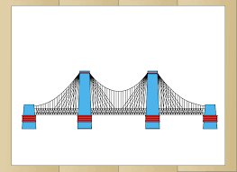
Point A: Program
Point B: Goal
What is the Goal you want to achieve with your program?
Having a goal is essential to provide direction for our programs. It must be a goal that motivates the youth group.
In order for you to know what you are doing you need a plan.
You need a plan to get from Point A to Point B.

Slide 5
BREAK OUT ROOMS
Discuss what types of Youth Programs we do for our youth and
why do we do them/What's the purpose???

Slide 6
WHY???
PROGRAMS GOAL
Youth Groups Christlikeness
Friday evening Vespers
Saturday night social
Service Activities
Prayer Experiences HOW???
-Notice how the programs are big and appealing.
-Do you notice that the programs require ACTION?
If we do a program based on Jesus life and our Goal is to be like Christ it needs to lead into Action. It needs to be more specific.
You need something additional that relates to the goal and the program-something that links them together in a way useful for our purposes, plans, implementation, and evaluation.
You need a BRIDGE between your programs and your goal. You need a PHILOSOPHY.

Slide 7
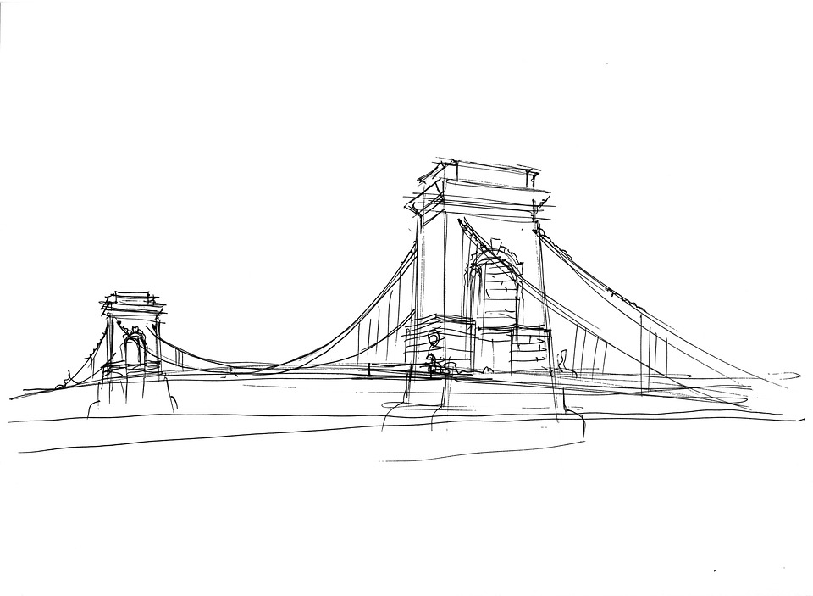
WHY?
WHY?
PROGRAMS
Youth Group
Friday evening Vespers
Saturday night social
Service activities
Prayer experiences
PHILOSOPHY
Fostering relationships
That build
Responsible
Servant
Leaders
GOAL
Christlikeness
HOW?
HOW?
THE BRIDGE: A statement of Philosophy

Slide 8
Break rooms
Between your group choose a program, a Goal and a philosophy to implement your overall goal.

Slide 9
Having a goal is essential to provide direction for our programs. It must be a goal that motivates the youth group.
“Suppose one of you wants to build a tower. Won’t you first sit down and estimate the cost to see if you have enough money to complete it?”
Luke 14:28
“Commit to the Lord whatever you do, and he will establish your plans.”
Proverbs 16:3

