Slide 1


Layaway for Get-a-way
Enrichment Day 2022

Slide 2

Planning a successful get-a-way
1- Dues
2- Systematic Giving
3- Donations
4- Church Budgets
5- The Communication Game
Ski trip story – no money

Slide 3

Why Dues?
1- Membership Privileges
2- Power of Buy-in
3- Adds to the Budget
4- Accountability
5- The Message it gives
Story of a 1st Class ticket on a plane that already left

Slide 4

Systematic Giving
1- Habits of saving is formed
2- Collective buying power
3- Easier to balance your budget
Story of my Camporee gone South

Slide 5
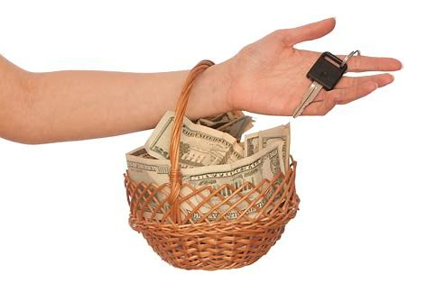
Donations
1- Comes in $$$
2- Comes in Gifts
3- Comes in Appreciation
4- Comes from Above
Story of free tents, hay, and horses

Slide 6
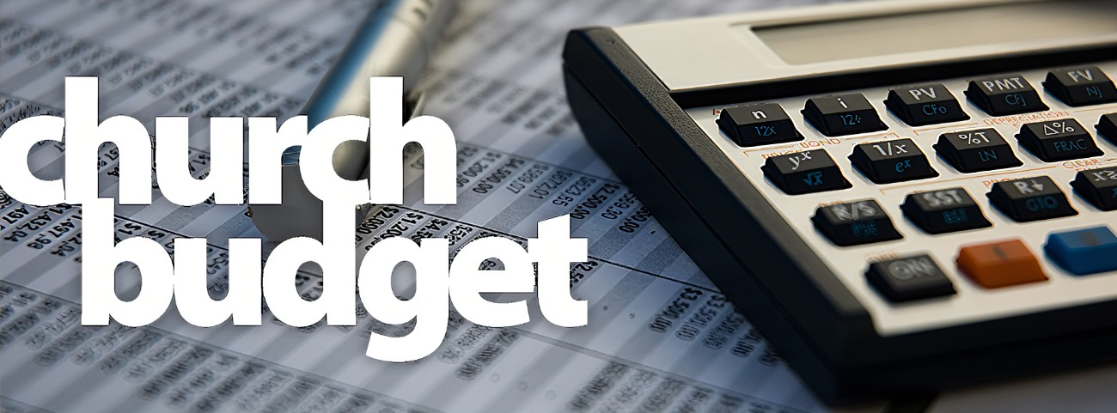
Church Budgets
1- Ask for it!
2- Submit your Budget
3- Submit your Activities
4- It is part of recognition
It is more than service projects

Slide 7
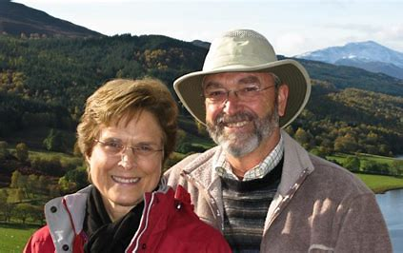
The Communication Game
1- Stories count
2- It’s the team to be in
3- Share the growth
The Story of Dick Duerksen

Slide 8

Planning a successful get-a-way
1- Dues
2- Systematic Giving
3- Donations
4- Church Budgets
5- The Communication Game
Review Time

