Slide 1
Selecting Your A-team
By Pastor Josué Feliciano
Chesapeake Conference

Slide 2
Selecting Team Members
How do you do it?

Slide 3
Questions for Consideration
What does it take to get the right people on the bus?
What skills should you look for?
What questions should you ask?
Why would people want to work with you?

Slide 4
PURPOSE
In this presentation you will learn how to select and work with team members.

Slide 5
WHY?
?
?
?
Having a successful youth group is a team effort. God doesn’t work solo. He engages others to join His team. The same is true in youth ministry.
?
?
?
?

Slide 6
Parents as a good resource
Because you are dependent on parents for transportation, food, income, and advice.
Parents need to know calendar, when are appointments, what to bring, how much money is needed, and the youth group philosophy.
Fostering Relationships That Build Responsible Servant Leaders

Slide 7
It is recommended to develop Parent Agreement forms
Why?

Slide 8
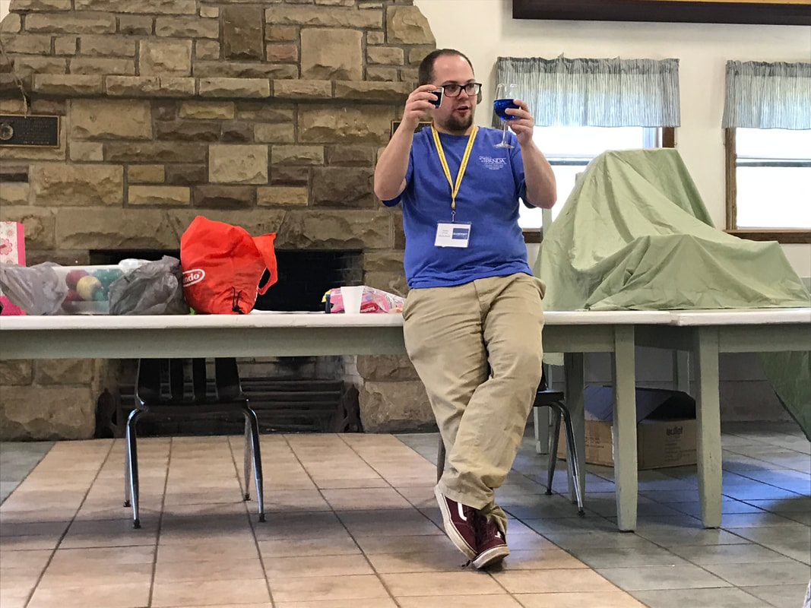
Adult Staff Needed
Because they have life experience youth people still lack
You need to share the load to prevent burnout
Because they have the gift of working with young people to help transform their lives for God
Because they can reach some of the youth that you can’t

Slide 9
Interview Adult Staff
Why?

Slide 10
Benefits of Interview
A face-to-face interview helps establish a working relationship with you as the leader.
They are not only making a commitment to the Lord to serve God’s young people, they are also making a commitment to you as the leader.
Since most communication is non-verbal, it is important you talk in person so you can best ascertain their response.
Have your assistant leader join the interview.

Slide 11
Senior Youth Needed
This is their opportunity to gain important leadership experience under the support of caring adults.
A suggestion is to use juniors and seniors in high schools and give them leadership responsibilities.
Juniors and seniors are called “upper class men” and are preparing to go out into the world.
This is your opportunity to develop the leaders for God’s church today and for the future.
Take them through the interview process like you do for the adults.

Slide 12
Interview Questions
Why?

Slide 13
Spiritual Journey
Questions (part 1)
Why do you love Jesus? How did you come to be a Christ follower? Do people consider you a spiritual leader?
How can you make this a spiritual experience for the young people??

Slide 14
History on Working with Youth Questions (part 2)
Describe a time when you worked with young people and how you knew you were being effective?

Slide 15
Positive Attitude Questions (part 3)
Do you tend to see a glass half full or half empty? How do you get along with other people?
Remind them that working with young people means that sometimes the best laid plans have to be scrapped or modified at the last minute. (weather, unforeseen) ADAPTABLE
Remind them that we want youth group to be a safe place which includes “being loyal to the absent.” (staff talking badly behind backs)

Slide 16
Would People Say Questions
(part 4)
Can people depend on what you say? Do you show up on time? Do you follow through on your commitments? Do you keep your promises?
Tell them how much you appreciate this important characteristic because God wants our best efforts.

Slide 17
Convicted Sexual Behavior
Questions (part 5)
Remind them that everyone must go through an official screening process through the conference office regarding their history. This is done in order to prevent predators from working with children and youth in the church. This applies for people who are staff members or people who are helping with a project.
If a problem comes up later, you have established a way to talk about it since it was part of the interview.

Slide 18
Do Young People Like You
Question (part 6)
Describe a time when you felt that young people responded to your leadership?
It is good for young people to like the adult staff, but adults do not have to be “the life of the party” in order to be effective with young people.

Slide 19
Helpful Skills
Questions (part 7)
Are you good at active listening? Can you drive a bus? Can you teach a class? Can you build things? Can you fix thing? Can you make things? Can you organize an event or ministry?

Slide 20
Personal Coach for the Youth Leader (important)
Why?

Slide 22
Coaching Process
Stage 1 - Engage
“Who?” Build a partnership with someone that is willing to be a personal coach to you. Partnerships are built on trust. The youth leader is the “pilot” - the personal coach is the “co-pilot.” The pilot decides where to go and how to get there. The co-pilot assists the pilot in whatever way the pilot wants/needs him to.

Slide 23
Coaching Process
Stage 2 - Discover
“What?” The personal coach must ask questions that help the youth leader find focus.

Slide 24
Coaching Process
Stage 3 - Create
“How?” The Youth leader is ready to create a plan that breaks the focus statement into hunks, chunks, and bites of work.

Slide 25
Coaching Process
Stage 4 - Commit
“When?” The youth leader must set accountability. The personal coach must recap the session by restating the commitment.
Finish up the session with extreme confidence in the youth leader.

Slide 26
QUESTIONS?

