Slide 1
Sandy Thomas
Chesapeake Conference Coordinator

Slide 2
Chesapeake Conference Discovery Program
Baby Birds
Birth to 2
Little Lambs
3 years old
Curious Cubs
4 years old
Eager Beavers
5 years old
Promotion to Adventurers

Slide 3
The Chesapeake Conference Coordinators
and Directors voted 5 years ago
to adopt the classes by ages
as in the Wright Publishing Program.
The NAD Little Lambs (Preschool)
Wright Publishing Little Lambs (3 years old)

Slide 4
Chesapeake Conference Discovery Program
Baby Birds
Birth to 2
Little Lambs
3 years old
Curious Cubs
4 years old
Eager Beavers
5 years old
Promotion to Adventurers

Slide 5
Discovery Program is only available through Wright Publications
Use drop down menu and click on Discovery Program

Slide 6
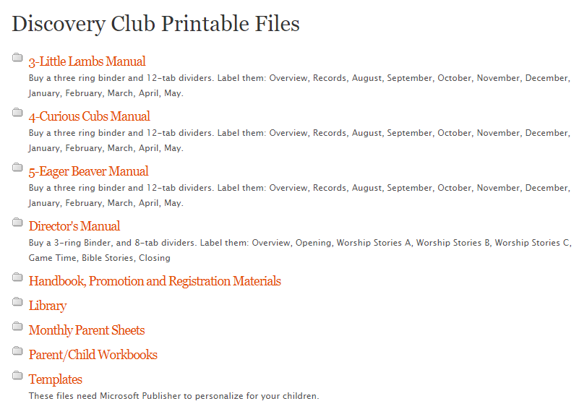

Slide 7
Chesapeake Conference Discovery Program
Baby Birds
Birth to 2
Little Lambs
3 years old
Curious Cubs
4 years old
Eager Beavers
5 years old
Promotion to Adventurers

Slide 8
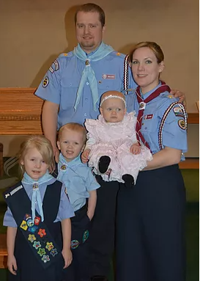
We (CC) wear Blue shirts and Blue scarves!
There are no award patches for them.

Slide 9
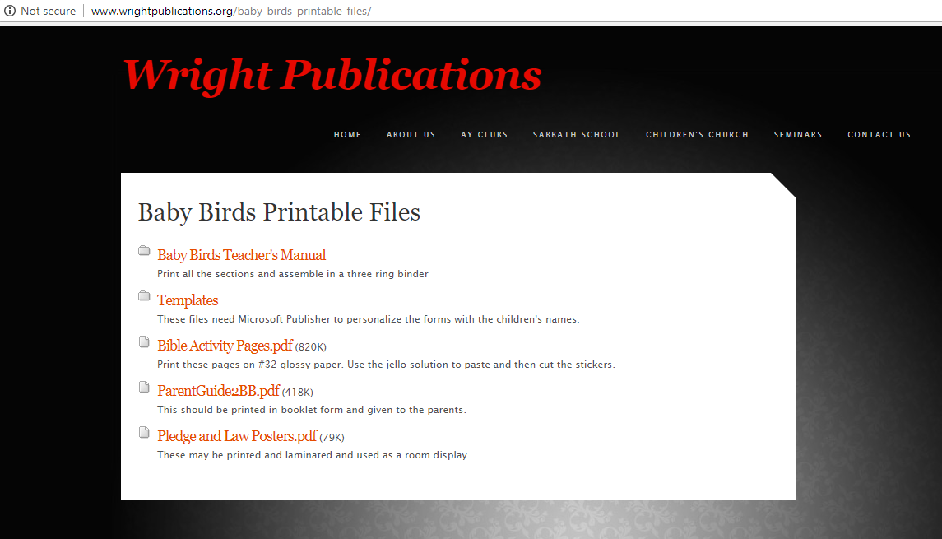

Slide 10
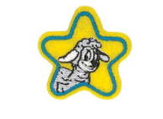
Little Lambs
3 year olds
Preschool
Class Patch
Award Star
Class Patch
Award Star
Curriculum is through Wrightpublications.org Products can be purchased through Pathfindershirt.com
NAD curriculum – clubministries.org
Products can be purchased through Adventsource.org
When we have conference events the Wright Publications age will drive what classes they are eligible be able to take as they will be geared to that age.

Slide 11
Curious Cubs – Preschool – 4 years old
Class Patch
Award Patch
Wrightpublications.org for curriculum Pathfindershirt.com for products

Slide 12
Eager Beavers – Kindergarten- 5 years old
Eager Beaver Patch
Florida Patch
Eager Beaver Patch
NAD Patch
Curriculum is through Wrightpublications.org
Products can be purchased through Pathfindershirt.com

Slide 13
The official supplier of Adventurer and Discovery supplies is www.Pathfindershirts.com for Chesapeake Conference.
Did you know?
They carry all the “old” logos and know what our conference requirements are.

Slide 15
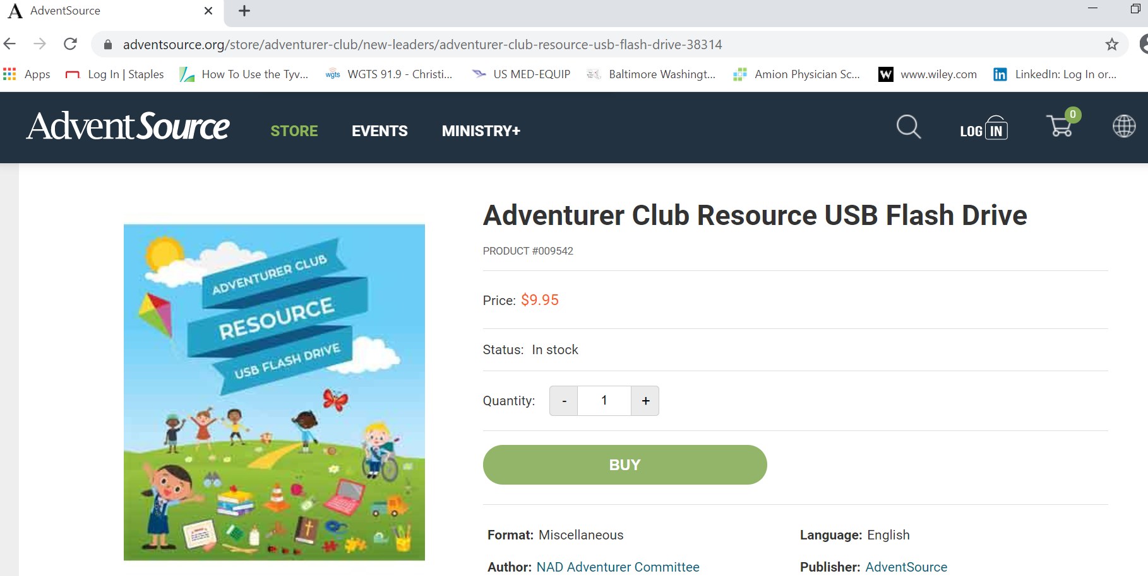

Slide 16
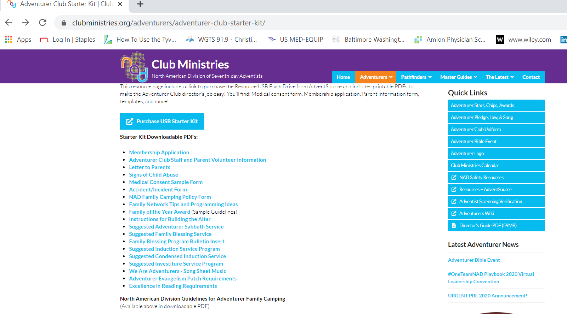

Slide 17
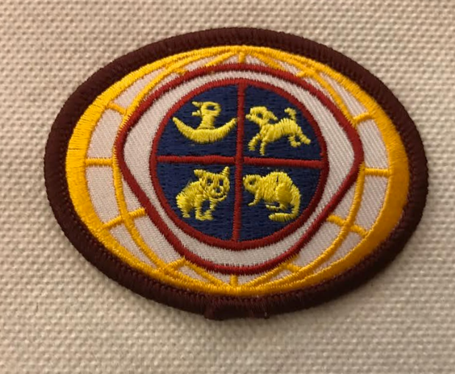
The Chesapeake Conference Coordinators and Directors voted 5 years ago
to use these patches, slide and scarf.
You can call Ann Reynolds at the Conference Office to see what supplies she may have in stock.

Slide 18
The Chesapeake Conference Coordinators
and Directors voted 5 years ago
to adopt the classes by ages
as in the Wright Publishing Program.
The NAD Little Lambs (Preschool)
Wright Publishing Little Lambs (3 years old)

Slide 19
Chesapeake Conference Discovery Program
Baby Birds
Birth to 2
Little Lambs
3 years old
Curious Cubs
4 years old
Eager Beavers
5 years old
Promotion to Adventurers

Slide 20
Thank you!

