Slide 1
Creating Community in an Age of Loneliness
The Need for Small Groups
Pastor John Rengifo

Slide 2
A culture craving relationship

Slide 4
John 17:20–23
“I do not pray for these alone, but also for those who will believe in Me through their word; ²¹ that they all may be one, as You, Father, are in Me, and I in You; that they also may be one in Us, that the world may believe that You sent Me.

Slide 5
John 17:20–23
And the glory which You gave Me I have given them, that they may be one just as We are one: ²³ I in them, and You in Me; that they may be made perfect in one, and that the world may know that You have sent Me, and have loved them as You have loved Me.

Slide 6
Discussion Question 1
Can you describe a meaningful relationship you’ve had in community with others? What made it so significant?

Slide 7
The Need for Small Groups

Slide 8
John 13:34, 35
“A new commandment I give to you, that you love one another; as I have loved you, that you also love one another. ³⁵ By this all will know that you are My disciples, if you have love for one another.”

Slide 9
Discussion Question 2
What do you think people today are looking for?

Slide 10
Why Small Groups? Three Reasons
It is where you build and deepen friendships

Slide 11
Why Small Groups? Three Reasons
It is where you build and deepen friendships
It is where believers receive care & teaching

Slide 12
Why Small Groups? Three Reasons
It is where you build and deepen friendships
It is where believers receive care & teaching
It is the perfect setting for inviting and reaching others

Slide 13
Discussion Question 3
Why is it that casual connections at church are just not enough to form close, meaningful relationships?

Slide 14
Help them find C.A.R.E.
C Community
A Accountability
R Relationship depth
E Experience

Slide 15
Discussion Question 4
How can small groups effectively grow disciples for Jesus?

Slide 16
Discussion Question 5
What are the elements for fostering community in a small group?

Slide 18
Discussion Question 6
How do I start or lead a small group?

Slide 19
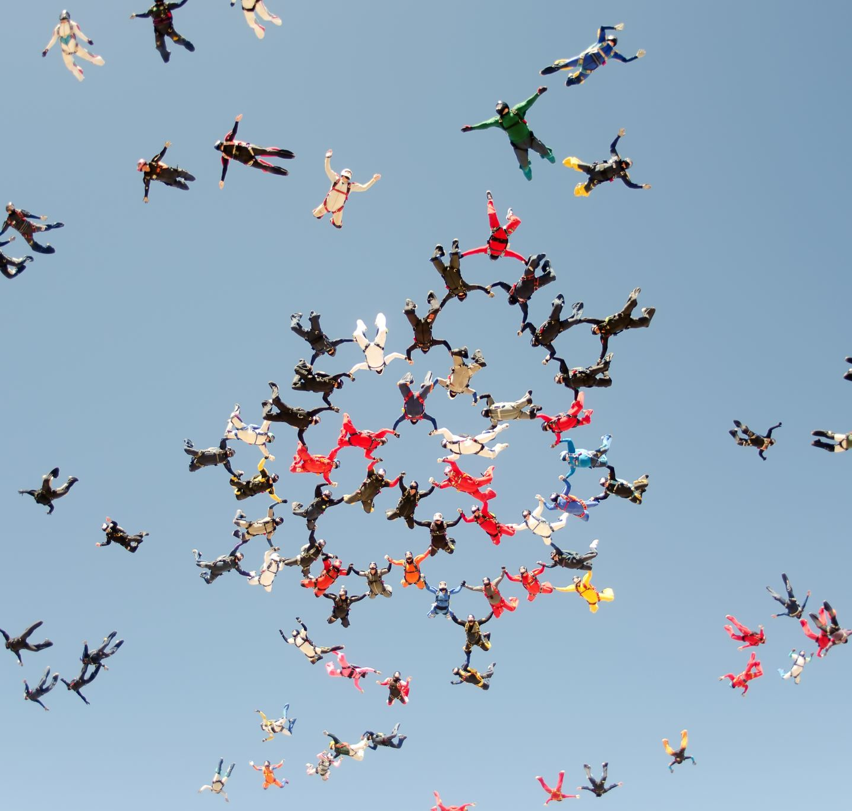
Contact Pastor John
Email: pastorjohn@ellicottcitychurch.org

