Slide 1
BUILDING A
GREAT TEAM
YOUTH GROUP ESSENTIALS
By: Gregory Sr. & Joan Hall

Slide 2
A PLACE
TO BELONG
YOUTH GROUP ESSENTIALS
By: Gregory Sr. & Joan Hall
Chesapeake Conference
Area Coordinators

Slide 3
A Place to Belong: Best Friends Forever
Relationships develop by progressing through different stages. Most stop at the first or second stage. A youth ministry can be proactive in moving people through more stages and towards greater intimacy, trust and fellowship.
A baseball diamond can illustrate four stages for developing relationships.

Slide 4
A Place to Belong: Best Friends Forever
1st Base - History: Basic information about one’s self (name, school, family, interests, even opinions and feelings).
First base represents HISTORY.
When you get a “Hit” you must travel to all the bases in order to get Home.
Getting Home is what “A Place To Belong” is all about!
So let’s get started with first base.

Slide 5
A Place to Belong: Best Friends Forever
2nd Base - High 5: Giving affirmation based on the history that was shared. Practice communicating affirmation. Ask for more information so you can add more affirmation.
Second base represents HIGH FIVE.

Slide 6
A Place to Belong: Best Friends Forever
3rd Base - Help: This posture of vulnerability is possible only after plenty of affirmation has developed strong trust (or unless a person is desperate). It’s risky, but it bonds people together and opens the door for mutual help.
Third base represents HELP.

Slide 7
A Place to Belong: Best Friends Forever
Home Plate - Home: Sometimes referred to as “fellowship” but it’s only attained after going around the bases, building trust through sharing history, being affirmed about many things, risking with one another by asking for help. The result of intimacy can’t be purchased or short-changed. It provides something all humans crave: A PLACE TO BELONG!
Home Plate represents HOME – A PLACE TO BELONG. .

Slide 8
CHAPTER 2
A PRICELESS GIFT:
WHAT ANYONE CAN GIVE…BUT MOST DON’T

Slide 9
L.I.S.T.E.N.

Slide 10
Proverbs 11:14, “Where there is no counsel, the people fall;
But in the multitude of counselors there is safety.”
Have you ever had someone in your life that really listened to you?
If you did, you were very fortunate.
The need to be listened to is one of the greatest needs of humans.
In this lesson we will focus on active listening skills.
Do you remember the baseball diamond analogy?
Active listening forms the heart of 2nd Base: High Five/ Affirmation.
BE A GOOD LISTENER
HOW?
Listen
Notes:
Affirmation means the action or process of affirming something or being affirmed.
Affirmation means also emotional support or encouragement.

Slide 11
A Place to Belong: Best Friends Forever
2nd Base - High 5: Giving affirmation based on the history that was shared. Practice communicating affirmation. Ask for more information so you can add more affirmation.
Second base represents HIGH FIVE.

Slide 12
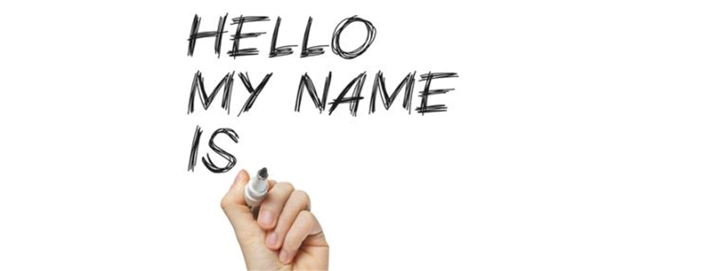
Let’s Introduce Ourselves…

Slide 13
SHARING EXERCISE
1. Take time right now and get into groups of two or at the most three.
2. Take one minute each sharing about someone in your life who really listened to you, and how you could tell they were a good listener.
3. Ready, go.

Slide 14
A Priceless Gift: What Anyone Can Give...But Most Don’t
Most people don’t listen. As a result, most of us don’t feel listened to. One key way to give affirmation (2nd base) is to listen to a person. There are skills people can learn and practice to become better listeners. Perhaps the first step is to get off of one’s own agenda and join another person’s agenda.
Active Listening

Slide 15
A Priceless Gift: What Anyone Can Give...But Most Don’t
Here are six listening skills to implement as you join another person’s agenda.
They form the acronym L.I.S.T.E.N.
Active Listening

Slide 16
A Priceless Gift: What Anyone Can Give...But Most Don’t
Look.
Eye contact provides focus.
Active Listening

Slide 17
A Priceless Gift: What Anyone Can Give...But Most Don’t
Interpret.
Put into your own words what you heard the person say; ask if that’s what they were saying.
Active Listening
Notes:
Stimuli means a thing or event that evokes a specific functional reaction in an organ or tissue.
"areas of the brain which respond to auditory stimuli“
Stimuli also means something that incites to action or exertion or quickens action, feeling, thought, etc.:
An example of external stimuli is your body responding to a medicine.
An example of internal stimuli is your vital signs changing due to a change in the body.

Slide 18
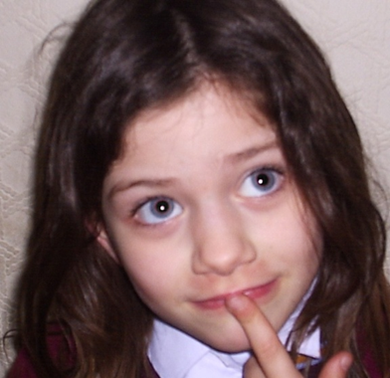
A Priceless Gift: What Anyone Can Give...But Most Don’t
Say more.
Ask a creative question about the speaker’s topic.
Active Listening

Slide 19
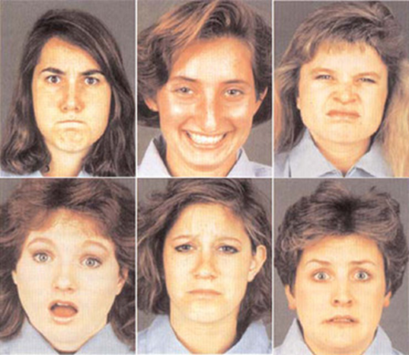
A Priceless Gift: What Anyone Can Give...But Most Don’t
Tell your own feelings.
Sense and name your feelings as you listen.
Active Listening

Slide 20
A Priceless Gift: What Anyone Can Give...But Most Don’t
Empathize.
Tentatively ask if what you’re feeling is the same as the speaker’s feelings.
Active Listening
What?
When?
Why?
How?

Slide 21
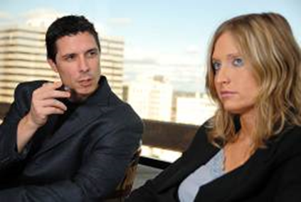
A Priceless Gift: What Anyone Can Give...But Most Don’t
Non-verbal communication.
Observe body language, facial expressions, tone of voice, and posture.
Active Listening

Slide 22
A Priceless Gift: What Anyone Can Give...But Most Don’t
DON’T DO THESE!
Barriers to avoid in order to be a good listener include:
Barriers
Expectation
Relationship
Boredom
Poor Self-Esteem
Daydreaming
Personal Situation
Emotional Mindset
Anger

Slide 23
A Priceless Gift: What Anyone Can Give...But Most Don’t
• Unfocused listening:
• Counter stories:
• Changing the topic:
• Rebuttals:
• Put downs:
allowing one’s self to be distracted or multi-tasking.
telling your own story that is better than the one you just heard.
Barriers
moving to your agenda rather than staying on the talker’s agenda.
correcting or giving unsolicited advice instead of listening.
might be funny to some, but it stops sharing because it makes the environment unsafe.
Proverbs 10:17, “He who keeps instruction is in the way of life,
But he who refuses correction goes astray.”
Notes:
Avoid the 5 barriers to being a good listener.

Slide 24
James 1:19, “So then, my beloved brethren, let every man be swift to hear, slow to speak, slow to wrath.”
L
Look.
I
Interpret.
Say more.
S
T
Tell your own feelings.
E
Empathize.
Non-verbal communication.
N

Slide 25
LET’S PRACTICE
1. Divide into a groups of three.
2. Person A will do the talking, person B uses the listening skills, and person C will be the observer and give feedback later.
3. Spend the next three minutes tell about a memorable vacation or some other experience. Person A talks, person B uses the listening skills, and person C will be the observer and give feedback later.
4. After three minutes, the observer will give feedback for one minute.

Slide 26
L.I.S.T.E.N.

Slide 27
Want to know how to build a great team? It all begins with you...

Slide 28
Conclusion
What is so important about listening? I listen!”
Sure you do. But how? How adapt are you, for example, in getting people to come right out and really talk to you?
Before you can get the most out of a listening situation, others must first believe that you really want to listen. They must feel that when they tell you something, it will be received by you in the proper spirit.
Learn to listen beyond the words, with your heart as well as your ears.
Observe the signs of the inner feelings such as voice quality, facial expressions, body posture and motions, etc. These actions are revealing, and sometimes may have an opposite meaning from the spoken word.
A friend put it this way: “You listened as if you wanted to hear what I was going to say, as if it was really important to you. And that makes me feel good!”
Proverbs 2:2, “So that you incline your ear to wisdom,
And apply your heart to understanding.”

Slide 29
Closing Prayer
Jeremiah 29:12, “Then you will call upon Me and go and pray to Me, and I will listen to you.”
HEAVENLY FATHER,
How many times have You spoken to me and I was not listening?
There are so many things You want to say to me but sometimes I am distracted.
Listening to You each day is a priceless gift.
Help me to listen.
In Jesus name,
Amen.

