Slide 1
Cross-Cultural Approaches
David Kim, Assoc. Pastor
Chesapeake Conference
Washington-Spencerville Korean/Good Hope Adventist

Slide 2
Background Bio

Slide 3
Untranslatable Words
Dapjeongneo (답정너)
Hyo (효)
Sobremesa
Backpfeifengesicht
Schadenfreude
Trade-off
Serendipity

Slide 4
Goals for Today
Understand why and how cross-cultural approaches in ministry is our Gospel commission
Discover principles that can be applied as we undertake cross-cultural ministry

Slide 5
Outline for Today
Define Culture
Discussion questions
Ask why deal with cross cultural approach
Answer why cross cultural approach is necessary
Discussion questions
Where cross cultural approach happens
Practical Cross Cultural Approaches
Awareness of major differences
Cross cultural communication
Examine major difference in cultural themes of sin
Discussion questions
"Cross" Cultural Approach of Paul

Slide 6
Culture
the customary beliefs, social forms, and material traits of a racial, religious, or social group
also : the characteristic features of everyday existence (such as diversions or a way of life) shared by people in a place or time

Slide 7
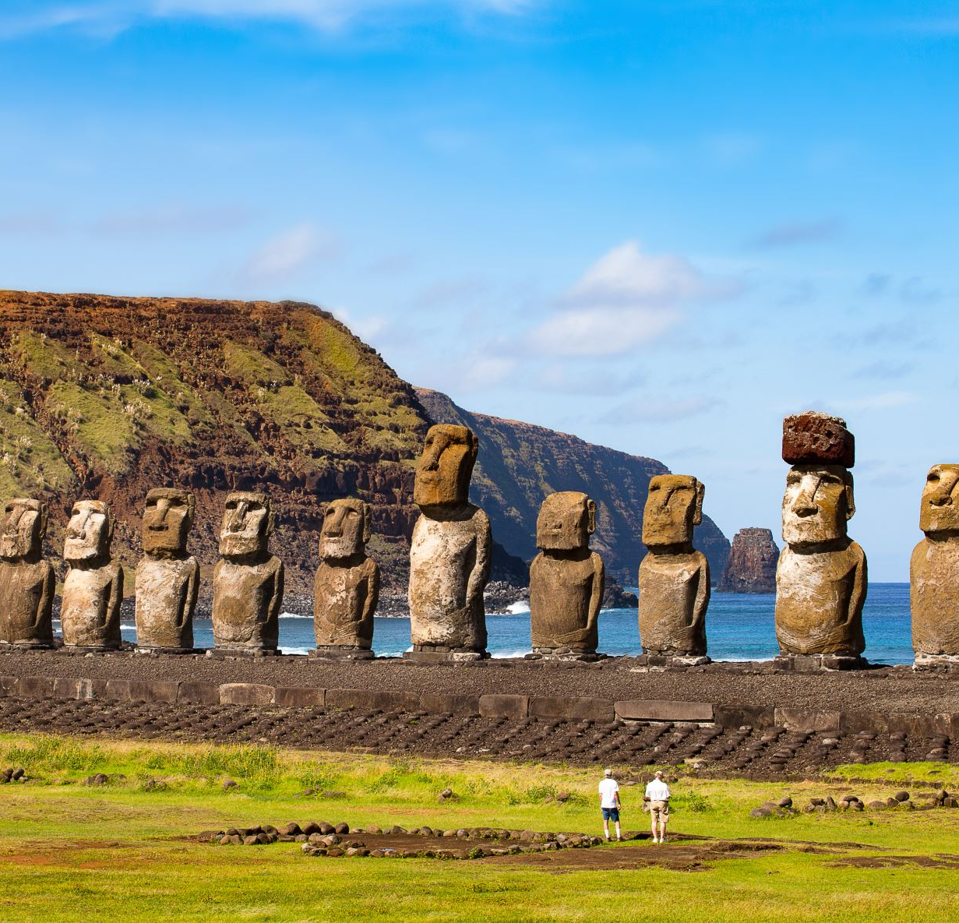
How is culture identified?

Slide 8
Culture expressed in language

Slide 9
Uniquely identifiable group with similar ways of thinking and viewing the world

Slide 10
Discussion
Can anyone name a word either in English or another language that is not easily translated?
Can someone belong to more than one culture?
If language and communication identifies a culture, how does non-verbal forms of communication apply? What is a non-verbal communication that is unique to a particular culture?

Slide 11
Why Cross-Cultural Approach?

Slide 12
Micah 4:1-2,6-7
Micah 4:1 In the last days the mountain of the LORD's temple will be established as the highest of the mountains; it will be exalted above the hills, and peoples will stream to it.
2 Many nations will come and say, "Come, let us go up to the mountain of the LORD, to the temple of the God of Jacob. He will teach us his ways, so that we may walk in his paths." The law will go out from Zion, the word of the LORD from Jerusalem.
Mic. 4:6-7 NIV 6 "In that day," declares the LORD, "I will gather the lame; I will assemble the exiles and those I have brought to grief.
7 I will make the lame my remnant, those driven away a strong nation. The LORD will rule over them in Mount Zion from that day and forever.

Slide 13
Matt 28:19
19 a"Go therefore and bmake disciples of call the nations, dbaptizing them in the name of the Father and the Son and the Holy Spirit,
20 teaching them to observe all that I commanded you; and lo, aI am with you 1always, even to bthe end of the age."

Slide 14
Mark 16:15
15 He said to them, "Go into all the world and preach the gospel to all creation.
16 Whoever believes and is baptized will be saved, but whoever does not believe will be condemned.

Slide 15
Rev 7:9-14
9 After this I looked, and there before me was a great multitude that no one could count, from every nation, tribe, people and language, standing before the throne and before the Lamb. They were wearing white robes and were holding palm branches in their hands.
10 And they cried out in a loud voice: "Salvation belongs to our God, who sits on the throne, and to the Lamb."
11 All the angels were standing around the throne and around the elders and the four living creatures. They fell down on their faces before the throne and worshiped God,
12 saying: "Amen! Praise and glory and wisdom and thanks and honor and power and strength be to our God for ever and ever. Amen!"
13 Then one of the elders asked me, "These in white robes-- who are they, and where did they come from?"
14 I answered, "Sir, you know." And he said, "These are they who have come out of the great tribulation; they have washed their robes and made them white in the blood of the Lamb.

Slide 16
Rev 14:6
6 Then I saw another angel flying in midair, and he had the eternal gospel to proclaim to those who live on the earth-- to every nation, tribe, language and people.

Slide 17
Gal 3:26-29
26 So in Christ Jesus you are all children of God through faith,
27 for all of you who were baptized into Christ have clothed yourselves with Christ.
28 There is neither Jew nor Gentile, neither slave nor free, nor is there male and female, for you are all one in Christ Jesus.
29 If you belong to Christ, then you are Abraham's seed, and heirs according to the promise.

Slide 18
Gen 11:1-9
1 Now the whole world had one language and a common speech.
2 As people moved eastward,1 they found a plain in Shinar2 and settled there.
3 They said to each other, "Come, let's make bricks and bake them thoroughly." They used brick instead of stone, and tar for mortar.
4 Then they said, "Come, let us build ourselves a city, with a tower that reaches to the heavens, so that we may make a name for ourselves; otherwise we will be scattered over the face of the whole earth."
5 But the LORD came down to see the city and the tower the people were building.
6 The LORD said, "If as one people speaking the same language they have begun to do this, then nothing they plan to do will be impossible for them.
7 Come, let us go down and confuse their language so they will not understand each other."
8 So the LORD scattered them from there over all the earth, and they stopped building the city.
9 That is why it was called Babel1-- because there the LORD confused the language of the whole world. From there the LORD scattered them over the face of the whole earth.

Slide 19
Acts 2:4-12
4 All of them were filled with the Holy Spirit and began to speak in other tongues1 as the Spirit enabled them.
5 Now there were staying in Jerusalem God-fearing Jews from every nation under heaven.
6 When they heard this sound, a crowd came together in bewilderment, because each one heard their own language being spoken.
7 Utterly amazed, they asked: "Aren't all these who are speaking Galileans?
8 Then how is it that each of us hears them in our native language?
9 Parthians, Medes and Elamites; residents of Mesopotamia, Judea and Cappadocia, Pontus and Asia,1
10 Phrygia and Pamphylia, Egypt and the parts of Libya near Cyrene; visitors from Rome
11 (both Jews and converts to Judaism); Cretans and Arabs-- we hear them declaring the wonders of God in our own tongues!"
12 Amazed and perplexed, they asked one another, "What does this mean?"

Slide 20
When the gospel is properly conveyed, it elevates humanity in all its expressions and honors God; it unifies the division created through misunderstanding and ill-will between people groups; but the gospel also unifies the person with God

Slide 21
Discussion
What “cultures” do you see that needs “crossing” today around you?
Christianity is sometimes seen as culturally divisive. Name some ways this has been the case recently. Why is this and what can we do to help correct this perception?
In a globalized interconnected world, think about what language is becoming; what does that mean for us and the world? What significance does the unique vocab of youth say about cross cultural approaches?

Slide 22
Where cross cultural approach happens

Slide 23
National Conference of State Legislatures
U.S. demographic trends so far, and in the possible future
D’Vera Cohn
Senior writer/editor
@allthingscensus

Slide 24
South
and
West
outpace
other
regions
“America’s Changing Population: What to Expect in the 2020 Census,” Population Reference Bureau, June 2019
October 23, 2019
3

Slide 25
Immigrants and their descendants
and
U.S.
population growth
% of U.S. Population
1965-2015
2015-2065
Source: Pew Research Center population estimates based on adjusted census data.

Slide 26
Mexico, China and India
are
top
birthplaces
for
immigrants
in
the
U.S.
October 23, 2019
16

Slide 27
Among new immigrant arrivals, Asians outnumber Hispanics
% of immigrants arriving to the U.S. in each year who are …
Note: Figures for 2001-2004 based on household population, excluding group quarters. 2017 figure includes arrivals from Jan. 1-Apr. 1, 2016.
Race and ethnicity based on self-reports. Asians include only non-Hispanics. Hispanics are of any race.
Source: Pew Research Center tabulations of 2001-2016 American Community Surveys (IPUMS)
October 23, 2019
17

Slide 28
Mexican immigrant decline driven by
fall
in
Mexican
unauthorized
immigrant
population
Note: Shading surrounding line indicates high and low points of the estimated 90% confidence interval. Data labels are for 1990,
1995, 2000, 2005, 2007, 2010, 2015 and 2017. Source: Pew Research Center estimates for 2005-2017 based on augmented
American Community Survey data from Integrated Public Use Microdata Series (IPUMS); for 1990, 1995 and 2000 based on
augmented March supplements to Current Population Survey.

Slide 29
www.pewresearch.org
Racial and
ethnic change to continue in future decades
% of total U.S. population
White
Black
Hispanic
Asian
2015
62
12
18
6
2025
58
13
19
7
2035
55
13
21
9
2045
51
13
22
10
2055
48
13
23
12
2065
46
13
24
14
Note: Whites, blacks and Asians include only those who are not Hispanic. Hispanics are of any race. Other races not shown.
Source: Pew Research Center population estimates and projections (2015)
September 17, 2018
24

Slide 30
Counties
where white population share fell
below
50%
between
2000
and
2018
https://www.pewresearch.org/fact-tank/2019/08/21/u-s-counties-majority-nonwhite/
October 23, 2019
25

Slide 31
Since
1967,
a
steady
rise
in
intermarriage
in
the
U.S.
Key facts about race and marriage, 50 years after Loving v. Virginia https://www.pewresearch.org/fact-tank/2017/06/12/key-facts-about-race-and-marriage-50-years-after-loving-v-virginia/
October 23, 2019
39

Slide 32
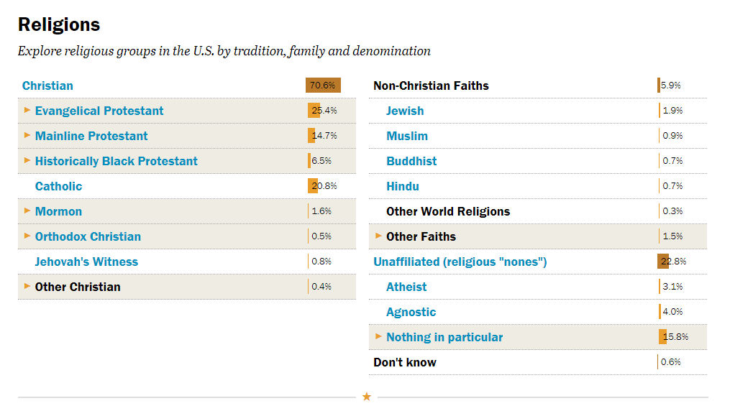

Slide 33
Practical Cross Cultural Approaches: Awareness of major differences

Slide 35
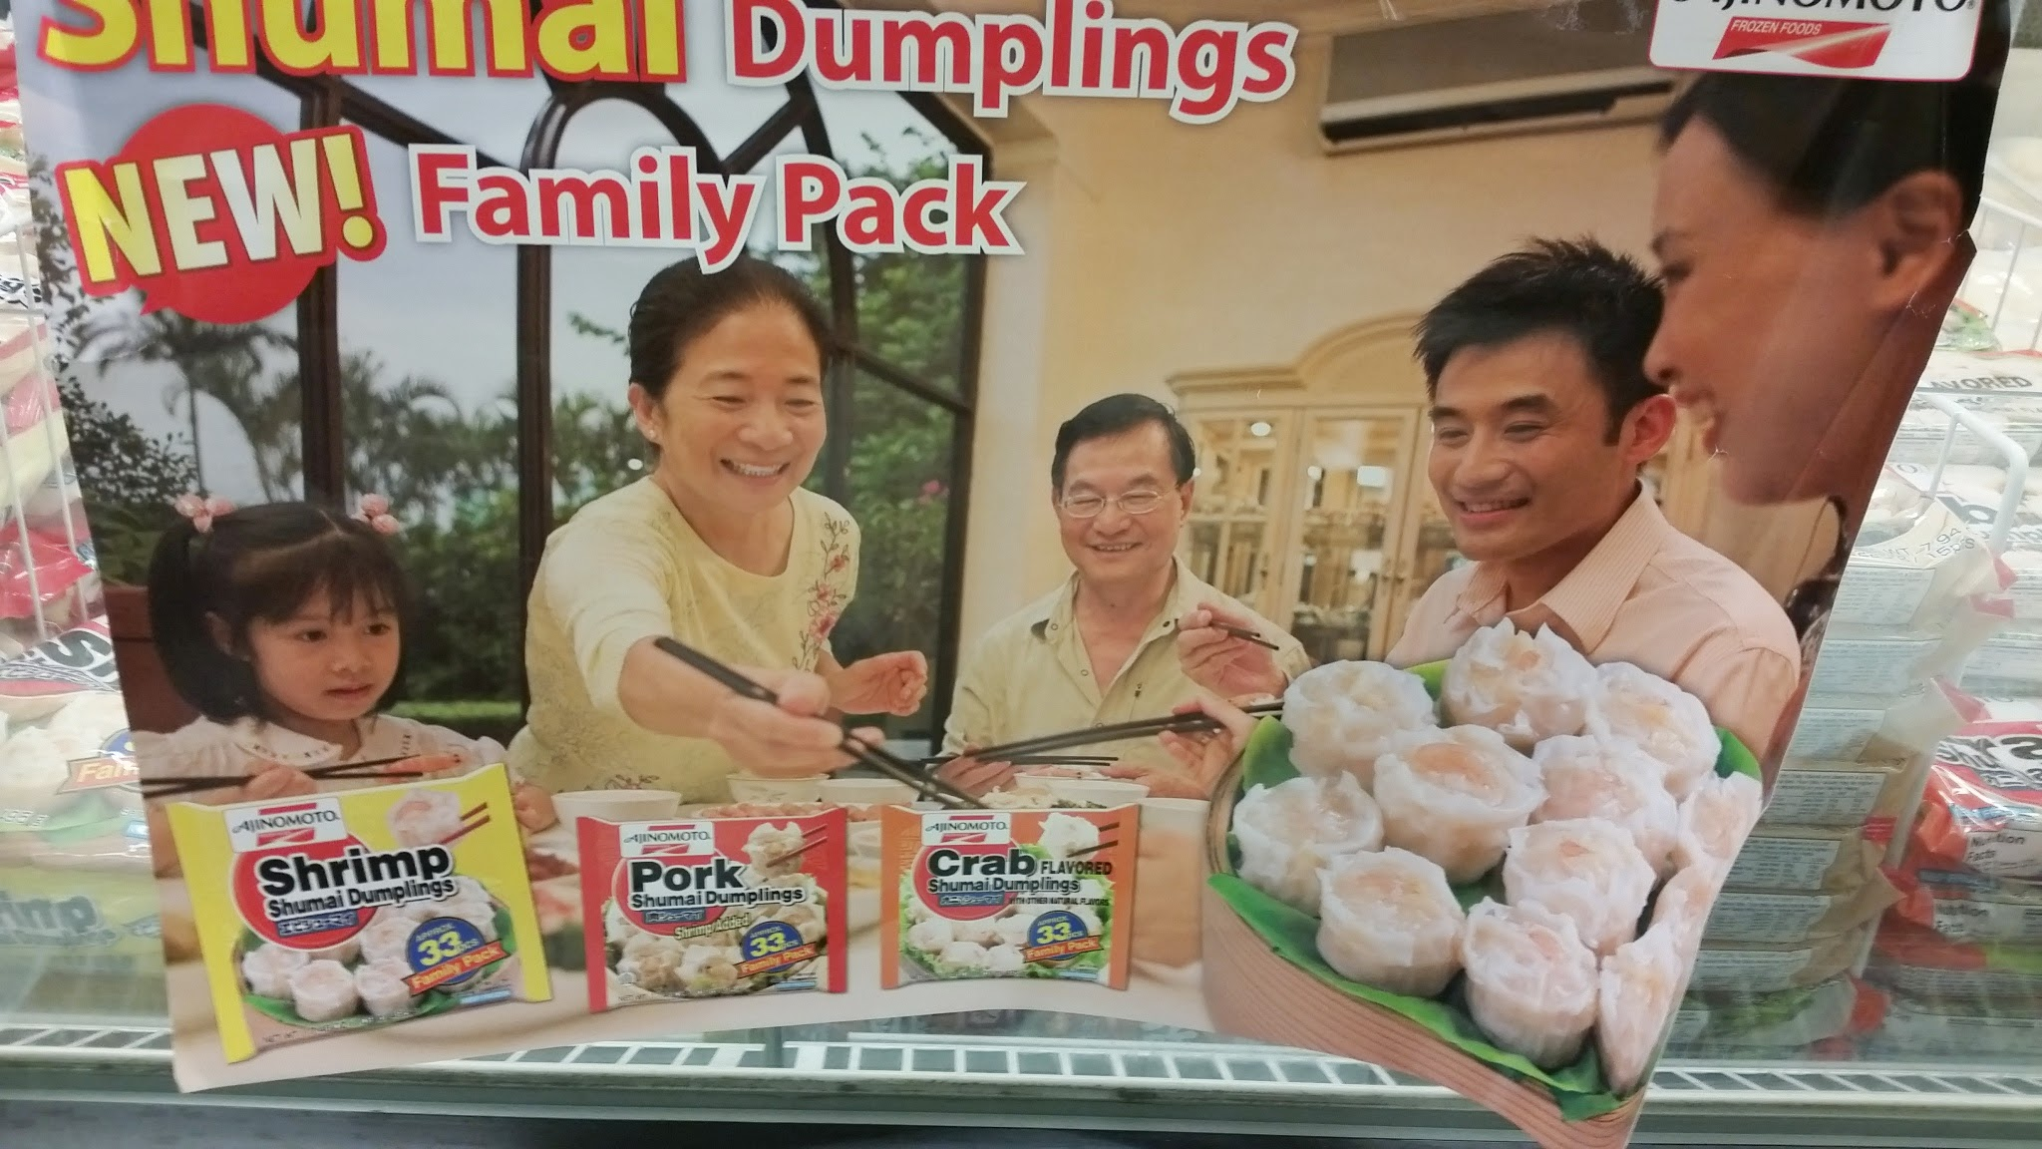

Slide 36
181.

Slide 37
182.

Slide 38
183.

Slide 39
184.

Slide 40
185.

Slide 41
186.

Slide 42
187.

Slide 43
188.

Slide 44
189.

Slide 45
190.

Slide 46
Cross-Cultural Communication

Slide 47
Emojis
Happy
West :)
East ^ ^
Sad
West :(
East ㅠㅠ
Surprised
West :O
East O.O
Bored
West :
East =_=

Slide 48
191.

Slide 49
209.

Slide 50
210.

Slide 51
213.

Slide 52
214.

Slide 53
237.

Slide 54
241.

Slide 55
250.

Slide 56
263.

Slide 57
264.

Slide 58
265.

Slide 59
266.

Slide 60
277.

Slide 61
281.

Slide 62
301.

Slide 63
Discussion
Read the story of the fall: Gen 2:19 – 3:24; if time permits, read the story of the prodigal son: Luke 15:11-32
What parts of the story speak to the guilt-innocence themes and what parts speak to the shame-honor themes?

Slide 64
Guilt – Shame Cultures

Slide 65
205.

Slide 66
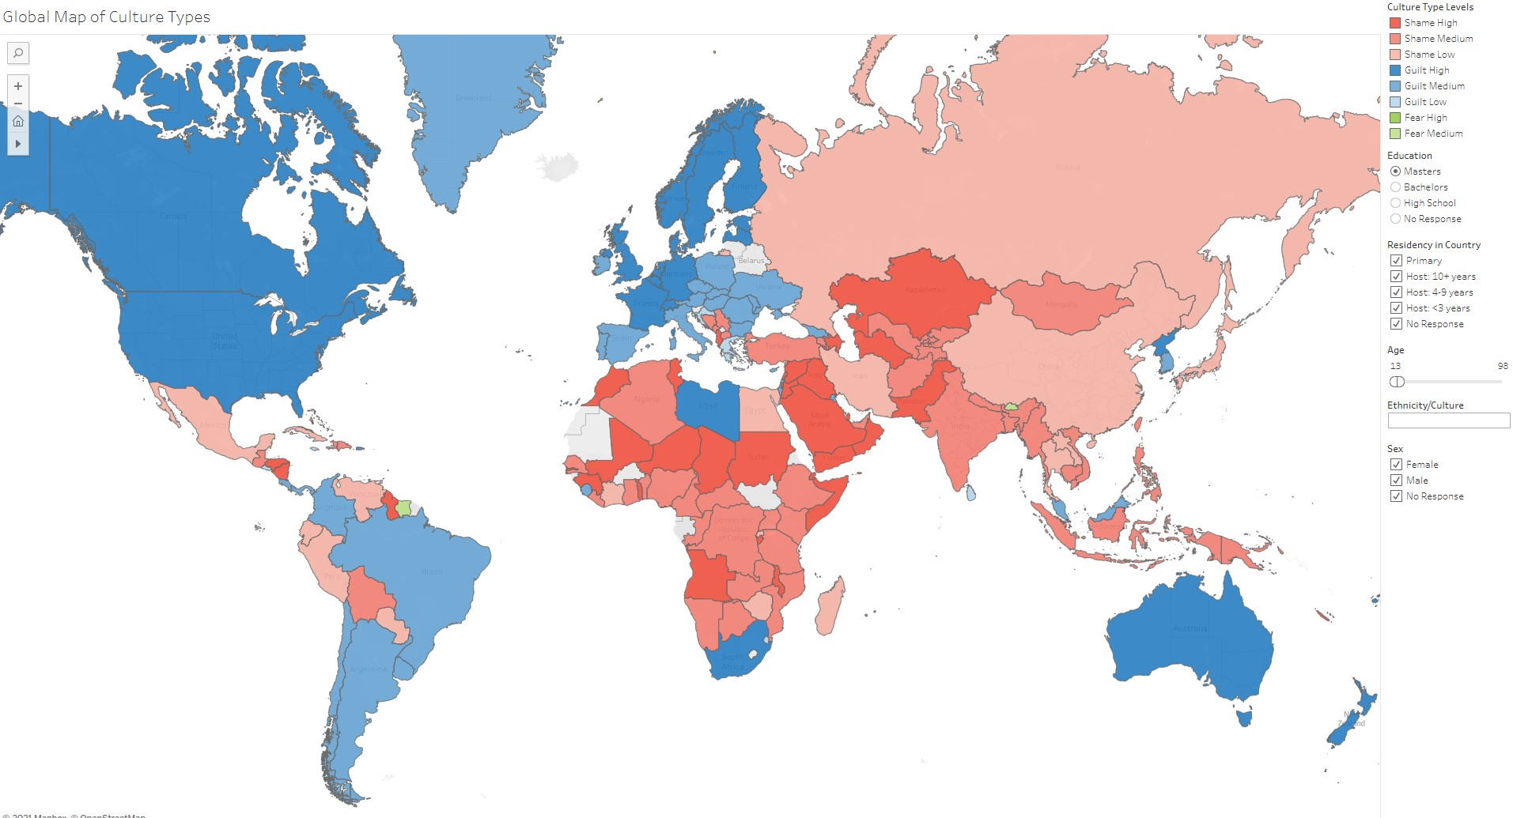

Slide 67
“Cross”-cultural Approach of Paul

Slide 68
1Cor 9:19-23
19 Though I am free and belong to no one, I have made myself a slave to everyone, to win as many as possible.
20 To the Jews I became like a Jew, to win the Jews. To those under the law I became like one under the law (though I myself am not under the law), so as to win those under the law.
21 To those not having the law I became like one not having the law (though I am not free from God's law but am under Christ's law), so as to win those not having the law.
22 To the weak I became weak, to win the weak. I have become all things to all people so that by all possible means I might save some.
23 I do all this for the sake of the gospel, that I may share in its blessings.

Slide 69
“Cross”-cultural Approach of Paul
Let go of your privilege
Adopt a servant posture
Be all things to all in wisdom

Slide 70
Books/Resources
Ministering in Honor-Shame Cultures: Biblical Foundations and Practical Essentials Paperback – September 1, 2016
by Jayson Georges (Author), Mark D. Baker (Author)
Christ and Culture, H. Richard Niebuhr
“Conflict Resolution: Cross-Cultural Perspectives,” Avruch and Black

