Slide 1

Developing an Awesome
TLT Program
Carl Rodriguez
Chesapeake Conference of SDA

Slide 2

Barna, George. 1995. Generation Next: What you need to know about today’s youth
“after studying patterns of faith for years, our research leads to a similar prognosis: if children are not reached with the gospel by age 13, the chances of their accepting the gospel after that point are greatly reduced.” – pg. 30.
“In fact, if we stretch the age frame to 8 through 13 years of age, that six-year stretch of time defines when roughly half of all Americans made their decisions to become true Christians. In other words, by the time students enter high school, the odds of accepting Christ as Savior are radically reduced.” -- Pg. 79

Slide 3
Barna, George. 1995. Generation Next: What you need to know about today’s youth
“If a person is ever going to become a Christian, the chances are great that he or she will do so before reaching the age of 18. About three-quarters of all people who have consciously, intentionally, and personally chosen to embrace Jesus Christ as their Savior did so before their 18th birthday.” – pg. 77

Slide 4

De Vries, M. 1994. Family-based youth ministry
“Most young people who disaffiliate with the church do so by the time they have become sixteen years old. Research confirms that those youth who drop out of the church do so not when they go for college, as is often assumed, but while they are still in high school.” – pg. 24
The crisis is that we are not leading teenagers to mature Christian Adulthood.” – pg. 26

Slide 5
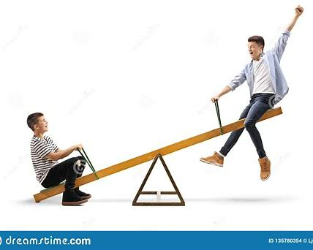
De Vries, M. 1994. Family-based youth ministry
“When young people grow up to be reactive Christians adults, they are constantly waiting for someone or something to attract them, to involve them, to impress them, A reactive Christian puts the responsibility for his spiritual life on someone else.” – pg. 27
Spiritual
Entertainment
Reactive Approach
The Seesaw or Fast Track Approach

Slide 6
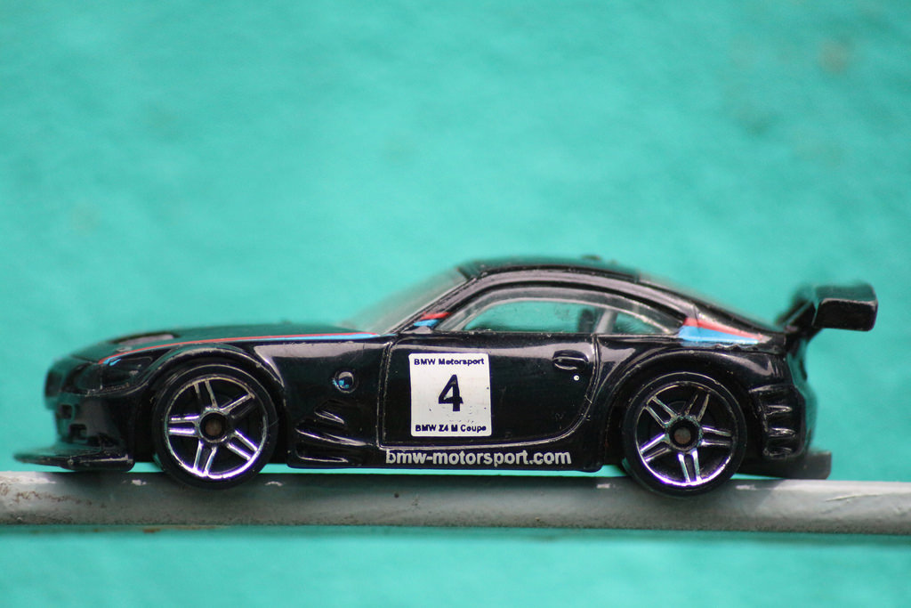
Discipleship is not for wimps
A weakness - the Fast Track Approach
The accession of members who have not been renewed in heart and reformed in life is a source of weakness to the church.
This fact is often ignored. Some ministers and churches are so desirous of securing an increase of numbers that they do not bear faithful testimony against unchristian habits and practices.
Notes:
----- Meeting Notes (9/6/13 23:31) -----
Helping to mold their character - Basketball fight story at a Youth Federation Tournament

Slide 7
Discipleship is not for wimps
A weakness - the Fast Track Approach
Those who accept the truth are not taught that they cannot safely be worldlings in conduct while they are Christians in name. {Ev 319.3}
Notes:
----- Meeting Notes (9/6/13 23:31) -----
Helping to mold their character - Basketball fight story at a Youth Federation Tournament

Slide 8

The Discipleship Funnel Approach

Slide 9

The Funnel of Disciple-ship
Come Level – they come for the fun, girls, friends
Grow level - they tolerate spiritual things as they have fun
Disciple Level – take the initiative for their spiritual growth
Develop Level - willing to help other people grow
Multiplier Level – become leaders to help others come
Notes:
----- Meeting Notes (9/6/13 23:31) -----
We want ready made Christians! Yet here are the 5 steps.

Slide 10

The Non-Neutral Environment Approach

Slide 11

Pros and Cons of NNE's
Pros
You don’t know the results
Youth like to mix things up
Youth are energized
You can inspire others
Cons
You can go too far.

Slide 12

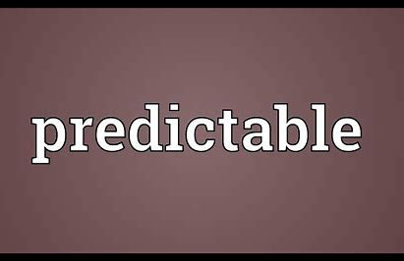
"Young people come alive when there's a change from what is predictable.
In fact, you don’t create NNE's for young people, they will create non-neutral environments for you."
Case & Cisneros

Slide 13

Breakout Time
Explain why the discipleship and NNE approaches are important for TLT ministry.

Slide 14

God Positioning System (GPS)
Your role as a leader
Eph. 4:11-16
11 It was he who gave some to be apostles, some to be prophets, some to be evangelists, and some to be pastors and teachers,
Introduction to the Essentials
Notes:
----- Meeting Notes (9/6/13 23:31) -----
As leaders, what is our role

Slide 15

God Positioning System (GPS)
Your role as a leader
Eph. 4:11-16
¹² to prepare God's people for works of service, so that the body of Christ may be built up ¹³ until we all reach unity in the faith and in the knowledge of the Son of God and become mature, attaining to the whole measure of the fullness of Christ.
Introduction to the Essentials
Notes:
----- Meeting Notes (9/6/13 23:31) -----
As leaders, what is our role

Slide 16

TLT Essential I – Help our TLT’s find their Gifts
Youthful talent, well organized and well trained, is needed in our churches. The youth will do something with their overflowing energies. Unless these energies are directed into right channels, they will be used by the youth in a way that will hurt their own spirituality, and prove an injury to those with whom they associate.-- Gospel Workers, p. 211. {ChS 30.4}

Slide 17
TLT Essential I – Help our TLT’s find their Gifts
God's Plan in a Diversity of Gifts.--In all the Lord's arrangements, there is nothing more beautiful than His plan of giving to men and women a diversity of gifts. The church is His garden, adorned with a variety of trees, plants, and flowers. He does not expect the hyssop to assume the proportions of the cedar, nor the olive to reach the height of the stately palm. Many have received but a limited religious and intellectual training, but God has a work for this class to do if they will labor in humility, trusting in Him. --Letter 122, 1902. {Ev. 98.3}

Slide 18
TLT Essential II – TLT’s are to → Go
Matthew 28:18-20 ¹⁸ Then Jesus came to them and said, “All authority in heaven and on earth has been given to me.¹⁹ Therefore go and make disciples of all nations, baptizing them in the name of the Father and of the Son and of the Holy Spirit,²⁰ and teaching them to obey everything I have commanded you. And surely I am with you always, to the very end of the age.” (NIV)

Slide 19
TLT Essential II – TLT’s are to → Go
We have an army of youth today who can do much if they are properly directed and encouraged. We want our children to believe the truth. We want them to be blessed of God. We want them to act a part in well-organized plans for helping other youth.
Let all be so trained that they may rightly represent the truth, giving reason of the hope that is within them, and honoring God in any branch of the work where they are qualified to labor – EGW (GC Bulletin, ?Vol. 5, no. 2, pg. 24 [Jan. 29, 30, 1893])

Slide 20
TLT Essential III
TLT’s Need Mentors and Discipleship
The youth need more than a casual notice, more than an occasional word of encouragement. They need painstaking, prayerful, careful labor. He only whose heart is filled with love and sympathy will be able to reach those youth who are apparently careless and indifferent. Not all can be helped in the same way. God deals with each according to his temperament and character, and we must co-operate with Him.

Slide 21
TLT Essential III
TLT’s Need Mentors and Discipleship
Often those whom we pass by with indifference, because we judge them from outward appearance, have in them the best material for workers, and will repay all the efforts bestowed on them. There must be more study given to the problem of how to deal with the youth, more earnest prayer for wisdom that is needed in dealing with minds. --EGW (Gospel Workers, p. 208, paragraph 1)

Slide 22

Break Out
Why are 3 TLT
Essentials important?
1- Helping them find their gifts
2- Teaching them to → Go
3- Find superb mentors and people who understand discipleship

Slide 23
The Yearly Programs for TLT’s
1) September & March Training – for certification
I Tell – learning new areas for Mission & Service
I Serve – Helping during the Adventurer Family Weekend
I Splash – Fun event for those who serve
(Hershey Park of Neito-ville)

Slide 24


I-Tell
I-Serve

Slide 25

I-Splash
I-Train

Slide 26
The Whole Group Discussion Time
Why are the 4 - I’s Important
In a TLT Program
I-Tell
I-Serve
I-Splash
I-Train

Slide 27
Summary
1- We looked at 3 approaches to TLT Ministry
2- We looked at the 3 Essentials for TLT Ministry
3- We looked at the 4 – I’s for TLT Ministry
Now Go make your TLT Ministry Awesome!

