Slide 1
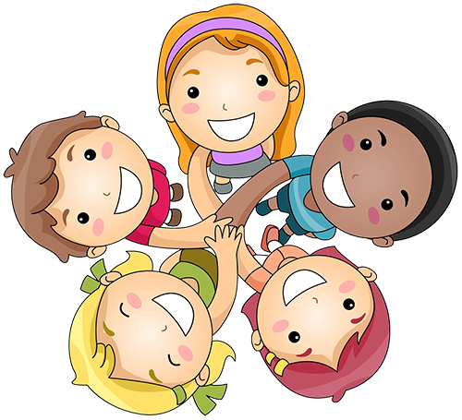
Friends
Adventurer Awards Day
October 18, 2020
This Photo by Unknown Author is licensed under CC BY-NC

Slide 2
Prayer
This Photo by Unknown Author is licensed under CC BY-SA-NC

Slide 3
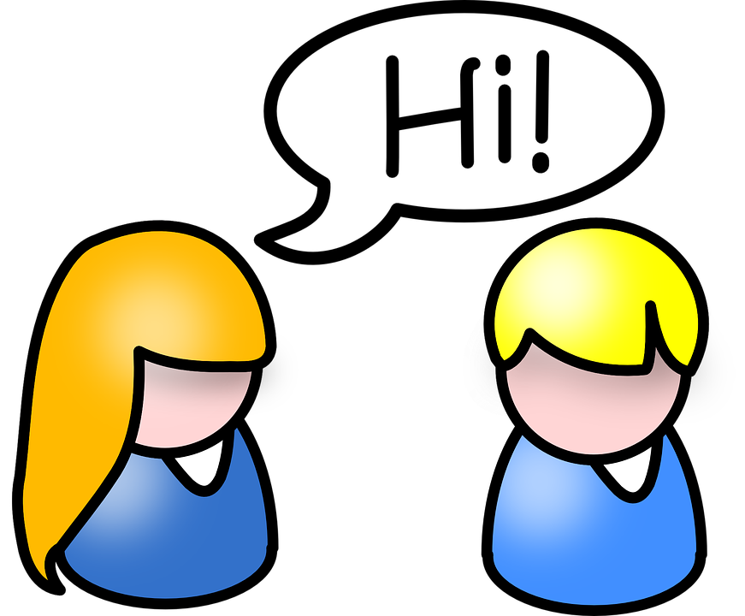
Welcome & Introduction
Mrs. Venus
Ms. Samantha
Ms. Sabine

Slide 4
Welcome Friends (Sung to London Bridge is Falling Down)
Welcome friends and, how are you?
How are you? How are you?
Welcome friends and, how are you?
We are happy!
This Photo by Unknown Author is licensed under CC BY-SA-NC

Slide 5
Who is a friend?
This Photo by Unknown Author is licensed under CC BY-NC

Slide 6
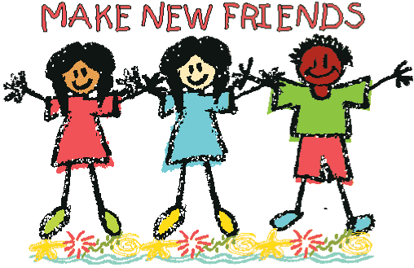
Name 3 ways you can make friends?
This Photo by Unknown Author is licensed under CC BY

Slide 7
Name 4 things you can talk about to be friendly with someone?
This Photo by Unknown Author is licensed under CC BY-SA

Slide 8
What makes you a good friend?
This Photo by Unknown Author is licensed under CC BY-ND

Slide 9
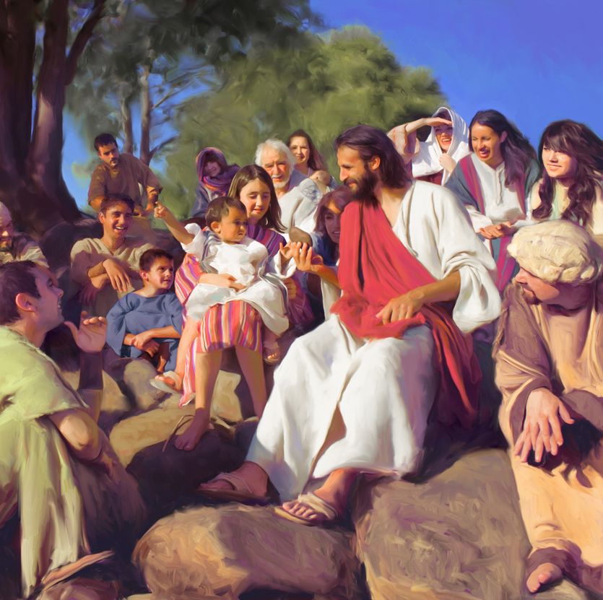
Did Jesus have friends?
This Photo by Unknown Author is licensed under CC BY-NC

Slide 10
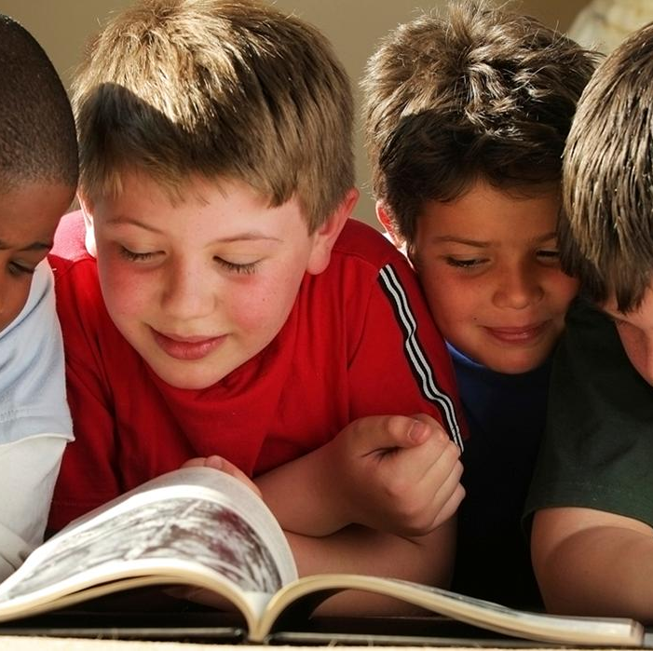
Bible Texts
John 11:5,11
Matthew 10:2-4
This Photo by Unknown Author is licensed under CC BY-ND

Slide 11
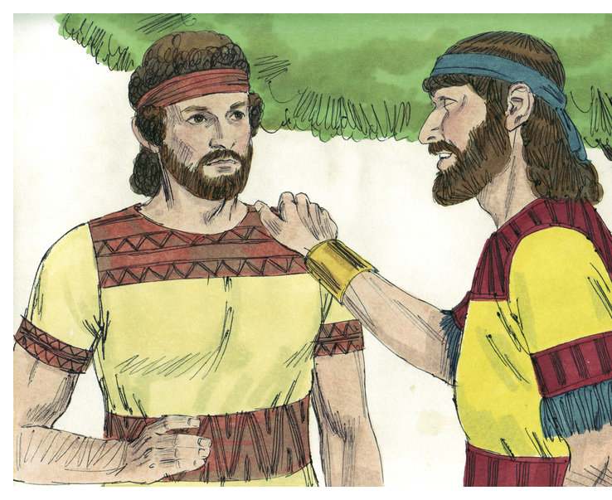
Match the Friends from the Bible
______ 1. David A. Elisha
______ 2. Paul B. Jesus
______ 3. Elijah C. Jonathan
______ 4. Ruth D. Silas
______ 5. Lazarus E. Naomi
This Photo by Unknown Author is licensed under CC BY-SA

Slide 12
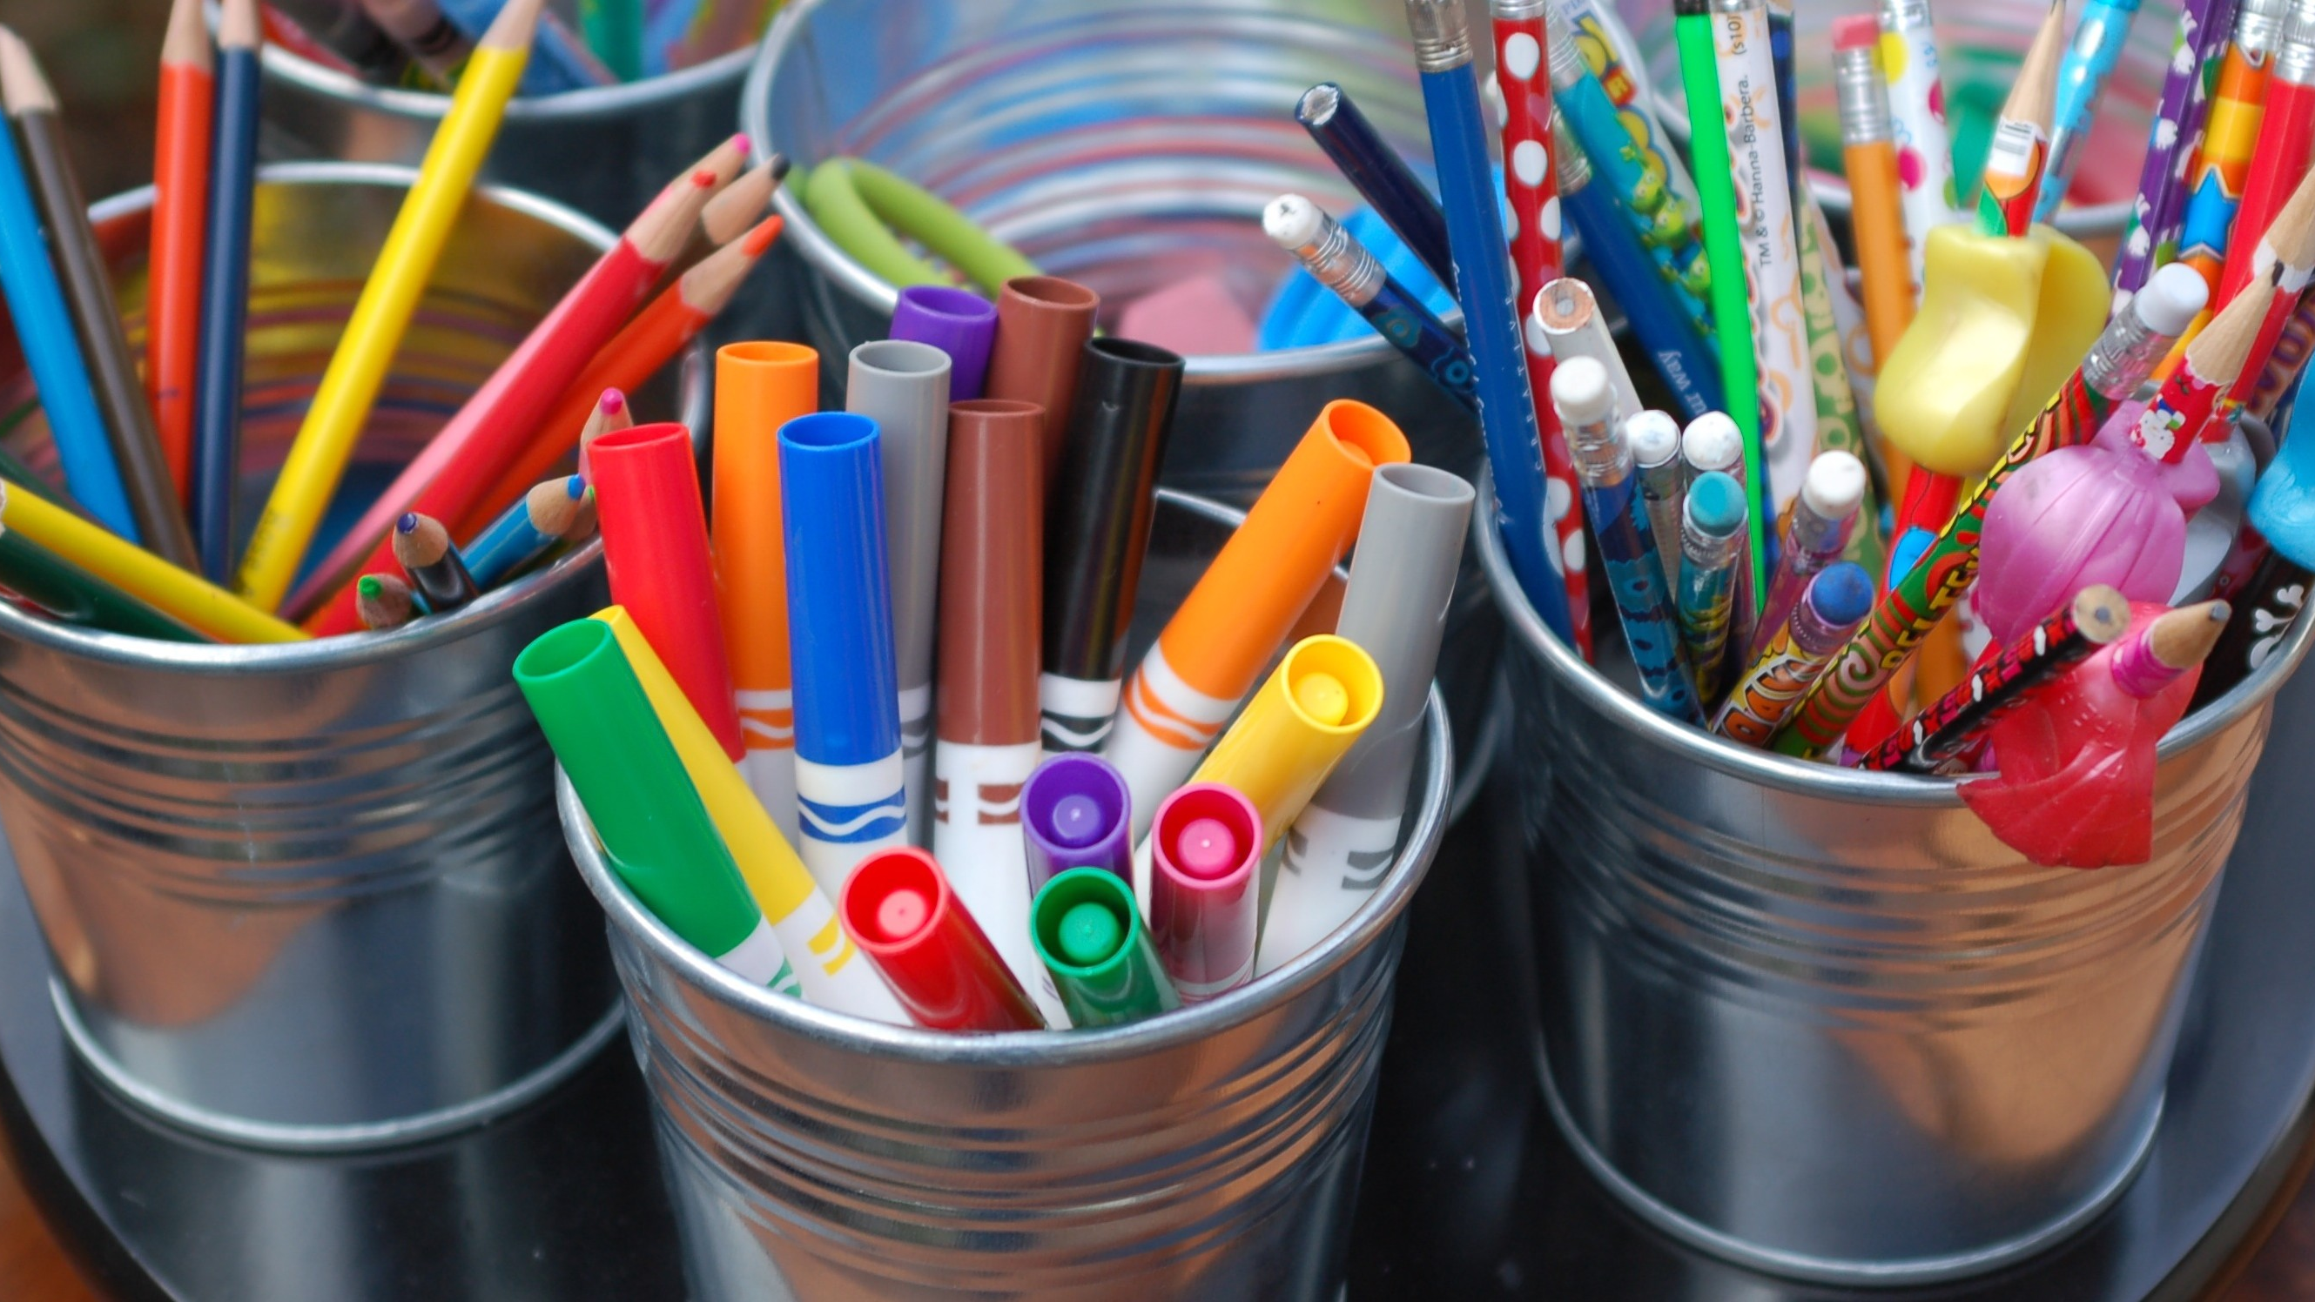
Craft time!
This Photo by Unknown Author is licensed under CC BY

Slide 13
The Pledge of Kindness
I Pledge to myself
On this very day
To try to be kind, in every way
To every person, big or small
I will help them if they fall
When I love myself and others too
That is the best that I can do

Slide 14
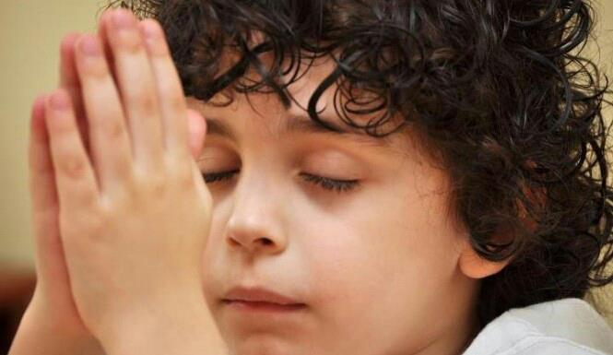
Closing Prayer
Thank you for being
our friends!!!!
This Photo by Unknown Author is licensed under CC BY

