Slide 1
Creative Resource
Development
by Richard Hurschman
Master Guide Coordinator
Chesapeake Conference

Slide 2
GOAL
To help identify, understand, develop,
and organize resources for the Master
Guide

Slide 3
SECTION 1
Basic Rules
1. This is an active participation discussion, IF my
voice is the loudest!
2. We begin and end with PRAYER

Slide 4
SECTION 2
Why are we really here?

Slide 5
A. TO BE A SERVANT OF GOD.
Galatians 4:7, “Wherefore thou art no
more a servant, but a son; and if a son,
then an heir of God through Christ.”

Slide 6
B. TRAINING
To provide you with advanced skills, tools,
and techniques that will maximize your
leadership and instructional talents

Slide 7
C. EXPOSING YOU TO IDEAS AND CONCEPTS TO BUILD YOUR CONFIDENCE
Proverbs 14:26, “In the fear of the LORD is
strong confidence: and his children shall
have a place of refuge.”

Slide 8
SECTION 3
What are resources?

Slide 9
A. PEOPLE
Staff, Support, Church,
and Family

Slide 10
B. FINANCIAL
Funding and Donations

Slide 11
C. SPACE
Space usage and
storage

Slide 12
D. ITEMS
Supplies, equipment, and
surplus

Slide 13
E. OFFICE
Admin. supplies

Slide 14
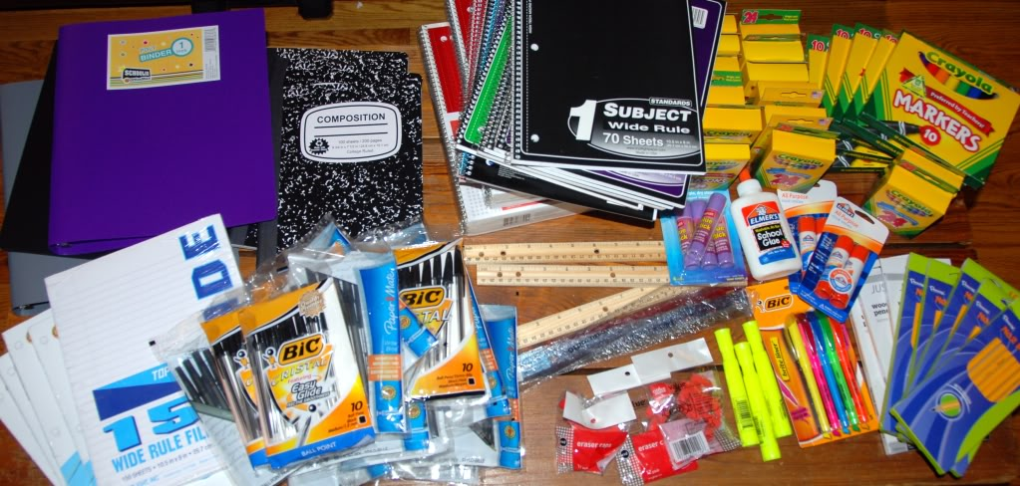
BREAK OUT SESSION 1
What other resources can you think of that I did not mention?
Notes:
This Photo by Unknown Author is licensed under CC BY-SA

Slide 15
F. GOOD STEWARDS
1 Peter 4:10, “As every man hath received the
gift, even so minister the same one to another, as
good stewards of the manifold grace of God.”

Slide 16
G. EMERGENCIES
I did not see that coming!!!

Slide 17
SECTION 4
Creative Gathering

Slide 18
A. PLACES
Know the best local and
online stores and sources

Slide 19
B. PEOPLE
Know your finders
Know your holders

Slide 20
Break out Session 2
What other gathering ideas do you have?
Notes:
This Photo by Unknown Author is licensed under CC BY-NC-ND
This Photo by Unknown Author is licensed under CC BY-NC-ND

Slide 21
SECTION 5
Organizing resources for use

Slide 22
A. WRITTEN
On Paper or electronic

Slide 23
B. ACTION
Implementing

Slide 24
C. MULTI USE
Splitting

Slide 25
D. AGAIN AND AGAIN!!
Reuse and Repurposing

Slide 26
Break Out Session 3
What other organization methods do you use?
Notes:
This Photo by Unknown Author is licensed under CC BY-NC-ND

Slide 27
E. EXTRA
What to do with leftovers

