Slide 1
Adventist Pioneer Heritage Honor
Charlie Koerting

Slide 2
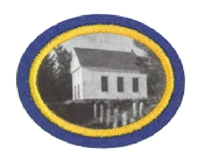
Adventist Pioneer Heritage Honor

Slide 3
Quick Disclaimers and Goals
If you have taken a Adventist History course (9 week course in academy or a 1 semester course in college), you have the honor.
My aim is not to cover every detail in history but rather to show the importance of our history to where we are today.
The goal is for us as leaders to share this history and its importance with our young people

Slide 5
Let’s talk about history
History is more than a set of boring facts which are irrelevant in todays world.
History informs us as to how we got to where we are
Our past can also provide glimpses into our future (those who don’t study the past are doomed to repeat it.)
The Bible is, to a large degree, a book of history
History is a good way of discerning God’s leading in our lives and in our organizations
3

Slide 6
Life Sketches of E. G. White
p 196
“We have nothing to fear for the future, except as we shall forget the way the Lord has led us, and His teaching in our past history.”

Slide 7
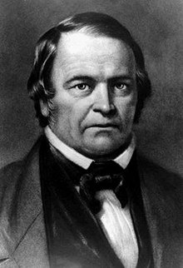
William Miller (1,2q,3a)

Slide 8
William Miller
Farmer and Baptist preacher
Fought in the war of 1812
Founded the Millerite movement, based on his reading of the Bible.
Based on his reading of Daniel 8, he preached that Christ would come, October 22, 1844
His followers were caught up with his message which led to the Great Disappointment when Christ did not come as predicted.
His farm in Whitehall, NY is an Adventist historical site.

Slide 9
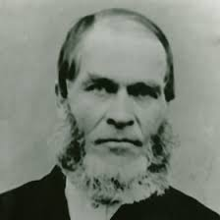
Hiram Edson (2h)

Slide 10
Hiram Edson
His studies after the Great Disappointment led to a better understanding of what the sanctuary was and what the cleansing meant.
He was a thoughtful Bible student and also a self-sacrificing contributor to the movement.
His barn in Clifton Springs, NY is an Adventist Historical site

Slide 11
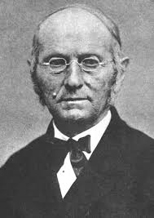
Joseph Bates (2d,6f)

Slide 12
Joseph Bates
Bates was a retired sea captain
He was a co-founder of the Seventh-day Adventist church, which was incorporated on May 21, 1863
He was an early advocate for the Sabbath and the third angels message
He was an organizer of the Sabbath conferences
He was a health reformer
His house in Fairhaven, MA is an Adventist Historic site.

Slide 13
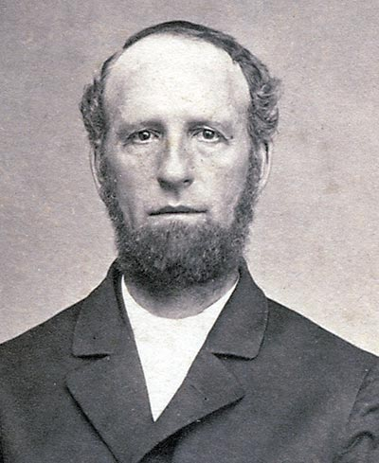
James White (2y,4a, 4c,4f,6m)

Slide 14
James White
He came from the Christian Connection tradition.
He was a teacher but resigned to become an Adventist preacher.
He married Ellen Harmon in 1846
He was a co-founder of the Seventh-day Adventist church
He borrowed money in 1852 to purchase a Washington Hand press so that he could do the printing of literature and magazines
He was the founder of the church’s publishing work. First publishing the Present Truth (July 1849) which then became the Advent Review and Sabbath Herald then the Review and Herald and finally the Adventist Review, which were the official papers of the church.
He first published the Signs of the Times in California in 1874

Slide 15
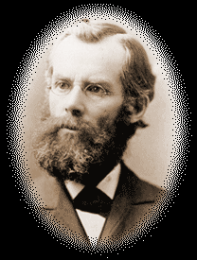
John Andrews (2c,3d)

Slide 16
John Andrews
Considered by many to Seventh-day Adventism’s first theologian.
He was the one, based on his studies, to determine that the Sabbath went from sunset to sunset
He was the first official overseas missionary of the church, traveling to Switzerland

Slide 17
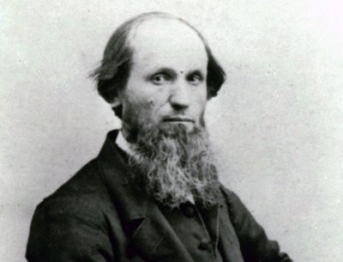
Michael Czechowski (2f)

Slide 18
Michael Czechowski
He was a converted Roman Catholic priest from Poland
He sought sponsorship from the church to go back to Europe to spread, however his questionable methods of handling his finances precluded that from happening.
He did go back to Europe and preached the Sabbath, starting congregations of Sabbath keepers in Switzerland and Romania (to which J. N. Andrews was sent to minister to).
You might say he was the first self-supporting missionary

Slide 19
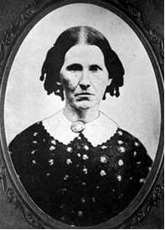
Rachel Oaks Preston (2s)

Slide 20
Rachel Oaks Preston
She was a Seventh-day Baptist who persuaded Frederick Wheeler (a Methodist minister who promoted the Adventist teachings of Miller) about the Sabbath.
This lead to the first Sabbath keeping Adventist congregation in Washington, New Hampshire in early 1844.

Slide 21
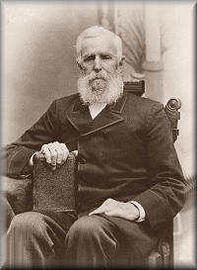
Frederick Wheeler (2x)

Slide 22
Frederick Wheeler
Convinced of the importance of the Sabbath by Rachel Oaks Preston
It was Wheeler that convinced Joseph Bates of the Sabbath
He founded the first Sabbath keeping Adventist congregation in 1844

Slide 23
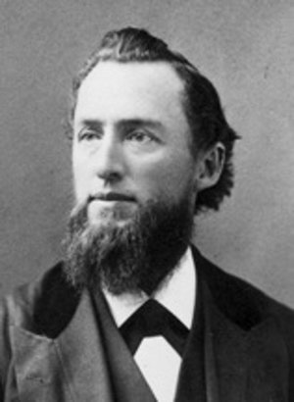
Uriah Smith (2u)

Slide 24
Uriah Smith
He was well educated
He was the long-time editor of the Review
He served in church leadership most of his life
He had a patent for a prosthetic leg with flexible joints, which he used since he lost his own leg in childhood
He was an opponent of Jones and Waggoner in 1888
He was a strong anti-Trinitarian (Arian)

Slide 25
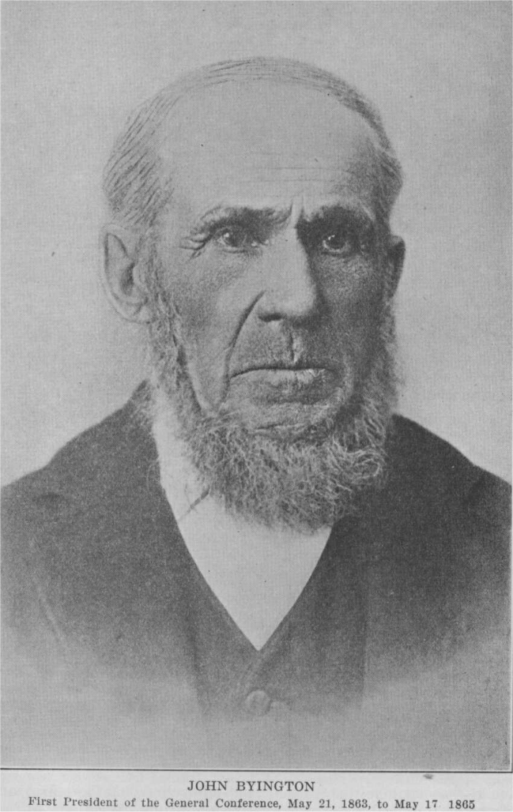
John Byington (2e)

Slide 26
John Byington
He was an active abolitionist and maintained a station on the underground railroad in Buck’s Bridge, NY
He was the first president of the General Conference

Slide 27
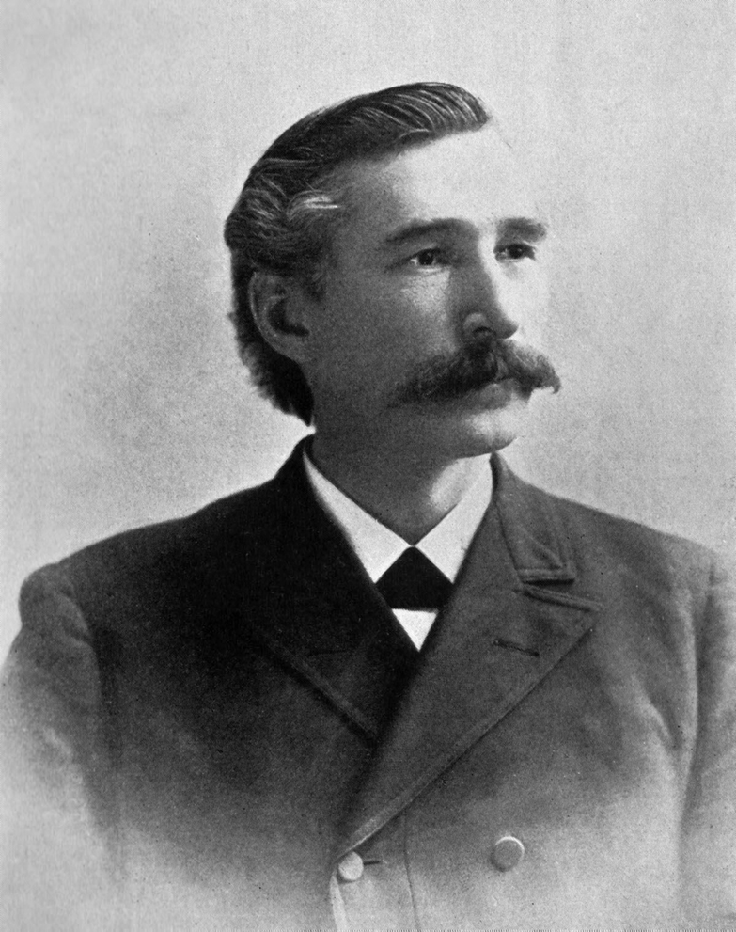
Alonzo Jones (2k, 3e)

Slide 28
Alonzo Jones
Early editor of the Signs of the Times
He was the denomination’s most prominent speaker for religious liberty at a time when the U.S. congress was considering Sunday legislation.
He was one of the principles actors in the 1888 general conference
He later sided with John Kellogg and left the church

Slide 29
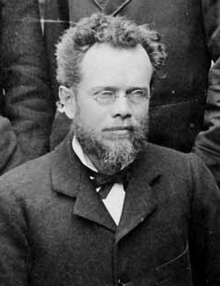
Ellet Waggoner (2k,3e)

Slide 30
Ellet Waggoner
He was a trained doctor
He co-edited the Signs of the Times with Alonzo Jones
His contribution to the 1888 general conference was an exposition of Paul’s letter to the Galatians.
He, like Jones left the church around the time of the Kellogg controversy

Slide 31
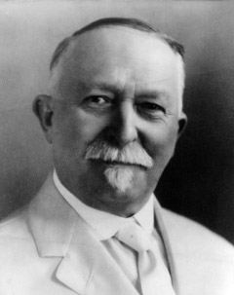
John Kellogg (3c,3f)

Slide 32
John Kellogg
Became one of the first Adventists to receive formal medical training
He went to work at the Western Health Reform institute, which was founded in 1863 and became the Battle Creek Sanitarium in 1866.
He was a very strong advocate for health reform
He was the inventor of peanut butter, corn flakes, and a number of other health/diet related innovations.
He precipitated a crisis in the church when he published the Living Temple, which contained pantheistic theology
He left the church and took the Battle Creek Sanitarium with him in the early 1900’s

Slide 33
Kate Lindsay (2p)

Slide 34
Kate Lindsay
The first women physician in the seventh-day Adventist church
She started medical school at the age of 28 in the second class that admitted women in the University of Michigan.
She founded the first nurses training school at Battle Creek
She served overseas and in Colorado (until her retirement)

Slide 35
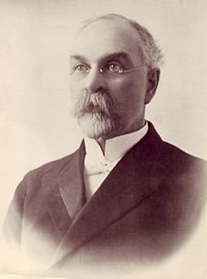
Arthur Daniels (2g,3f,5a)

Slide 36
Arthur Daniels
He was a pioneer Adventist missionary to New Zealand and Australia.
He had developed a close working relationship with Ellen white while in Australia
He became the General Conference president in 1901, during one of the more difficult periods of the church’s history.
He was president from 1901 to 1922 (longest serving)
He oversaw the diversification of the denomination from Battle Creek
He introduced the concept of the Union conference in 1901 to give more local control to the churches around the world.

Slide 37
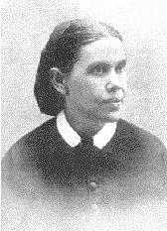
Ellen White (7)

Slide 38
Ellen White
She was born in Gorham Maine in 1827
She died in her home “Elmshaven” near Healdsburg, CA in 1915
She expressed the prophetic gift as outlined in the Bible
She experienced her first vision in December 1844
She promoted the education and health work that remain cornerstones of the church to this day.
In 1863 she had her vision on health reform.

Slide 39
Ellen White (cont)
She referred to herself as the Lord’s messenger
She had her vision on the great controversy in Lovett’s Grove, OH
She spent a number of years (in a sort of exile after 1888) in Australia, where she lived in her home called Sunnyside, at Avondale College, which she helped found.
She was a prolific author and speaker and her crowning literary work was the 5 volume Conflict of the Ages series.

Slide 40
Ellen White (cont.)
A large number of her letters to others were compiled by her into 9 volumes, entitled the Testimonies for the Church.
After her death, she left her writings to her estate, which was to be governed by a board of 5 church leaders. This estate now resides at the General Conference and supports the disseminations of her writings a well as housing research materials.

Slide 41
Important Dates
Great Disappointment
Oct 22, 1844
Adventist Church Incorporated
May 21, 1863
Health Reform Begins
1863
J N Andrews, First Missionary
1874
General Conference, Righteousness by Faith
1888

Slide 42
Important Dates (continued)
Reorganization
1901
Fires of Battle Creek
Feb & Dec 1902
Gland, Switzerland
1907
27/28 Fundamental Beliefs
1980 & 2005

Slide 43
Publications
Adventist Review and Sabbath Herald – founded in 1849 as the Present Truth became the Adventist Review after several name changes over the years.
Advent Tidend – This was a paper started by J. G Mattson for Scandinavian immigrants to the United States
Les Signes des Temps/Signs of the Times – Les Signes is the French version of the Signs of the Times which was started in 1874 in California

Slide 44
Publications (cont.)
Liberty Magazine/Liberty – First called the American Sentinel was started in 1886 to promote religious liberty at a time when Sunday laws were being contemplated.
Medical Evangelist/Medical evangelism – Founded 1908 and was published by the College of Medical Evangelists which became Loma Linda University. Emphasis was health and medical work. Publication ceased in 1962

Slide 45
Publications (cont.)
Present Truth – Forerunner to the Adventist Review. Emphasis was doctrine.
Youth’s instructor – Magazine for young people (16-30), which began in 1852. It was discontinued and Insight magazine was published in its place.

Slide 46
Church Organization
you
local church
conference
union
division
general conference

Slide 47
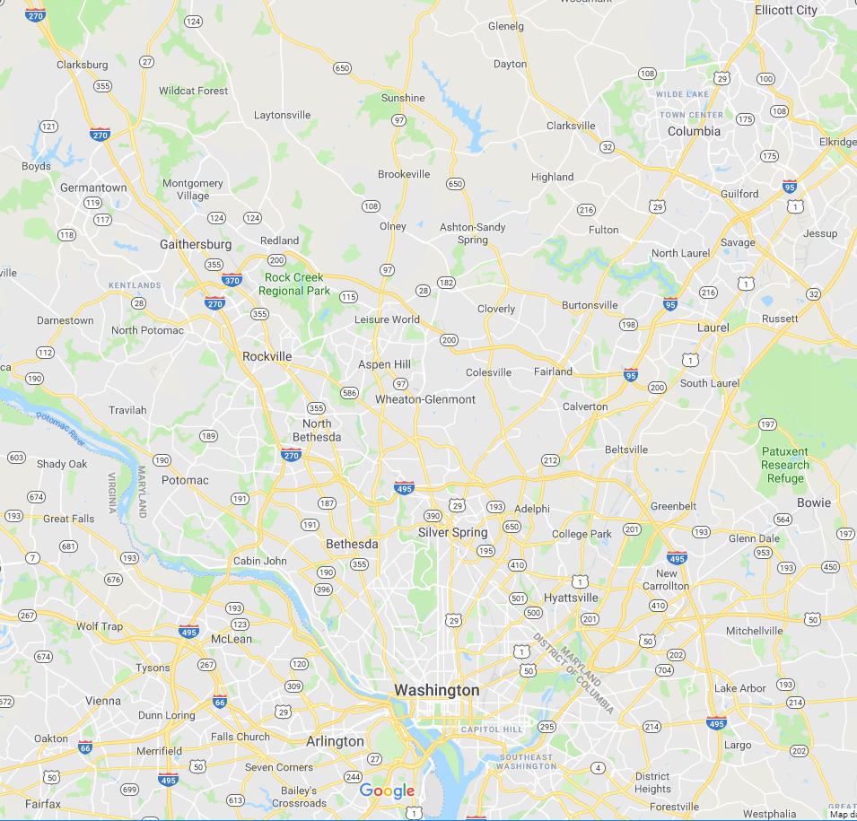
Columbia Union
Chesapeake Conference
North American Division
General Conference

Slide 48
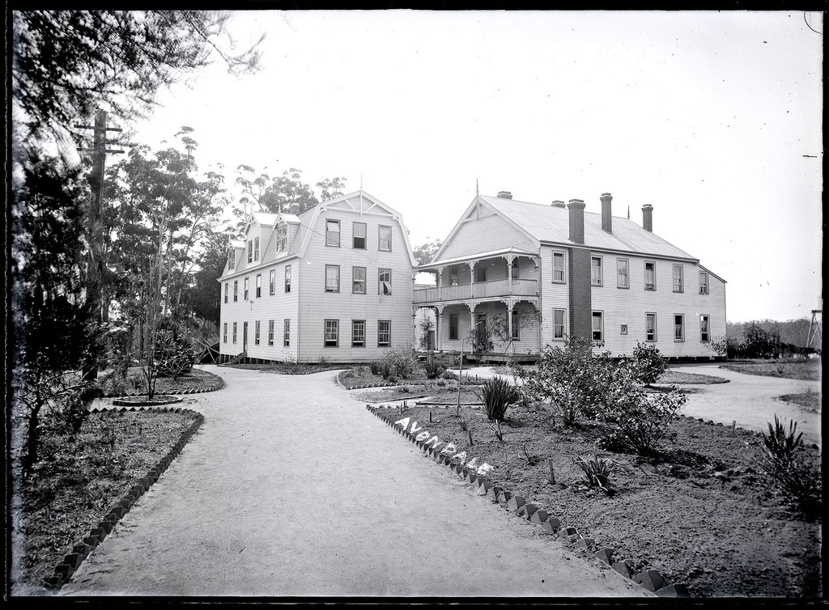
Avondale College

Slide 49
Avondale College
Founded in Cooranbong, Australia 1897 under the direction of Ellen White
It offered a curriculum based on principles espoused by Ellen White, which was quite different from the other colleges of the day.
It provided the model for other Adventist colleges around the world (including the U.S.)

Slide 50
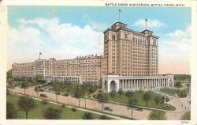
Battle Creek Sanitarium

Slide 51
Battle Creek Sanitarium
Founded in 1866 and was the successor to the Western Health Reform Institution which was founded in 1863.
It was the center of the church’s health work under the direction of John H. Kellogg
It burned down in 1902 but was rebuilt much larger against the counsel of Ellen White
John H. Kellogg gained control of the institution and it left the church along with him in 1906.
The building is now a federal office building after Kellogg sold it to the government in the 1940’s as a result of the great depression.

Slide 52
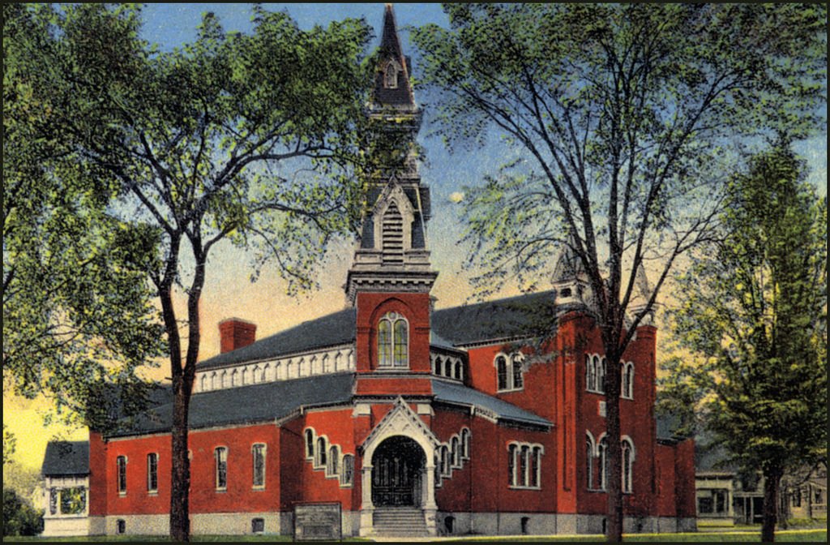
Dime Tabernacle

Slide 53
Dime Tabernacle
Constructed in 1879
Money was raised by the suggestion of James White that Adventist church members donate 1 dime per month to go for building the church
It could seat 4,000 people
A number of general conference sessions where held there
The funerals of James and Ellen White were held there
It burned down in 1922

Slide 54
Norsk Bokforlag
It was the center of the publishing work in Scandinavia
It was established in 1932 and functions to this day

Slide 55
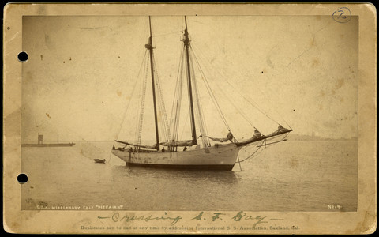
Pitcarin Missionary Ship

Slide 56
Pitcairn Missionary Ship
Ship was acquired by the church in 1890 and was used to carry missionaries around the Pacific before steamship service was widely available.
The ship was paid for by Sabbath School Missionary offerings

Slide 57
Sanitarium Health Food Co.
Founded in 1898
Mission was to provide foods for healthy living

Slide 58
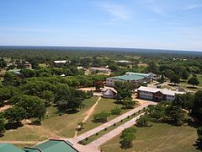
Solusi College

Slide 59
Solusi College
Established as the Solusi mission in 1894 in what is now Zimbabwe
It was named after a local chief who came and brought many of his people to the mission.

Slide 60
Systematic Benevolence
A system of raising funds from members to support the ministry.
This relieved the ministers from being self supporting and allowed them to focus all their efforts on the ministry.
This turned into the tithing system we now have in the church

Slide 61
Tract Society
Founded in 1869 in South Lancaster MA
This was the precursor to the system of ABC’s we have today.

Slide 62
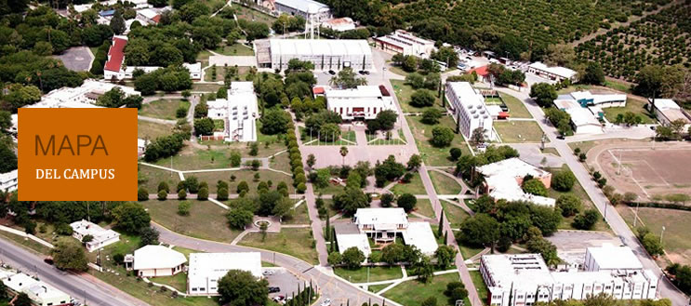
Universidade de Montemorelos

Slide 63
Universidad Montemorelos
Founded in 1942
Has a medical school that serves much of Latin America

Slide 64
Voice of Prophecy
Founded in the 1920’s by HMS Richards
Noted for it’s bible correspondence schools, which recently completed its one millionth course
It was the forerunner of all the Adventist media ministries

Slide 65
Adventist History in Regards to Youth
Luther Warren organized the first young peoples society in 1879
The Young People’s Department of the church was officially organized at the GC session in Gland Switzerland in 1907
The Pathfinder program was developed in the 1940’s by John Hancock in Southern California

Slide 66
Virtual Tour of an Adventist Heritage Site

Slide 67
Some Final Observations
The Seventh-day Adventist church has always had its challenges and it has always survived.
The early Adventist church largely consisted of a group of mission and vision driven young people in their 20’s and 30’s.
Our church history shows what is possible when young people get involved.

Slide 68
Life Sketches of E. G. White
p 196
“We have nothing to fear for the future, except as we shall forget the way the Lord has led us, and His teaching in our past history.”

Slide 69
Romans 8:28
“And we know that in all things God works for the good of those who love him, who have been called according to his purpose.”

Slide 70
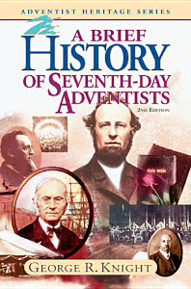
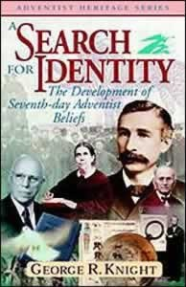


Resources

Slide 71
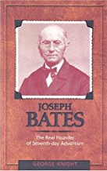
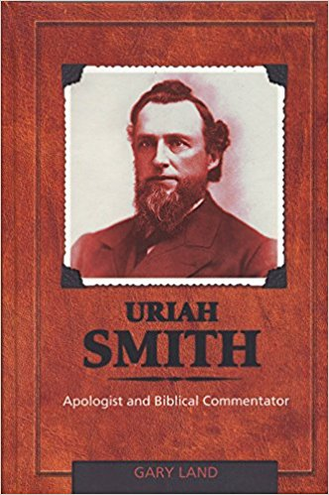
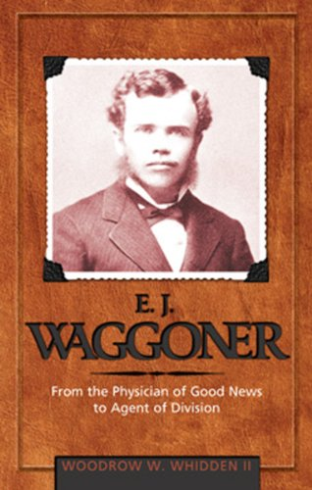
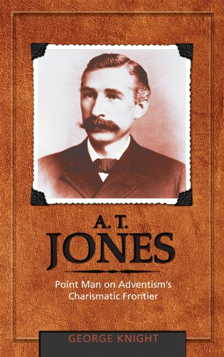
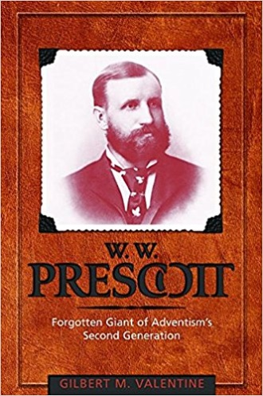
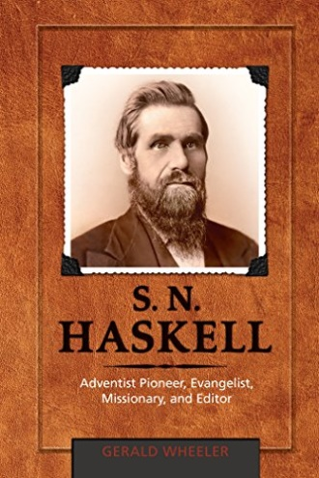
Resources (cont.)

Slide 72


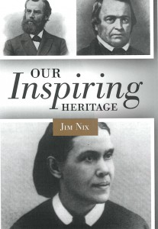
Resources (cont.)

Slide 73
Resources (cont.
www.whiteestate.org
https://am.adventistmission.org/videos
(2016 has the history of Adventist Missions)

