Slide 1
Monetary Success
Josué Feliciano
Youth Pastor Hagerstown
Chesapeake Conference

Slide 2
1. Have a Written Plan
(budget)

Slide 3
Budgeting is setting a plan for your money

Slide 4
Without a Budget you will always wonder where your money went!

Slide 5
What do you dream about for tomorrow that you would Sacrifice for today?

Slide 6
Expense Categories
Costs that reoccur monthly
Rent Electricity/Gas
Water Trash Cable/Internet
Cell/Phone Insurance Tithe/Offering
Child Care Prescription/Doctor

Slide 7
Debt Categories
Monies owed that can be paid off
Mortgage Payment Car Payment Credit Card(s)
Student Loans Finance Company Credit Line

Slide 8
Budget Categories
Funds to live on (the bad guys)
Food Eating Out Gas
Personal Care Household Needs Allowance
Incidentals Hair Cuts Public Transportation
Clothing Vacation Gifts Car Repairs
Pets Savings School Supplies
Entertainment

Slide 9
2. Get Out of Debt
(free your income)

Slide 10
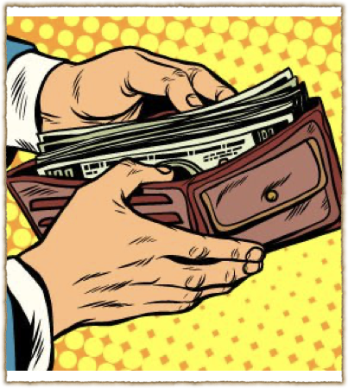

Get Control of our Income
Powerful Wealth-Building Tool
Payments limit wealth growth
Eliminating debt increases income

Slide 11
Average Family
Income of $40,000 per year
$850 House payment, $530 Car payments
$165 Student loan, $185 Credit cards, $120 Other
$1,850 Invested, makes a million in 15 years
The Key is to pay off the DEBT

Slide 12
The Debt Snowball
Put debts in order from smallest to largest
Pay minimum payments to all except the smallest one
Pay as much as you can to the smallest
Then continue with the next debt in line

Slide 13
Important to Debt-Snowball Success
Use Envelope System for Budget Category
Getting current before using Debt-Snowball
Smallest-to-largest payoff (no cheating)
Sacrifice (bigger sacrifice = bigger reward)
Stop borrowing

Slide 14
3. Live on Less than
You make

Slide 15
Most People not Getting Ahead
They live on all their income each month, sometimes more
They carry balances on credit cards
Multiple items financed.
Don’t know how to say NO to purchases

Slide 16
People Getting Ahead
Written Budget (all cash envelope system)
Determine what is important (clear priorities)
Have a goal that you are ready to sacrifice for
Do not depend on credit to live
Not distracted from your goal(s)

Slide 17
4. Save Some Money
(short & long-term)

Slide 18
Emergency Funds
Every family needs an emergency fund
Emergency funds are for the benefit of your immediate family
These funds are for relief purposes for unexpected expenses of emergency/necessities
Suggested starting amount $1,000

Slide 19
Short Term
Part of your monthly should include Savings
These funds help in a variety of areas and help keep your budget focused
i.e. - car repair, savings, vacation, clothing, gifts, entertainment
“but whoever gathers money little by little makes it grow,” Proverbs 13:11

Slide 20
Long-Term
Save for major purchases over time
Major purchases should be carefully considered while getting out of debt
Automobiles are a major purchase that should always be planned for
These are funds that are built over long periods

Slide 21
Four Principles to Monetary Success
1. Have a Written Plan (budget)
2. Get Out of Debt (free your income)
3. Live on Less than You make
4. Save Some Money (short & long-term)

Slide 22
Which of the four principles meant the most to you and why?

