Slide 1
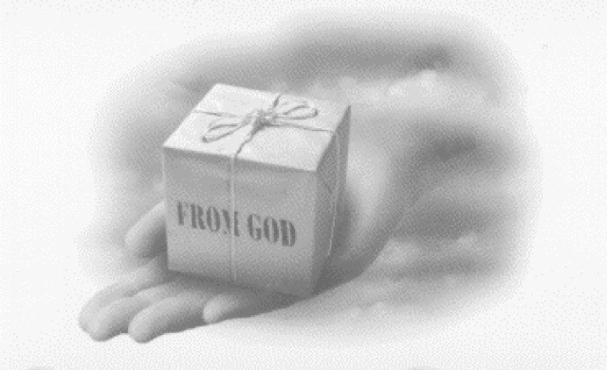
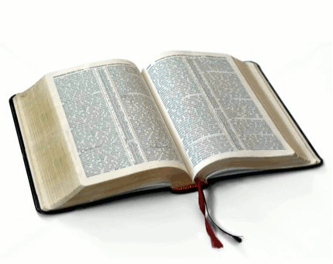
By Gregory Sr. & Joan Hall
Area Coordinators
Chesapeake Conference
Understanding Your Spiritual Gifts!
Use It or Lose It!

Slide 2
Home Depot
Is a place that helps people to use their own gifts and talents that they already possess.
It also enables those who are dreamers to cultivate and develop their own gifts and talents for effective use.

Slide 3
Why not use it?
After leaving a Home Depot experience each person is empowered to labor according to their own gifts and talents they desire to develop.

Slide 4
Romans 12:4-8 (NKJV)
For as we have many members in one body, but all the members do not have the same function, so we, being many, are one body in Christ, and individually members of one another. Having then gifts differing according to the grace that is given to us, let us use them: if prophecy, let us prophesy in proportion to our faith; or ministry, let us use it in our ministering; he who teaches, in teaching; he who exhorts, in exhortation; he who gives, with liberality; he who leads, with diligence; he who shows mercy, with cheerfulness.

Slide 5
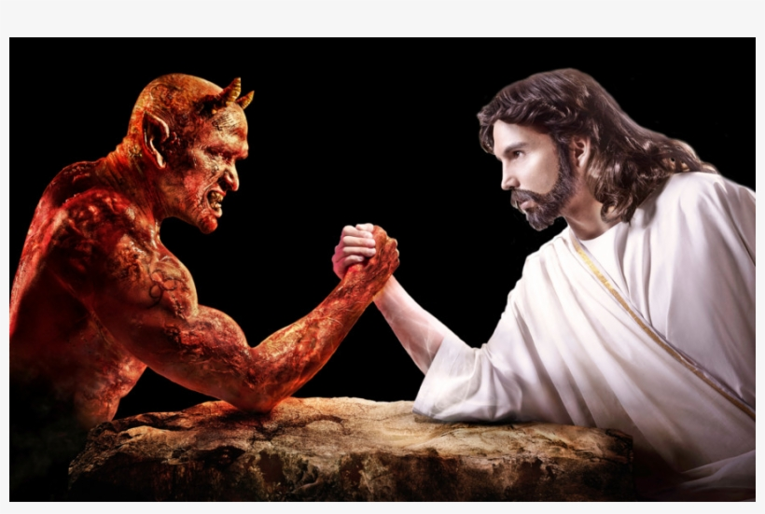
God vs. The Devil
The LORD has equipped every person with at least one spiritual gift.
God’s desire is that we would grow the church and/ or Pathfinder club, using our gifts.
The enemy’s desire is that we keep them to ourselves. By keeping them to ourselves, you stunt your growth and the churches and/ or Pathfinder clubs.

Slide 6
1 Peter 4:7-11 (NIV)
Therefore be alert and of sober mind so that you may pray. Above all, love each other deeply, because love covers over a multitude of sins. Offer hospitality to one another without grumbling. Each of you should use whatever gift you have received to serve others, as faithful stewards of God’s grace in its various forms. If anyone speaks, they should do so as one who speaks the very words of God. If anyone serves, they should do so with the strength God provides, so that in all things God may be praised through Jesus Christ.

Slide 7
Purpose of the Gifts
To build up the church.
To build up one another.
To bring souls to Jesus.
To help you to become excited and engaged again in ministry.
To take away the frustration of tedious and monotonous ministry.

Slide 8
Reason for the Gifts
The Holy Spirit distributes the gifts to believers, thus benefitting the whole church.
Acts 2:38 (NIV), Peter replied, “Repent and be baptized, every one of you, in the name of Jesus Christ for the forgiveness of your sins. And you will receive the gift of the Holy Spirit.

Slide 9
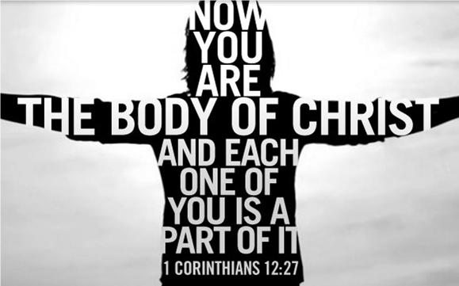
Reason for the Gifts
1 Corinthians 12:7-11 (HCSB), A demonstration of the Spirit is given to each person to produce what is beneficial: to one is given a message of wisdom through the Spirit, to another, a message of knowledge by the same Spirit, to another, faith by the same Spirit, to another, gifts of healing by the one Spirit, to another, the performing of miracles, to another, prophecy, to another, distinguishing between spirits, to another, different kinds of languages, to another, interpretation of languages. But one and the same Spirit is active in all these, distributing to each person as He wills.

Slide 10
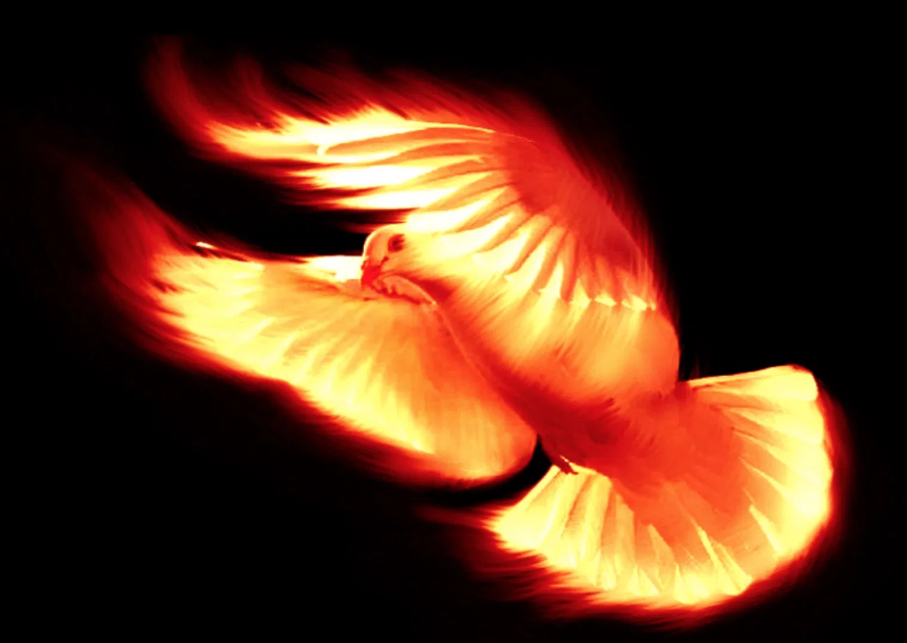
Reason for the Gifts
The Holy Spirit provides the special power necessary to proclaim the gospel to the ends of the earth.
Acts 1:8 (NIV), But you will receive power when the Holy Spirit comes on you; and you will be my witnesses in Jerusalem, and in all Judea and Samaria, and to the ends of the earth.
We need that power!!!

Slide 11
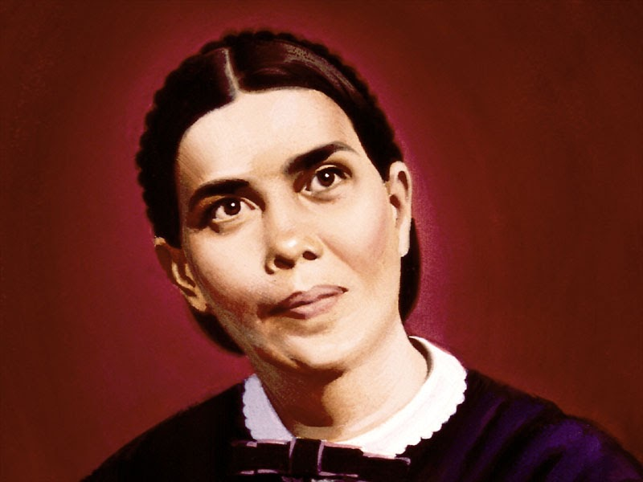
The Gifts of God are
to be used for the saving
of souls.
Ellen White

Slide 12
Spiritual Gift Defined
An ability or prompting of the Holy Spirit, given to us freely, and is energized and empowered by God for His service.

Slide 13
Gifts
vs.
Talents

Slide 14
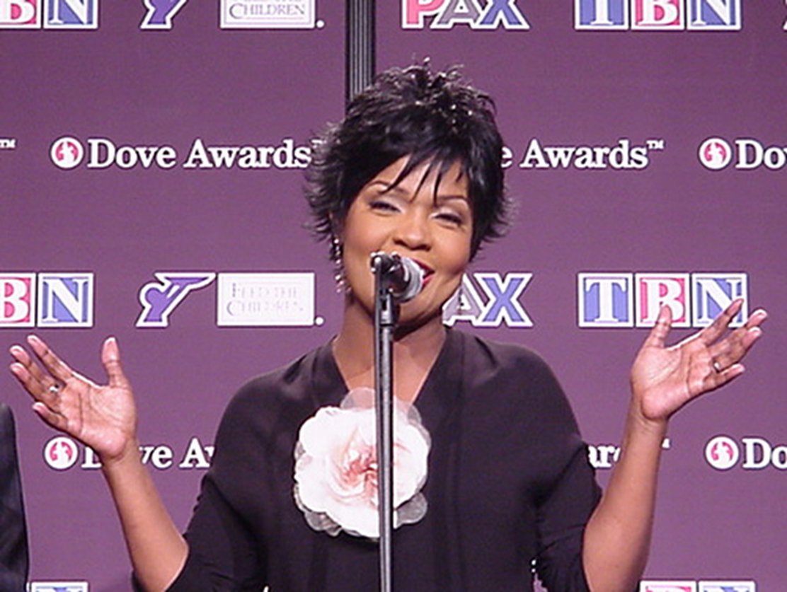
CeCe Winans
Oprah Winfrey

Slide 15
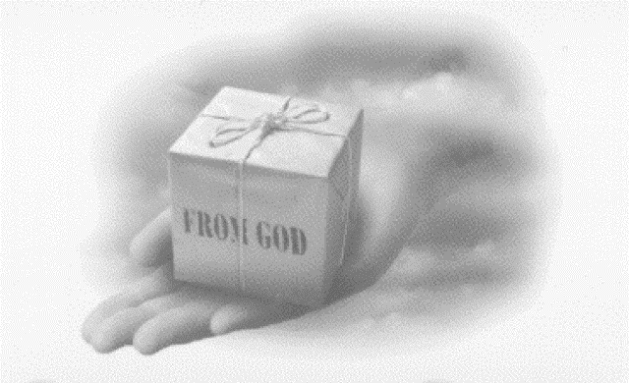
Which one is spiritually gifted
and which one is talented?
Notes:
Breakout Rooms

Slide 16
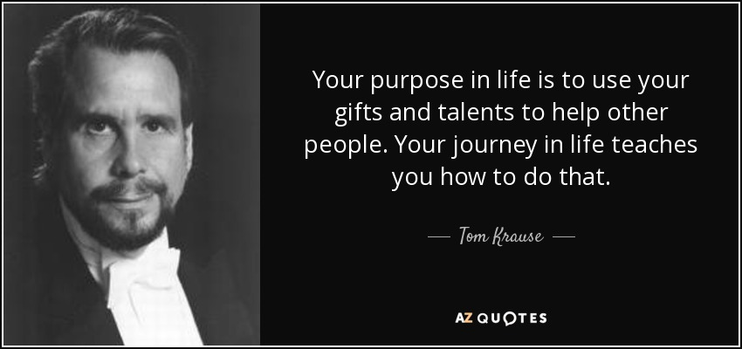

Slide 17
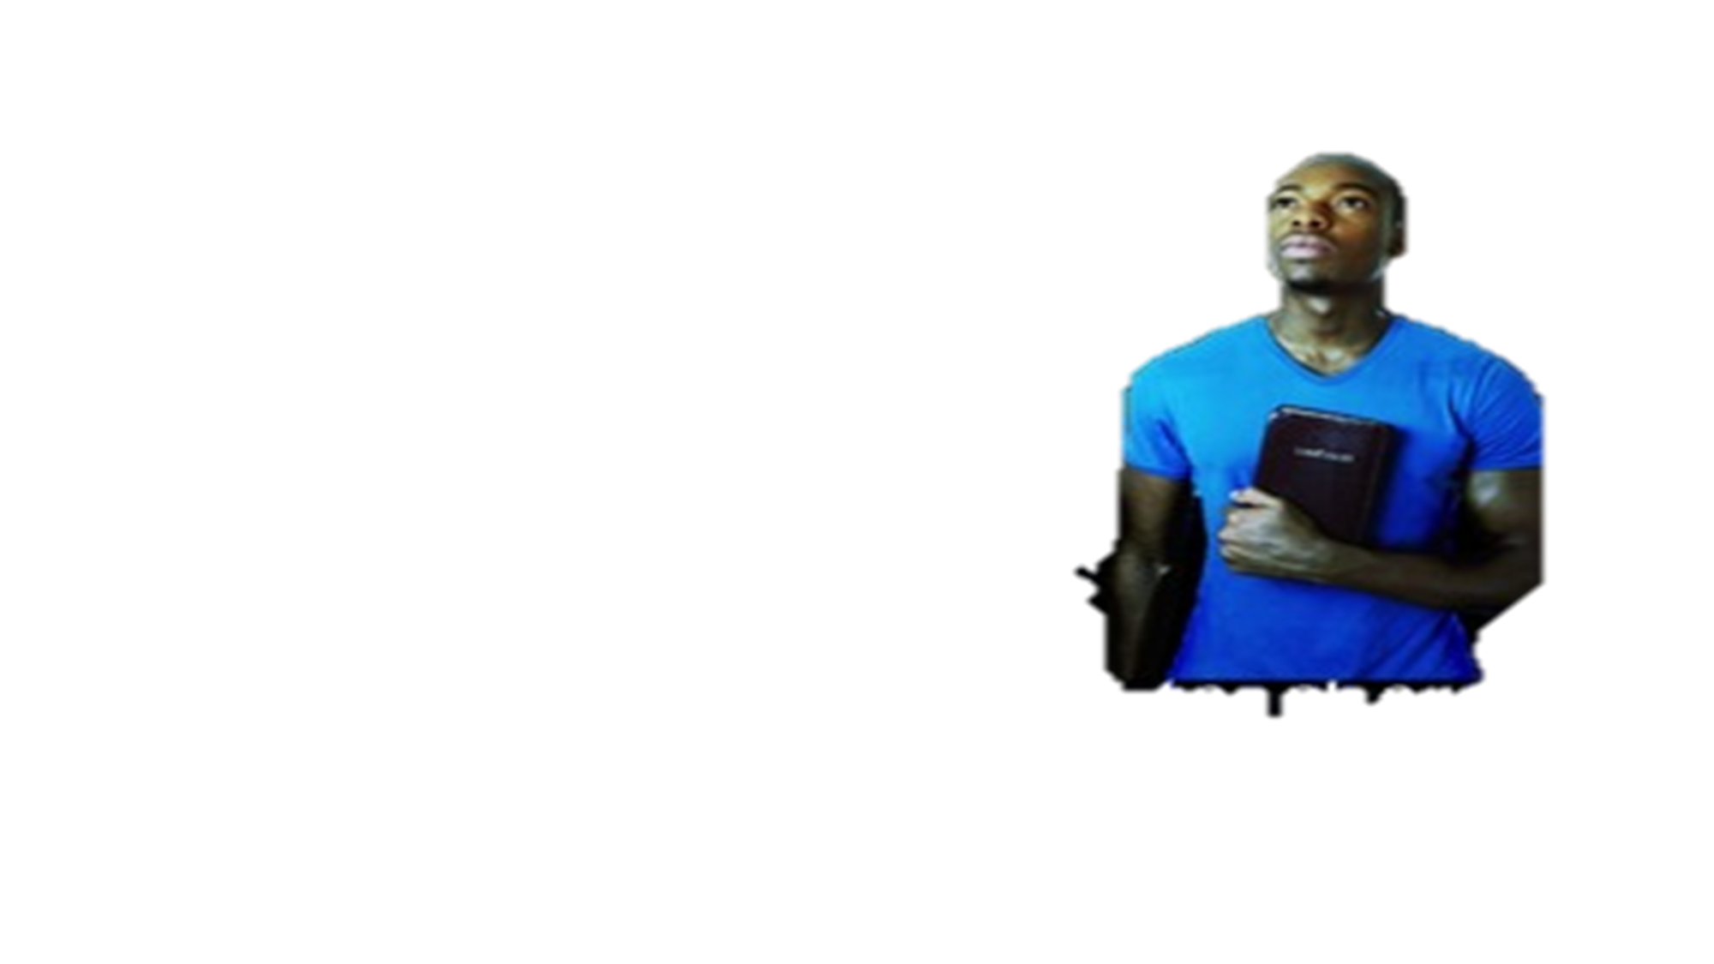
What are some Spiritual Gifts?
In 1 Corinthians 12, Paul includes: wisdom, knowledge, faith, healing, miracles, prophesy, discernment, interpretation of tongues, helps and administration.
In Ephesians 4 and 1 Corinthians 12, Paul lists five equipping positions in the church.
These are: Apostles, Prophets, Evangelists,
Pastors and Teachers.

Slide 18
No One is Excluded
Everybody
Can Do Something

Slide 19
Where do you grow best?
The only way for the gift to grow is in the best soil.
The Church

Slide 21
What is my gift?
1 Corinthians 12:31 (NLT)
“So you should earnestly desire the most helpful gifts.
But now let me show you a way of life that is best of all.”
Get ready to find out
Notes:
Breakout Rooms

Slide 22
To summarize what the seven spiritual gifts look like in action, imagine seven people around a dinner table having dinner together.
The hostess walks in with a dessert tray, and she accidently spills the tray.
How would the seven people representing each of the seven gifts in Romans 12:6-8 respond to a spilled dessert?
(1) The person with the gift of prophecy would say, “That’s what happens, when you’re not careful.”
His motivation is to convict people of their sin, what they did wrong.

Slide 23
(2) The person with the gift of serving might say, “I will help you clean it up.”
She has the desire to meet a practical need.
(3) The person with the gift of teaching might say, “The reason that tray fell, is because you put too many things on this side, and you needed to balance the weight more carefully.”
He wants to clarify truth.
(4) The person with the gift of exhortation would say, “Next time, we can serve dessert with the meal.”
She gives a practical solution to the problem, so it doesn’t happen again.

Slide 24
(5) The person with the gift of giving would say, “I will buy a new dessert.”
He uses his personal assets to meet a practical need.
(6) The person with the gift of mercy would respond by hugging the hostess and saying, “It’s okay. Don’t feel badly. It could happen to anyone.”
She doesn’t care about the dessert.
She not focusing on the six people around the table.
She is empathizing with that one person who is in distress at the time.

Slide 25
(7) And the person with the gift of leading would respond to the spilled dessert by saying, “Bob, would you get some towels to wipe up the table? Mary, grab the mop for the floor. And Jane, help me fix some other dessert.”
That is the gift of leading.
Now, remember all of the spiritual gifts are necessary for the proper functioning of the body of Christ.
And most importantly, God wants us to exhibit characteristics of each of the gifts.

Slide 27
Knowing is Half the Battle
Exercise the Gifts God has Given to You!

Slide 28
QUESTIONS?

