Slide 1
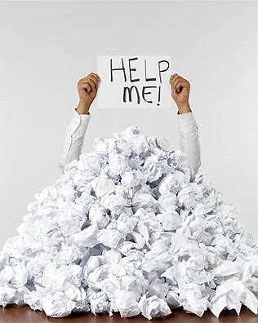
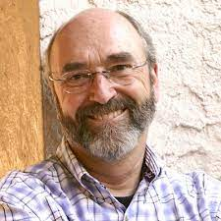

Paperwork Made Easy
Introduction – Story of Dick Duerksen
By Carl Rodriguez

Slide 2

Share 3 points you learned from the Story
_________________
_________________
_________________

Slide 3
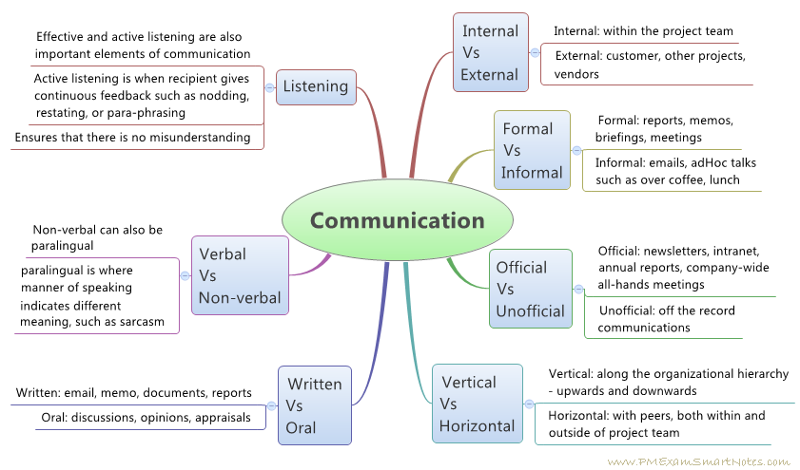
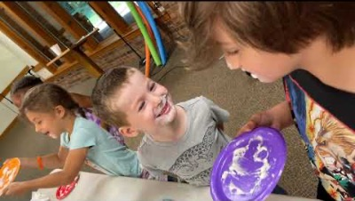
Paperwork → Different Communication Types
Which Types work best?
https://www.youtube.com/watch?v=rhP4dOq6h5A&t=18s

Slide 4
Share why videos & pictures are important
_________________
_________________
_________________

Slide 5
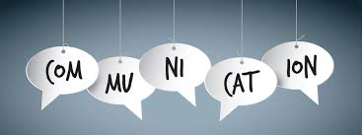
Why is Paperwork/electronic form important?
Contracts
Ministry Descriptions
Emails
Planners
Staging
Reports

Slide 6
Planner should include
 | Friend | Companion | Explorer | Ranger | Voyager/Guide
Church Heritage will be the focus for Sabbath Morning – Session I Classes intended for designated class level
Session 1 Sabbath – Sept 25 9:00-10:30 am | God’s Messenger Pam Ellis | Missionary Pastor Bruno Lourenco | Prayer Rae Tunney | Peacemaker Honor Pastor Josue Feliciano | Sanctuary Honor Carl Rodriguez
Nature Appreciation – Sessions 2 & 3 - Pathfinders may take any class they choose
Session 2 Sabbath – Sept 25 10:45 – 12:15pm | Dogs Mike Hockman | Trees Charlie Koerting | Volcano The Hall’s | Creation Honor The Kirks | Christian Drama Carl Rodriguez
Session 3 Sabbath – Sept 25 4:00 – 5:30 pm | Moths and Butterflies Elisha Bonilla | Viruses Charlie Koerting | Meteorite The Hall’s | Bible Marking Michael Tunney | Puppetry Randy Myaing Carl Rodriguez
First-aid, Health & Safety – Session 4 – Honor classes intended for designated class level
Session 4 Sabbath – Sept 25 6:45 – 8:15 pm | Red Alert Pam Ellis | First Aid, Basic Delia Wright | Basic Rescue Tunney’s | First Aid Elisha Bonilla | CPR Larry Zimmer
Arts & Crafts & Vocational – Sessions 5 & 6 – Pathfinders may take any class they choose
Session 5 Sunday – Sept 26 9:00-10:30 am | Camp Skills 1 Mike Hockman | Origami Herbie Dennison | Lighthouses Charlie Koerting | Creative Journaling Sierra Koerting Ann Reynolds | Flag Football Randy Myaing
Session 6 Sunday – Sept 26 10:45 – 12:15 am |  | Volleyball Nahum Herter | Bridges Likisha Young | Glass Painting Elisha Bonilla | Disc Frisbee Randy Myaing
1- Location
2- Time
3- Event
4- Person in charge
5- Target group
6- Participants per session
7- Maximum allowable participant
for whole event
8- Registration approach
– Hyatt / Disney
9- % ratio for total activities
10 – Marketing Approach & Cost

Slide 7
Why are planners important?
_________________
_________________
_________________

Slide 8
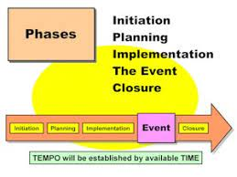
Staging as part of Paperwork
1- Set up for Group One
2- Set up for Group Two
3- Arrival of Group One
4- Arrival of Group Two
Lunch Staging
Lunch time
Closure

Slide 9
Why is staging important?
_________________
_________________
_________________

Slide 10

Reports = Communication
Expenses
Baptisms
Growth
Schedule
Staff
Training
Trips

Slide 11
Why is reporting important?
_________________
_________________
_________________

