Slide 1
Leading and Connecting with Generation Z
Diego Boquer,
Baltimore Whitmarsh
Chesapeake Conference

Slide 2
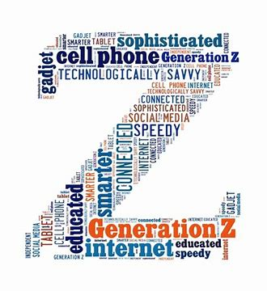
Who are they?
Born between 1996-2010
Between Millennials and Gen. Alpha

Slide 3
Leadership
Leadership is influence
It is based on relationship

Slide 4
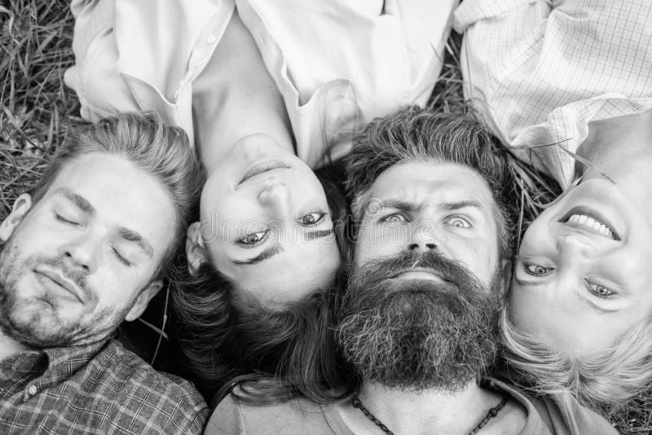
10 things we must know to connect AND LEAD GEN ZERS

Slide 5
1. Digital Natives

Slide 6
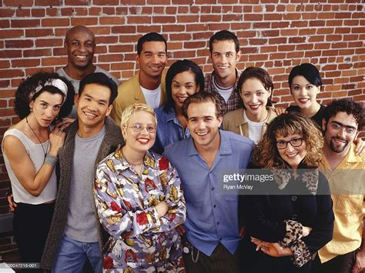
2. Entrepreneurial

Slide 7
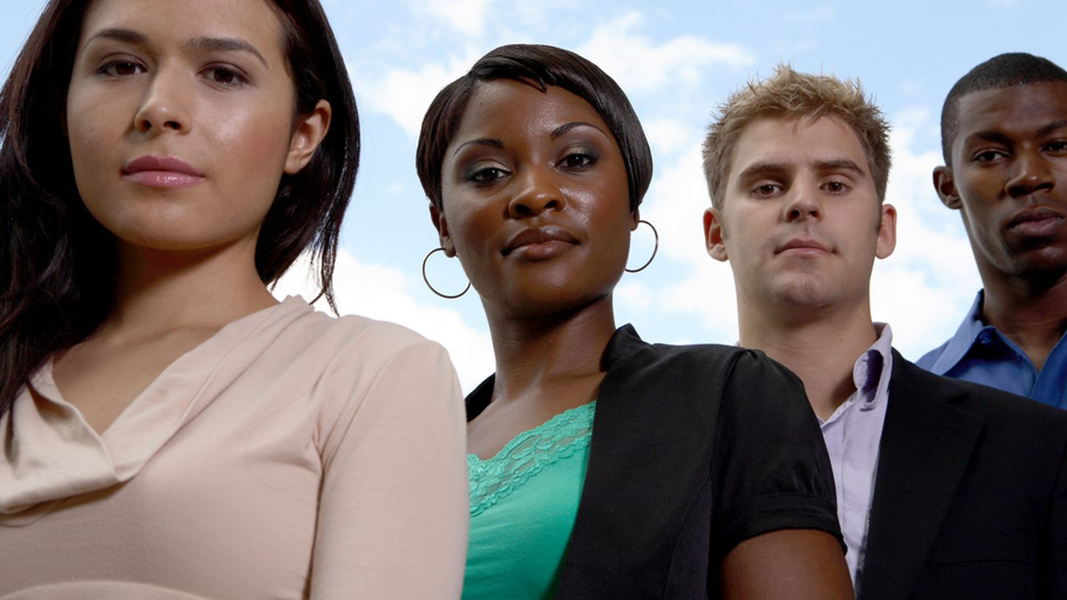
3. Diversity

Slide 8
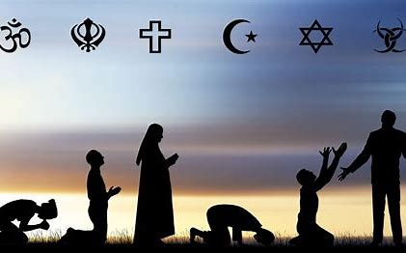
4 Religious pluralism

Slide 9
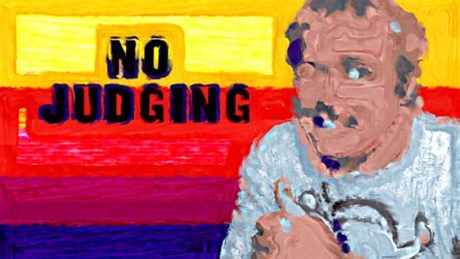
5. Sexual relativism

Slide 10
6. Overwhelmed

Slide 11
7. Loneliness

Slide 12
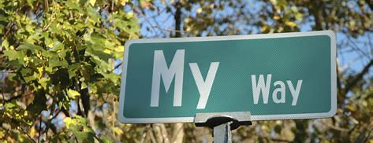
8. Individualistic

Slide 13
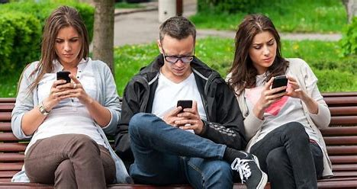
9. Superficial relationships

Slide 14
10.

Slide 15
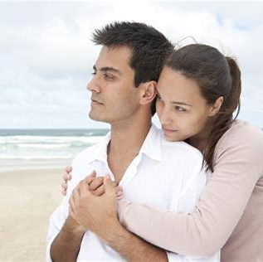
So what?
Genuine relationships
Transparency
Be positive. Complement them!
If you don’t have something nice to say, remain quiet.
Don’t be afraid to talk about taboos.
Empower them.
Challenge them in the right way!

Slide 16
Leading and Connecting with Generation Z
Diego Boquer,
Baltimore Whitmarsh
Chesapeake Conference

