Slide 1
Financial Ethics and Accountability
Chesapeake Conference Youth Leaders Convention-Master Guide Advanced Track
September 11, 2021
Charlie Koerting

Slide 2
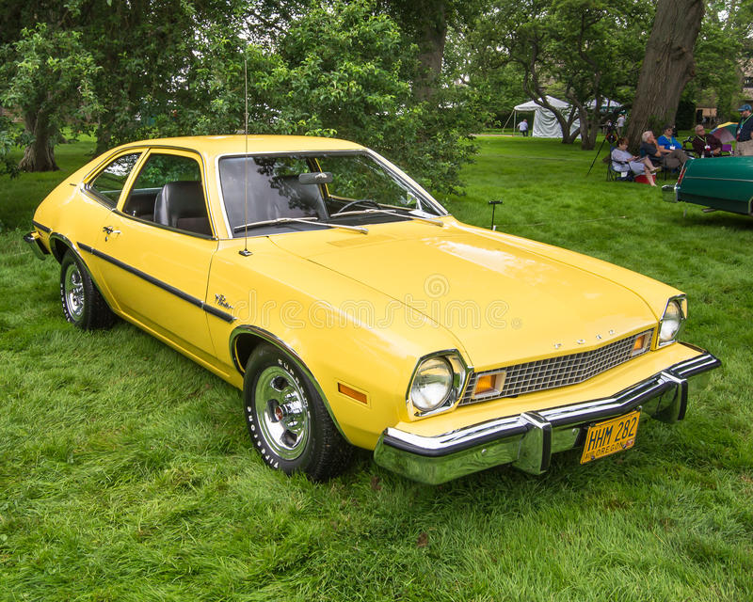

Slide 6
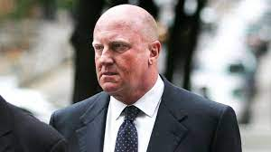

Slide 7
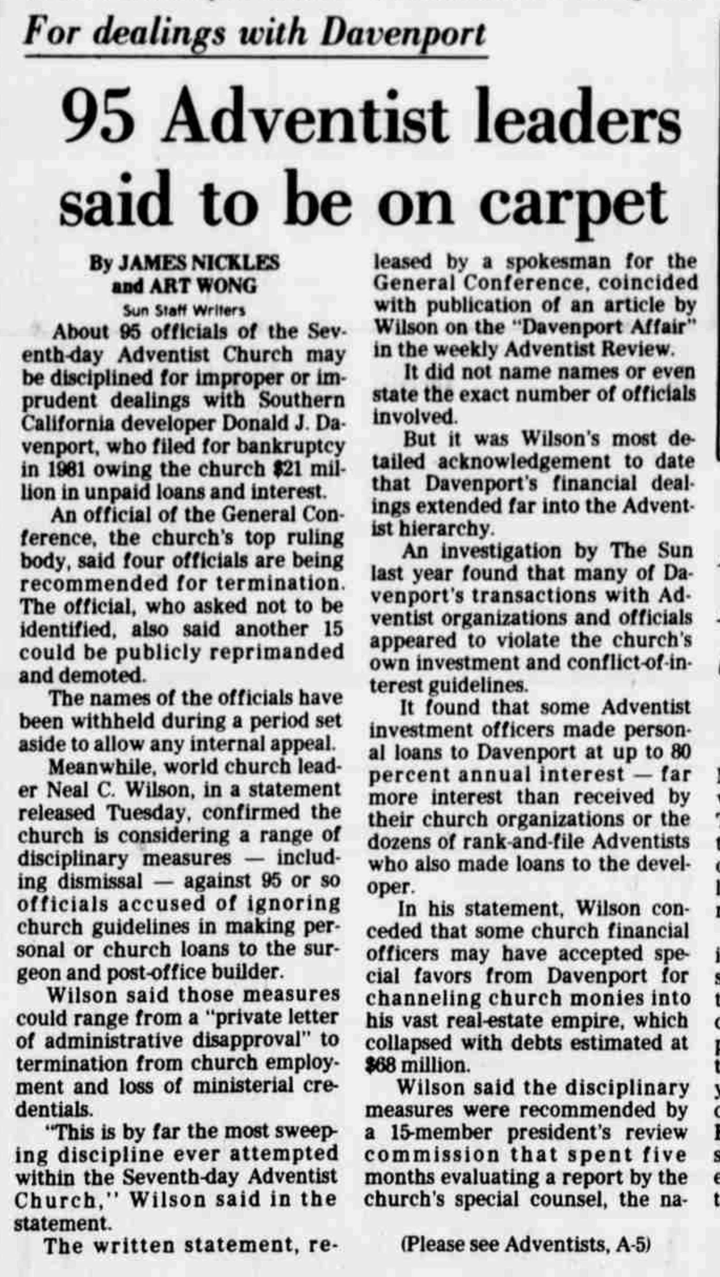
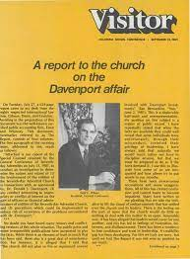

Slide 9
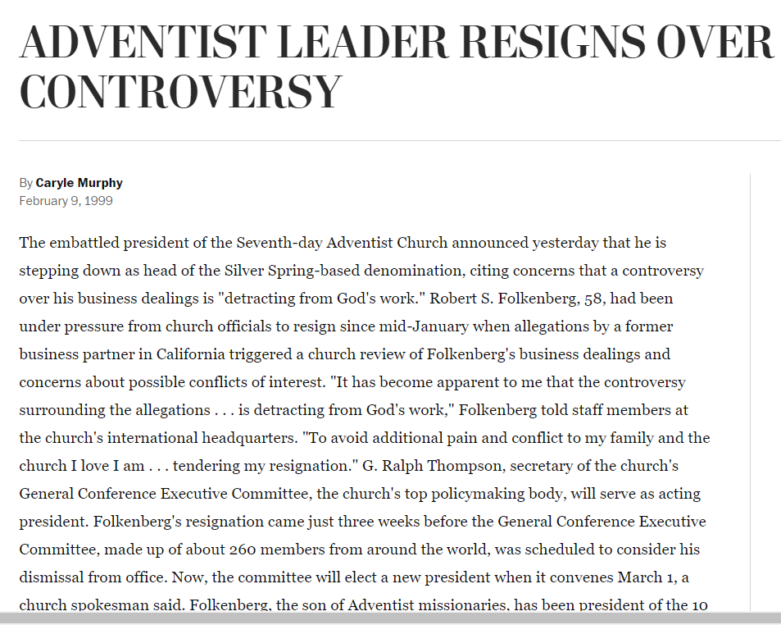

Slide 10
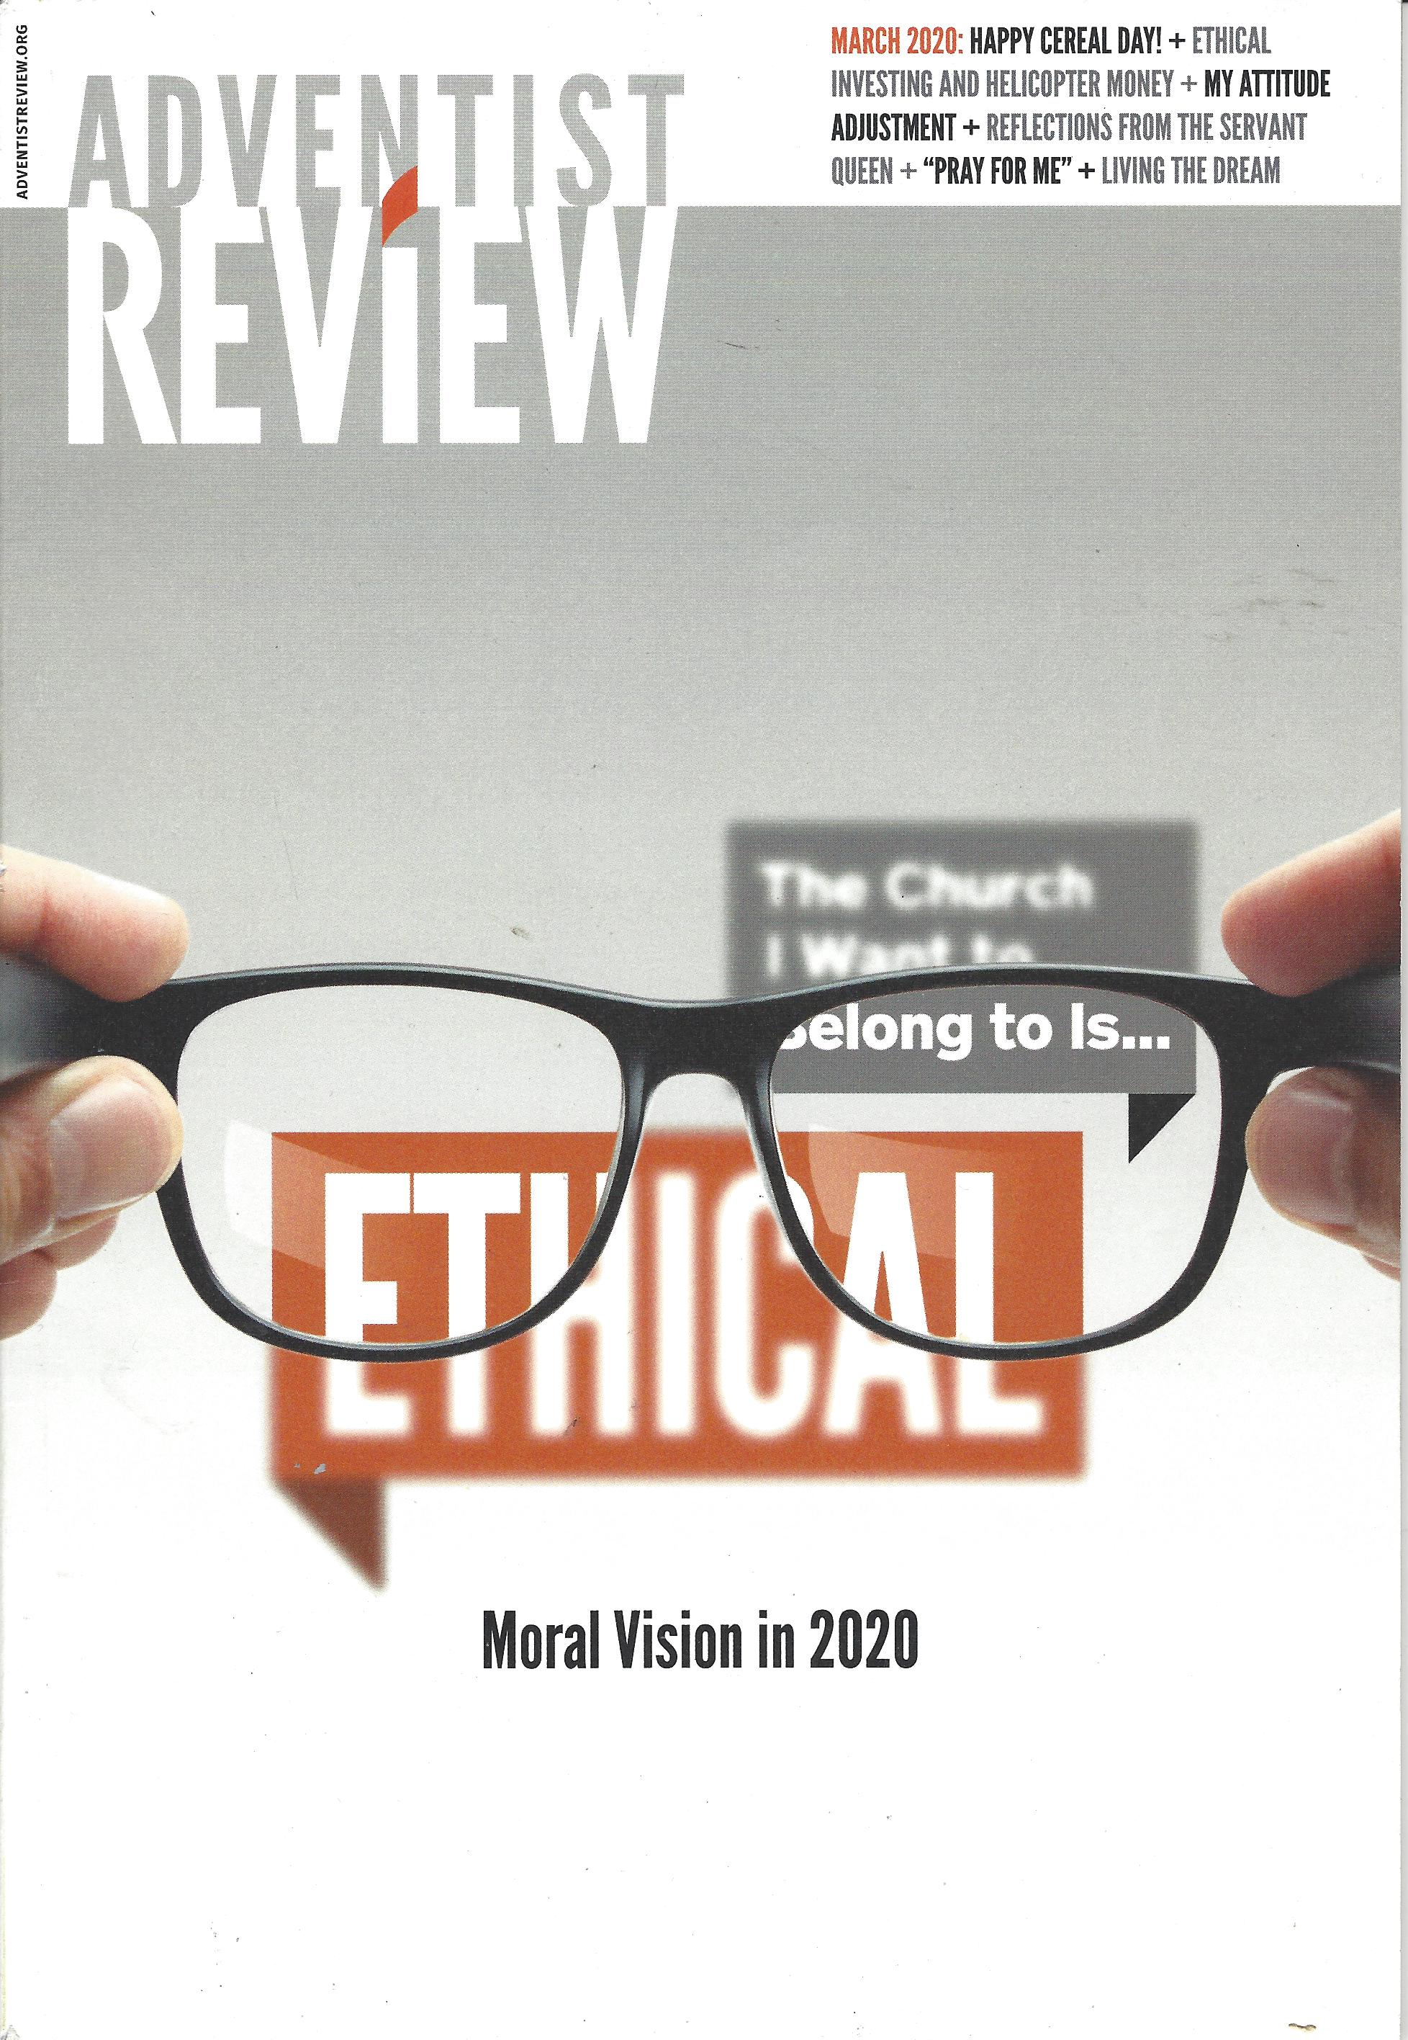

Slide 11
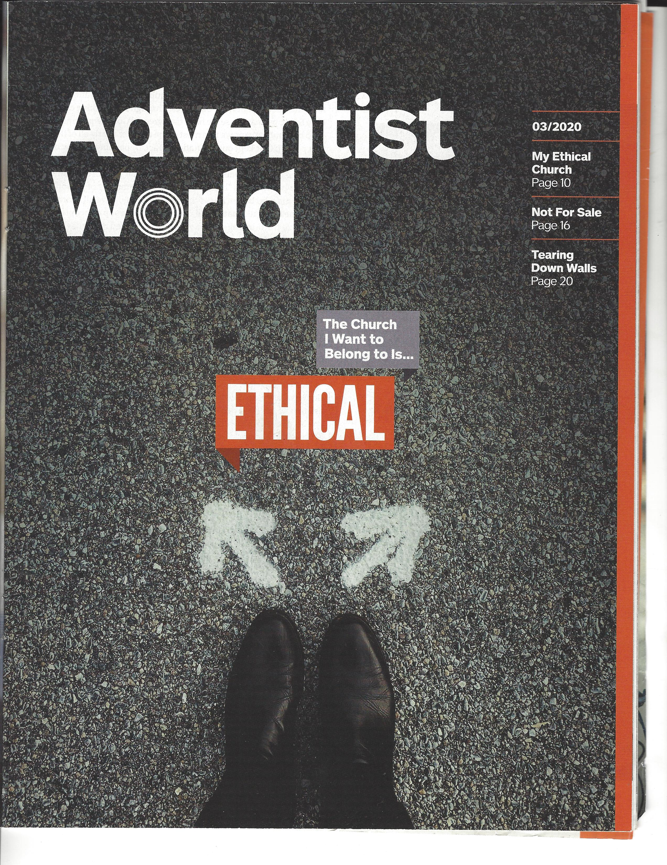

Slide 12
What comes to mind when you hear the word ethics?

Slide 13
So exactly what is ethics?
the branch of knowledge that deals with moral principles.
moral principles that govern a person's behavior or the conducting of an activity.

Slide 14
The “street” definition of ethics
Doing the right thing in the right way

Slide 15
Biblical ethics
Colossians 3:16
Colossians 3:23
Leviticus 19:2
Leviticus 19:13
Leviticus 19:18
Luke 6:31
Luke 16:10
Proverbs 11:1
Proverbs 11:3
Psalms 25:21
1 Corinthians 6:9-11
Matthew 5:37

Slide 16
So what have these texts told us about ethics?

Slide 17
Ethical Behavior = Moral Behavior

Slide 18
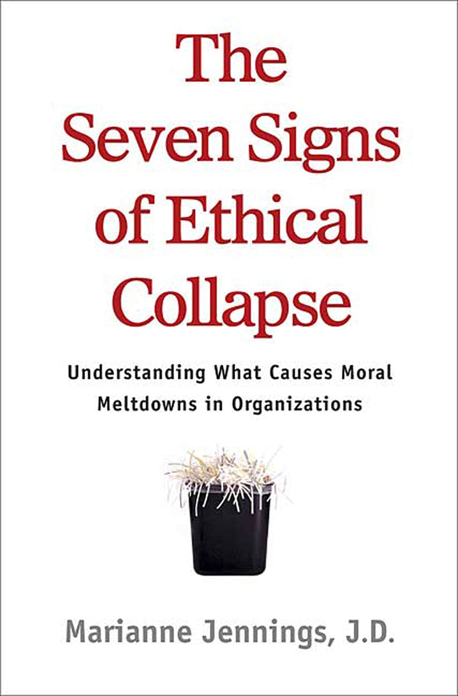

Slide 19
Jenning’s Seven Signs
Pressure to maintain numbers.
Fear and silence.
Young 'uns and a bigger-than-life CEO.
A weak board.
Conflicts (of interest).
Innovation like no other.
Goodness in some areas atoning for evil in others.

Slide 20
Conflict of Interest
A situation in which a person is in a position to derive personal benefit from actions or decisions made in their official capacity.

Slide 21
Ethics vs the Law
In general, the legal standard is a minimum requirement. Frequently, the ethical standard is the higher standard.

Slide 22
Some IRS regulations
Disqualified persons
Excess benefits

Slide 23
The main result of ethical lapses
Ethical problems are great destroyers of trust. Frequently, the good work of a lifetime is destroyed by a single ethical lapse. This applies to both individuals and organizations.

Slide 24
Ethically sound ways of operating
Be accountable
Make sure you get proper approval from your governing body
Be aware of your organization’s financial policies and its legal responsibilities
Understand your spending authority
Always be open and “above board”

Slide 25
Ethically sound ways of operating (cont)
As a board or team member, be willing to ask hard questions
Ask how this action will look to someone on the outside
Do what you say and say what you do
When in doubt, seek counsel from someone on the “outside”
Declare any conflicts of interest
Practice the “Golden Rule”

Slide 26
Some Case Studies for Discussion

Slide 27
The Disappearing Memorial Funds
An individual bequeathed the church a significant amount of money to renovate the chapel on the church campus. The church experienced several lean years in giving but since there was no separate distinction between the operating and memorial funds, it looked like there was money in the bank and the board spent it in spite of warnings from the treasurer. Several years had passed and when the church wanted to renovate the chapel, there was not enough money in the bank to cover the amount that was supposed to be in the memorial funds.

Slide 28
A Family Affair
After a Pathfinder International Camporee, which was paid for by fundraisers run by the club there were funds leftover. At the camporee, several families of Pathfinders as well as some non-Pathfinders were present. These people had paid their own way. The funds that remained where used to reimburse these families for their expenses. This was not budgeted or approved in advance by the board and several members of the families were also on the Church Board. These reimbursements were also paid out of the personal business account of one of the Pathfinder staff.

Slide 29
Dealing With Excess Funds
Money was raised for a Pathfinder Event and when it was over several thousand dollars remained in the account. The youth needed some money for a mission trip so the Youth Council asked the board to redesignate those funds for the Mission Trip.

Slide 30
The Fundraiser
An opportunity arose at the last minute to participate in a fundraiser for the Pathfinder Club through an organization that was run by a friend of the club director. The club fronted the organization several hundred dollars, without getting approval from the Church Board, to get the materials for the fund raiser.

Slide 31
The Budgetless Event
The Pathfinder club was planning on attending a camporee and had raised money to cover the costs. However no budget was submitted to the church board and the club asked for a large cash advance for the trip at the last minute.

Slide 32
The Needy Family
The head of the Community Services Ministry had a financial problem and needed funds to pay her electric bill. Since she felt she qualified as a person of need, she took a cash advance from the treasurer and paid her bill. The receipts were turned in to the treasurer for this expenditure.

Slide 33
I Want It My Way
A ministry was set up as a cooperative venture between several SDA churches. It was set up as a quasi independent ministry, with it’s own board but being accountable to the churches through a triannual constituency meeting, in which the officers and board were to be chosen. A leader was chosen for this ministry who did not appreciate active oversight and chose his own picks for the board, did away with the constituency meetings, and even set up a separate 501C for this ministry, all without constituency or board approval from the constituent churches.

Slide 34
“Trust is the ultimate human currency” Bill McDermott

Slide 35
“Trust is the church’s most important human resource. We live in an age that exhibits a crisis of confidence in leaders. Strategy, technique, innovation, technology, performance, and social media are important words for organizational success. It’s easy to become preoccupied with them. But they are ineffectual without trust. Where trust exists, other resources become available. Where trust is lacking, other resources will diminish.” Lowell Cooper, Adventist Review, March 2020

Slide 36
“The greatest want of the world is the want of men - men who will not be bought or sold; men who in their inmost souls are true and honest; men who do not fear to call sin by its right name; men whose conscience is as true to duty as the needle to the pole; men who will stand for the right though the heavens fall.”
E. G. White, Education p 12

Slide 37
Resources
SDA Accounting Manual https://www.nadadventist.org/sites/default/files/inline-files/SDAAM_Jan2011Final.pdf
https://moneywise.adventist.org/
https://www.irs.gov/charities-and-nonprofits
https://nonprofitrisk.org/resources/articles/how-to-lose-your-501c3-tax-exempt-status-without-really-trying/

