Slide 1
Ministry for
Meta-modern Young Adults
Carl Rodriguez
Chesapeake Conference

Slide 2
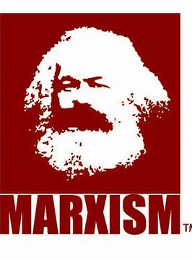
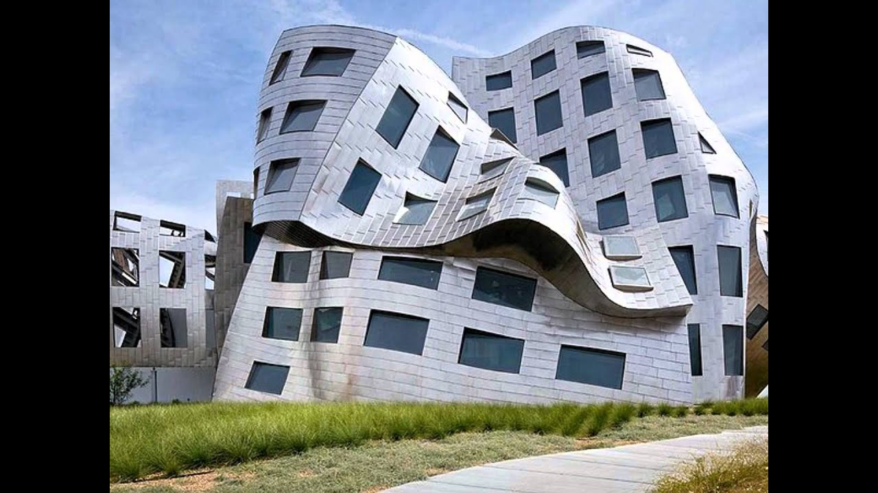
Review on How we got here
Modernism Both Industrial Ages Post-Modernism
(Science and reason over God) (Keep Religion to yourself)
(1760’s – 1987 [Berlin Wall]) From Europe → US (2020)
Government Movements Globalism Movement
Communism, National Socialism → Anti-Christian One world government law, no God, no war
Free Market People’s Movement - Social Justice Free Market – Each nation should their free Unions, Labor Laws, Slavery system of Governance – Brexit, Poland, Egypt…
Christian Movement Christian Movement from Evangelism towards
- Sunday School (Church reading and writing) - Community
- YMCA (Young Men Christian Association) - Discipleship
- Visibility

Slide 3
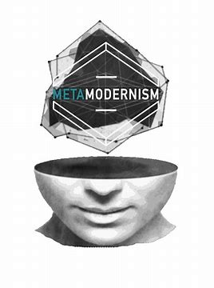
Review on How we got here
Globalism + Urbanism → Meta-modern
My truth is now – Subjective over Objective
Christian Movement →
Discipleship comes to the forefront

Slide 4

Meta-modern Approaches
Ministry of Community
Ministry of Discipleship
Ministry of Visibility

Slide 6

Break Out
Why is Community
(A place to belong)
so important for today’s young people?

Slide 7

The Discipleship Funnel
How is evangelism different from discipleship?

Slide 8

The Discipleship Funnel
Come Level - they come for the fun, girls, friends
Grow level - they tolerate spiritual things as they have fun
Disciple Level - take the initiative for their spiritual growth
Develop Level - willing to help other people grow
Multiplier Level - become leaders to help others come
5 levels
Notes:
----- Meeting Notes (9/6/13 23:31) -----
We want ready made Christians! Yet here are the 5 steps.

Slide 9
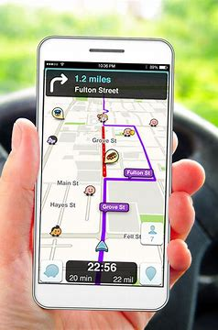
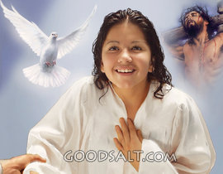
(GPS) God Positioning System - Acts 2:38,39
³⁸ Peter replied, "Repent and be baptized, every one of you, in the name of Jesus Christ for the forgiveness of your sins. And you will receive the gift of the Holy Spirit.
³⁹ The promise is for you and your children and for all who are far off-for all whom the Lord our God will call." (NIV)
The Gift of the Holy Spirit – Rom. 12, 1 Cor. 12
Learning how to use your GPS is part of discipleship growth
Notes:
----- Meeting Notes (9/6/13 23:31) -----
The three gifts to His disciples - the promise

Slide 10
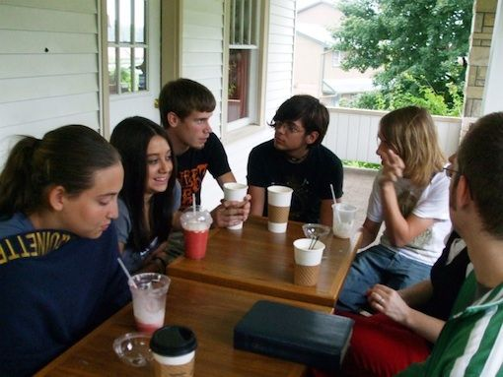
Breakout Time
Why is discipleship so important for today’s young people?

Slide 11

Visibility Factor = Faith in visible action
(Meta-moderns want to
experience faith)
Fellowship – Lunch
Scripture – Elizabeth Mornings
Praying – Honduras Project / Short Prayer
Serving – (enable or not)

Slide 12

Breakout Time
Why is the
Visibility Factor
Important?
Fellowship
Reading
Praying
Serving

Slide 13

Time to wrap it up!
Modernism (reason over God)
Postmodernism (keep God to yourself)
Meta-modern Approaches
- Ministry of Community
- Ministry of Discipleship
- Ministry of Visibility

