Slide 1
Pathfinder Club Organization & Programming
Mike Hockman - Chesapeake Conference

Slide 2
Steps In Organizing a Pathfinder Club
Counsel with the Conference Youth Ministries Personnel.
Meet with the Pastor.
Present the plan to the church board.

Slide 3
Steps In Organizing a Pathfinder Club
Second meeting of the Church Board to elect Pathfinder Director and Deputies.
Inform the congregation during the worship service.
Pathfinder officers elect remaining Staff.

Slide 4
Steps In Organizing a Pathfinder Club
Pathfinder officers and staff attend conference Pathfinder Basic Staff Training Course.
Plan yearly program.
Present all plans at a Pathfinder Staff Meeting.
Advise, write letters or personally contact potential families.

Slide 5
Steps In Organizing a Pathfinder Club
Home visitation.
Induction Ceremony.
Establishing church and community interest.
Evaluation.

Slide 6
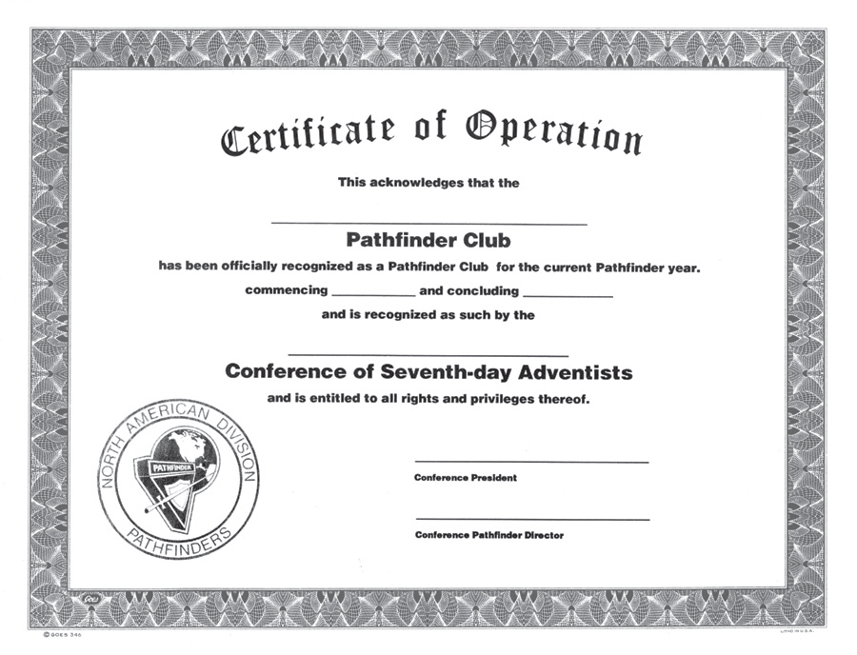

Slide 7
Membership
Pathfinder membership is 5 thru 10 grades.
Application forms for membership must be completed.
All Pathfinders must pay membership and insurance fees as required.
Pathfinders must come to meetings and club-sponsored events in the uniform unless otherwise indicated by club director.
Learn and keep the Pledge and Law.

Slide 8
Membership
Faithful in attendance.
Participate in club activities.
Parents willing to support and cooperate with the club staff.

Slide 9
Pathfinder Programs
Meetings
Inductions
Pathfinder Day
Investitures
Conference Events
Camping

Slide 10
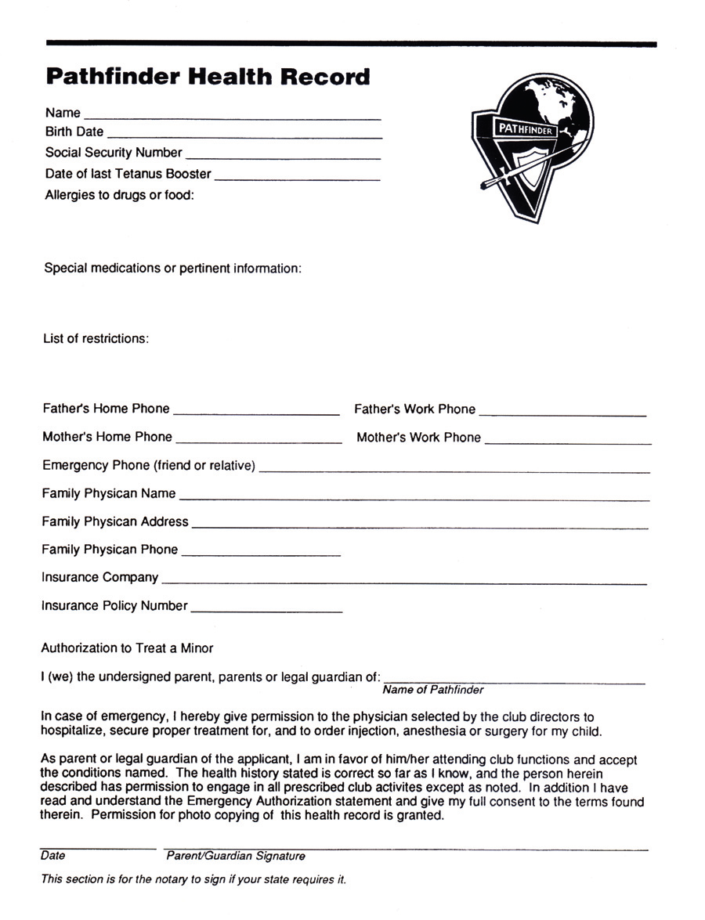

Slide 11
Operating Policies
Uniforms
Finances
Reporting
Membership
Insurance

Slide 12
Uniforms
Purpose of the Uniform
When it should be worn
When it should not be worn
Uniform for directors and counselors; also parade uniforms, and field uniforms.
Insignia and placement on uniform.

Slide 13
y

Slide 14
Girls
Black Skirt or Pants (by Club)
Tan Blouse
Black Sash
Neckerchief & Slide
Dress Shoes
Black Pathfinder Belt
Black Socks or Tan Hose (by Club)
Black Tuxedo Tie (Staff Only)
Berets are optional

Slide 15
x
Boys
Black Pants
Tan Shirt
Black Sash
Black Socks
Neckerchief & Slide
Black Dress Shoes
Pathfinder Belt
Black Tie (Staff Only)
Berets are optional

Slide 16
Finances Club Source of Income
Annual Membership Fees.
Offerings.
Sponsorship by Church Members.
Special Projects.
Fund-raising Campaigns

Slide 19
Sample Pathfinder Club Budget 1
Club Expenses
Crafts & Clerical (Stamps, etc.) $ 665.00
Public Relations (Camera, Bulletin Board) $ 250
Induction (Candles, Refreshments) $ 50
Camp outs & Travel $ 4,200
- (Field trips, Expenses to and from Camp outs, etc.)
Bus Maintenance & Repairs $ 1,000
Pathfinder Insurance & Ad Min $ 310
Staff Orientation Training & Books $ 450
Camping Equipment $ 350
- (Tents, Stoves, Ice Chest)
Awards .........................................................175
Total .........................................................$7450
Club Income
Dues ($10.00 per member) $ 600
Fees (60.00/member for Trips $ 3,600
Sponsors $ 500
Pathfinder Offerings $ 750
Club Projects ` $ 1,000
Church Subsidy $ 1,000
Total $ 7,450

Slide 20
Sample Pathfinder Club Budget 2
Budget for 20___ Present Membership _______ Projected Membership______
Teen Pathfinders 10
Junior Pathfinders 15
Staff Personnel 15
Total 40
Pathfinders 5
Staff Personnel 2
Total 7

Slide 21
Sample Pathfinder Club Budget 2
Income Budget 20___
Dues ($6.00 per year) $ 30
Fees for Trips $ 60/Pathfinder $ 300
Church Subsidy* $ 480
Charter Membership Fee
(Sponsors) $ 200
Club Projects $ 700
Total Income $ 1,710
Expense Budget 20___
Honor Equipment $ 300
Office Supplies $ 100
Convention Costs $ 200
Public Relations $ 200
Outing and Camping Equipment $ 500
Investiture Pins, Patches
Honor Awards and Badges $ 100
Special Equipment and Insurance $ 60
Pathfinder and US Flags $ 50
Special Events $ 200
Total Expenses $1710

Slide 22
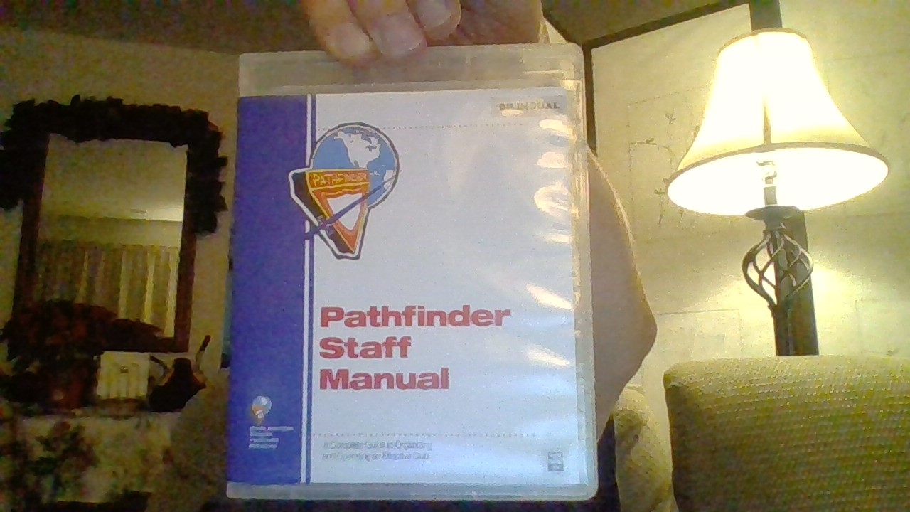

Slide 25
Advent Source
(800) 328-0525
(402) 486-8800
(402)486-8819 Fax
www.adventsource.org
Pathfinder Shirts
(407) 865-6530
www.pathfindershirts.org
The End

