Slide 1
Meaningful Worship
Javier Scharon
Chesapeake Conference

Slide 2
What Is Worship?

Slide 3
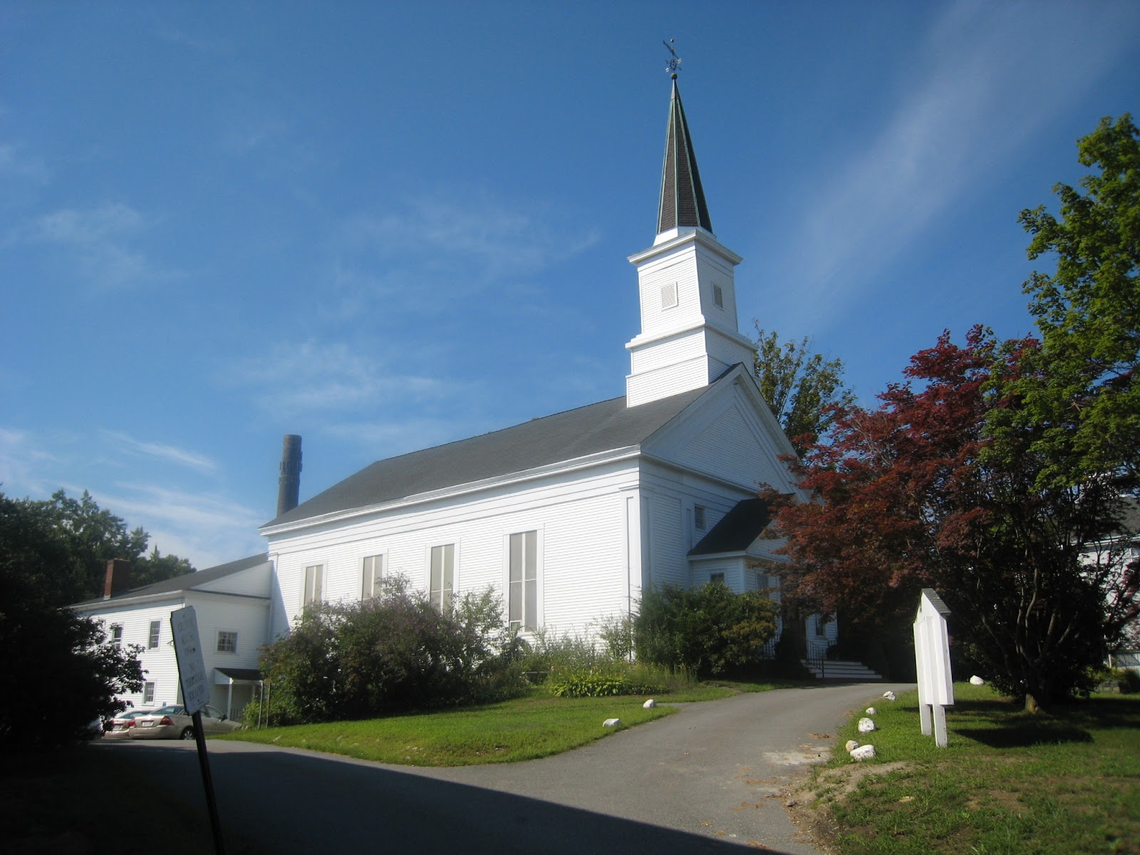
This Photo by Unknown author is licensed under CC BY-NC-ND.

Slide 4
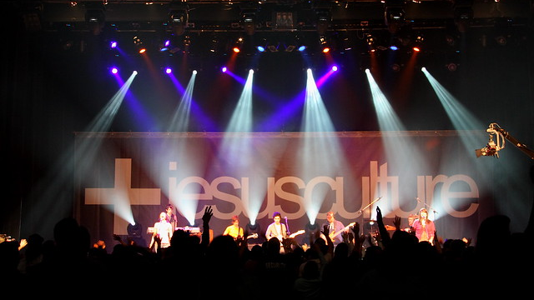
This Photo by Unknown author is licensed under CC BY-NC-ND.

Slide 5
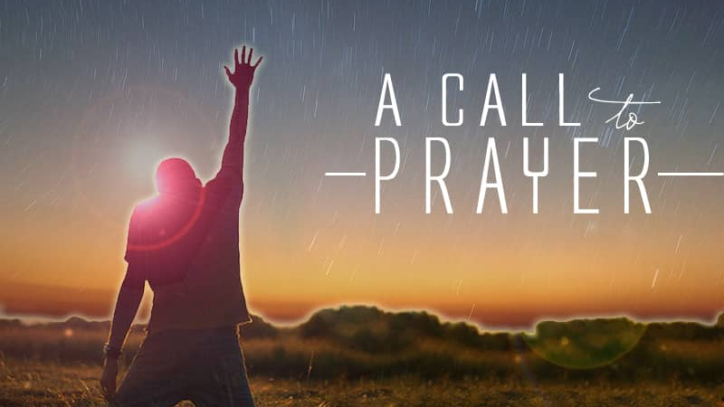
Prayer
This Photo by Unknown author is licensed under CC BY-NC-ND.

Slide 6
"When God's people begin to praise and worship Him using the biblical methods He gives, the power of His presence comes among His people in an even greater measure."
Graham Truscott
This Photo by Unknown author is licensed under CC BY-SA-NC.

Slide 7
What Is Worship?
Discussion Question 1

Slide 8
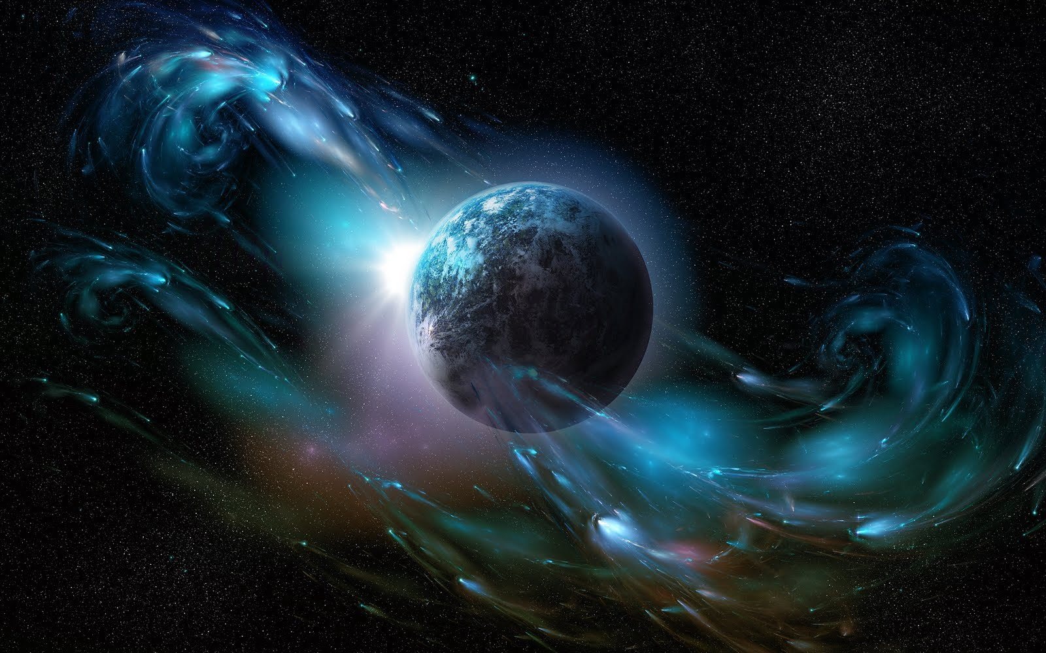
Then God spoke all these words:
2 I am the Lord your God, who brought you out of the land of Egypt, out of the house of slavery; 3 you shall have no other gods before me.
4 You shall not make for yourself an idol, whether in the form of anything that is in heaven above, or that is on the earth beneath, or that is in the water under the earth. 5 You shall not bow down to them or worship them;
Exodus 20:1-5 NRSV
This Photo by Unknown author is licensed under CC BY-NC-ND.

Slide 9
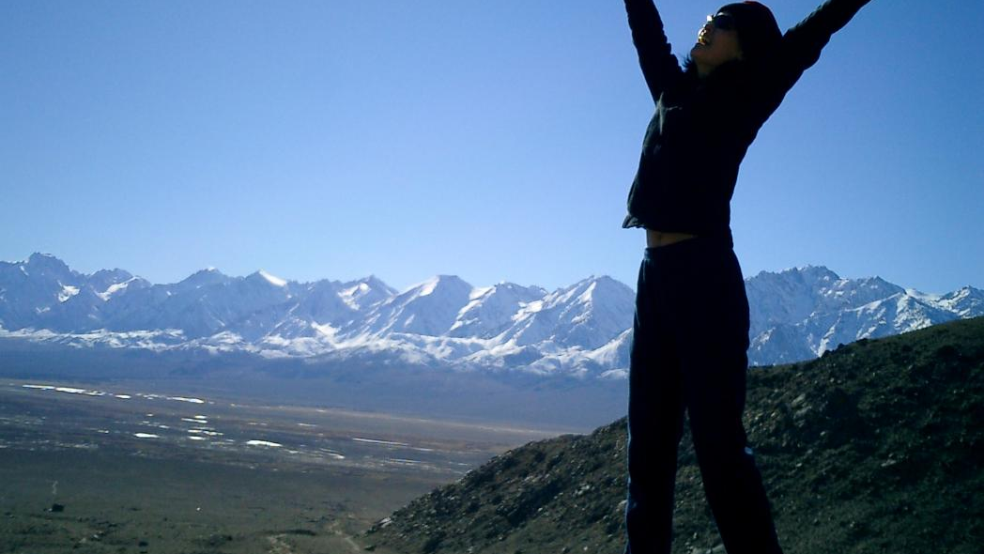
1 O come, let us sing to the Lord; let us make a joyful noise to the rock of our salvation! 2 Let us come into his presence with thanksgiving; let us make a joyful noise to him with songs of praise! 3 For the Lord is a great God, and a great King above all gods. 4 In his hand are the depths of the earth; the heights of the mountains are his also. 5 The sea is his, for he made it, and the dry land, which his hands have formed.
6 O come, let us worship and bow down, let us kneel before the Lord, our Maker!
Psalm 95: 1-6 NRSV
This Photo by Unknown author is licensed under CC BY-NC-ND.

Slide 10
Elements of Meaningful Worship:
Joy
Thankfullness
Recognition of who God is
Recognition of God's power
Recognition of God's sovereignty
Act of obedience and reverance

Slide 11
Discussion Question 2
What does my worship look like?
This Photo by Unknown author is licensed under CC BY-ND.

Slide 12
1. Exodus 19: 1-24
2. 2Chronicles 7:1-3
3. Acts 1&2

Slide 13
How does God respond to worship?
Discussion Question 3
This Photo by Unknown author is licensed under CC BY-SA-NC.

Slide 14
Worship is 24/7
I will bless the LORD at all times; His praise shall continually be in my mouth.
Psalm 34:1
This Photo by Unknown author is licensed under CC BY-SA.

Slide 15
Draw near to God, and he will draw near to you.
James 4:8a NRSV

