Slide 1
Wilderness AKA Creation Theology
Master Guide Advance
Carl Rodriguez
Chesapeake Conference of SDA
5 T’s Credit to Ashley Denton

Slide 2
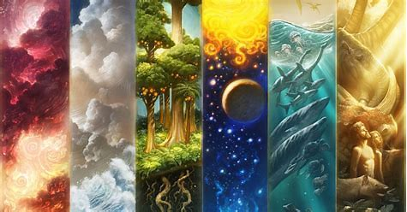
Psalms 104
²⁴ How many are your works, Lord! In wisdom you made them all; the earth is full of your creatures.

Slide 3
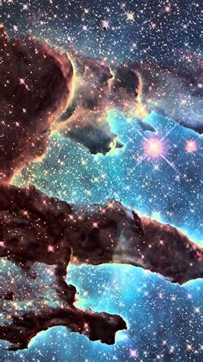
Psalms 19
¹ The heavens declare the glory of God; the skies proclaim the work of his hands.
² Day after day they pour forth speech; night after night they reveal knowledge. ³ They have no speech, they use no words; no sound is heard from them. ⁴ Yet their voice goes out into all the earth, their words to the ends of the world.

Slide 4
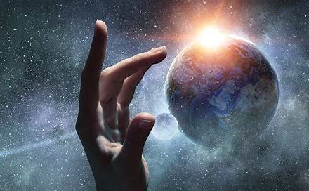
Jesus Messages
51% were outdoors
16% were indoors
33% uncertain

Slide 5
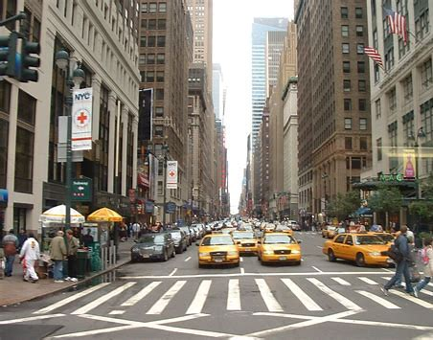
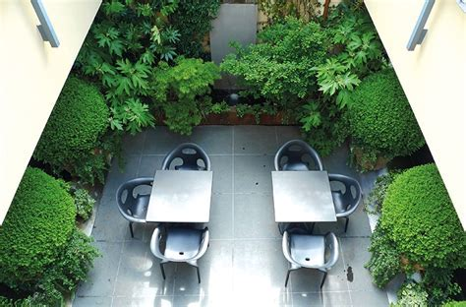
Agrarian Society → Urban Society → Urban / Nature Projects

Slide 6
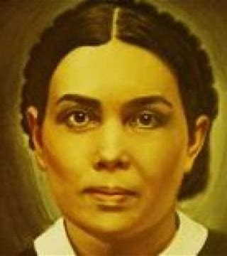
Book Education – chapter 10 - EGW
“Upon all created things is seen the impress of the Deity. Nature testifies of God. The susceptible mind, brought in contact with the miracle and mystery of the universe, cannot but recognize the working of infinite power.”
So far as possible, let the child from his earliest years be placed where this wonderful lesson book shall be open before him. Let him behold the glorious scenes painted by the great Master Artist upon the shifting canvas of the heavens, let him become acquainted with the wonders of earth and sea, let him watch the unfolding mysteries of the changing seasons, and, in all His works, learn of the Creator.

Slide 7
Group Discussion Time
Why is going back to nature becoming a huge trend?

Slide 8
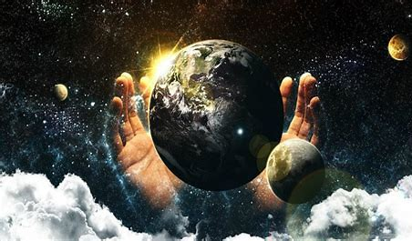
Let go back to the beginning

Slide 9
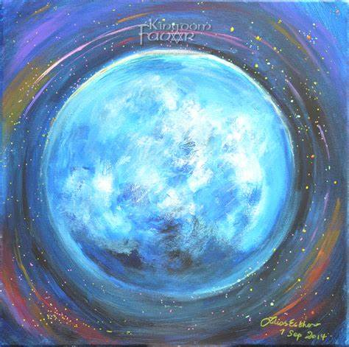
Genesis 1
1 In the beginning God created the heavens and the earth. ² Now the earth was formless and empty, darkness was over the surface of the deep, and the Spirit of God was hovering over the waters.
³ And God said, “Let there be light,” and there was light. ⁴ God saw that the light was good, and he separated the light from the darkness. ⁵ God called the light “day,” and the darkness he called “night.” And there was evening, and there was morning—the first day.

Slide 10
Days of Weeks | Tempo | Terrain | Trials | Trust | Training
Time | Order Time Management Balance Life Retreat Ex. 12:14 Ex. 20:8 | 76 Nature Honors Psalms 139:7-14 | Result of Sin Exposes Unbelief Faith Dependance Reflection Mark 6:45-51 | Fruits of the Spirit Matthew 6:25-27 Ps. 46:10 | Stewardship Shepherd Mentoring Discipleship Ps. 51:12
Water (Life / Baptism)
Earth Vegetation CO2 Level
Light Seasons / Photosynthesis
Water/ Sky Creatures
Land Creatures
Rest

Slide 11
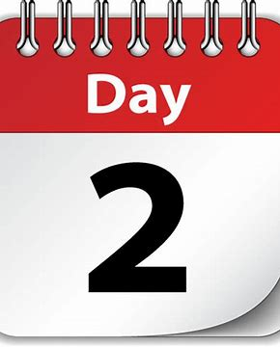
Genesis 1
⁶ And God said, “Let there be a vault between the waters to separate water from water.” ⁷ So God made the vault and separated the water under the vault from the water above it. And it was so.⁸ God called the vault “sky.” And there was evening, and there was morning—the second day.

Slide 12
Days of Weeks | Tempo | Terrain | Trials | Trust | Training
Time | Order Time Management Balance Life Retreat Ex. 12:14 Ex. 20:8 | 76 Nature Honors Psalms 139:7-14 | Result of Sin Exposes Unbelief Faith Dependance Reflection Mark 6:45-51 | Fruits of the Spirit Matthew 6:25-27 Ps. 46:10 | Stewardship Shepherd Mentoring Discipleship Ps. 51:12
Water (Life / Baptism)
Earth Vegetation CO2 Level
Light Seasons / Photosynthesis
Water/ Sky Creatures
Land Creatures
Rest

Slide 13
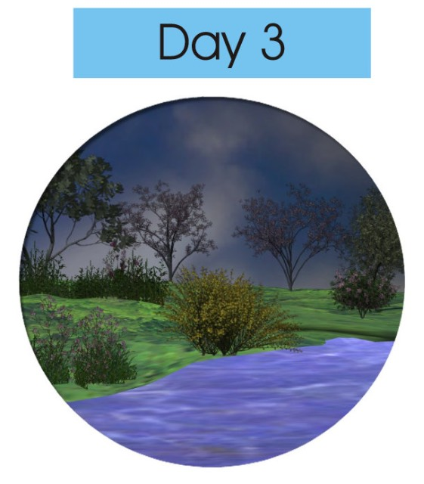
Genesis 1
⁹ And God said, “Let the water under the sky be gathered to one place, and let dry ground appear.” And it was so.
¹⁰ God called the dry ground “land,” and the gathered waters he called “seas.” And God saw that it was good.
¹¹ Then God said, “Let the land produce vegetation: seed-bearing plants and trees on the land that bear fruit with seed in it, according to their various kinds.” And it was so.

Slide 14
Genesis 1
¹² The land produced vegetation: plants bearing seed according to their kinds and trees bearing fruit with seed in it according to their kinds. And God saw that it was good.
¹³ And there was evening, and there was morning—the third day.

Slide 15
Days of Weeks | Tempo | Terrain | Trials | Trust | Training
Time | Order Time Management Balance Life Retreat Ex. 12:14 Ex. 20:8 | 76 Nature Honors Psalms 139:7-14 | Result of Sin Exposes Unbelief Faith Dependance Reflection Mark 6:45-51 | Fruits of the Spirit Matthew 6:25-27 Ps. 46:10 | Stewardship Shepherd Mentoring Discipleship Ps. 51:12
Water (Life / Baptism)
Earth Vegetation CO2 Level
Light Seasons / Photosynthesis
Water/ Sky Creatures
Land Creatures
Rest

Slide 16
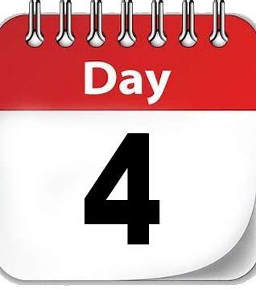
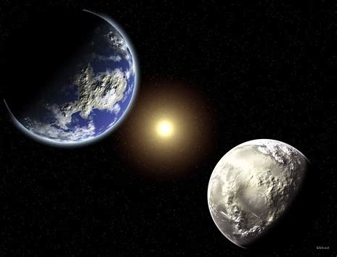
Genesis 1
¹⁴ And God said, “Let there be lights in the vault of the sky to separate the day from the night, and let them serve as signs to mark sacred times, and days and years,
¹⁵ and let them be lights in the vault of the sky to give light on the earth.” And it was so.
¹⁶ God made two great lights—the greater light to govern the day and the lesser light to govern the night. He also made the stars.

Slide 17
Genesis 1
¹⁷ God set them in the vault of the sky to give light on the earth,
¹⁸ to govern the day and the night, and to separate light from darkness. And God saw that it was good.
¹⁹ And there was evening, and there was morning—the fourth day.

Slide 18
Days of Weeks | Tempo | Terrain | Trials | Trust | Training
Time | Order Time Management Balance Life Retreat Ex. 12:14 Ex. 20:8 | 76 Nature Honors Psalms 139:7-14 | Result of Sin Exposes Unbelief Faith Dependance Reflection Mark 6:45-51 | Fruits of the Spirit Matthew 6:25-27 Ps. 46:10 | Stewardship Shepherd Mentoring Discipleship Ps. 51:12
Water (Life / Baptism)
Earth Vegetation CO2 Level
Light Seasons / Photosynthesis
Water/ Sky Creatures
Land Creatures
Rest

Slide 19
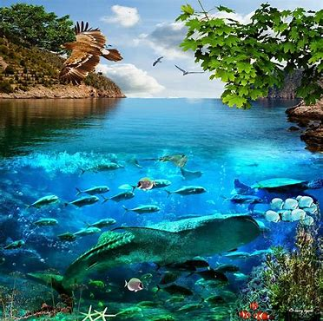
Genesis 1
²⁰ And God said, “Let the water teem with living creatures, and let birds fly above the earth across the vault of the sky.”
²¹ So God created the great creatures of the sea and every living thing with which the water teems and that moves about in it, according to their kinds, and every winged bird according to its kind. And God saw that it was good.

Slide 20
Genesis 1
²² God blessed them and said, “Be fruitful and increase in number and fill the water in the seas, and let the birds increase on the earth.”
²³ And there was evening, and there was morning—the fifth day.

Slide 21
Days of Weeks | Tempo | Terrain | Trials | Trust | Training
Time | Order Time Management Balance Life Retreat Ex. 12:14 Ex. 20:8 | 76 Nature Honors Psalms 139:7-14 | Result of Sin Exposes Unbelief Faith Dependance Reflection Mark 6:45-51 | Fruits of the Spirit Matthew 6:25-27 Ps. 46:10 | Stewardship Shepherd Mentoring Discipleship Ps. 51:12
Water (Life / Baptism)
Earth Vegetation CO2 Level
Light Seasons / Photosynthesis
Water/ Sky Creatures
Land Creatures
Rest

Slide 22
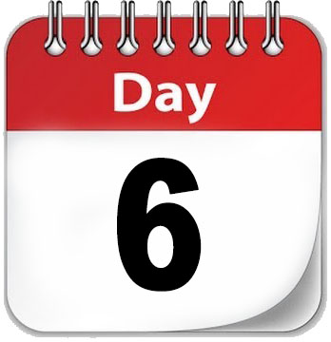
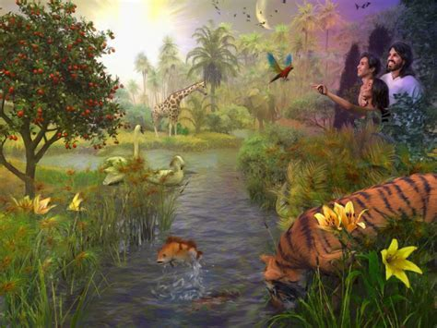
Genesis 1
²⁴ And God said, “Let the land produce living creatures according to their kinds: the livestock, the creatures that move along the ground, and the wild animals, each according to its kind.” And it was so.
²⁵ God made the wild animals according to their kinds, the livestock according to their kinds, and all the creatures that move along the ground according to their kinds. And God saw that it was good.

Slide 23
Genesis 1
²⁶ Then God said, “Let us make mankind in our image, in our likeness, so that they may rule over the fish in the sea and the birds in the sky, over the livestock and all the wild animals, and over all the creatures that move along the ground.”
²⁷ So God created mankind in his own image, in the image of God he created them; male and female he created them.

Slide 24
Genesis 1
²⁸ God blessed them and said to them, “Be fruitful and increase in number; fill the earth and subdue it. Rule over the fish in the sea and the birds in the sky and over every living creature that moves on the ground.”
²⁹ Then God said, “I give you every seed-bearing plant on the face of the whole earth and every tree that has fruit with seed in it. They will be yours for food.

Slide 25
Genesis 1
³⁰ And to all the beasts of the earth and all the birds in the sky and all the creatures that move along the ground—everything that has the breath of life in it—I give every green plant for food.” And it was so.
³¹ God saw all that he had made, and it was very good. And there was evening, and there was morning—the sixth day.

Slide 26
Days of Weeks | Tempo | Terrain | Trials | Trust | Training
Time | Order Time Management Balance Life Retreat Ex. 12:14 Ex. 20:8 | 76 Nature Honors Psalms 139:7-14 | Result of Sin Exposes Unbelief Faith Dependance Reflection Mark 6:45-51 | Fruits of the Spirit Matthew 6:25-27 Ps. 46:10 | Stewardship Shepherd Mentoring Discipleship Ps. 51:12
Water (Life / Baptism)
Earth Vegetation CO2 Level
Light Seasons / Photosynthesis
Water/ Sky Creatures
Land Creatures
Rest

Slide 27
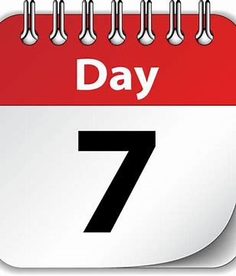
Genesis 2
¹ Thus the heavens and the earth were completed in all their vast array.
² By the seventh day God had finished the work he had been doing; so on the seventh day he rested from all his work.
³ Then God blessed the seventh day and made it holy, because on it he rested from all the work of creating that he had done.

Slide 28
Group Discussion Time
How can you link the creation story with
Outdoor Leadership?

Slide 29
Days of Weeks | Tempo | Terrain | Trials | Trust | Training
Time | Order Time Management Balance Life Retreat Ex. 12:14 Ex. 20:8 | 76 Nature Honors Psalms 139:7-14 | Result of Sin Exposes Unbelief Faith Dependance Reflection Mark 6:45-51 | Fruits of the Spirit Matthew 6:25-27 Ps. 46:10 | Stewardship Shepherd Mentoring Discipleship Ps. 51:12
Water (Life / Baptism)
Earth Vegetation CO2 Level
Light Seasons / Photosynthesis
Water/ Sky Creatures
Land Creatures
Rest

Slide 30
Tempo
Exodus 12:14 - “This is a day you are to commemorate; for the generations to come you shall celebrate it as a festival to the Lord—a lasting ordinance.
Exodus 20:8 - “Remember the Sabbath day by keeping it holy.

Slide 31
Days of Weeks | Tempo | Terrain | Trials | Trust | Training
Time | Order Time Management Balance Life Retreat Ex. 12:14 Ex. 20:8 | 76 Nature Honors Psalms 139:7-14 | Result of Sin Exposes Unbelief Faith Dependance Reflection Mark 6:45-51 | Fruits of the Spirit Matthew 6:25-27 Ps. 46:10 | Stewardship Shepherd Mentoring Discipleship Ps. 51:12
Water (Life / Baptism)
Earth Vegetation CO2 Level
Light Seasons / Photosynthesis
Water/ Sky Creatures
Land Creatures
Rest

Slide 32
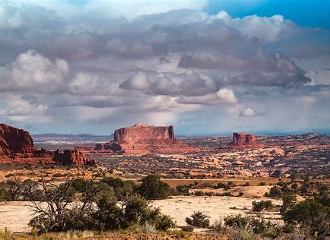
Terrain - Psalms 139:7-14
⁷ Where can I go from your Spirit? Where can I flee from your presence?
⁸ If I go up to the heavens, you are there;
if I make my bed in the depths, you are there.
⁹ If I rise on the wings of the dawn, if I settle on the far side of the sea, ¹⁰ even there your hand will guide me, your right hand will hold me fast.

Slide 33
Terrain - Psalms 139:7-14
¹¹ If I say, “Surely the darkness will hide me and the light become night around me,” ¹² even the darkness will not be dark to you; the night will shine like the day,
for darkness is as light to you.
¹³ For you created my inmost being; you knit me together in my mother’s womb. ¹⁴ I praise you because I am fearfully and wonderfully made; your works are wonderful, I know that full well.

Slide 34
Days of Weeks | Tempo | Terrain | Trials | Trust | Training
Time | Order Time Management Balance Life Retreat Ex. 12:14 Ex. 20:8 | 76 Nature Honors Psalms 139:7-14 | Result of Sin Exposes Unbelief Faith Dependance Reflection Mark 6:45-51 | Fruits of the Spirit Matthew 6:25-27 Ps. 46:10 | Stewardship Shepherd Mentoring Discipleship Ps. 51:12
Water (Life / Baptism)
Earth Vegetation CO2 Level
Light Seasons / Photosynthesis
Water/ Sky Creatures
Land Creatures
Rest

Slide 35
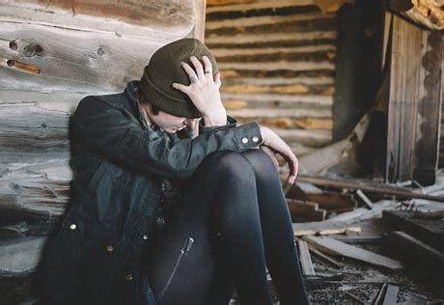
Trials - Mark 6:45-51
⁴⁵ Immediately Jesus made his disciples get into the boat and go on ahead of him to Bethsaida, while he dismissed the crowd.
⁴⁶ After leaving them, he went up on a mountainside to pray.
⁴⁷ Later that night, the boat was in the middle of the lake, and he was alone on land.
⁴⁸ He saw the disciples straining at the oars, because the wind was against them. Shortly before dawn he went out to them, walking on the lake. He was about to pass by them,

Slide 36
Trials - Mark 6:45-51
⁴⁹ but when they saw him walking on the lake, they thought he was a ghost. They cried out,
⁵⁰ because they all saw him and were terrified. Immediately he spoke to them and said, “Take courage! It is I. Don’t be afraid.”
⁵¹ Then he climbed into the boat with them, and the wind died down. They were completely amazed,

Slide 37
Group Discussion Time
How does the themes of
Tempo
Terrain
Trials
And outdoor leadership connect?

Slide 38
Days of Weeks | Tempo | Terrain | Trials | Trust | Training
Time | Order Time Management Balance Life Retreat Ex. 12:14 Ex. 20:8 | 76 Nature Honors Psalms 139:7-14 | Result of Sin Exposes Unbelief Faith Dependance Reflection Mark 6:45-51 | Fruits of the Spirit Matthew 6:25-27 Ps. 46:10 | Stewardship Shepherd Mentoring Discipleship Ps. 51:12
Water (Life / Baptism)
Earth Vegetation CO2 Level
Light Seasons / Photosynthesis
Water/ Sky Creatures
Land Creatures
Rest

Slide 39
Trust - Matthew 6:25-27
²⁵ “Therefore I tell you, do not worry about your life, what you will eat or drink; or about your body, what you will wear. Is not life
more than food, and the body more than clothes?
²⁶ Look at the birds of the air; they do not sow or reap or store away in barns, and yet your heavenly Father feeds them. Are you not much more valuable than they?
²⁷ Can any one of you by worrying add a single hour to your life?

Slide 40
Trust - Psalms 46
¹⁰ He says, “Be still, and know that I am God; I will be exalted among the nations, I will be exalted in the earth.”

Slide 41
Days of Weeks | Tempo | Terrain | Trials | Trust | Training
Time | Order Time Management Balance Life Retreat Ex. 12:14 Ex. 20:8 | 76 Nature Honors Psalms 139:7-14 | Result of Sin Exposes Unbelief Faith Dependance Reflection Mark 6:45-51 | Fruits of the Spirit Matthew 6:25-27 Ps. 46:10 | Stewardship Shepherd Mentoring Discipleship Ps. 51:12
Water (Life / Baptism)
Earth Vegetation CO2 Level
Light Seasons / Photosynthesis
Water/ Sky Creatures
Land Creatures
Rest

Slide 42
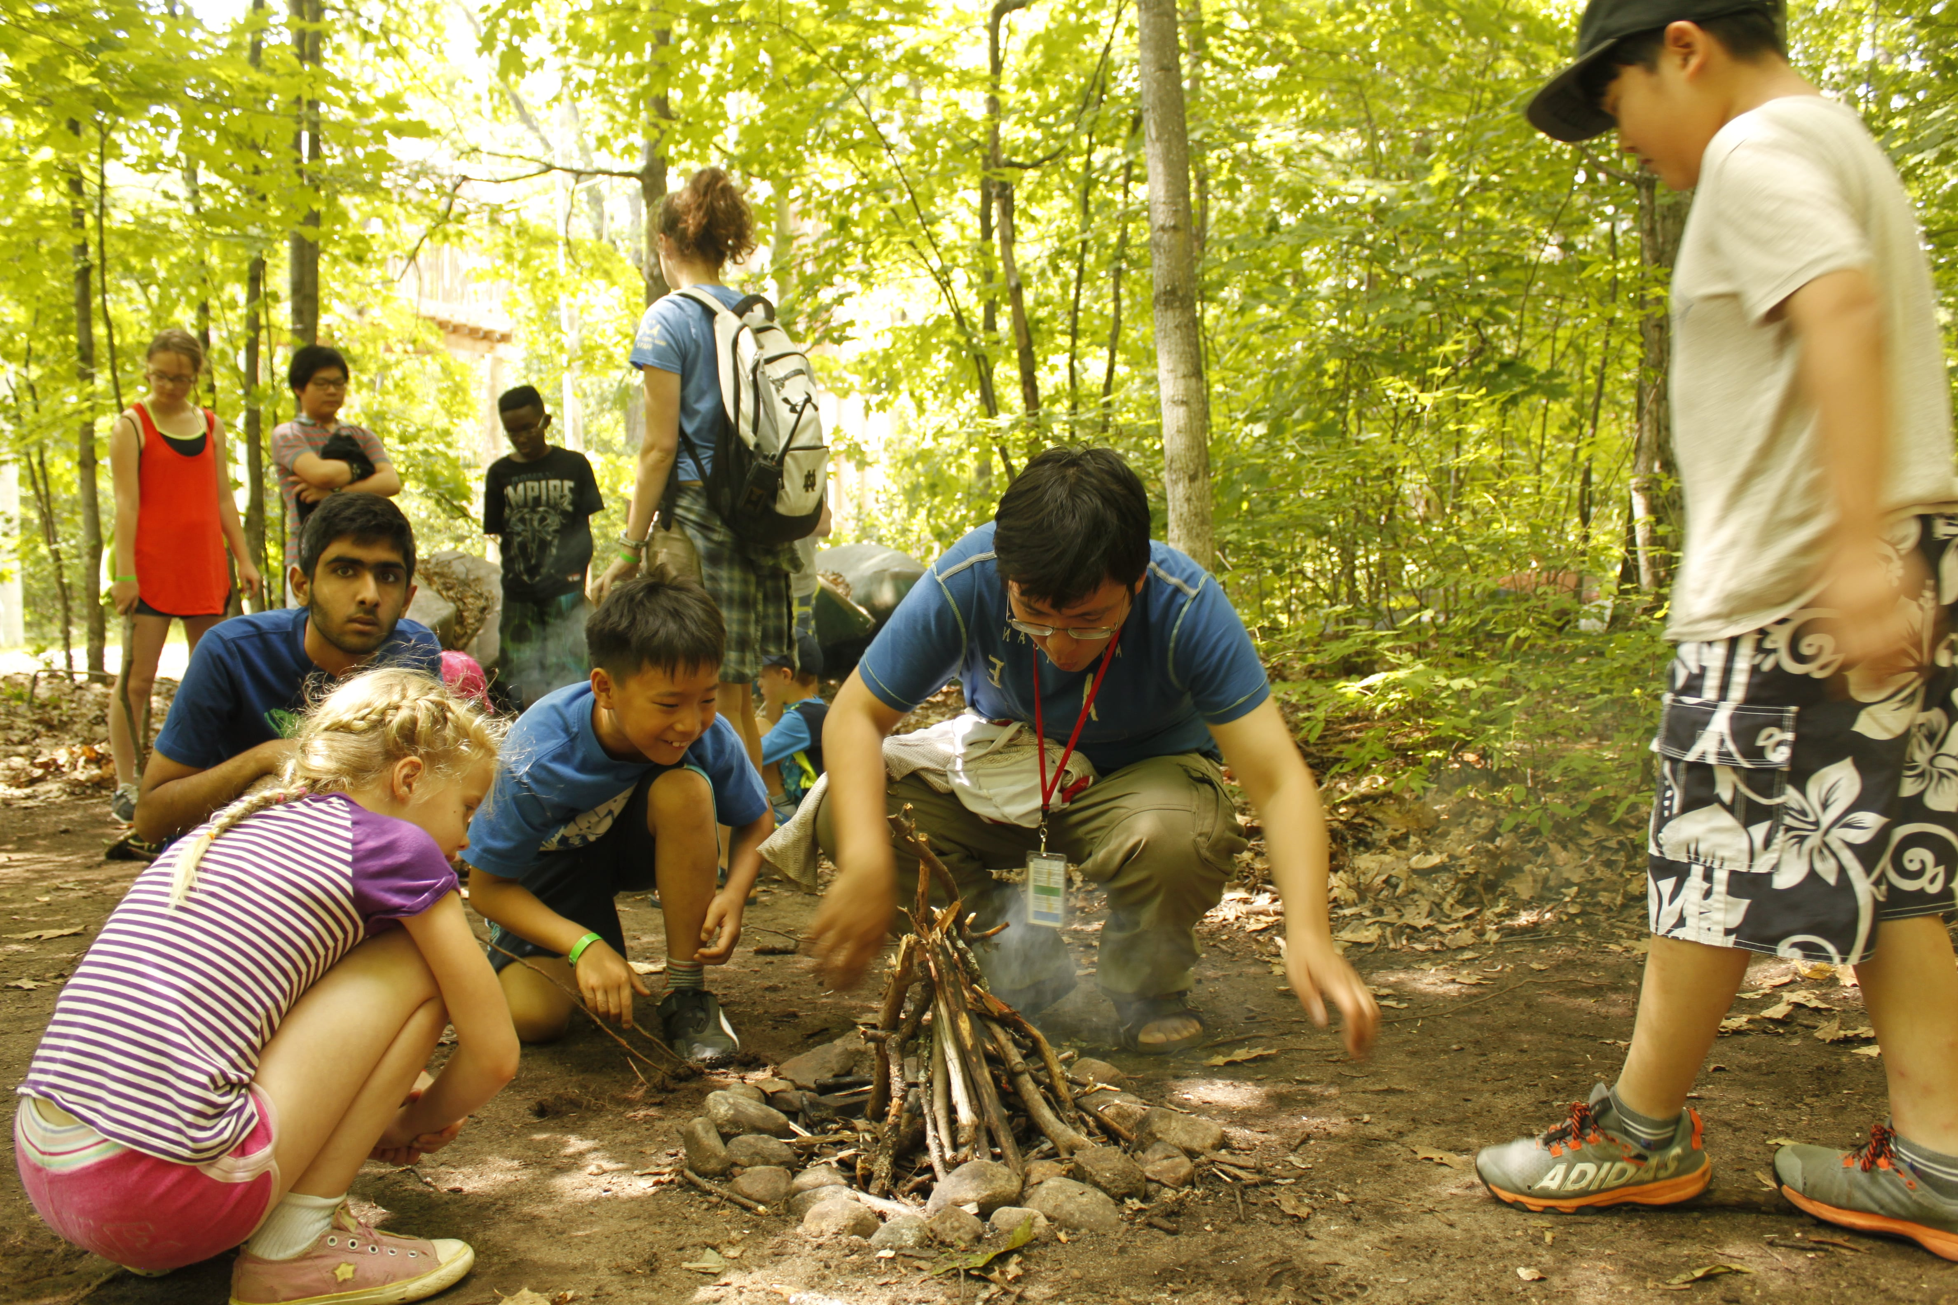
Training - Psalm 51:12
¹² Restore to me the joy of your salvation and grant me a willing spirit, to sustain me.

Slide 43
Group Discussion Time
How does the themes of
Trust
Training
And outdoor leadership connect?

Slide 44
A thought to contemplate on
Creation
Creation
Steward
God
Go
Steward
Restore
Restore
God made creation – He wants us to be stewards of it and to restore it
God want us to Go to His creation, teach them to be stewards,
And share the hope of being restored

Slide 45
Days of Weeks | Tempo | Terrain | Trials | Trust | Training
Time | Order Time Management Balance Life Retreat Ex. 12:14 Ex. 20:8 | 76 Nature Honors Psalms 139:7-14 | Result of Sin Exposes Unbelief Faith Dependance Reflection Mark 6:45-51 | Fruits of the Spirit Matthew 6:25-27 Ps. 46:10 | Stewardship Shepherd Mentoring Discipleship Ps. 51:12
Water (Life / Baptism)
Earth Vegetation CO2 Level
Light Seasons / Photosynthesis
Water/ Sky Creatures
Land Creatures
Rest

Slide 46
Wilderness AKA Creation Theology
Master Guide Advance
Carl Rodriguez
Chesapeake Conference of SDA

