Slide 1
Master Guide Class Communication Theory by Carl Rodriguez Chesapeake Conference

Slide 2
Story of Communication
Union Youth Director
When information
is expressed
and acknowledged efficiently
without the intended meaning
being changed

Slide 3
Albert Mehrabian Theory of Communication Part One the 55%

Slide 4
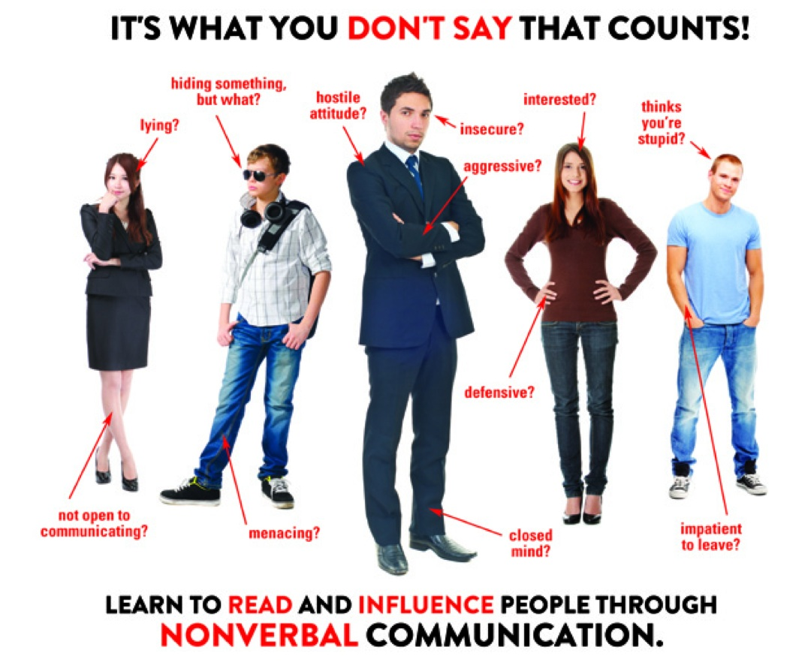
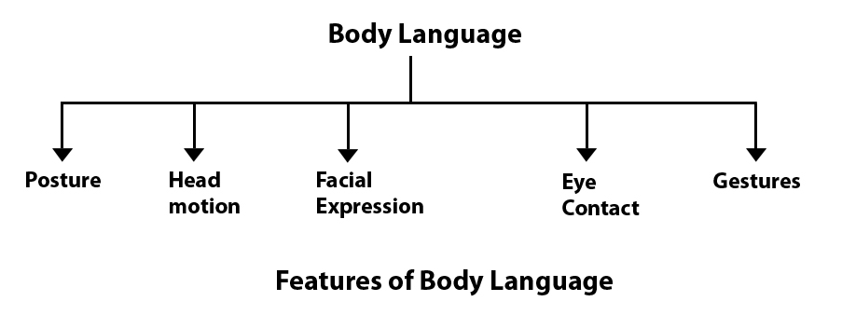
Different body language for different culture groups
Story of Korean Pastor at the Office
Story of feet dandling down
Why is understanding Body Language
important for leaders?

Slide 5
Break Out
Why is understanding Body Language important for leaders?

Slide 6
Albert Mehrabian Theory of Communication Part Two the 45%

Slide 7
Written Word
Emails
What's Apps
Letters
Symbols
Signs
Books
Resume / CV
Power Points
News Papers
Blogs
Why is the written word still important?
In ten words or less, write a captive tag line

Slide 8
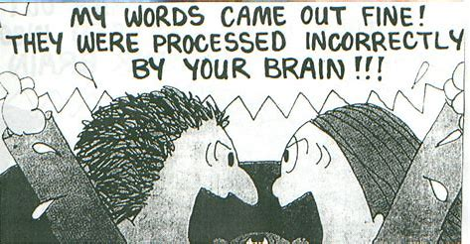
Expressed Word
Tones
Inflexions
Pauses
Speed
Modulation
Proverbs 18:21
The tongue has the power of life and death,
and those who love it will eat its fruit.
Please read Proverbs 18:21 and practice using 2 of the 5 ways to express words

Slide 9
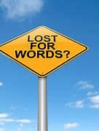
Break Out
Read out loud Proverbs 18:21
while practicing T. I. P. S. – M.
and Tag Line

Slide 10
Why listen?
1- For ideas / advice
2 - For understanding / learning
3 - To form a friendship
4 - For business
5 - For God’s voice
Notes:
Repeats / long winded / no point.

Slide 11
What are the best ways to listen?
1 - Listen between the lines
2 - Read body lingo
3 - Remember the story line
Explain the differences between hearing and actual listening

Slide 12
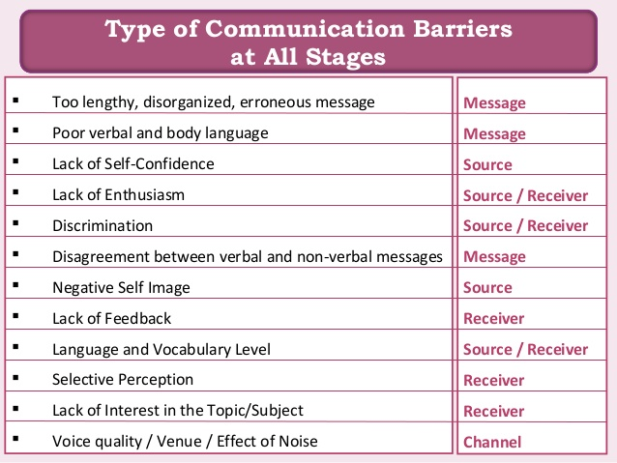
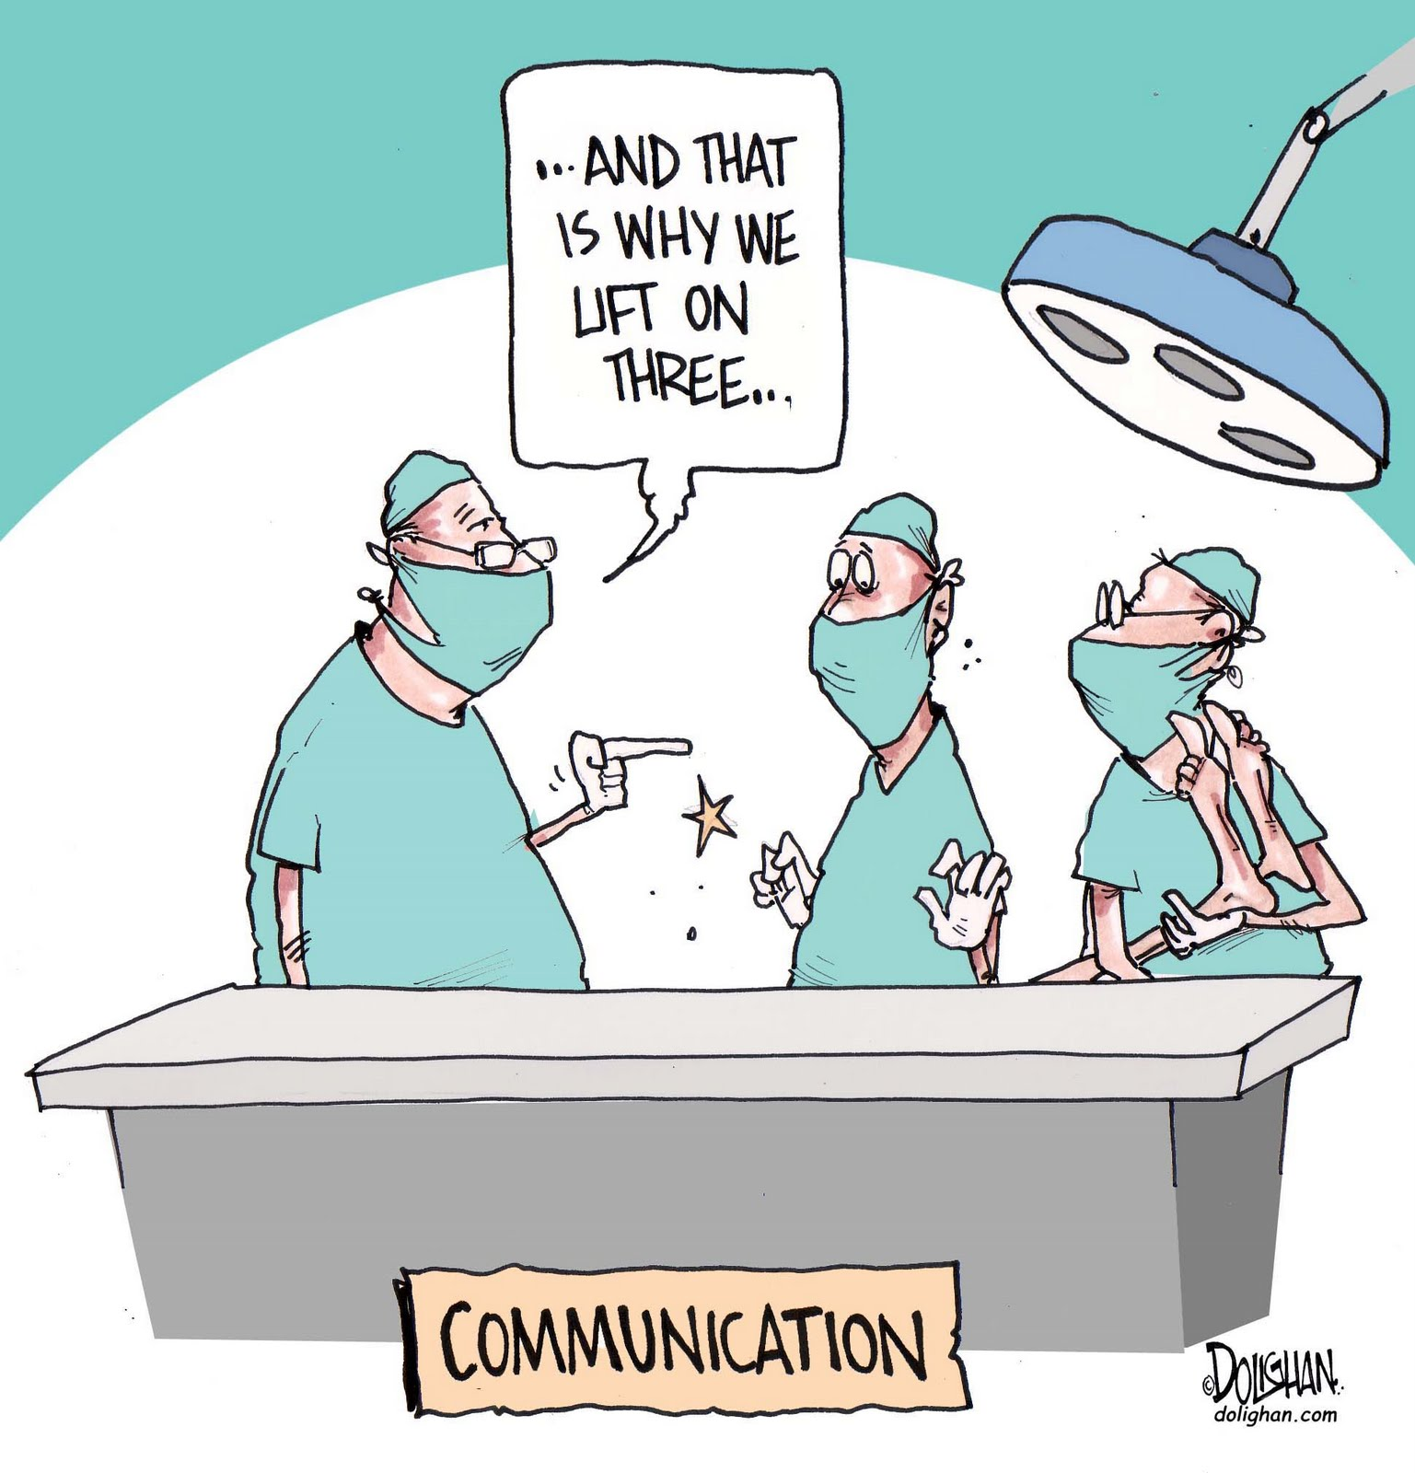
Interference in Communications

Slide 13
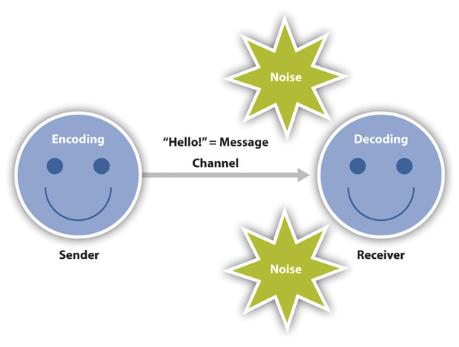
Break Out
How do we minimize interference in communications?

Slide 14
Summary
When information
is expressed
and acknowledged efficiently
without the intended meaning
being changed

