Slide 1
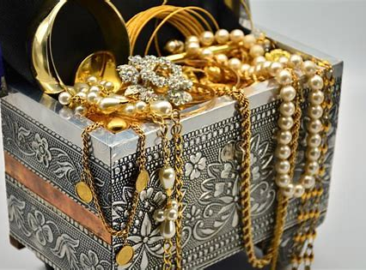
Historical Biblical Finance and Christian Principles
By Carl Rodriguez

Slide 2
Who created Gold & Pearls? Genesis 2:10-12
¹⁰ A river watering the garden flowed from Eden; from there it was separated into four headwaters.
¹¹ The name of the first is the Pishon; it winds through the entire land of Havilah, where there is gold.
¹² (The gold of that land is good; aromatic resin^{[d]} and onyx are also there.)
[d] Or good; pearls

Slide 3
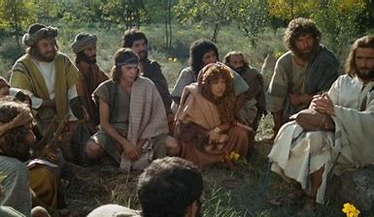
The Parables of the Hidden Treasure and the Pearl Matthew 13: 44-46
⁴⁴ “The kingdom of heaven is like treasure hidden in a field. When a man found it, he hid it again, and then in his joy went and sold all he had and bought that field.
⁴⁵ “Again, the kingdom of heaven is like a merchant looking for fine pearls.
⁴⁶ When he found one of great value, he went away and sold everything he had and bought it.

Slide 4
Group Time Christian Principle 1 The Exchange
In both parables an exchange was made.
What was gained?
Can the person sell the field or pearl again?
What is the Christian Principle here?

Slide 5
Genesis 41 The goal of $$$
⁴⁶ Joseph was thirty years old when he entered the service of Pharaoh king of Egypt. And Joseph went out from Pharaoh’s presence and traveled throughout Egypt.
⁴⁷ During the seven years of abundance the land produced plentifully.
⁴⁸ Joseph collected all the food produced in those seven years of abundance in Egypt and stored it in the cities. In each city he put the food grown in the fields surrounding it.

Slide 6
Genesis 41 The goal of $$$
⁵⁶ When the famine had spread over the whole country, Joseph opened all the storehouses and sold grain to the Egyptians, for the famine was severe throughout Egypt.
⁵⁷ And all the world came to Egypt to buy grain from Joseph, because the famine was severe everywhere.

Slide 7
Genesis 47 The goal of $$$
¹⁴ Joseph collected all the money that was to be found in Egypt and Canaan in payment for the grain they were buying, and he brought it to Pharaoh’s palace.
¹⁵ When the money of the people of Egypt and Canaan was gone, all Egypt came to Joseph and said, “Give us food. Why should we die before your eyes? Our money is all gone.”

Slide 8
Genesis 47 The goal of $$$
¹⁶ “Then bring your livestock,” said Joseph. “I will sell you food in exchange for your livestock, since your money is gone.”
¹⁸ When that year was over, they came to him the following year and said, “We cannot hide from our lord the fact that since our money is gone and our livestock belongs to you, there is nothing left for our lord except our bodies and our land.

Slide 9
Genesis 47 The goal of $$$
¹⁹ Why should we perish before your eyes—we and our land as well? Buy us and our land in exchange for food, and we with our land will be in bondage to Pharaoh.

Slide 10
Group Time Christian Principle 2 Goal of money
Luke 12: 16 And he told them this parable: “The ground of a certain rich man yielded an abundant harvest.
¹⁷ He thought to himself, ‘What shall I do? I have no place to store my crops.’
Did Joseph give the grain free? Why not?
Is making people slaves acceptable?
Read Luke 12:16-21 Hebrews 13:16, 1 John 3:17, 1 Timothy 6:10, and Deuteronomy 23:19-20
¹⁸ “Then he said, ‘This is what I’ll do. I will tear down my barns and build bigger ones, and there I will store my surplus grain.
¹⁹ And I’ll say to myself, “You have plenty of grain laid up for many years. Take life easy; eat, drink and be merry.”’
²⁰ “But God said to him, ‘You fool! This very night your life will be demanded from you. Then who will get what you have prepared for yourself?’ ²¹ “This is how it will be with whoever stores up things for themselves but is not rich toward God.”

Slide 11
Group Time Christian Principle 2 Goal of money
Heb. 13:16 And do not forget to do good and to share with others, for with such sacrifices God is pleased.
Did Joseph give the grain free? Why not?
Is making people slaves acceptable?
Read Luke 12:16-21 Hebrews 13:16, 1 John 3:17, 1 Timothy 6:10, and Deuteronomy 23:19-20
1 John 3:17. If anyone has material possessions and sees a brother or sister in need but has no pity on them, how can the love of God be in that person? Dear children, let us not love with words or speech but with actions and in truth.

Slide 12
Group Time Christian Principle 2 Goal of money
1 Tim. 6:10 For the love of money is a root of all kinds of evil. Some people, eager for money, have wandered from the faith and pierced themselves with many griefs.
Did Joseph give the grain free? Why not?
Is making people slaves acceptable?
Read Luke 12:16-21 Hebrews 13:16, 1 John 3:17, 1 Timothy 6:10, and Deuteronomy 23:19-20 and comment
Deut. 23: 19 Do not charge a fellow Israelite interest, whether on money or food or anything else that may earn interest.
²⁰ You may charge a foreigner interest, but not a fellow Israelite, so that the Lord your God may bless you in everything you put your hand to in the land you are entering to possess.

Slide 13
The Talent
Deuteronomy 8:18
Remember the Lord your God, for it is He who gives you the ability to produce wealth.
Proverbs 3:9 Honor the Lord with your wealth, with the first fruits of all your crops; then your barns will be filled to overflowing, and your vats will brim over with new wine.

Slide 14
Matthew 25:14-30
¹⁴ “Again, it will be like a man going on a journey, who called his servants and entrusted his wealth to them.
¹⁵ To one he gave five bags of gold, to another two bags, and to another one bag, each according to his ability. Then he went on his journey.
¹⁶ The man who had received five bags of gold went at once and put his money to work and gained five bags more.
¹⁷ So also, the one with two bags of gold gained two more.

Slide 15
Matthew 25:14-30
¹⁸ But the man who had received one bag went off, dug a hole in the ground and hid his master’s money.
¹⁹ “After a long time the master of those servants returned and settled accounts with them.
²⁰ The man who had received five bags of gold brought the other five. ‘Master,’ he said, ‘you entrusted me with five bags of gold. See, I have gained five more.’
²¹ “His master replied, ‘Well done, good and faithful servant! You have been faithful with a few things; I will put you in charge of many things. Come and share your master’s happiness!’

Slide 16
Matthew 25:14-30
²² “The man with two bags of gold also came. ‘Master,’ he said, ‘you entrusted me with two bags of gold; see, I have gained two more.’
²³ “His master replied, ‘Well done, good and faithful servant! You have been faithful with a few things; I will put you in charge of many things. Come and share your master’s happiness!’
²⁴ “Then the man who had received one bag of gold came. ‘Master,’ he said, ‘I knew that you are a hard man, harvesting where you have not sown and gathering where you have not scattered seed.

Slide 17
Matthew 25:14-30
²⁵ So I was afraid and went out and hid your gold in the ground. See, here is what belongs to you.’
²⁶ “His master replied, ‘You wicked, lazy servant! So you knew that I harvest where I have not sown and gather where I have not scattered seed?
²⁷ Well then, you should have put my money on deposit with the bankers, so that when I returned I would have received it back with interest.
²⁸ “‘So take the bag of gold from him and give it to the one who has ten bags.

Slide 18
Matthew 25:14-30
²⁹ For whoever has will be given more, and they will have an abundance. Whoever does not have, even what they have will be taken from them.
³⁰ And throw that worthless servant outside, into the darkness, where there will be weeping and gnashing of teeth.’

Slide 19
Group Time Christian Principle 3 Talents are from God
2 Thess. 3: 10 For even when we were with you, we gave you this rule: “The one who is unwilling to work shall not eat.”
What is the main point of this last-day events parable?
Why was the profit not taken from the producer and given to the lazy & wicked man?
Please read for comments
2 Thessalonians 3:10 &
1 Timothy 5:8
1 Timothy 5: 8 Anyone who does not provide for their relatives, and especially for their own household, has denied the faith and is worse than an unbeliever.

Slide 20
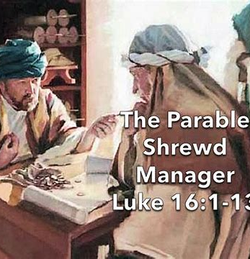
Luke 16:1-15 The Parable of the Shrewd Manager
Jesus told his disciples: “There was a rich man whose manager was accused of wasting his possessions.
² So he called him in and asked him, ‘What is this I hear about you? Give an account of your management, because you cannot be manager any longer.’
³ “The manager said to himself, ‘What shall I do now? My master is taking away my job. I’m not strong enough to dig, and I’m ashamed to beg—

Slide 21
Luke 16:1-15 The Parable of the Shrewd Manager
⁴ I know what I’ll do so that, when I lose my job here, people will welcome me into their houses.’
⁵ “So he called in each one of his master’s debtors. He asked the first, ‘How much do you owe my master?’
⁶ “‘Nine hundred gallons of olive oil,’ he replied. “The manager told him, ‘Take your bill, sit down quickly, and make it four hundred and fifty.’
⁷ “Then he asked the second, ‘And how much do you owe?’ “‘A thousand bushels of wheat,’ he replied. “He told him, ‘Take your bill and make it eight hundred.’

Slide 22
Luke 16:1-15 The Parable of the Shrewd Manager
⁸ “The master commended the dishonest manager because he had acted shrewdly. For the people of this world are more shrewd in dealing with their own kind than are the people of the light.
⁹ I tell you, use worldly wealth to gain friends for yourselves, so that when it is gone, you will be welcomed into eternal dwellings.
¹⁰ “Whoever can be trusted with very little can also be trusted with much, and whoever is dishonest with very little will also be dishonest with much.
¹¹ So if you have not been trustworthy in handling worldly wealth, who will trust you with true riches?

Slide 23
Luke 16:1-15 The Parable of the Shrewd Manager
¹² And if you have not been trustworthy with someone else’s property, who will give you property of your own?
¹³ “No one can serve two masters. Either you will hate the one and love the other, or you will be devoted to the one and despise the other. You cannot serve both God and money.”
¹⁴ The Pharisees, who loved money, heard all this and were sneering at Jesus.
¹⁵ He said to them, “You are the ones who justify yourselves in the eyes of others, but God knows your hearts. What people value highly is detestable in God’s sight.

Slide 24
Group Time Christian Principle 4 Accountability
What in the world is this parable about?
What is the Christian Principle here?
Please read to comment verse 10 →
¹⁰ “Whoever can be trusted with very little can also be trusted with much, and whoever is dishonest with very little will also be dishonest with much.

Slide 25
Borrowing and Debt = Plastic Surgery
Proverbs 22
7 The rich rule over the poor, and the borrower is slave to the lender.
26 Do not be one who shakes hands in pledge or puts up security for debts;
27 if you lack the means to pay, your very bed will be snatched from under you.

Slide 26
Group Time Christian Principle 5 Debt Freedom
Why is becoming debt free important?

Slide 27
USA in Bible Prophecy Revelation 13 – the dependency
¹¹ Then I saw a second beast, coming out of the earth. It had two horns like a lamb, but it spoke like a dragon.
¹⁶ It also forced all people, great and small, rich and poor, free and slave, to receive a mark on their right hands or on their foreheads,
¹⁷ so that they could not buy or sell unless they had the mark, which is the name of the beast or the number of its name.

Slide 28
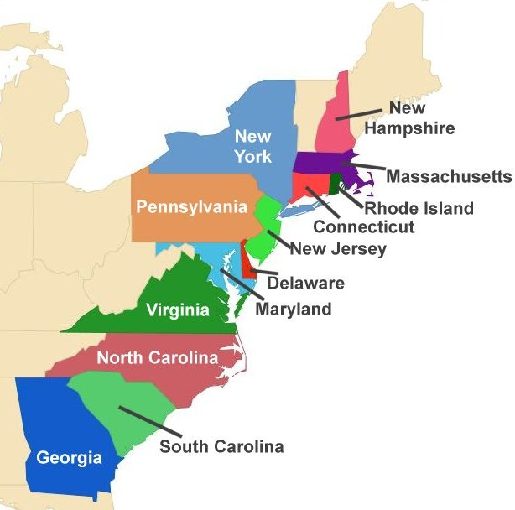
The Southern Influence Free Market System
In 1607, after founding Jamestown only 38 of the 104 settlers survived due to famine.
In 1609, the Virginia Company sent 500 settlers to Virginia. After 6 months, 440 were dead by starvation and disease.
In 1611, a new governor was sent from England, and he quickly realized that the problem was the colony’s system of communal ownership – socialism.

Slide 29
The Southern Influence Free Market System
A free-market system was put in place with private property ownership & privileges. People good sell and trade from their labor, and the famine ended.
This new system or philosophy (free market) is based on the principle of Scripture.
2 Thess. 3:10 For even when we were with you, we gave you this rule: "If a man will not work, he shall not eat." (NIV)

Slide 30
The Northern Influence Tri-form of Government
Christians introduced a tri-form of government from book of Isaiah 33:22
“For the LORD is our judge, the LORD is our lawgiver, the LORD is our king; it is he who will save us.” (NIV)
Today we have the three branches of government.
Judge (Judicial Branch) - Courts are to judge fairly
Lawgivers (Legislative Branch) - House of Representatives and Senators are to formulate legislative laws that benefit our people.
King (Governing Branch) President, governors, mayors, etc. are to govern.

Slide 31
Systems at play for a common cause peace & safety
When Protestantism shall stretch her hand across the gulf to grasp the hand of the Roman power, when she shall reach over the abyss to clasp hands with spiritualism, when, under the influence of this threefold union, our country shall repudiate every principle of its Constitution as a Protestant and republican government and shall make provision for the propagation of papal falsehoods and delusions, then we may know that the time has come for the marvelous working of Satan and that the end is near.—Testimonies for the Church 5:451 (1885). LDE 131.4
Slavery – total control
Communism - common ownership (reaction to IR)
Socialism – government controls (reaction to IR)
Free Market – individual’s right to market (from USA 1611)
Capitalism – companies control (from Industrial Revolution)
Libertarianism – common liberty (reaction to 1776)
Anarchy – no control

Slide 32
Group Time Christian Principle 6 Dependance on God
1 Thessalonians 5:3 While people are saying, “Peace and safety,” destruction will come on them suddenly, as labor pains on a pregnant woman, and they will not escape.
Who should you trust for your sustainability?
2 Thessalonians 2:3 Don’t let anyone deceive you in any way, for that day will not come until the rebellion occurs and the man of lawlessness is revealed, the man doomed to destruction. ⁴ He will oppose and will exalt himself over everything that is called God or is worshiped, so that he sets himself up in God’s temple, proclaiming himself to be God.

Slide 33
1- God gave us Gold, Silver, Pearls → improvement
2- Money has a goal → Bless others
3- We all receive a talent → To provide for family
4- Accountability of wealth → Stewardship
5- Debt → Freedom is what God wants
6- Dependance on God → Trust and Faith

