Slide 1
Planning Fun Sabbath & Social Activities
SHERIDAN WELLS, NE Area Coordinator
SHARON MARINKOVIC, NE Area Coordinator
Chesapeake Conference

Slide 2
Ice Breaker
Human Tic-Tac-Toe

Slide 3
THE SABBATH IS A DELIGHT
Isaiah 58:13-14 NKJV
¹³ “If you turn away your foot from the Sabbath, From doing your pleasure on My holy day, And call the Sabbath a delight, The holy day of the Lord honorable, And shall honor Him, not doing your own ways, Nor finding your own pleasure, Nor speaking your own words,
¹⁴ Then you shall delight yourself in the Lord; And I will cause you to ride on the high hills of the earth, And feed you with the heritage of Jacob your father. The mouth of the Lord has spoken.”
Mark 2:23-27
23 Now it happened that He went through the grainfields on the Sabbath; and as they went His disciples began to pluck the heads of grain. 24 And the Pharisees said to Him, “Look, why do they do what is not lawful on the Sabbath?”
25 But He said to them, “Have you never read what David did when he was in need and hungry, he and those with him: 26 how he went into the house of God in the days of Abiathar the high priest, and ate the showbread, which is not lawful to eat except for the priests, and also gave some to those who were with him?”
27 And He said to them, “The Sabbath was made for man, and not man for the Sabbath. 28 Therefore the Son of Man is also Lord of the Sabbath.”
Notes:
Breakout discussion on what these verse are telling us about the Sabbath (5 Minutes)

Slide 4
What is God Asking Us To Do?
He is asking us to enjoy this day that He made for us
He is not asking us to go through the motions of “Keeping the Sabbath” while our hearts are far from Him
He is asking us to keep it holy
He is not asking us to deprive ourselves of anything, but to indulge in what the Sabbath can offer that no other day can
Notes:
Keeping it holy doesn’t mean following a strict set of rules but rather putting away distractions from Him. Make the time to spend with him. Sabbath offers a “no pressure” time with Him – Guilt free
Question for class: What can we indulge in on Sabbath that we can’t on other days?
Possible answers: Seeing church family, napping, seeing family, enjoying the pastor’s sermon, discussion with other believers, respite from work and school

Slide 5
Teaching Children about Sabbath
We need to show children how to celebrate Sabbath
Adventurers can help
Raise children to see the “cans” not the “can't”
Notes:
It’s important for children to learn to see Sabbath as a celebration of creation and a celebration of their relationships with God because if they see it as a day of strict rules and “can’ts,” Sabbath, Jesus, and the Church have the potential to become a burden as they get older. When they see the Sabbath as an obstacle rather than an enjoyment.
Adventurers is a great way to provide children a joyful relationship with the Sabbath, Jesus, and the Church. We teach them to see how to enjoy God and his creation and how to celebrate the Sabbath by spending time with God and learning more about Him.
There are going to be “can’ts” on Sabbath, but we can raise our Adventurers to see the “cans” that Sabbath provides rather than the things it “keeps” them from doing. We can provide from a young age to see why Sabbath is such an important part of life.

Slide 6
Sabbath Rest
Physical and mental break
Preparation for the week
Spiritual revival
Notes:
Spiritual revival: Sabbath fortifies us for the next six days. We don’t always have the time to indulge in our spiritual lives as much as we would like during the week. Sabbath is our “all you can eat” spiritual buffet.

Slide 7
Sabbath Fun – What Does it Look Like?
Worship
Service
His Word
Activities
Adventurers

Slide 8
Worship
Have children participate
Singing
Story Time
Sabbath School
Children’s Church/AY
Notes:
Peanut Gallery worship ideas
Having children participate in any element of worship gives them a sense of ownership. They are no longer passive watchers but active participants. Participation allows them to realize that worship is for them as well. It helps them to develop their own, independent relationship with God.
Kids can participate by singing, playing instruments, greeting, collecting offering, making announcements, and even in the planning for the shy ones. PARTICIPATION DOES NOT MEAN BEING UP FRONT.

Slide 9
Service
OCC
Homeless ministry
Thanksgiving baskets
Taking care packages to firemen/neighborhood friends
Creating care package for the pastor
Nursing Home
Notes:
Peanut Gallery service ideas

Slide 10
His Word
Felt Boards
Puppet Show
Bible Videos
Bible Trivia (Swords Up/Kahoot)
Verse Memorization
Reading the Bible at their level
Notes:
Peanut Gallery His Word ideas

Slide 11
ACTIVITIES
Scavenger Hunt
VBS Activities
Art Projects | Journaling | Crafts
Nature Walk
Cooking/Baking Fun
Biblical Movie
Beach
Picnics
Notes:
Peanut Gallery Activities ideas

Slide 12
Adventurers
Program Requirements are already Christ centered
Fun way for kids to spend time with Jesus and with their parents on Sabbath
You can include elements of Worship/Service/His Word/Activities in the program (Opening Ceremony, Service Projects, etc)
Awards can be modified to be Christ centered
Notes:
When do you have your Adventurer meetings?
History of WW Adventurer Club. We meet on Sabbath and modified our curriculum – awards, basic requirements, activities – to be Sabbath-appropriate.

Slide 13
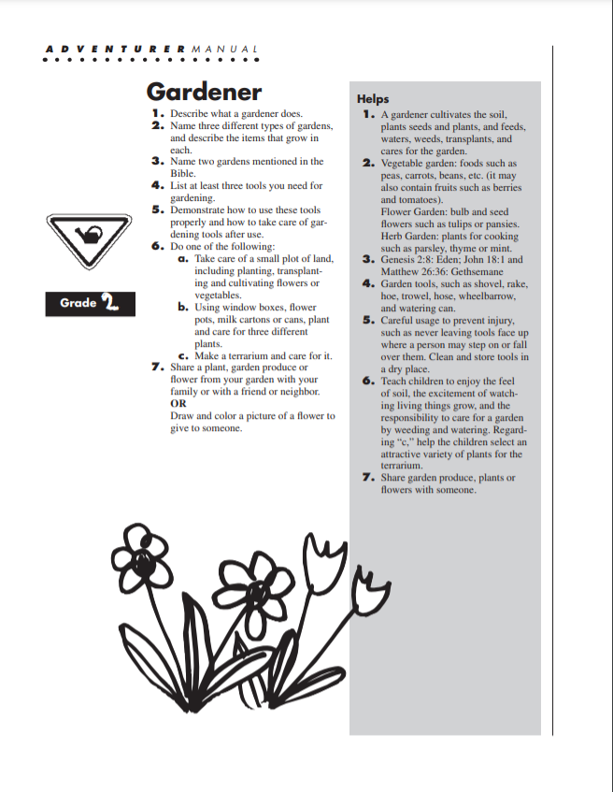
Notes:
Original Gardener award.

Slide 14
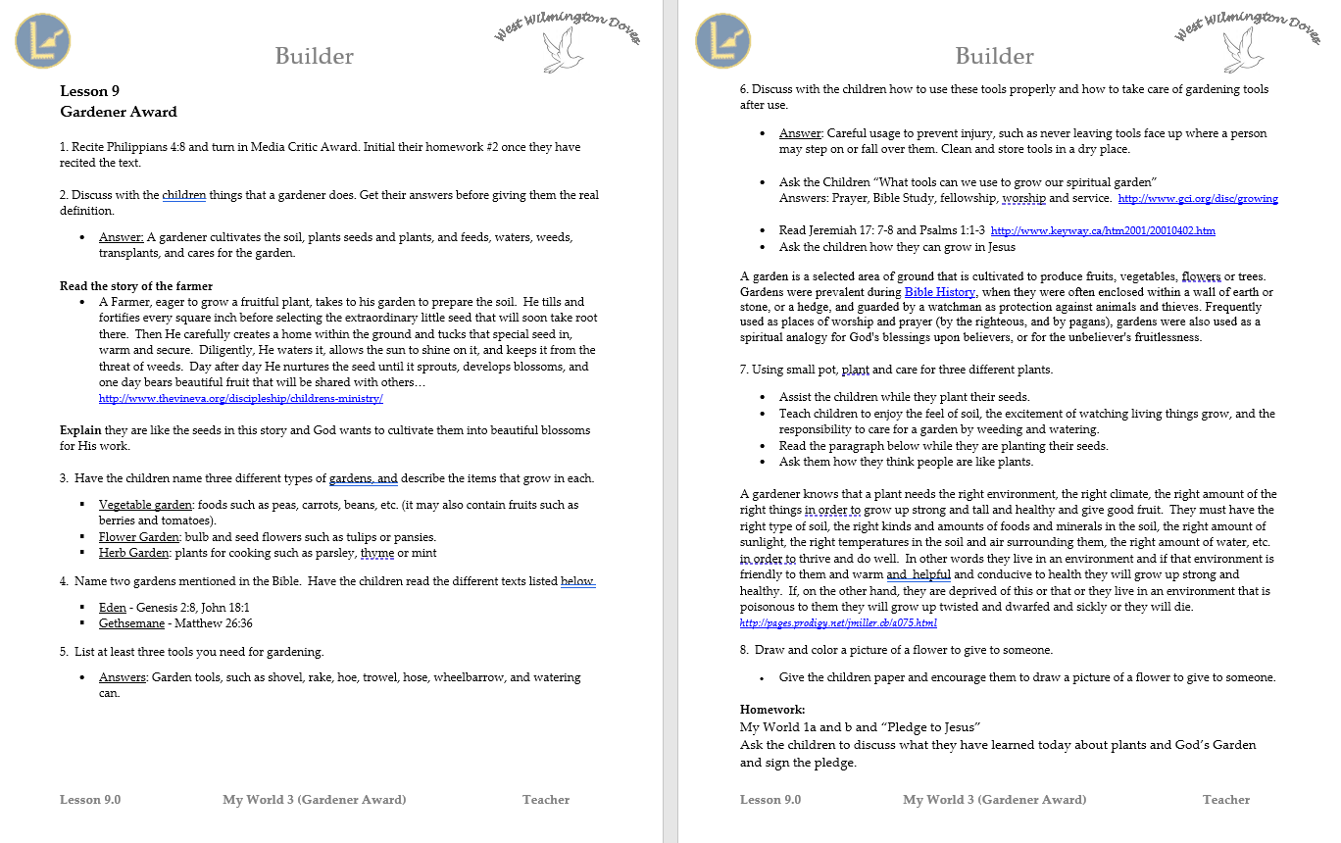
Notes:
Modified, Christ-centered Gardener award.

Slide 15
DISCUSSION
What Sabbath activities have you planned and implemented successfully?
Have you planned Sabbath activities that didn’t turn out as well as you had hoped?
What Lessons Learned can you share?

Slide 16
Social Activities
Planning
Location Ideas
Resources Needed
Safety Precautions

Slide 17
Planning
Create a team
Get board approval if not part of yearly calendar
Know your resources and limitations
Age appropriate
Know the weather for outdoor activities, have a Plan B
Advertising to the church (newsletter, announcements, bulletin, word of mouth)
Notes:
To plan, all you need is some friends and a group chat. It works! Once you have a team, keep the momentum going. Don’t let them forget about you!

Slide 18
Location Ideas
Church grounds
Local Park
Recreational Venue (Trampoline Park, Mini Golf, etc.)
Church Member’s Home/Grounds
Campground
Hayride
Beach

Slide 19
Resources Needed
Food
Transportation
Funding
Volunteers/Chaperones
Supplies
Notes:
Food: If you are scheduling an event around a meal time, either provide food or make sure people know to bring their own.
Transportation: Is it available? What are your options?
Funding: Can the ministry cover the cost? Do you need donations or to charge participants a fee?
Supplies: (Sports equipment, Cutlery, Technology, Food, etc.)

Slide 20
Safety Precautions
Permission Slips Needed?
First Aid Kit
CPR Certification Needed?
Ratio of Kids - Chaperones is appropriate
Male & Female Chaperones
Buddy System
For large outings, everyone wear club t-shirts for easy visibility
Make sure kids are aware of rules ahead of time
Notes:
Bring your permission slips and consent to treat forms with you always. Do not leave home without them. Cannot emphasize this enough.

Slide 21
What did we learn?

Slide 22
Our Contact Information
Sharon Marinkovic
Sharon.marinkovic@gmail.com
302-598-6845
Sheridan Wells
Sheridan.wells.sw@gmail.com
302-824-3996

