Slide 1




Understanding Teaching & Learning Styles
By Carl Rodriguez
Chesapeake Conference

Slide 2
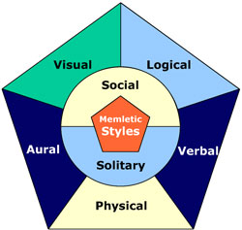
How to teach
different Styles of
Learning (Input)
& Thinking (Storage)
Holy Spirit & Culture Where do they fit in?
How to UNDERSTAND

Slide 3
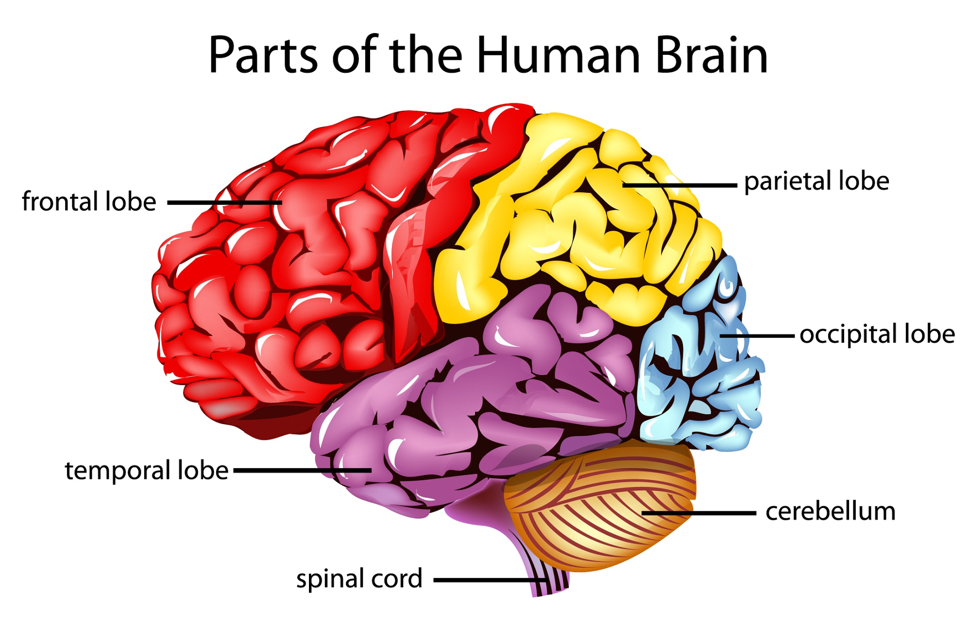
Motor Function Problem Solving
Integration of 5 senses
Vision Processing
Auditory Processing
Receives Information and regulates motor functions
Input
Notes:
Frontal lobes are involved in motor function, problem solving, spontaneity, memory, language, initiation, judgement, impulse control, and social and sexual behavior.
Parietal lobe - Integration of sight, smell, tough, taste, hearing
Occipital lobe is the visual processing center of the mammalian brain containing most of the anatomical region of the visual cortex
Temporal lobe -The primary auditory processing for production of speech, comprehension, and recognition
Cerebellum - receives information from the sensory systems, the spinal cord, and other parts of the brain and then regulates motor movements

Slide 4
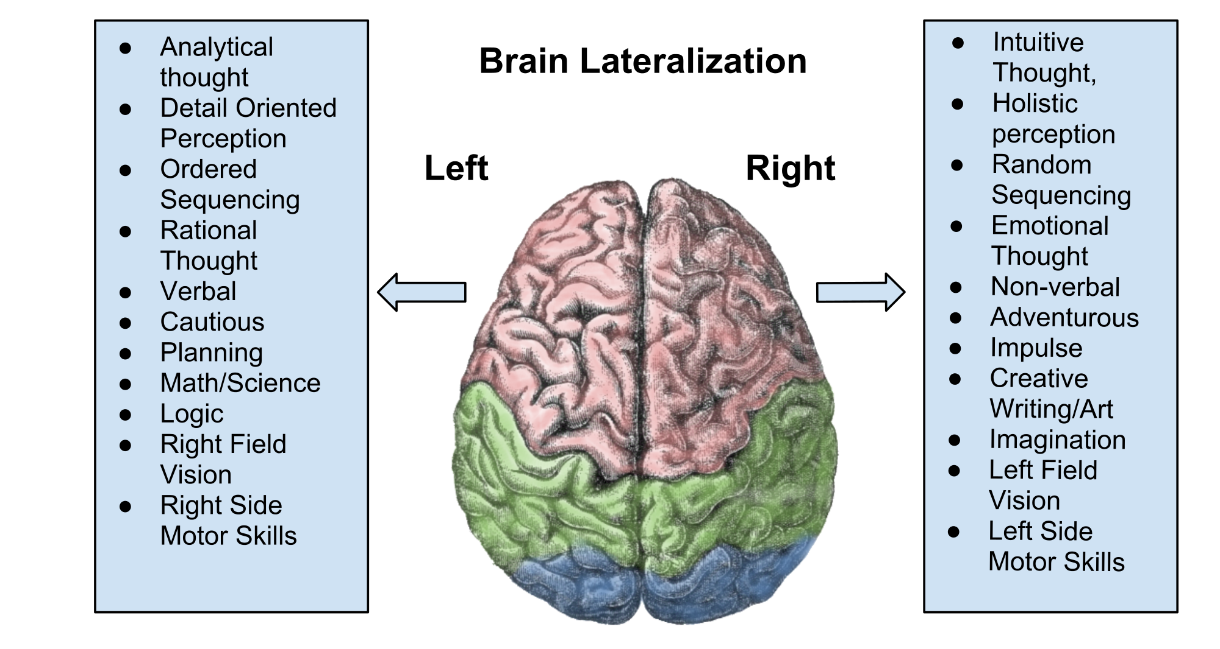
Notes:
Read left and right switching back and forth

Slide 5
Interpretation
Notes:
Interpretation

Slide 6
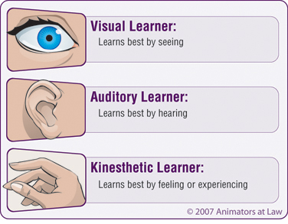
The simple Method
Why I use the simple Method for Sermons and PowerPoints?
The Visual learner - sees
The Auditory Learner – Hears (Aural)
The Kinesthetic LEARNER - FEELS THE STORIES (Physical)
Notes:
How does the combine work?

Slide 7
THE ADVANCED METHOD
NOTICE
WHAT 4 AREAS ARE ADDED TO THE SIMPLE METHOD?
HOW DOES THE ADDITIONS HELP UNDERSTAND LEARNING STYLES?
Notes:
How does Aural & Logic come into play?
How does Social & Solitary come into play?

Slide 8

the basis of learning styles
Your learning styles have more influence than you may realize. Your preferred styles guide the way you learn.
They also change the way you internally represent experiences, the way you recall information, and even the words you choose.
Notes:
The more one uses the better the learning curve

Slide 9
the basis of learning styles
Research shows us that each learning style uses different parts of the brain. By involving more of the brain during learning, we remember more of what we learn. Researchers using brain-imaging technologies have been able to find out the key areas of the brain responsible for each learning style.
Notes:
The more one uses the better the learning curve

Slide 10
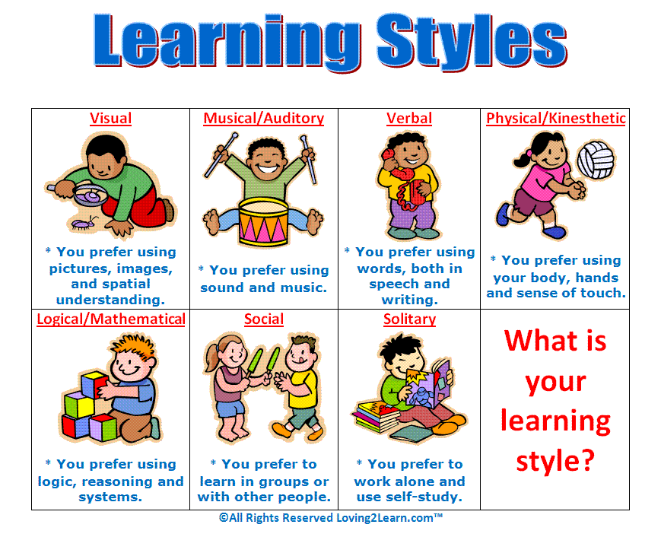
FROM A CHILD’S PRESPECTIVE
Notes:
Have someone read each

Slide 11
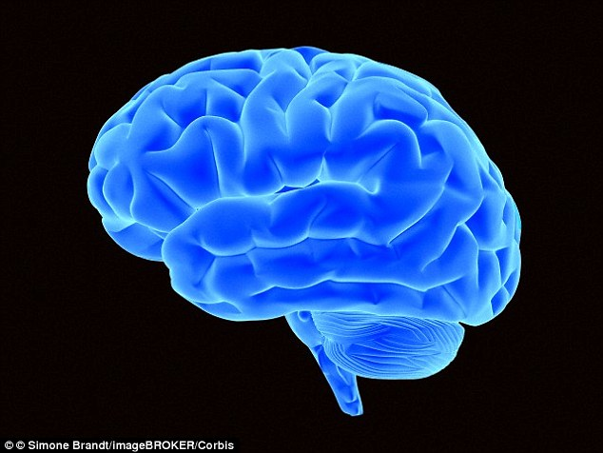
Visual (SPATICAL) Breakdown
The occipital lobes at the back of the brain manage the visual sense. Both the occipital and parietal lobes manage spatial orientation.
a right-brained learner is typically good at deciphering visual data in the form of maps and graphs. While they excel at subjects such as geometry, they struggle with arithmetic and numbers in general.
Notes:
Have someone read the slide

Slide 12
Visual (SPATICAL) Breakdown
Incorrectly labelled as “late bloomers” for their struggles with reading and writing, these learners simply see the world in a different manner.
They are imaginative, think outside of the box and quickly process what they see rather than what they hear.
Notes:
Have someone read the slide

Slide 13
Planning for Visual (SPATICAL) people
Please give examples
1-
2-
3-
4-
5-

Slide 14
Aural (AUDITORY/MUSIC) Breakdown
The temporal lobes handle aural content. The right temporal lobe is especially important for music.
thinks in sounds rather than images. They think chronologically and learn best through step-by-step methods.
Unlike visual learners, they have an impeccable memory for conversations and enjoy debates and discussions. They have strong language skills and perform well on oral exams.
Notes:
Have someone read the slide

Slide 15
Aural (AUDITORY/MUSIC) Breakdown
As the name suggests, they also have musical talents and are able to discern individual notes, rhythms and tones. On the downside, they have difficulty interpreting facial expressions and gestures, as well as complex graphs and charts.
Notes:
Have someone read the slide

Slide 16
Planning for Aural (AUDITORY/MUSIC) people
Please give examples
1-
2-
3-
4-
5-

Slide 17
Verbal (LINGUISTICS) Breakdown
The temporal and frontal lobes, especially two specialized areas called Broca’s and Wernicke’s areas (in the left hemisphere of these two lobes).
verbal learners are adept at processing information through the use of language. They excel at reading, writing, listening and speaking.
Notes:
Have someone read the slide

Slide 18
Verbal (LINGUISTICS) Breakdown
They have an excellent memory for things they have read and enjoy all types of word games, puns, rhymes and tongue twisters.
Many of them also enjoy learning different languages. These learners particularly enjoy their writing, drama and speech classes.
Notes:
Have someone read the slide

Slide 19
Planning for Verbal (LINGUISTICS) people
Please give examples
1-
2-
3-
4-
5-

Slide 20
Physical (KINESTHETIC) Breakdown
The cerebellum and the motor cortex (at the back of the frontal lobe) handle much of our physical movement.
are always moving and doing something with their hands. They learn best when their bodies are involved in the learning process. This can mean anything from creating artwork with their hands to being able to manipulate what is being learned.
Notes:
Have someone read the slide

Slide 21
Physical (KINESTHETIC) Breakdown
These types of learners' benefit from larges spaces that enable to them to draw and write. They can also find walking back and forth while reading conducive to their learning.
It comes to no surprise that physical learners are many times athletically gifted and tend to live in the present moment rather than in the future or the past.
Notes:
Have someone read the slide

Slide 22
Planning for Physical (KINESTHETIC) people
Please give examples
1-
2-
3-
4-
5-

Slide 23
Logical (MATHEMATICAL) Breakdown
The parietal lobes, especially the left side, drive our logical thinking.
This type of learner is skilled at mathematical and logical reasoning. They are able to solve problems involving numbers and can easily decipher abstract visual information.
Notes:
Have someone read the slide

Slide 24
Logical (MATHEMATICAL) Breakdown
They are also adept at analyzing cause and effect relationships and tend to think linearly. They like to classify and group information, as well as create ordered lists, agendas and itineraries. They are able to perform relatively complex calculations in their heads and enjoy strategy games such as chess and backgammon.
Notes:
Have someone read the slide

Slide 25
Planning for Logical (MATHEMATICAL) people
Please give examples
1-
2-
3-
4-
5-

Slide 26
Social (INTERPERSONAL) Breakdown
The frontal and temporal lobes handle much of our social activities. The limbic system (not shown apart from the hippocampus) also influences both the social and solitary styles. The limbic system has a lot to do with emotions, moods and aggression.
Notes:
Have someone read the slide

Slide 27
Social (INTERPERSONAL) Breakdown
Social learners are gifted at reading others’ emotions and facial expressions, as well as relationship dynamics.
They are also very good at identifying the root cause of communication problems.
Notes:
Have someone read the slide

Slide 28
Planning for Social (INTERPERSONAL) people
Please give examples
1-
2-
3-
4-
5-

Slide 29
Solitary (INTRAPERSONAL) Breakdown
The frontal and parietal lobes, and the limbic system, are also active with this style.
likes to use self-study and work alone. Usually, solitary learners are in tune with their feelings, who they are and what they are capable of doing.
Notes:
Have someone read the slide

Slide 30
Solitary (INTRAPERSONAL) Breakdown
These types of learners are very independent, so they guide themselves on their journey to learning something new each day. They are particularly gifted in the areas of self-management and self-reflection.
Notes:
Have someone read the slide

Slide 31
Planning for Solitary (INTRAPERSONAL) people
Please give examples
1-
2-
3-
4-
5-

Slide 32
Format - 90 minutes
Fall in (Verbal – visual – Aural)
Games (Social - Physical)
Honor / Class work (Logic +)
Worship – one verse (Solitary)
Fall out – prayer (All)

Slide 33
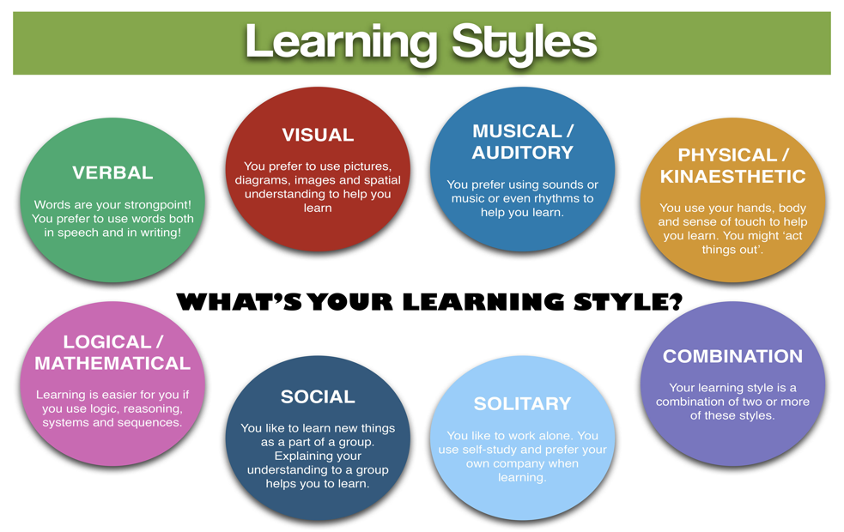
Recap

Slide 34

Notes:
Pass out handouts

Slide 35
How to teach
different Styles of
Learning (Input)
& Thinking (Storage)
Holy Spirit & Culture Where do they fit in?
How to UNDERSTAND

Slide 36
Notes:
Read left and right switching back and forth

Slide 37
Storage

Slide 38
Concrete
(Left brain)
You’re dealing with the here and now and processing information based on what you see, hear, think, feel, and taste. “It is what it is.” You want a real example.

Slide 39
Abstract
(Right Brain)
looking for the patterns. You’re more cerebral in your analysis. You’re using your intuition and imagination. “Things aren’t always what they appear to be.” You abstract from the examples.

Slide 40
Random
(Right Brain)
You’re processing chunks of information in a random way. You can hop around with ease.

Slide 41
Sequential
(Left Brain)
You processing chunks of information in a linear way. You prefer a plan or set of steps to follow.

Slide 42
Storage

Slide 44
Concrete-Sequential (Left – Left)
Practical and well organized. They like to plan their work
and work their plan.
Thinking processes are logical, instinctive and deliberate.
Strive for perfection and have an eye for detail.
Focus on material reality and physical objects.
Creativity lies not with originality but with making it more effective than the original.
Prefer an environment that is ordered, practical, quiet, and stable.

Slide 45
Concrete Sequential (CS)
You want your information presented sequentially with concrete facts and data.
concrete sequential learners learn well when one example or concept follows another in a linear way. Hopping around is a problem and can create frustration and confusion.

Slide 46
Planning for CS people
Please give examples
1-
2-
3-
4-
5-

Slide 47
Concrete-Random (Left – Right)
Practical and live in the physical world, but they like to learn by trial and error. Rather than a plan, they want options.
Thinking processes are instinctive, intuitive, and impulsive.
Events affected by outside variables.
Focus on practical applications, methods, and processes.
Creativity is original, inventive, and unique.
Prefer an environment that is stimulus rich and competitive.

Slide 48
Concrete Random (CR)
You don’t care what sequence the information comes your way, as long as it’s concrete and you can relate to it.
concrete random learners can skip around pretty quickly, but they need examples to latch on to. They’re pretty effective at cutting through fog and finding where the rubber meets the road.

Slide 49
Planning for CR people
Please give examples
1-
2-
3-
4-
5-

Slide 50
Abstract-Sequential (Right-Left)
Like to develop ideas in a logical way. How someone feels about something does not change reality.
Thinking processes are intellectual, analytical, correlative, fluid, and quick.
Loves books.
Focus attention on knowledge, concepts, and ideas.
Creativity lies within models, theories, and synthesizing.
Prefer an environment that is ordered, quiet, independent,
and mentally stimulating.

Slide 51
Abstract Sequential (AS)
Abstractions are great as long as they follow a sequential flow. abstract sequential learners like taking notes, outlining, doing research, and writing reports. Working patiently and methodically. Being prepared for class. Debating and using logical deductions and rational arguments. Maintaining high standards, which may lead them to being critical of their work.

Slide 52
Planning for AS people
Please give examples
1-
2-
3-
4-
5-

Slide 53
Abstract-Random (Right-Right)
Work from the heart, not the head. How someone feels about it makes a great deal of difference.
Thinking processes are based in feelings, which makes this type of person good at establishing a rapport with people.
Make sense of the world using feelings and emotions.
Focus on emotional attachments, relationships, and memories.
Creativity is imaginative and often expressed through music and art.
Prefer an environment of emotional experiences, active and colorful, and physical freedom.

Slide 54
Abstract Random (AR)
Abstractions are great and it doesn’t matter what sequence. abstract random learners have the simplest time learning because the sequence doesn’t matter but can have a hard time sharing what they know. they get bored when information is sequential and detailed.

Slide 55
Planning for AR people
Please give examples
1-
2-
3-
4-
5-

Slide 58
Format - 90 minutes
Fall in (c) (S) (S)
Games (A) (R)
Honor / Class work (c) (A) (R)
Worship – one verse (A) (c) (R)
Fall out – (R) prayer

Slide 59
Test Time

Slide 60
Notes:
Pass out handouts

Slide 62
Psalm 139:14
¹⁴ I praise you because I am fearfully and wonderfully made;
your works are wonderful,
I know that full well.

