Slide 1
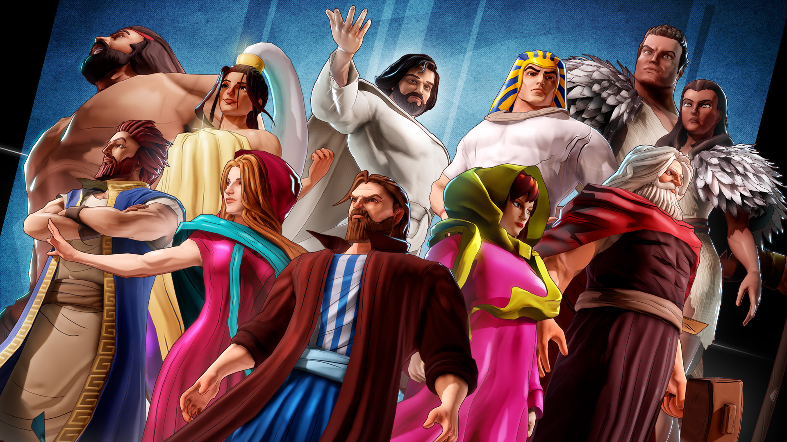
Team of Destiny:
Winning It All
By Frankie JimÉnez, JR.
Chesapeake Conference

Slide 2
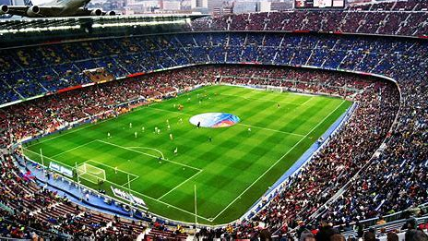
Are you a spectator or a player in the game of life?
Supernatural powers are at work in the game of life.
1. In individuals
2. In groups
Are you prepared to be in the biggest game of all?
God is inviting you to be a player in the Game of Life

Slide 3
Lesson Purpose
Develop a youth group that joins Christ’s team to transform human hearts and the entire world.

Slide 4
Why?
God is active in overcoming evil with good. Young people are made for action, which makes them ideal players to get in the game of life now.

Slide 5
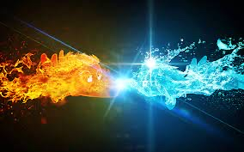
The game: IN THE GAME OF LIFE THERE ARE TWO TEAMS GOOD VS EVIL
GOOD I OBSERVER IN THE WORLD
LITTLE ONES PLAYING
PARENTS LOVING THEIR CHILDREN
STRONG FAMILIES
BREAKOUT: 1 MINUTE

Slide 6
The game: IN THE GAME OF LIFE THERE ARE TWO TEAMS GOOD VS EVIL
EVIL I OBSERVER IN THE WORLD
ADICTIONS
SECULAR LIFE STYLES
ENTERTAINMENT
BREAKOUT: 1 MINUTE

Slide 7
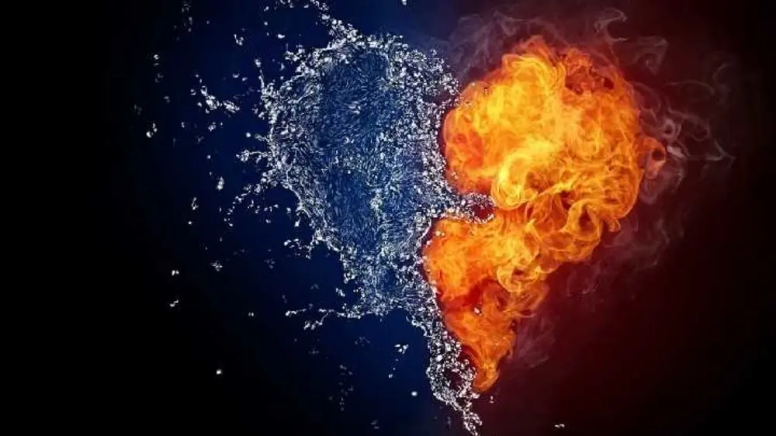
The game: Identify three examples of GOOD VS EVIL in yourself
GOOD I OBSERVER IN THE ME
HELPING HAND
GOOD LISTENER
CLEAR SENSE OF DIRECTION
BREAKOUT: 1 MINUTE

Slide 8
The game: Identify three examples of GOOD VS EVIL in yourself
EVIL I OBSERVER IN THE ME
AT TIMES JUDGEMENTAL
PROCRASTINATION
MISREPRENTING GOD IN WORK PLACE
BREAKOUT: 1 MINUTE

Slide 9
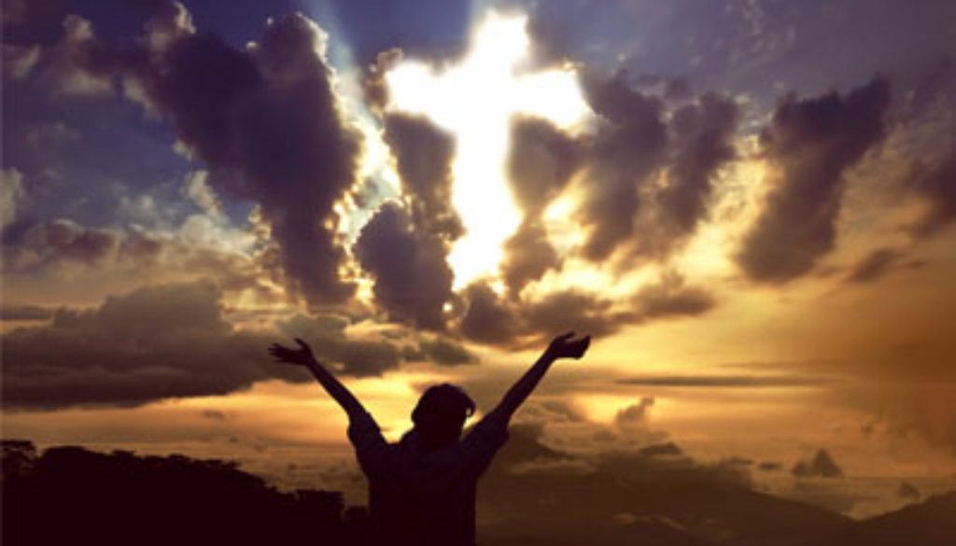
The Life Game:
Who wins? God Wins!
The big win (in the past): The Cross.
When Jesus died on the cross it appeared at first as though evil had won. But it turns out that his death sealed the win universally. Jesus is the champion!

Slide 10
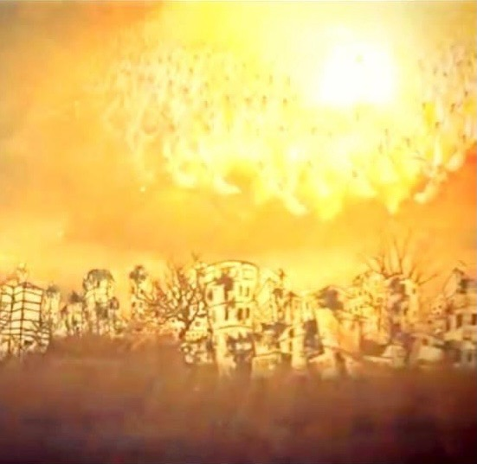
The Life Game: How?
He already Won!!
The big win (in the future): The second coming of Christ.
Jesus already won the game on a universal scale. Satan is now limited to planet earth and he often appears to be winning. But Jesus wins here again and puts an end to Satan and his game. That's when Jesus will make everything new on earth.

Slide 11
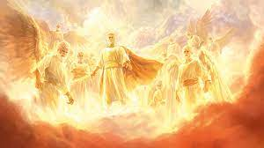
The Life Game:
When?
Many Times!!!
The big win (now): When you are “born again.”
At the time you are born on this planet, your natural selfishness puts you on the team called evil. But when you are born again -when you say “Yes” to Jesus -God places you on his team called good.

Slide 12
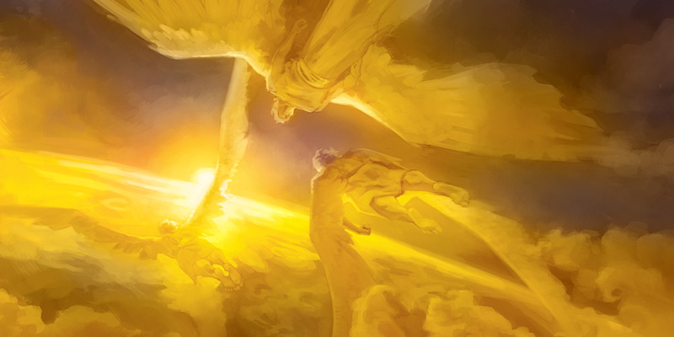
“God wins.” “By choosing to be on Christ team you choose when, where, and why you “die.” And the amazing thing is that the moment you die, God resurrects you to live the rest of your days for Him. You're on God's team now.”
—Building a Great Team, p.99

Slide 13
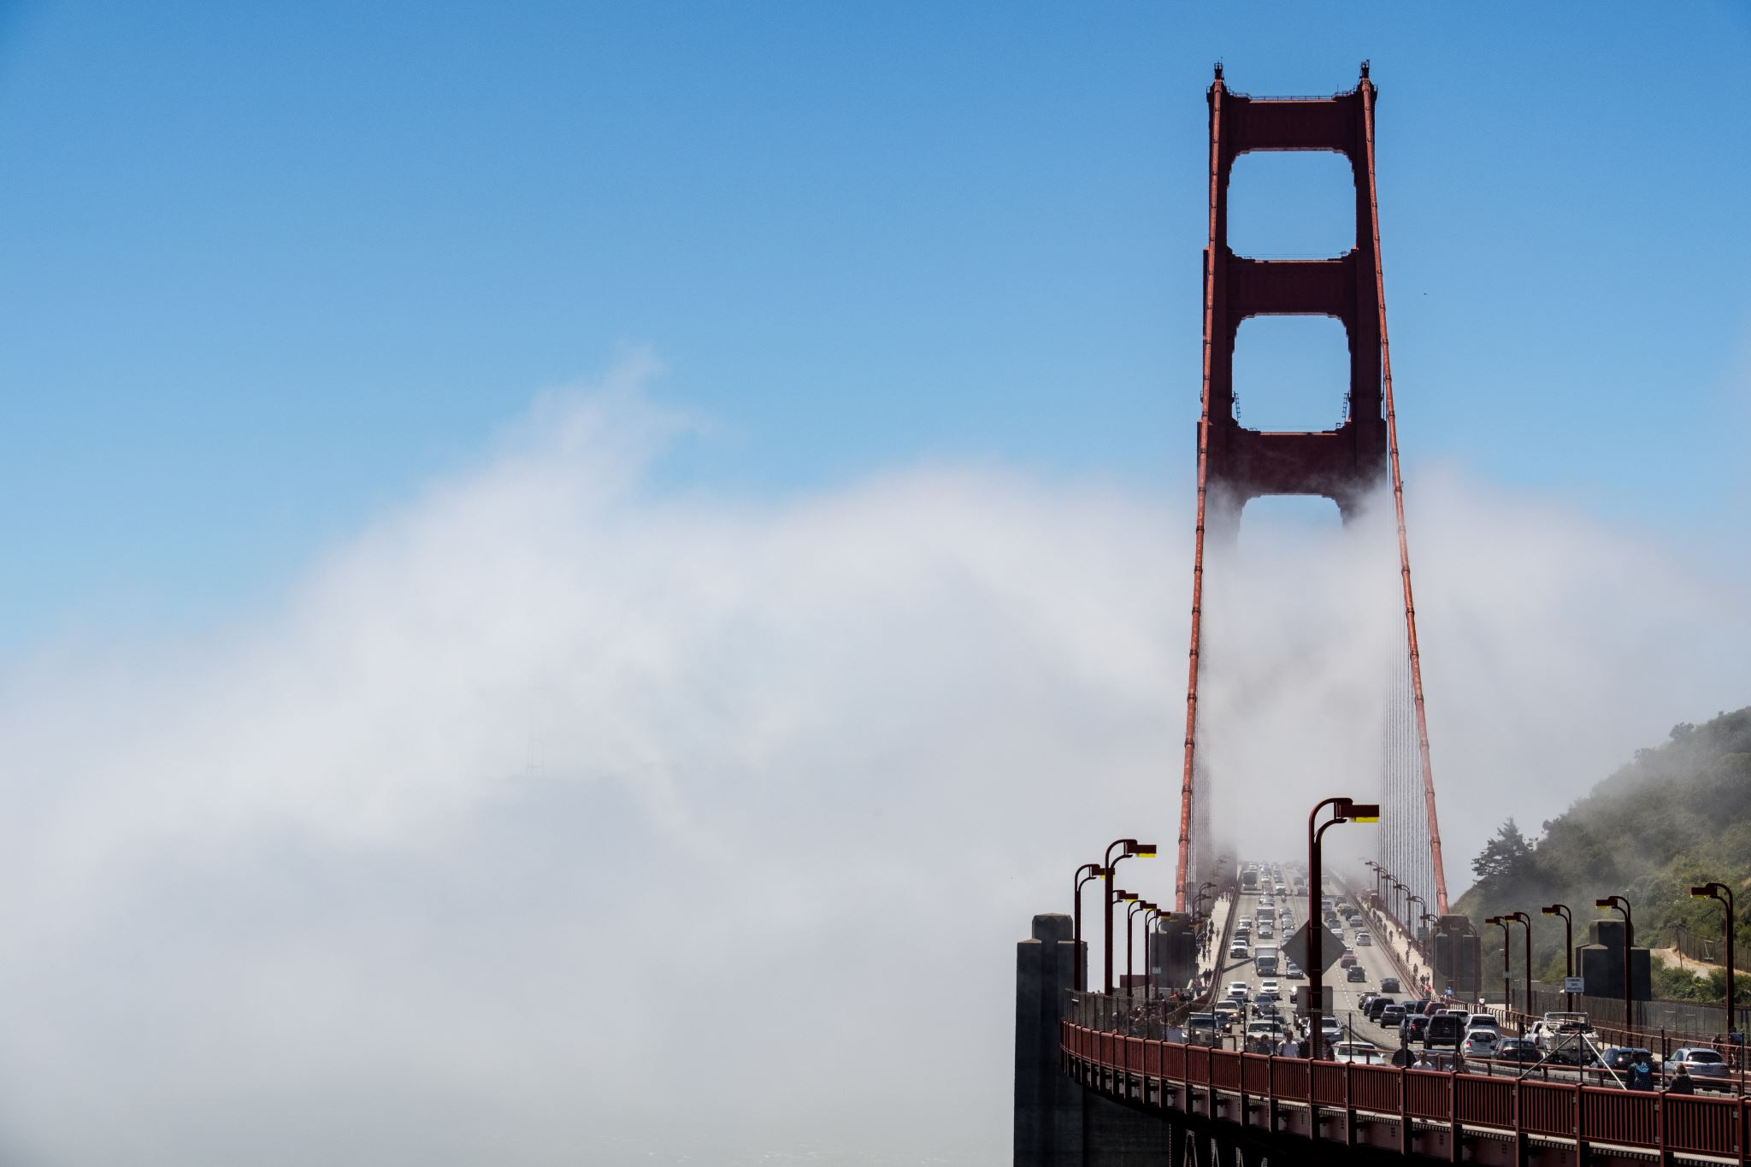
QESTIONS:
WHERE HAVE YOU SEEN GOD IN THE PAST?
WHERE DOES IT SEEM THAT EVIL IS WINNING RIGHT NOW?
WHICH TEAM ARE YOU ON RIGHT NOW?
WHO DO YOU THINK WILL WIN IN THE FUTURE? WHY?
BREAKOUT: 5 MINUTES
Notes:
Get ready to introduce 4 Bible characters

Slide 14
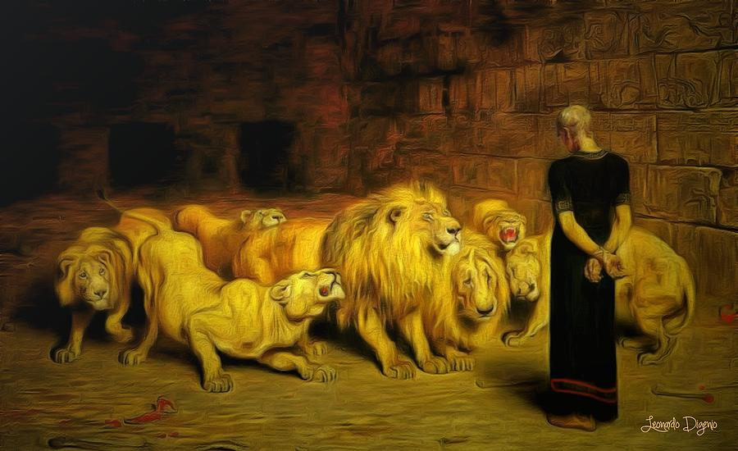
God's only choice? Shadrack, Meshach, and Abed-Nego could have been used like they were on the plane of Dura when Daniel wasn’t around, (Daniel 3). Ellen white was God's third choice for a prophet in the 19th century.
Trusted the faith of his childhood even when living in hostile culture
Made a commitment
Bonded with a small group
First person to try out the Daniel diet (AKA God's diet)
Strove for and achieved excellence
Served the powers at hand
Dependent on divine understanding
Tested
Worshipped only Yahweh
Faithfully prayed
Not captive to the hierarchal model
Daniel

Slide 15
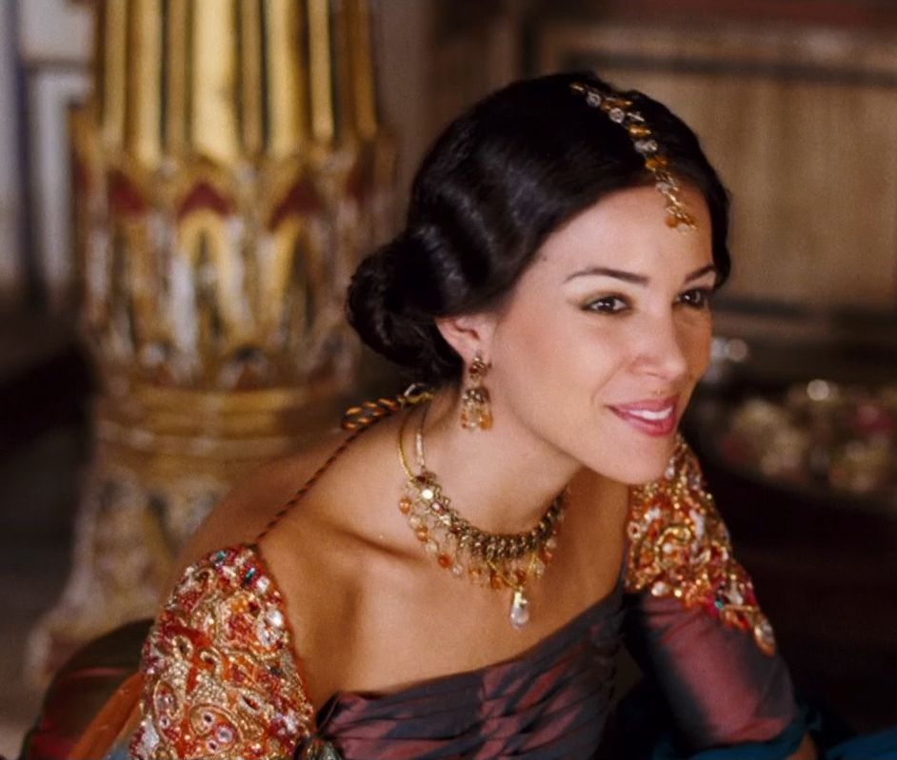
Mordechai told her that if she didn't stand up for God's people, God would provide deliverance from another place and Esther would simply die.
A background of horrible hardship
Assimilated into the dominant culture
Hid her religious background and stopped her religious practices
Experienced success to the highest level of her time
Faced a crisis that challenged her identity
Turned to prayer and invited others to join her
Took a life and death risk
Use the skills she had while relying on God
Celebrated the great reversal of victory after what seemed hopeless
Esther

Slide 16
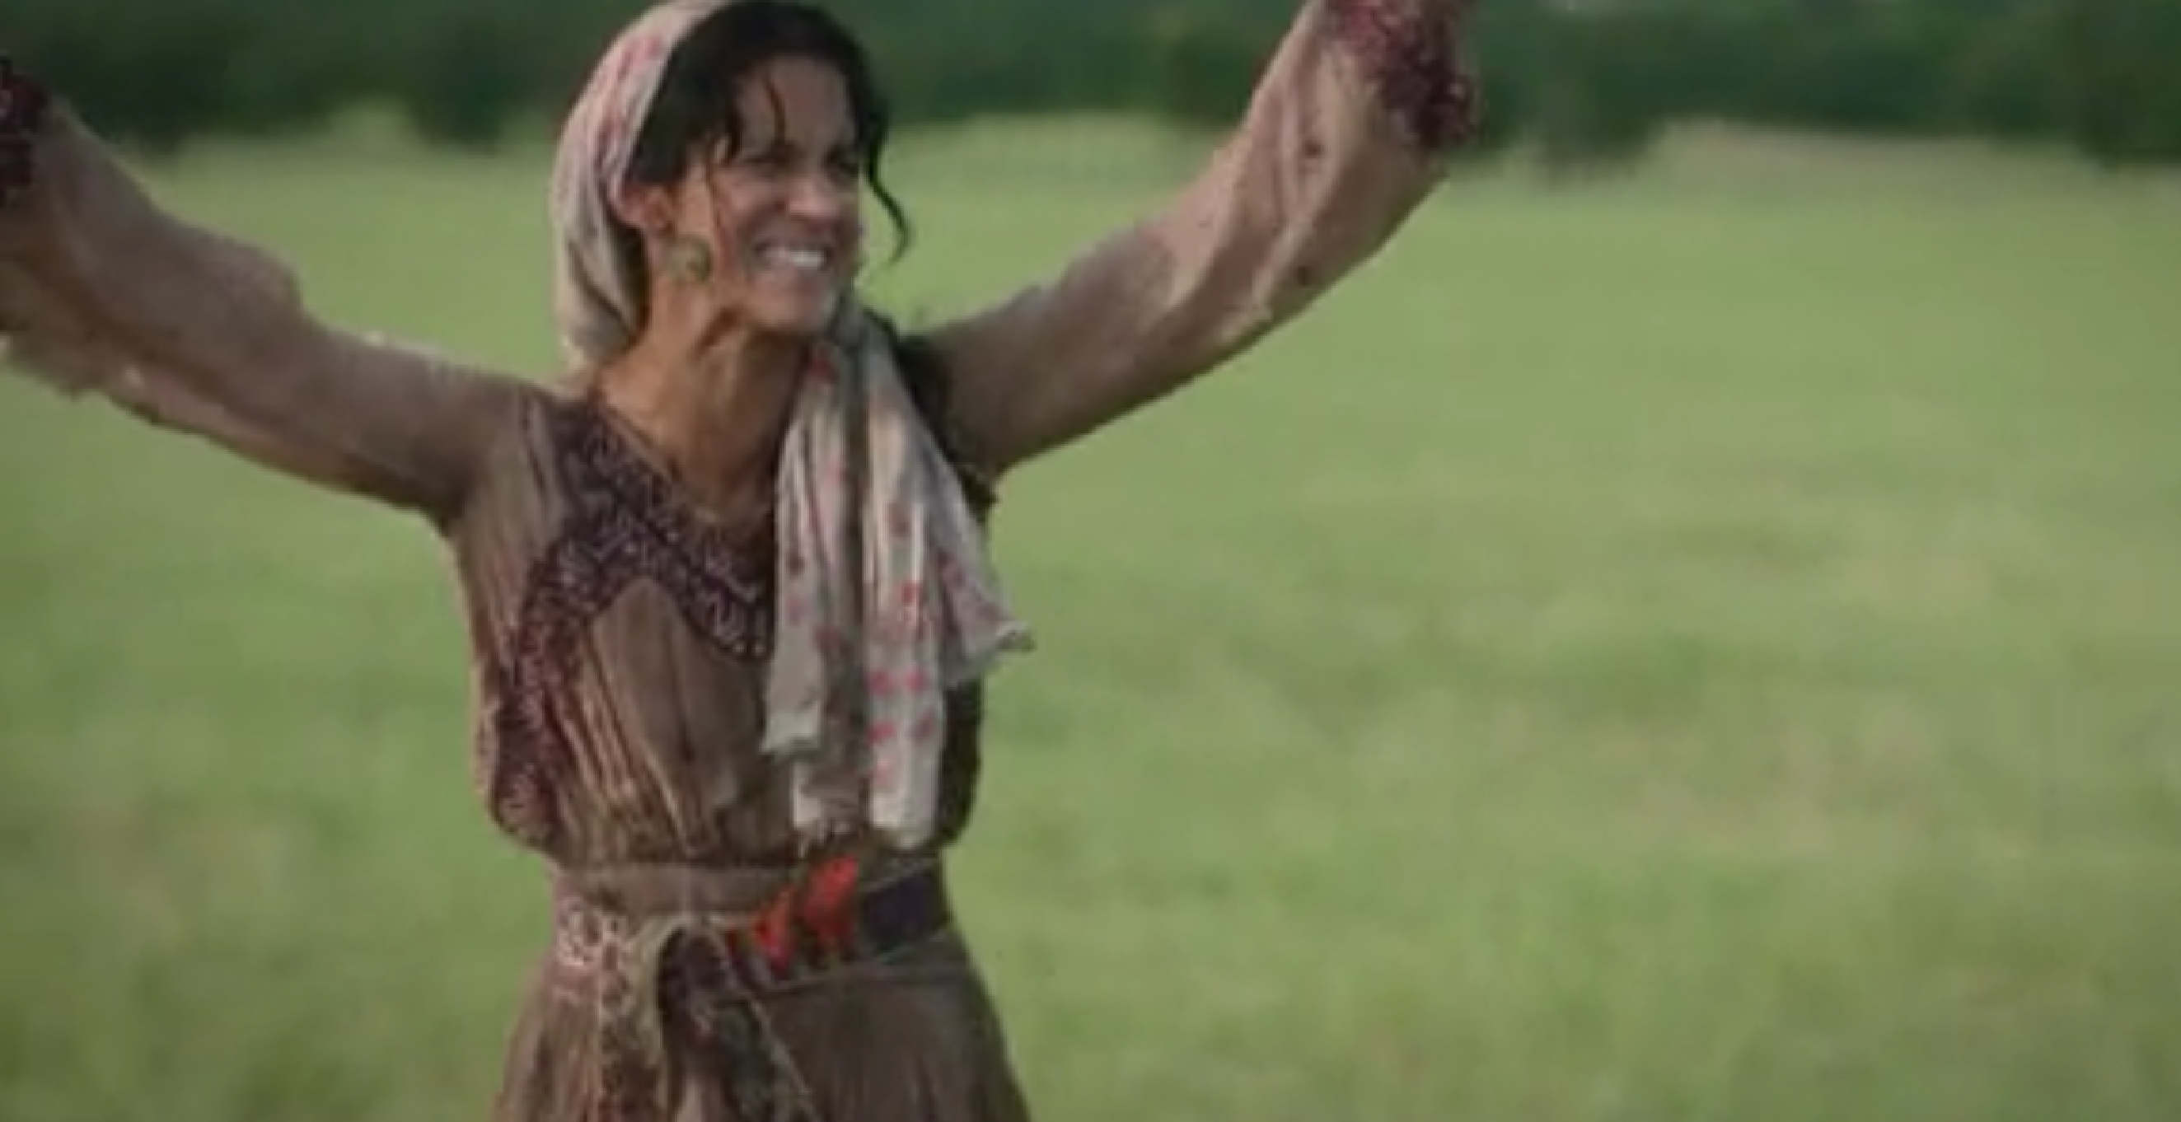
Disciples returned with nobody. The woman came back with the entire town.
Considered a mixed breed ethnically
Bad at relationships
Used by people (sold out easily)
Just getting by at the present time
Engaged in conversation Jesus initiated
Got completely swept away by Jesus
Led her whole town to Jesus
Woman at the Well

Slide 17
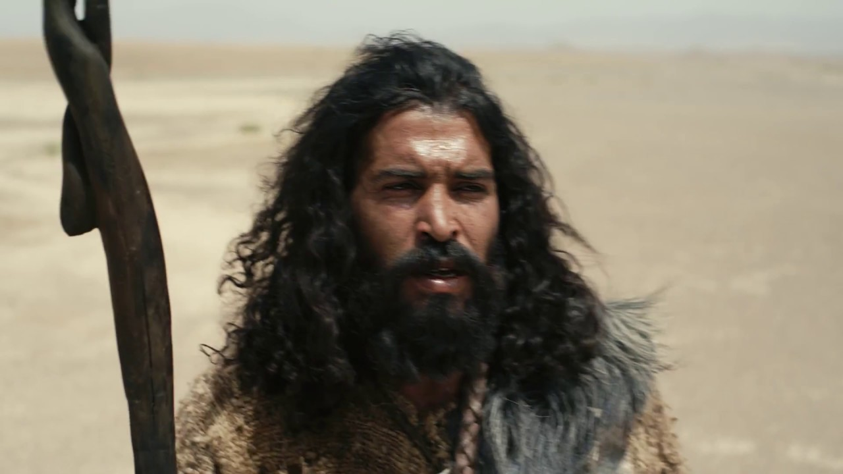
Miraculous birth see, Luke 1. Could also happen to anyone else God chooses.
Grew up as part of God's people (priest’s kid)
Called people to repent sinners and God's people
Called for admission of guilt and a desire for change
Gave practical console for serving others
Practiced a unique lifestyle food and dress and housing
Not the superstar but prepared people for the superstar
From popular two less popular to prison to death
Had serious questions about Jesus
Gave his life as a martyr for the Kingdom of God
John the Baptist

Slide 18
Which of these four Bible players do you identify with the most? Why?
Daniel
Esther
Woman at the Well
John the Baptist
BREAKOUT: 5 MINUTES

Slide 19
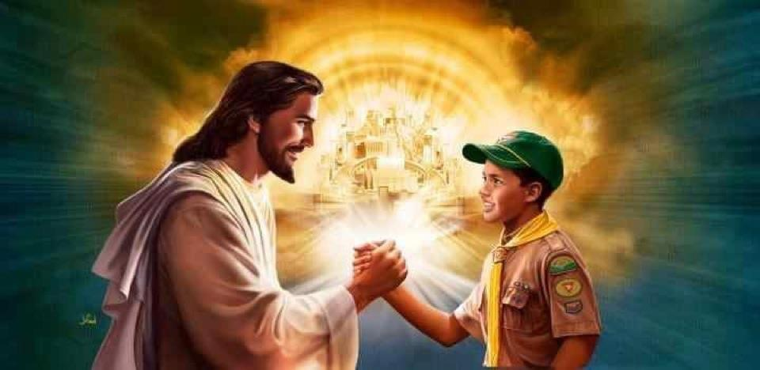
What do you bring to the game?
How does this compare to the Bible player with whom you just identified with?
Write this out individually and share in small groups.
Example: (two answers for each question).
Me: (write write write).
my Bible player: (write write write).
Background
Skills / talents
Liabilities
Ego
Energy
Teamwork
Trust
Inspiration
BREAKOUT: 6 MINUTES

Slide 20
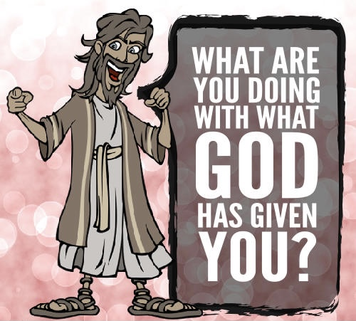
CONCLUSION:
Evaluate your current situation
Gather your different choices
List your time & financial investments
Plan for the future
What are you doing, or what will you do, with what you have been given?

Slide 21
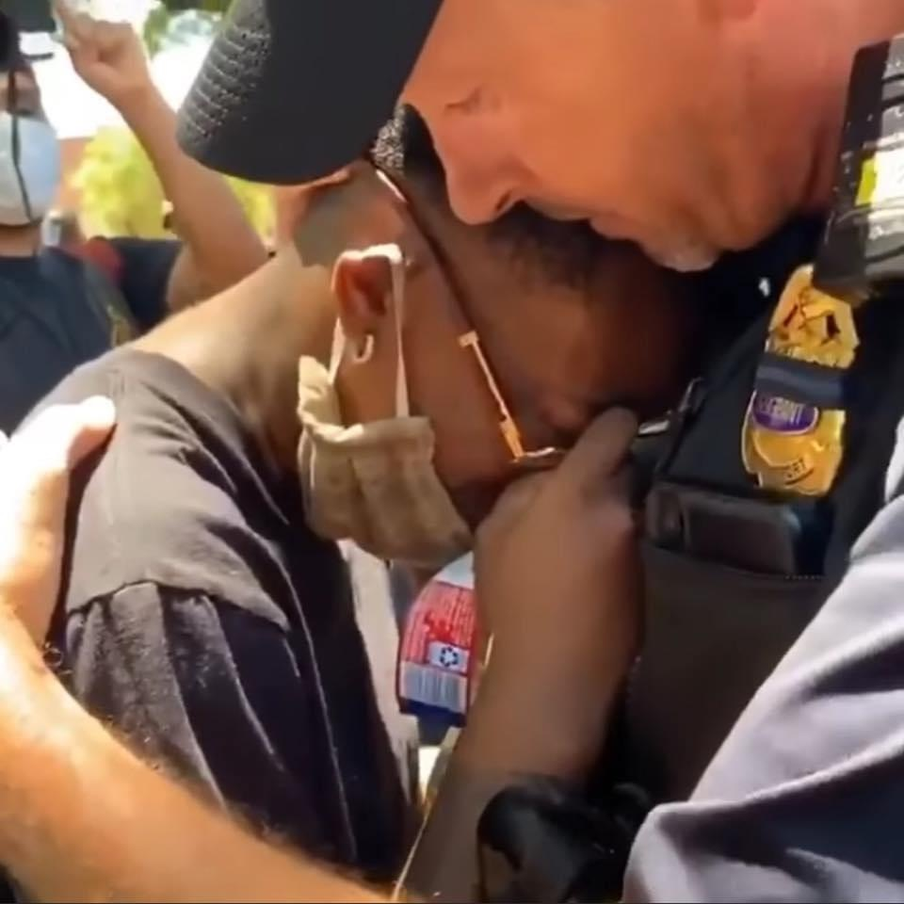
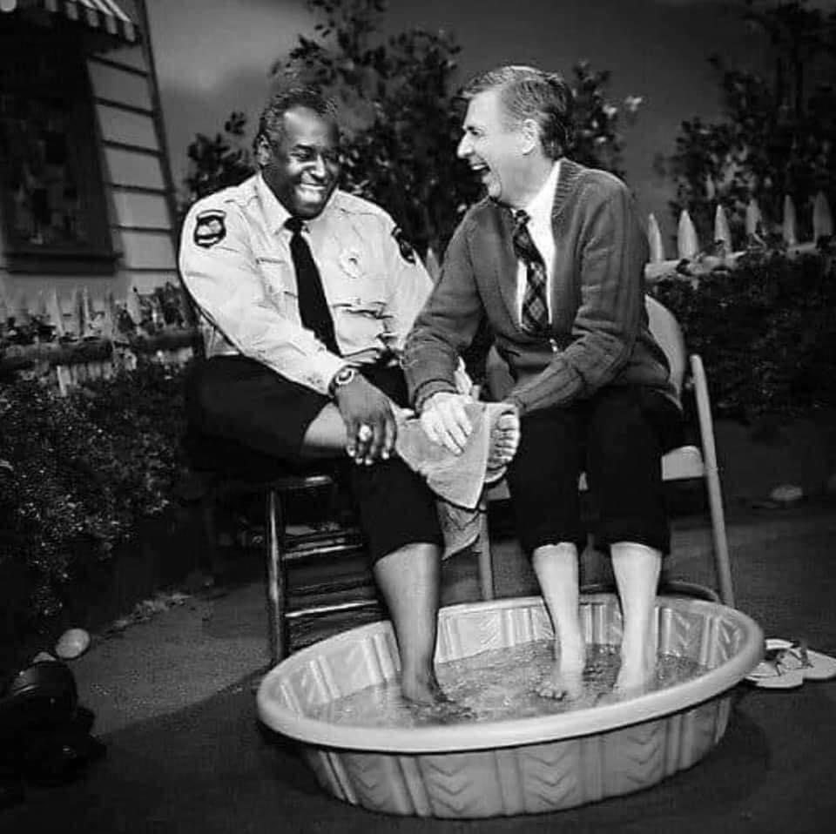
CONCLUSION:
Discerning and responding to the Times Now:
what is the game about right now?
what is your culture saying?
who are the players?

Slide 22
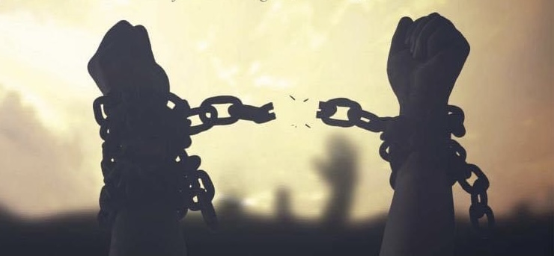
Icebreaker story from, The Desire of Ages, p.339.3-340.1 How to make it your own?
Because, we all need a GREAT SENSE OF DIRECTION
You share the Good News by starting with your personal testimony of How God has delivered you.
Not even Satan himself can take that away from you!
Icebreaker story from, The Desire of Ages, p.339.3-340.1 How to make it your own?
Because, we all need a GREAT SENSE OF DIRECTION
You share the Good News by starting with your personal testimony of How God has delivered you.
Not even Satan himself can take that away from you!

Slide 23
CALLING
I want to challenge you now!
Stand!
Be like Daniel, and turn to prayer to get God's perspective!
Be like Esther, and take your stand no matter what happens from this point on.
Be like the Woman at the well, listen to Jesus and draw others to him.
Be like John the Baptist, and call those in church, and out of church to repent!
Be like Jesus, and do all these things with LOVE, MEEKNESS, and RESPECT

