Slide 1
Recruiting your A-team
Carl Rodriguez
Chesapeake Conference

Slide 2
Recruiting your A-team
1- The leader comprehends
his or her vision and mission
2- Finding Position Players
(GPS)
3- Trust breed's trust
4- Know how to have fun
5- Be organized

Slide 3
Expectations
1- People wanting to join
your team expect you to
know your Vision and
Mission.
2- Vision allows me to say
yes
3- Mission allows me to say no

Slide 4
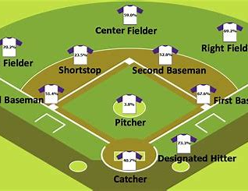
Finding Position Players
If you need a catcher, why ask a shortstop to play catcher?

Slide 5
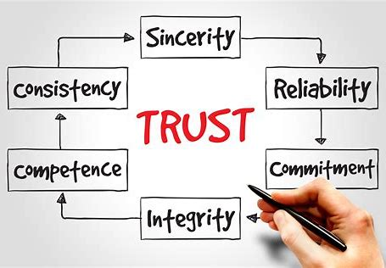
Trust breeds Trust
“Consecrated ignorance and dedicated incompetence”
Dr. Ronald Peters

Slide 6
Know how
to have fun
Share some ideas of
Kosher Fun

Slide 7
Ideas for showing you are Organized
1- Vetting Process
2- Requirements for
Position
3- Calendar of Events

Slide 8
Time to wrap it up!
1- Leader comprehends
his or her vision and mission
2- Finding Position Players (GPS)
3- Trust breed's trust
4- Know how to have fun
5- Be organized

