Slide 1
Obtaining Financial Freedom
Do you know how to get there?
BY Pastor Feliciano
Chesapeake Conference

Slide 2
No one can serve two masters. Either he will hate the one and love the other, or he will be devoted to the one and despise the other. You cannot serve both God and Money.
Matthew 6:24

Slide 3
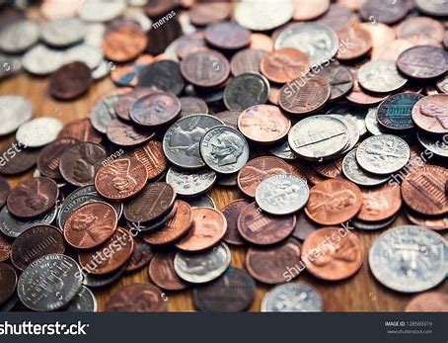
Dishonest money dwindles away, but he who gathers money little by little makes it grow.
Proverbs 13:11

Slide 4
Better one handful with tranquility than two handfuls with toil and chasing after the wind.
Ecclesiastes 4:6

Slide 5
What mistakes have you
made with money?

Slide 6
What do you dream about?
What are you willing to sacrifice for?

Slide 7
Budgeting is setting a plan for your money

Slide 8
Without a Budget you will always wonder where your money went!

Slide 9
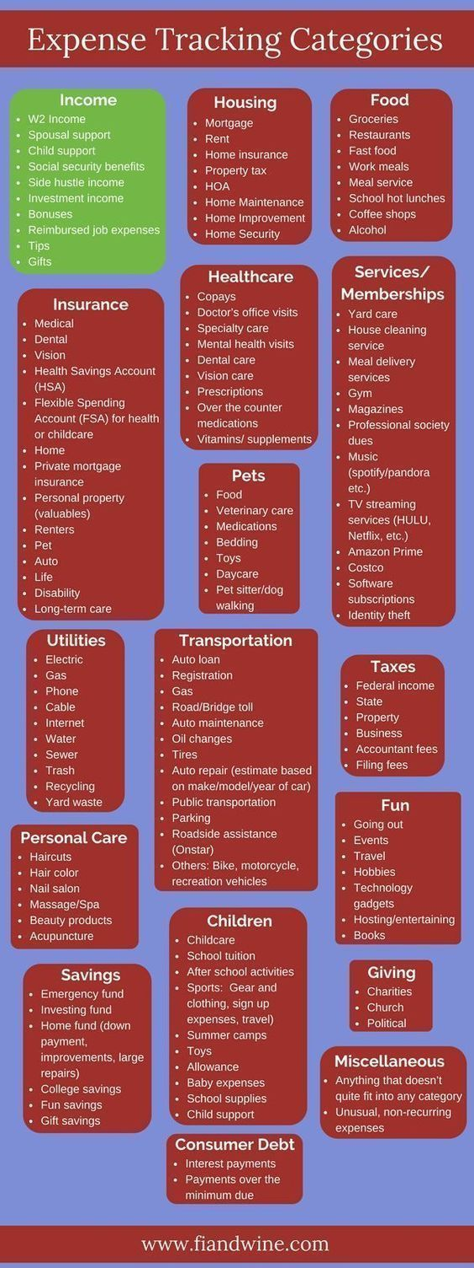
Expense Categories
Checking Account
Rent Electricity/Gas
Water Trash Cable/Internet
Cell/Phone Insurance Tithe/Offering
Child Care Prescription/Doctor

Slide 10
Debt Categories
Mortgage Payment Car Payment Credit Card(s)
Student Loans Finance Company Credit Line

Slide 11
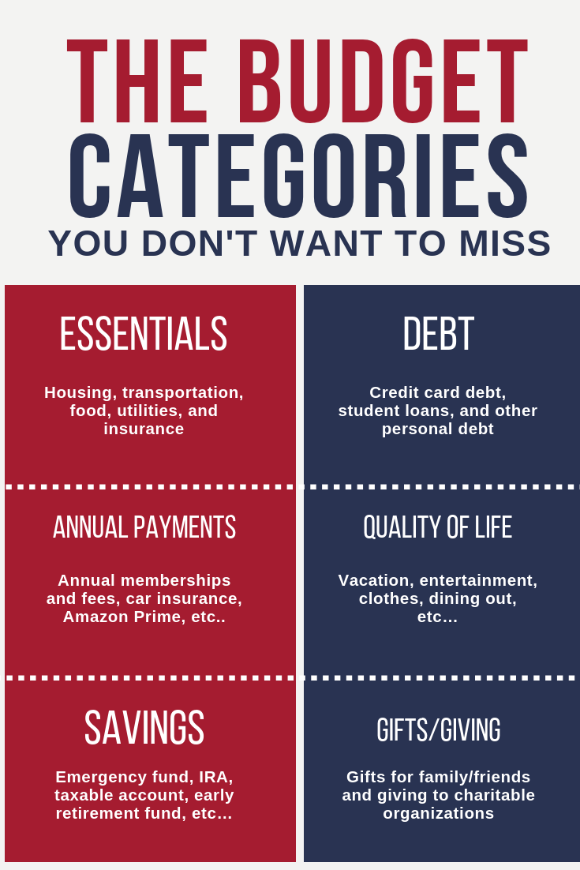
Budget Categories
Food Eating Out Gasoline
Personal Care Household Needs Allowance
Hair Cuts Public Transportation
Clothing Vacation Gifts
Pets Savings School Supplies
Incidentals Entertainment Car Repairs

Slide 12
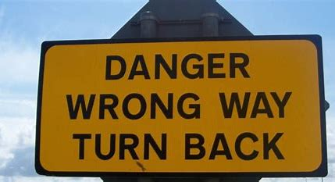
Money Mistakes Most Make
There are areas that you naturally overspend. People don’t budget those items ahead of time. They purchase with credit and ATM cards and don’t track their spending. They are not trained or disciplined in spending money.

Slide 13
Envelope Budget System
With the envelope system you use cash for different categories of your budget. Take money out in cash at the beginning of the month and you keep that cash tucked away in envelopes. You can see exactly how much money you have left in a budget category just by taking a quick peek in your envelope. (use for budget category) This trains your money to obey and you get more done.

Slide 14
Budget Categories
Food Eating Out Gasoline
Personal Care Household Needs Allowance
Hair Cuts Public Transportation
Clothing Vacation Gifts Car Repairs
Pets Savings School Supplies
Incidentals Entertainment

Slide 15
Benefits to Envelope System
Control over your money
No over spending
You know where your money went
Always money for what is important

Slide 16
Personal Experience Using Budget

Slide 17
Homework Time

Slide 19
Obtaining Financial Freedom (part 2)
Do you know how to get there?

Slide 20
Let no debt remain outstanding, except the continuing debt to love one another, for he who loves his fellowman has fulfilled the law.
Romans 13:8

Slide 21
Get Control of our Income
Powerful Wealth-Building Tool
Payments limit wealth growth
Eliminating debt increase income

Slide 22
Average Family
Income of $40,000 per year
$850 House payment, $530 Car payments
$165 Student loan, $185 Credit cards, $120 Other
$1,850 Invested, makes a million in 15 years
The Key is to pay off the DEBT

Slide 23
The Debt Snowball
Put debts in order from smallest to largest
Pay minimum payments to all except the smallest one
Pay as much as you can to the smallest
Then continue with the next debt in line

Slide 24
Important to Debt-Snowball Success
Use Envelope System Budget
Getting current before starting Debt-Snowball
Smallest-to-largest payoff (no cheating)
Sacrifice (bigger sacrifice = bigger reward)
Focused Intensity (gazelle intense)
Stop borrowing

Slide 25
Example Cases

Slide 26
Family Example #1
Combined Income - 3,500
Budget - 850
Expenses - 1,750
Extra - 475
Debts - payment/balance
Car payment - 200/8000
Student loan - 225/20,000
Master Card - 125/8,000
Discover - 75/5000

Slide 27
Family Example #2
Debts - payment/balance
Car payment #1 - 500/15000
Car payment #2 - 200/8000
Student loan - 225/20,000
Master Card - 200/10,000
Discover - 75/5000
Combined Income - 7,000
Budget - 950
Expenses - 1,950
Extra - 3,900

Slide 28
Family Example #3
Combined Income - 3,000
Budget - 850
Expenses - 1,650
Lacking - 300
Debts - payment/balance
Car payment - 300/10,000
Student loan - 225/20,000
Master Card - 200/5,000
Discover - 75/3000

Slide 29
Family Example #4
Combined Income - 5,000
Budget - 850
Expenses - 1,750
Extra - 1,300
Debts - payment/balance
Car payment - 500/15,000
Student loan - 225/20,000
Master Card - 200/10,000
Discover - 175/7000

Slide 30
Two Important Secrets to Success
Limit your expenses and budget to ensure maximum impact on debt elimination
Make extra income by more work and selling things for debt elimination

Slide 31
Q & A

Slide 32
Obtaining Financial Freedom (part 3)
Do you know how to get there?

Slide 33
The rich rule over the poor, and the borrower is servant to the lender,
Proverbs 22:7

Slide 34
Debt-Snowball Recap
What did we learn in Part 2?

Slide 35
Baby Steps
Step 1 - Save $1,000 to start Emergency Fund (EF)
Step 2 - Pay off all debts using debt snowball
Step 3 - Save 3-6 months of expenses for EF
Step 4 - Invest 15% of household income into Roth IRA’s and pretax retirement funds 401K
Step 5 - Save for our children’s college fund (529 plan)
Step 6 - Pay off your home early
Step 7 - Build wealth and give

Slide 36
Emergency Funds
Every family needs an emergency fund
Emergency funds are for the benefit of your immediate family
Starting the Baby Steps, amount $1,000, before debts begin to be paid
These funds are for relief purposes for unexpected expenses of emergency/necessities

Slide 37
Beware of Situations
LENDING money in an effort to help others
BORROWING money from others to cover difficulties
Best Practice - If you can afford to gift them (requestor) money, give it and do not lend

Slide 38
Term Life Insurance
Unless you are rich, ever family should have Term
Term Insurance protects your family by replacing your income
You need 10-12 times your annual income (20 year term)
Whole Life insurance is a Rip-off, way more expensive then term insurance

Slide 39
Major Purchases
Purchases should be saved up for over time
Major Purchases should be carefully considered while getting out of debt
Automobiles are a major purchase that should always be planned for
Transportation provides mobility, but nothing more

Slide 40
The BIGGEST LIE is that we need credit to survive!!!

Slide 41
Credit & FICO
Credit and FICO scores are only a measure of being able to borrow money
In order to keep scores up, you need to continue to borrow money
Credit and FICO ends up being a trap
The best way is to live without credit

Slide 42
Q & A

Slide 43
Obtaining Financial Freedom (part 4)
Do you know how to get there?

Slide 44
“The plans of the diligent lead to profit as surely as haste leads to poverty.”
Proverbs 21:5

Slide 45
“The wise store up choice food and olive oil, but fools gulp theirs down.”
Proverbs 21:20

Slide 46
Emergency Fund, Major Purchases, Credit Card Recap
What did we learn yesterday?

Slide 47
Investing for Tomorrow
Be Financially Healthy for Life

Slide 48
Reasons to Invest:
Financially Secure
Able to do what you want
To have choices of what to do

Slide 49
“56% of Americans do not systematically prepare for retirement age by investing.”
– USA Today

Slide 50
“Out of one hundred people age sixty-five, ninety-seven of them can’t write a check for $600, fifty-four are still working, and three are financially secure.”
– USA Today

Slide 51
Step 4: Invest 15% for Later
Ideal is 15% of before tax gross income annually
This does not include company matches
Invest in Growth-Stock Mutual Funds

Slide 52
Investment Steps
Obtain any matching funds that you can from your company
Many companies match the first 3%, maximize the match
Next invest the rest of the 15% into a ROTH Fund
ROTH funds grow from after tax dollars

Slide 53
Difference between 401K and ROTH

Slide 54
Differences 401K vs. ROTH
401K uses pretax dollars (easier)
401K must pay taxes on each withdrawal
ROTH uses post tax dollars (more kept)
ROTH doesn’t pay taxes on any withdrawals

Slide 55
“Only the money you invest will grow. None of the money that you don’t invest will grow.”
– Pastor Josue Feliciano

Slide 56
Example of Investments

Slide 57
Example 1
Age 25
Invests $50 per month
40 year span of time
Total = $588,289

Slide 58
Example 2
Age 25
Invests $150 per month
40 year span of time
Total = $1,764,715

Slide 59
Example 3
Age 40
Invests $50 per month
25 year span of time
Total = $93, 942

Slide 60
Example 4
Age 40
Invests $150 per month
25 year span of time
Total = $281,827

Slide 61
Example 5
Age 25
Invests 15% per month
40 year span of time
Making $35,000 and increasing $10,000 every ten years
Total = $5,726,652

Slide 62
Educate Children about Money
No allowance, work for money, instant-reward
All should learn to (give, save, spend)
Investing should start after college (15%)
Share what you are doing with money, goals being attained (mentorship)

Slide 63
Money for Children’s College
To stop the generational debt, help with college
Educational 529 plan is an investment account like a retirement fund but for college
Use local state schools to get the most education for the money
Encourage student to work while in college

Slide 64
Q & A

