Slide 1
TEAM PURPOSE:
What Winning Looks Like
By Jim Wood
Chesapeake Conference

Slide 3
The BIG Flick
Book 1: A Place to Belong
Book 2: Building a Great Team
Book 3: Positive Transformations
Book 4: Making Good Choices
Book 5: Growing Great Relationships

Slide 4
The BIG Flick (continued) Building A Great Team
Review: Book One, A Place to Belong
Chapter 1 – First Team Member: Why Be a Leader ?
Chapter 2 – Team Purpose: What Winning Looks Like
Chapter 3 – Pastor and Board as Teammates: Nuts and Bolts of Youth Group
Chapter 4 – The Champions: Selecting Team Members
Chapter 5 – Conference Office as Teammates: Responsibilities and Reports
Chapter 6 – Team of Destiny: Winning it All

Slide 5
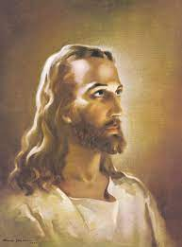
TEAM PURPOSE: What Winning Looks Like
FORWARD-LOOKING: VISION People need to know where the group is going. You must have a clear vision for the future of the group and be able to articulate it.
OVERALL GOAL “Christlikeness”
PHILOSOPHY “Fostering Relationships that Build Responsible Servant Leaders”

Slide 6
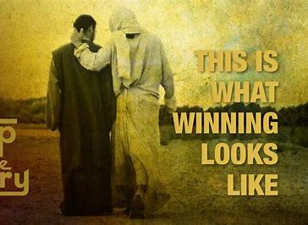
TEAM PURPOSE: What Winning Looks Like
How to make promises together with your youth group.
Helping the entire group develop inspiring activities.

Slide 7
TEAM PURPOSE: What Winning Looks Like
LESSON PURPOSE: To help your youth group develop a meaningful list of service activities that are right for them.

Slide 8
TEAM PURPOSE: What Winning Looks Like
LESSON PURPOSE: To help your youth group develop a meaningful list of service activities that are right for them.
WHY ? If you don’t, the spiritual vitality of the youth group will die. If your youth group only remains in a warm, caring, and safe place and neglects to serve others in need, the friendships in youth group will eventually turn selfish.

Slide 9
TEAM PURPOSE: What Winning Looks Like
How do we develop service projects that the youth group is excited about ?
How do we tap into what already motivates them to a winning program for reaching others ?

Slide 10
TEAM PURPOSE: What Winning Looks Like
LOVE LIST

Slide 11
TEAM PURPOSE: What Winning Looks Like
LOVE LIST
NEEDS LIST

Slide 12
TEAM PURPOSE: What Winning Looks Like
Step # 1, Review Your Lists
Step # 2, Seek God for Direction Through Prayer
Step # 3, Discuss Your Options
Step # 4, List Projects

Slide 13
PROMISES
LOVE ONE ANOTHER “A new commandment I give to you, that you love one another.” -- John 13: 34
GREATER THINGS “I tell you the truth, anyone who believes in me will do the same works I have done, and even greater works.” -- John 14: 12 “Yes, ask me for anything in my name and I will do it.” -- John 14: 14

Slide 14
PROMISES
A COMMAND IS A PROMISE “And the King will say, ‘I tell you the truth, when you did it to one of the least of these my brothers and sisters, you were doing it to me!’” -- Matthew 25: 40
GOD IS FAITHFUL “And my God will meet all your needs according to the riches of his glory in Christ Jesus.” -- Philippians 4: 19

