Slide 1
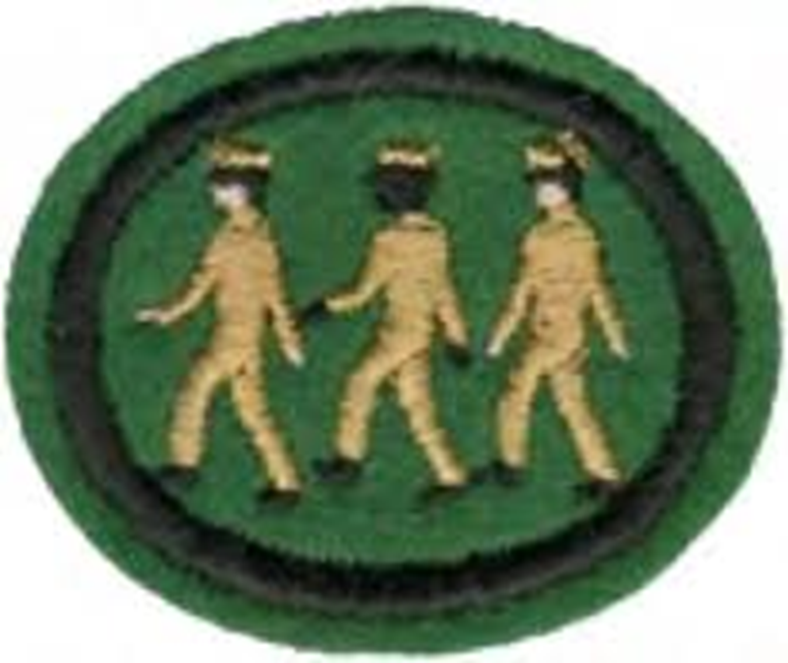
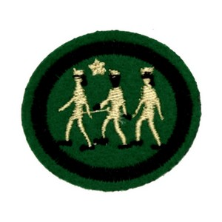
Drill and Marching
Randy Myaing
Chesapeake Conference
Drill Coordinator

Slide 2
Why Drill?
The Importance of Drill. ... Overall, the drill system worked: Pathfinders stayed together and could be commanded as a group. These days, drill is mostly used for ceremonies, such as parades, and to instill pride and discipline during training
(such as basic training).

Slide 4
Attention Position
The most common command given by leaders to gather their elements into formations is the command "Fall IN", at which time the person takes their position in the formation and at the position of attention. From this position, almost any other drill command can be executed.

Slide 5
How many?

Slide 6
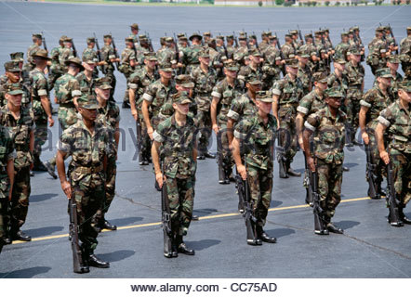
12X4

Slide 7
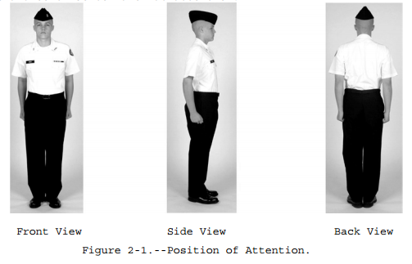
Attention

Slide 8
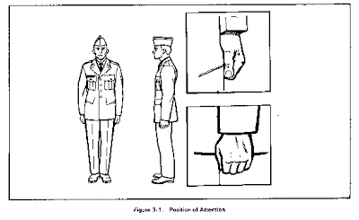
Position of Attention

Slide 9
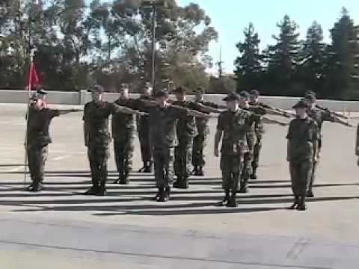
Dress Right, Dress

Slide 10
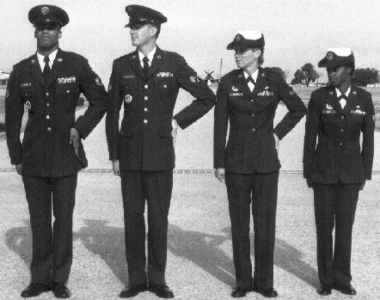
Close Interval Dress Right Dress

Slide 11
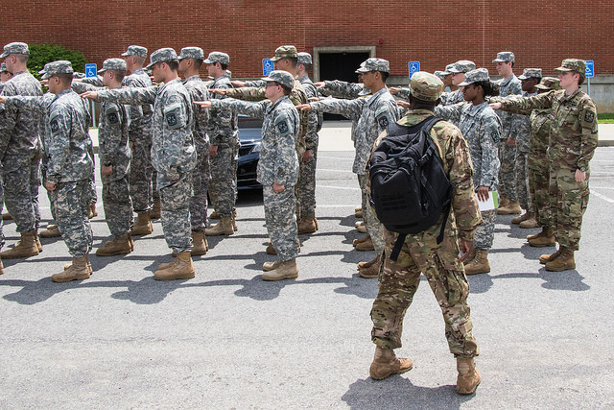
Cover

Slide 12
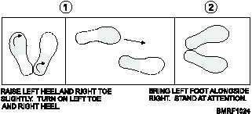
Right Face

Slide 13
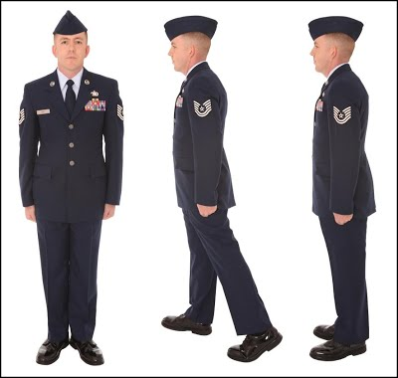
Right Face

Slide 14
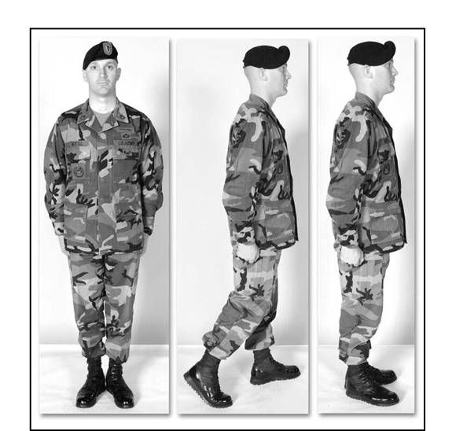
Left Face

Slide 15
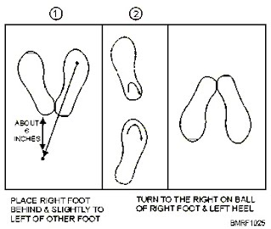
About Face

Slide 16
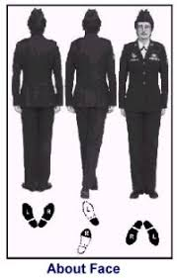
About Face

Slide 17
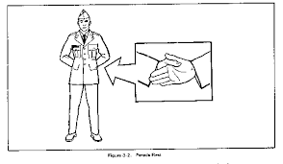
Parade Rest

Slide 18
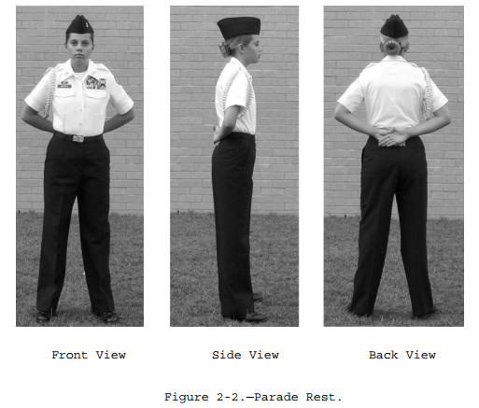
Parade Rest

Slide 19
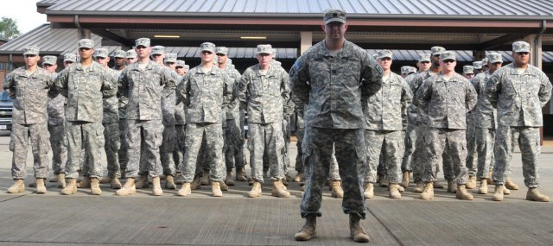
Parade Rest Formation

Slide 20
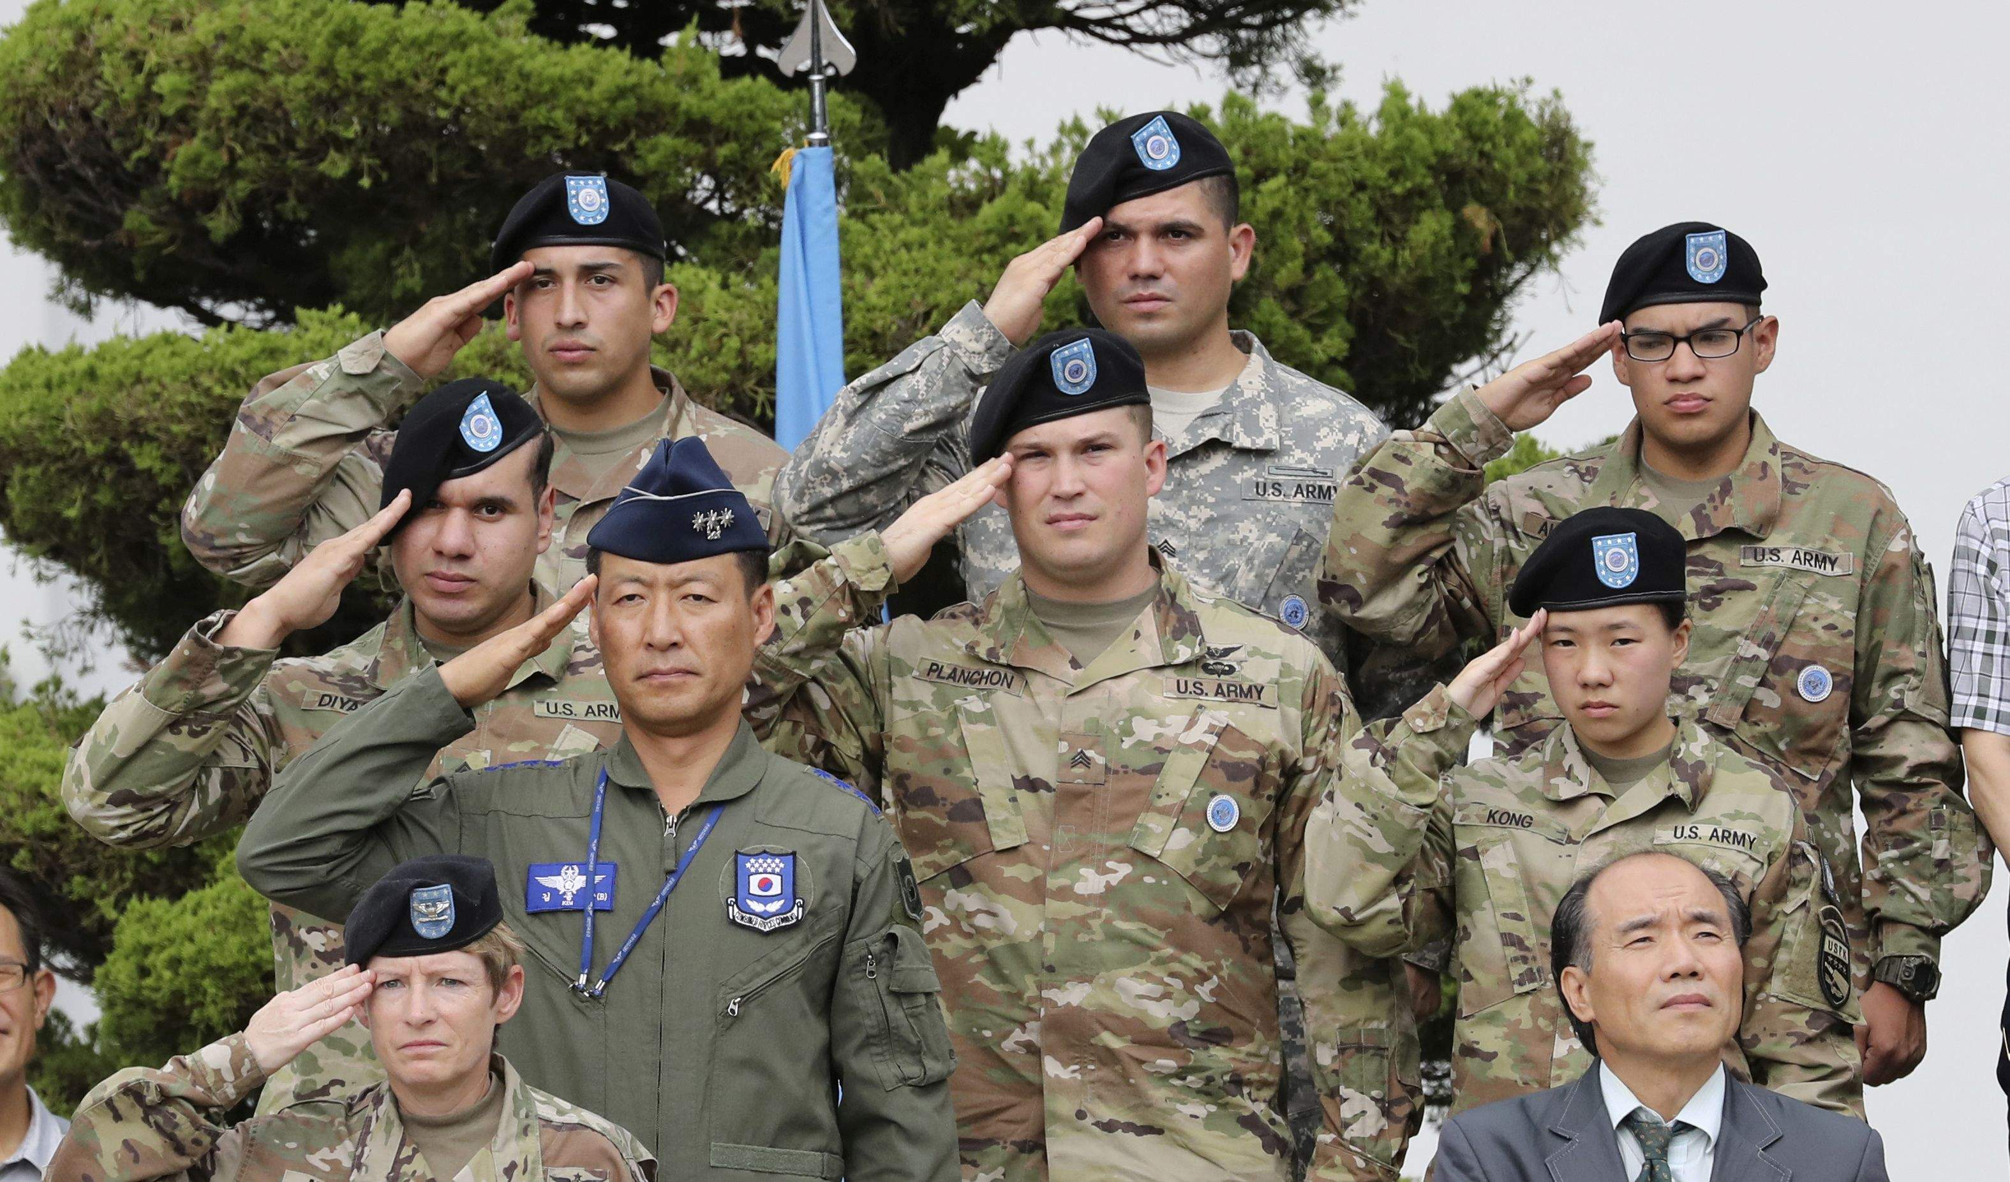
Salute

Slide 21
Salute

Slide 22
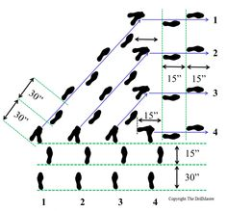
Column Right

Slide 23
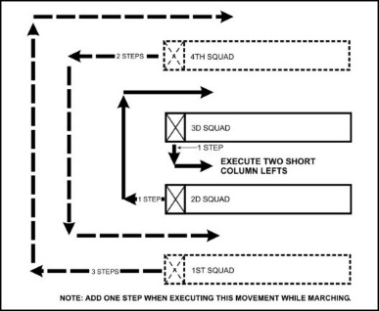
Counter Column

Slide 24
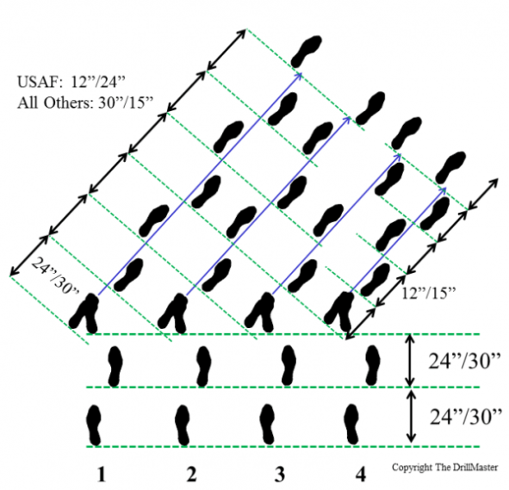
Column Half Right

Slide 25
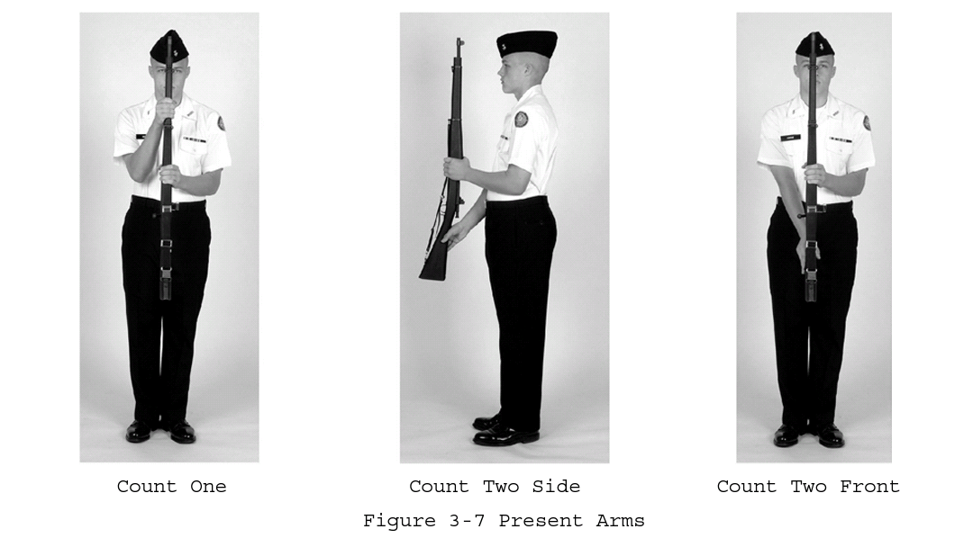
Present Arms

Slide 26
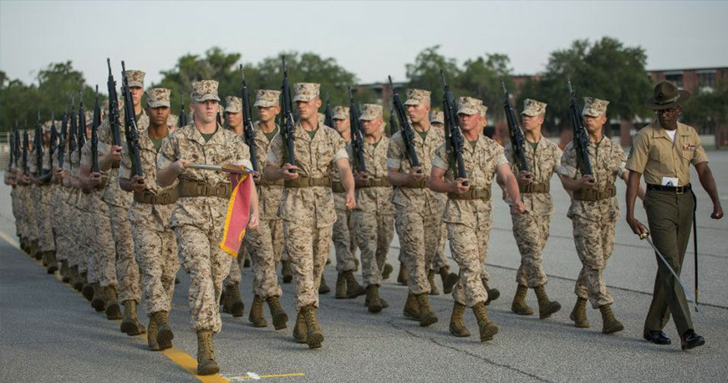
EYES RIGHT

Slide 27
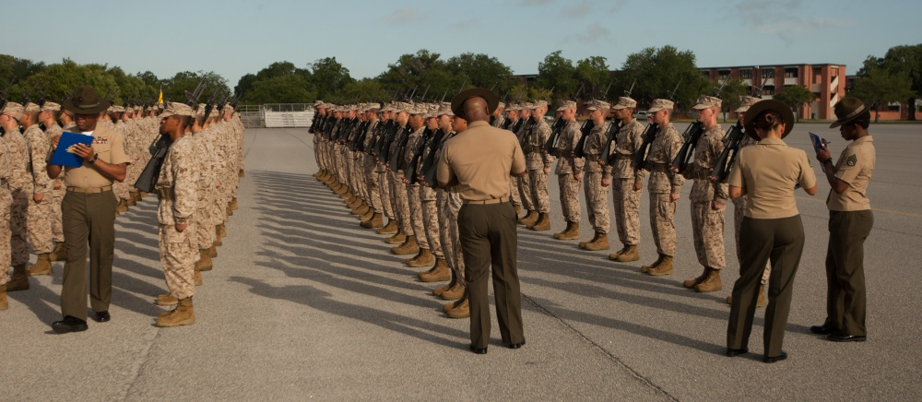
Open ranks

Slide 28
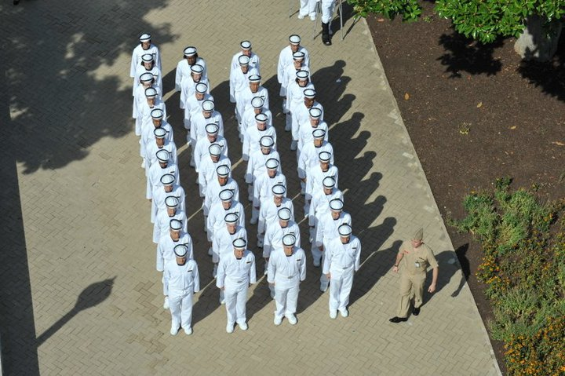

Slide 29
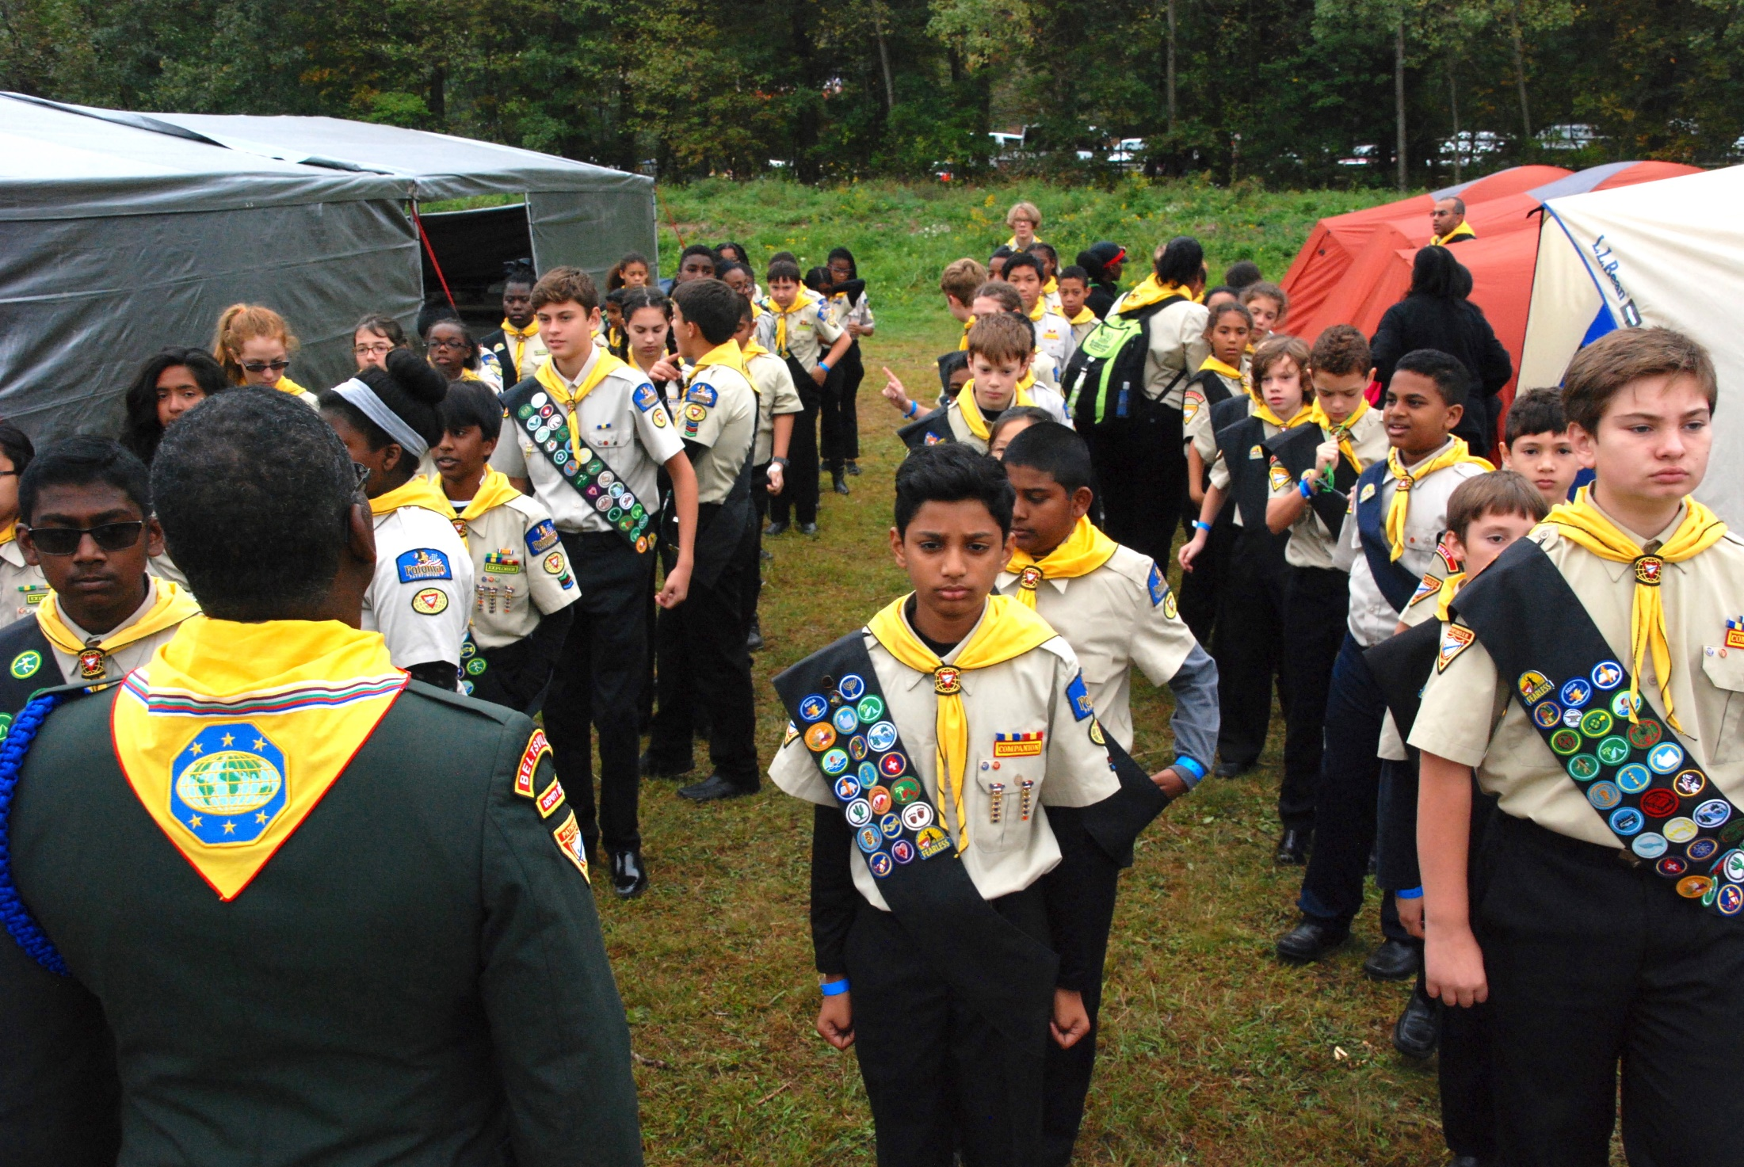

Slide 30
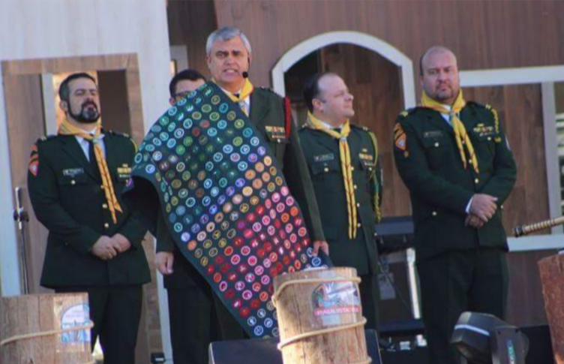

Slide 31
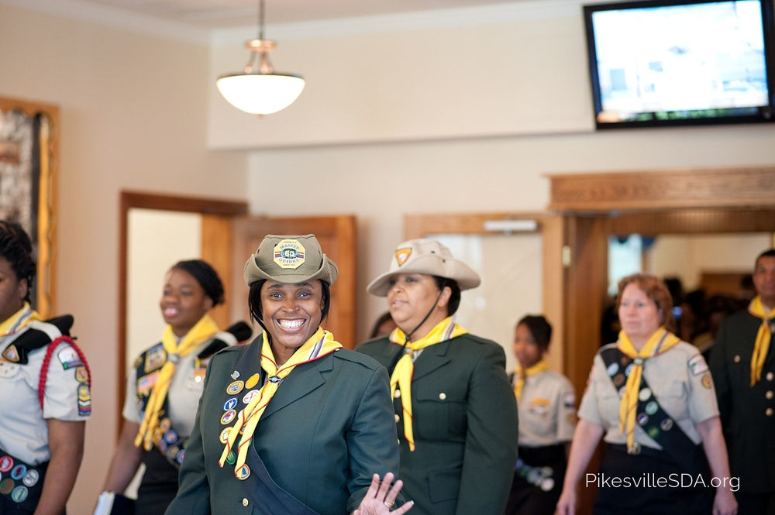

Slide 32
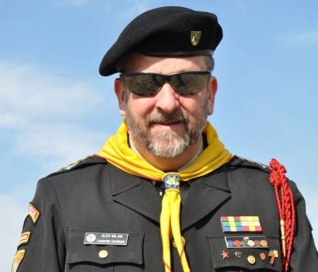

Slide 34
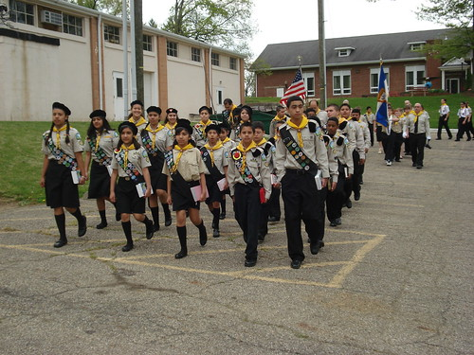

Slide 35
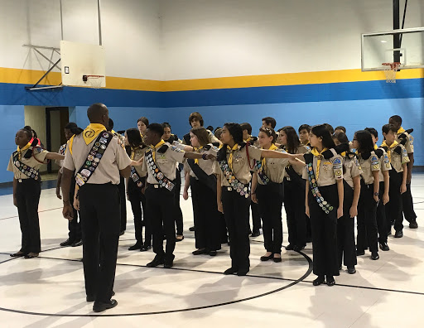

Slide 36
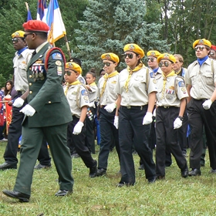

Slide 37
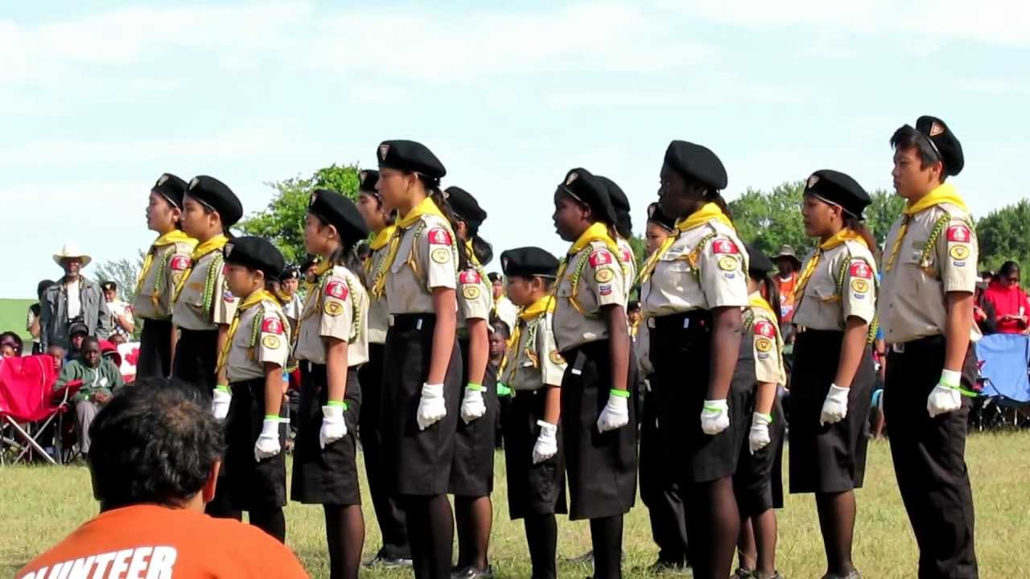

Slide 38
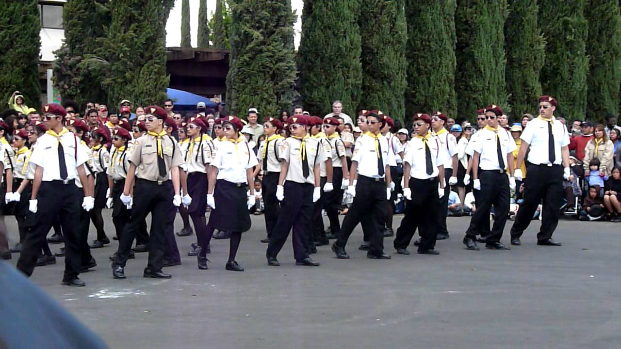

Slide 39
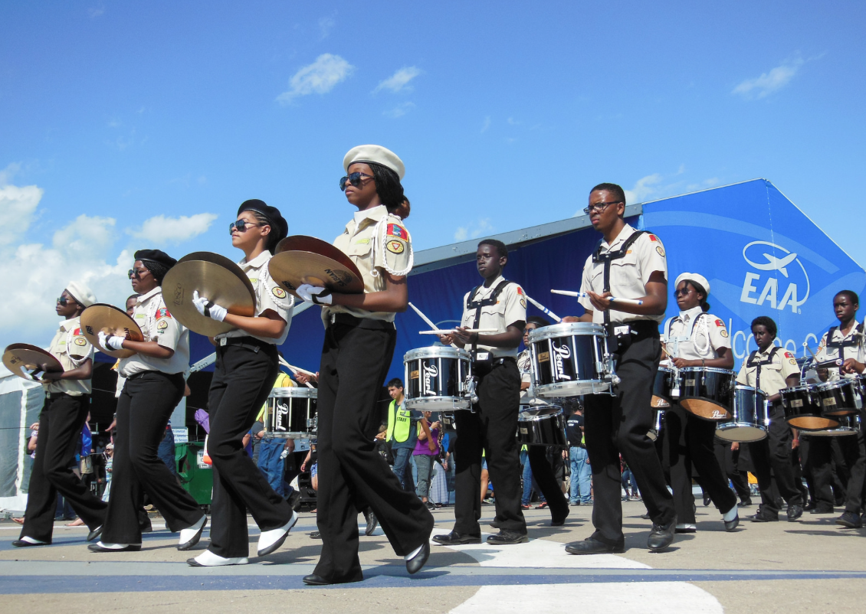

Slide 40
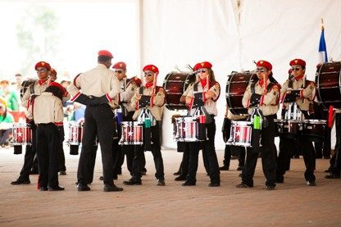

Slide 41
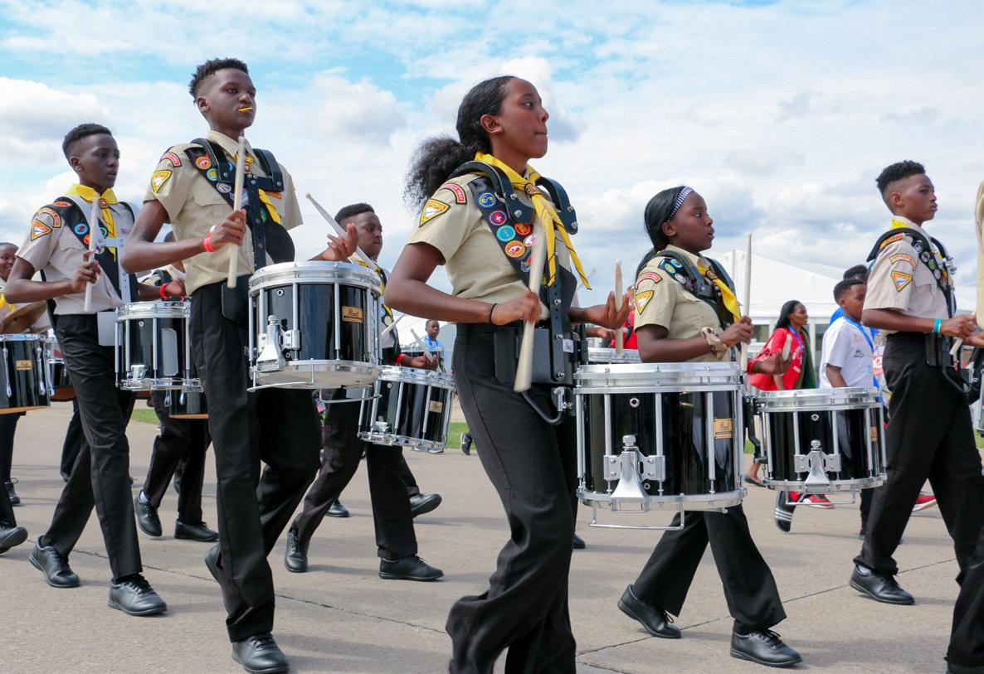

Slide 42
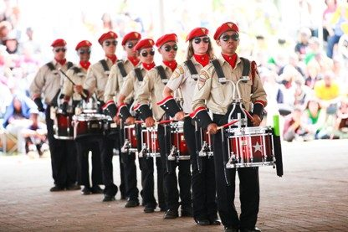

Slide 43
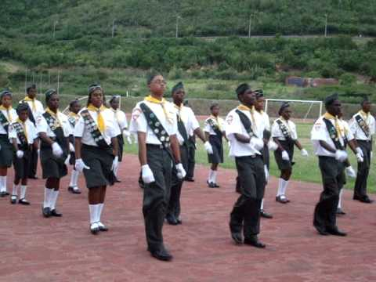

Slide 44
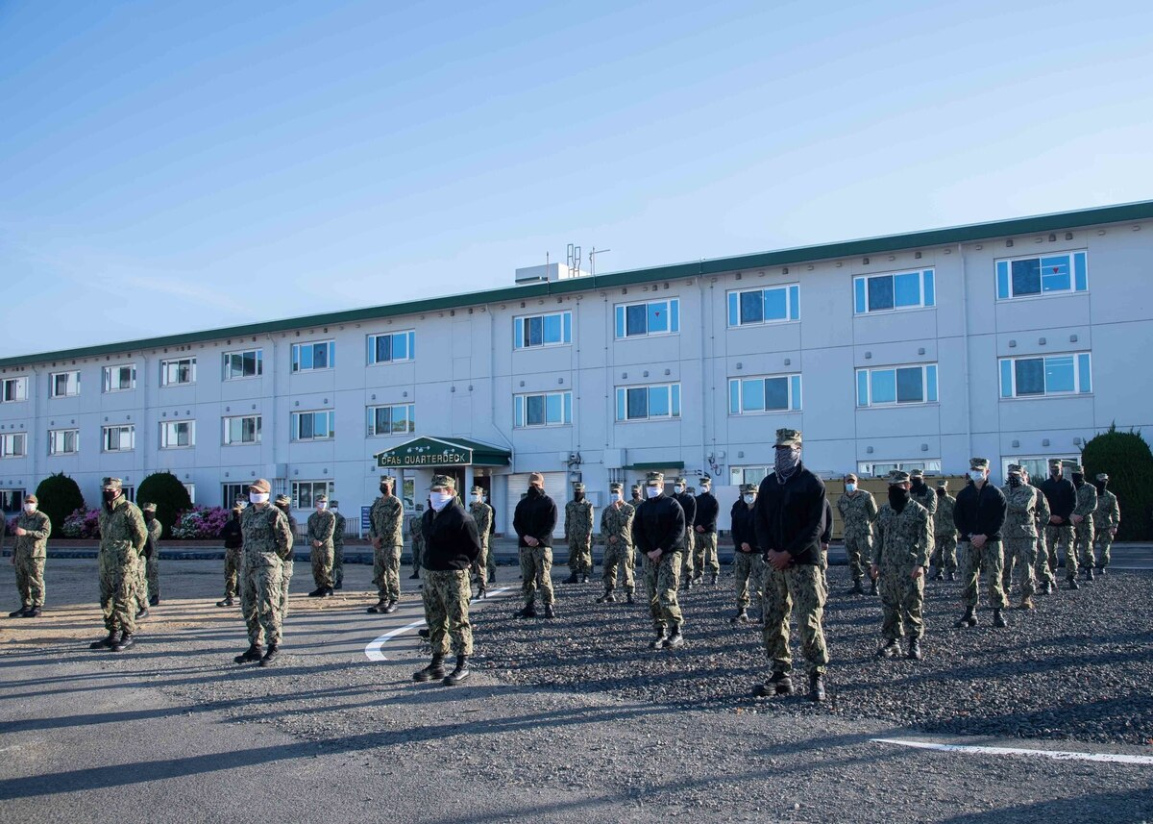

Slide 45
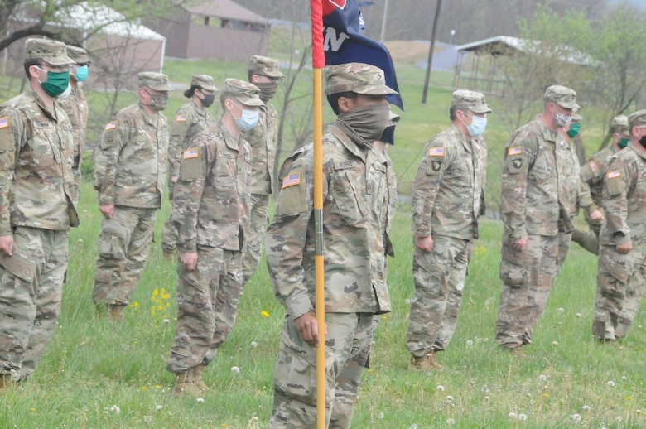

Slide 48
Questions?

Slide 49
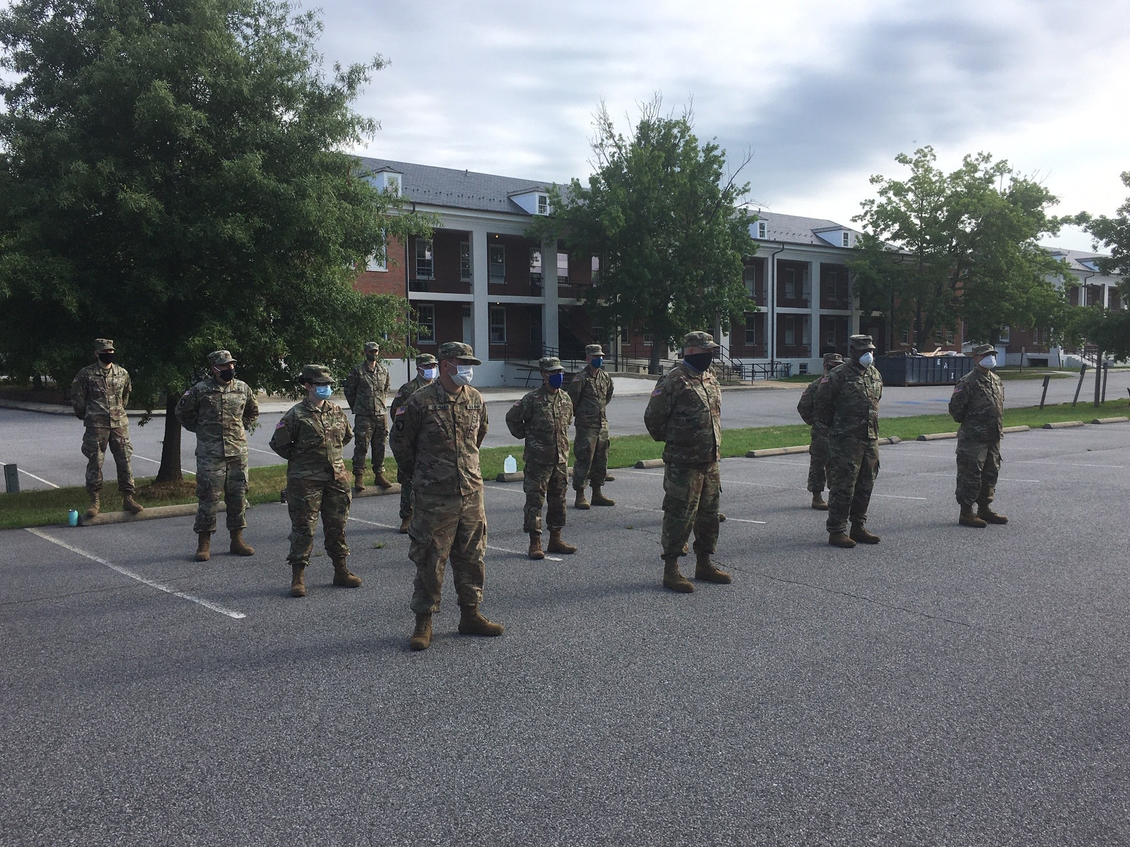

Slide 50
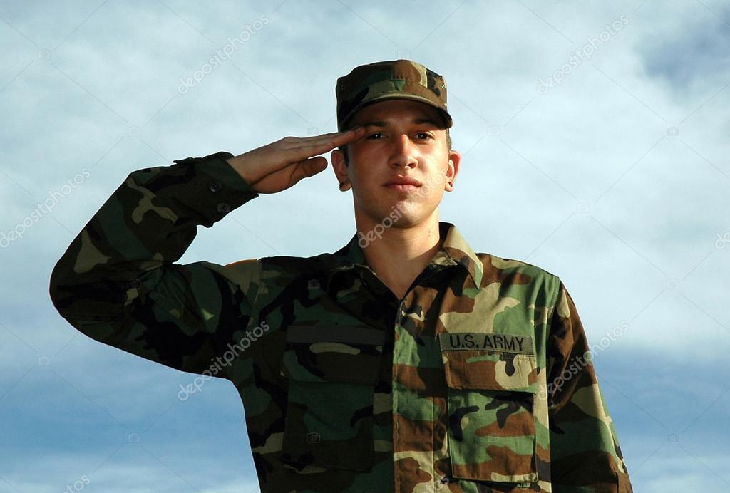
Video Clip Helps
https://www.youtube.com/watch?v=CiVVL_Obw30
https://www.youtube.com/watch?v=uMKiPEufm1k
https://www.youtube.com/watch?v=Y7nC_G1PysQ
Parade Rest.
https://www.youtube.com/watch?v=iWkl8icIonY
Stand at ease
https://www.youtube.com/watch?v=m1SXQYxQkTk
Present Arm

Slide 51
Video Clip Helps
https://www.youtube.com/watch?v=wZUbU199zjk
About Face
https://www.youtube.com/watch?v=TMjq8PV6qjI
Count off
https://www.youtube.com/watch?v=NVPfvTkZFcw
Close Interval March (I don’t like this one)
https://www.youtube.com/watch?v=NVPfvTkZFcw
Fall In
https://www.youtube.com/watch?v=MOY3lUmTopc
Dress Right Dress
https://www.youtube.com/watch?v=MlD9JEnow50
Left and Right Face

Slide 52
Video Clip Helps
https://www.youtube.com/watch?v=x4BHJLFU31E
Cover and Recover
https://www.youtube.com/watch?v=gyf-EmryH6U
Forward March
https://www.youtube.com/watch?v=w1Zp8pbfUKc
Mark Time March
https://www.youtube.com/watch?v=FPnXCXNkoKc
Column Left and Right march
https://www.youtube.com/watch?v=2vayL-ajdFw
Right and Left Flank
https://www.youtube.com/watch?v=2_-puYiZ0OE
Rear March
https://www.youtube.com/watch?v=4p0DsVPkyZg
Motivation drill demo by Japanese

