Slide 1
A SIMPLE FORMULA FOR SUCCESS
Carl Rodriguez
Chesapeake Conference

Slide 2
Review of the LAST 4 Chapters
Chapter 1
Developing a Fabulous Youth Group – The baseball diamond
History (getting to know each other) (1st base)
High 5 – affirming one another (2nd base)
Help – asking for help to be successful (3rd base)
Home – the positive and safe place to belong

Slide 3
Review of the LAST 4 Chapters
Chapter 2 - L.I.S.T.E.N (2nd Base)
Look – stay focus
Interpret – put in your own words what your heard
Say More – a creative question or affirmation
Tell your feelings – share your feelings on their story
Empathize – sharing in the other person feelings
Non-Verbal Communication – Body Lingo

Slide 4
Review of the LAST 4 Chapters
Chapter 3 - Planning Made Easy (3rd Base)
The key is having a philosophy (the bridge) to achieve your goal. It links the how to get their and why do it.
What is the goal → Christlikeness

Slide 5
Review of the LAST 4 Chapters
Chapter 4 – Never a Dull Moment (Home Plate)
Non-Neutral Environment (NNE)
If your program includes NNE’s and purpose, the result is active and vibrate ministry.

Slide 6
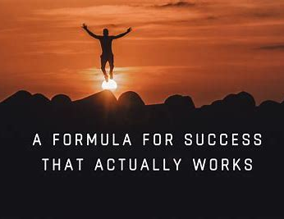
Chapter 5 1 Thessalonians 5:16
“Rejoice always”
Success = 4F + DYNAMIC

Slide 7
4 F’s – Getting Down to Basics
Food
Friends
Fun
Faith
Psalm 34:8
Taste and see that the LORD is good;

Slide 8
Breakout Time
The 4 F’s
Why are their important to each group?
Food
Friends
Fun
Faith

Slide 9
Group D.Y.N.a.m.i.c. skills
Data & Feelings
Years of Age & Gender
Norms & Decision Making
Action & Talk
Maintenance-type & Task-type
Influence & Leadership Style
Core Group & Individual

Slide 10
Group D.Y.N.a.m.i.c. skills
Data people (explain actions) & Feelings people (prompts one to action)
Years of Age (differences) & Gender (change of dynamics)

Slide 11
Breakout Time
Data People(explain actions) & Feelings People (prompts one to action)
Years of Age (differences) & Gender (change of dynamics)

Slide 12
Group D.Y.N.a.m.i.c. skills
Norms (expected or not) & Decision Makers (group or leader)
Action People (doer) & Talkers (ideas) Does the talk match the walk

Slide 13
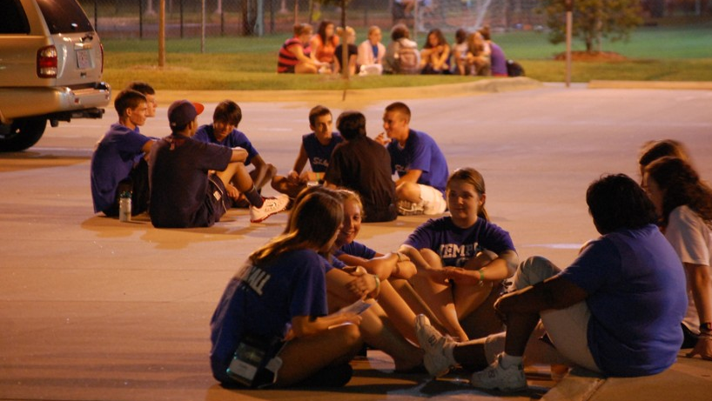
Breakout Time
Norms (expected or not) & Decision Makers (group or leader)
Action People (doer) & Talker (ideas) Does the talk match the walk

Slide 14
Group D.Y.N.a.m.i.c. skills
Maintenance-type People (keep everyone happy) & Task-type People (let’s get something done)
Influence (who in the group has real influence) & Leadership Style (boss, group, laissez-fair)

Slide 15
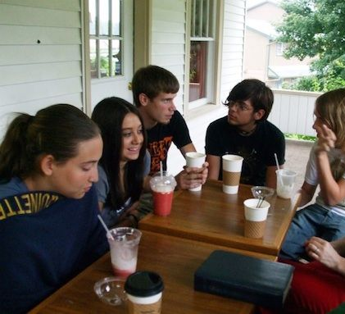
Breakout Time
Maintenance-type People (keep everyone happy) & Task-type People (let’s get something done)
Influence (who in the group has real influence) & Leadership Style (boss, group, laissez-fair)

Slide 16
Group D.Y.N.a.m.i.c. skills
Core Group (peer pressure and is it really a group) & Individual (rights reserved and preserved)
C – can also be for community. It is a place we feel loved and want to belong

Slide 17
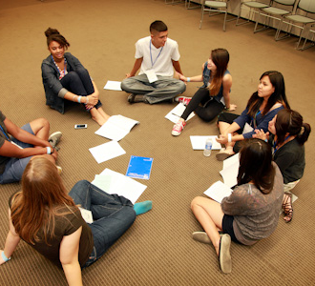
Breakout Time
Core Group (peer pressure and is it really a group) & Individual (rights reserved and preserved)
La Communidad!

Slide 18
Time to wrap it up!
Success = 4F + DYNAMIC
Le - 4F’s (food, friends, fun, faith)
D.Y.N.A.M.I.C.S.

Slide 19
4 F’s – Getting Down to Basics
Food
Friends
Fun
Faith
Psalm 34:8
Taste and see that the LORD is good;

Slide 20
Group D.Y.N.a.m.i.c. skills
Hebrews 10:24-25
²⁴ And let us consider how we may spur one another on toward love and good deeds,²⁵ not giving up meeting together, as some are in the habit of doing, but encouraging one another—and all the more as you see the Day approaching.
Data & Feelings
Years of Age & Gender
Norms & Decision Making
Action & Talk
Maintenance-type & Task-type
Influence & Leadership Style
Core Group & Individual

