Slide 1
Legs to your legacy
Pastor Javier Mendez
LEGIT Church, PA Conference

Slide 2
“Good leaders employ others; Great leaders deploy others.”

Slide 3
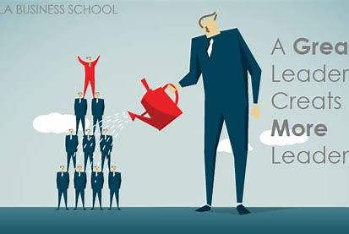
Elijah focused on Elisha
David focused on Solomon
Jesus focused on Peter- and gave him the church

Slide 4
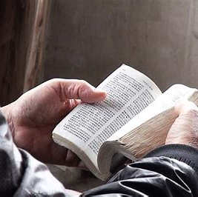
Matthew 28:18 “All authority on heaven and on Earth has been given to me.”
The great commission NOT THE GREAT SUGGESTION

Slide 5
The greatest act of leadership, is mentoring

Slide 6
If what you learned, accomplished, built, succeeded in dies with you, you are a FAILURE.

Slide 7
Only mature people want others to be greater than they are.

Slide 8
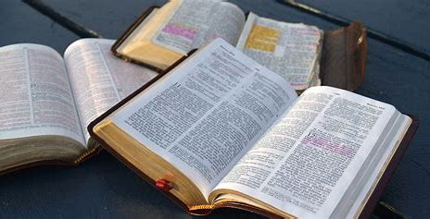
Jesus, the greatest leader of all time,
said “It’s better for you that I go away.” John 16:7

Slide 9
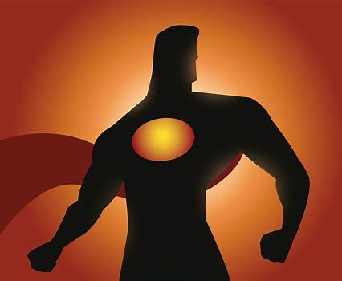
Who have you equipped and empowered to take over?
Who are you mentoring?

Slide 10
YOU WILL DIE someday, so you better start training someone.

Slide 11
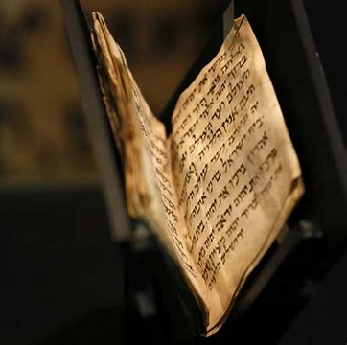
John 14:12
“Very truly I tell you, whoever believes in me will do the works I have been doing. And they will do even greater things than these.”

Slide 12
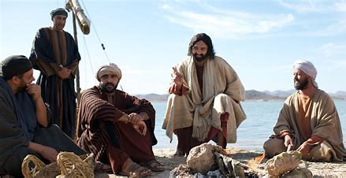
Jesus was secure in himself.
He wanted his disciples to be greater than him.

Slide 13
