Slide 1
Mission and Motivation
Dr. Charlie Koerting
Chesapeake Conference

Slide 2
Goals of this Course
Understand our mission in terms of the Great Commandments and the Great Commission
Understand the 7 levels of moral development and how they impact our motivation as individuals, Pathfinders, and Pathfinder staff
Understand how our spiritual growth (sanctification) affects how we are motivated

Slide 3
Definition of mission
An important assignment carried out for political, religious, or commercial purposes, typically involving travel.
The vocation or calling of a religious organization, especially a Christian one, to go out into the world and spread its faith.

Slide 4
Lets Start With Our Mission
Matthew 22:36-40

Slide 5
Lets Start With Our Mission
Love God
Love fellow man
Matthew 28:18-20

Slide 6
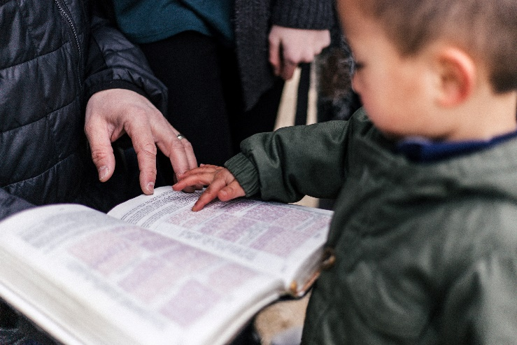
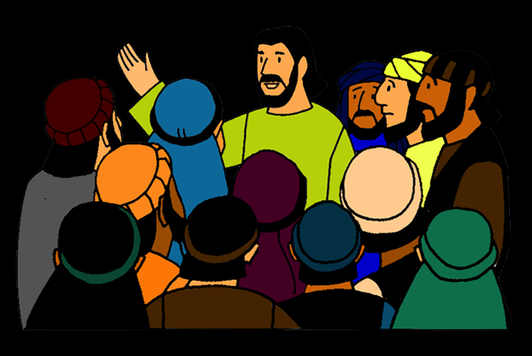
Lets Start With Our Mission
Love God
Love fellow man
Baptizing
Teaching
Make disciples

Slide 7
Breakout Question #1 (3 min)
How does the Pathfinder program fulfill our Christian mission? (Please be specific in relating parts of the program to the elements of the mission)

Slide 8
Definition of Motivation
the reason or reasons one has for acting or behaving in a particular way
the general desire or willingness of someone to do something

Slide 9
The Seven Levels of Moral Development
7
6
5
4
3
2
1

Slide 10
The Seven Levels of Moral Development
7
6
5
4
3
2
1
Matthew 25:14-30

Slide 11
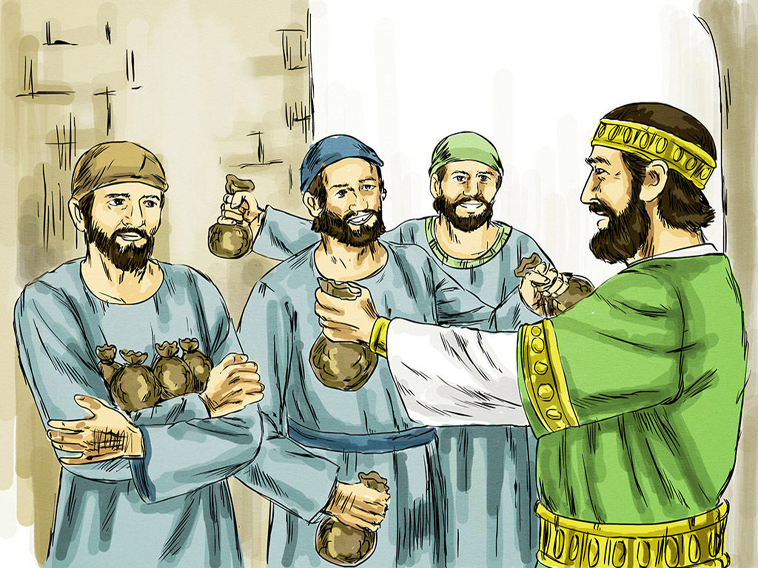
Reward and punishment
Biblical example - Parable of the talents
Pathfinder example – “If you don’t quiet down, there will be no smores at campfire tonight!”
Staff example – “I can’t help you because I will be held accountable if I fail.”
Chief characteristic - fear

Slide 12
The Seven Levels of Moral Development
7
6
5
4
3
2
1
Matthew 19:16-26
Reward and punishment

Slide 13
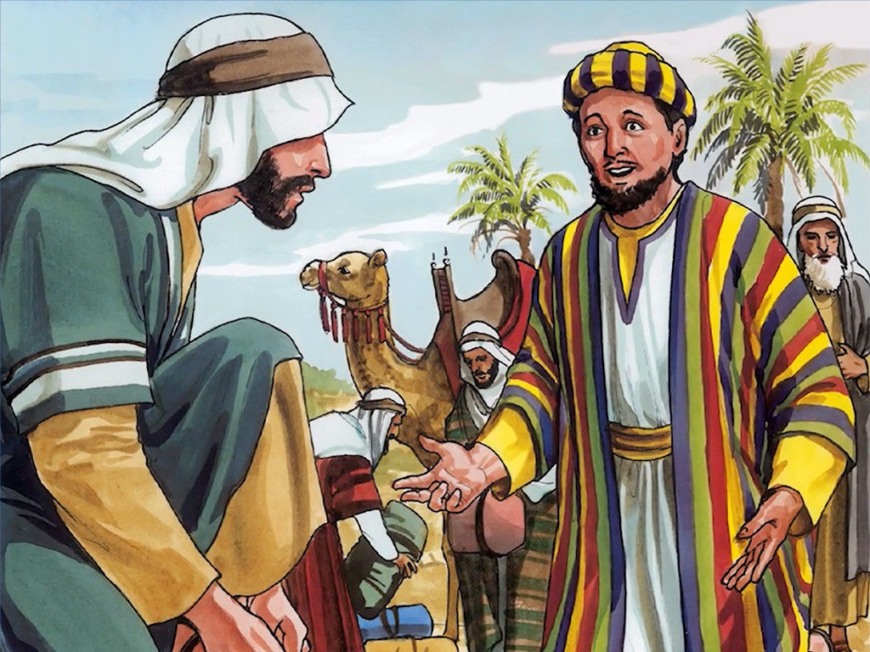
Marketplace exchange
Biblical example – The rich young ruler
Pathfinder example – “If you get invested, we will have a pool party at the end of the year.”
Staff example – “I will help out as long as my child is in Pathfinders.”
Chief characteristic – bartering

Slide 14
The Seven Levels of Moral Development
7
6
5
4
3
2
Matthew 6:1-8
1
Marketplace exchange
Reward and punishment

Slide 15
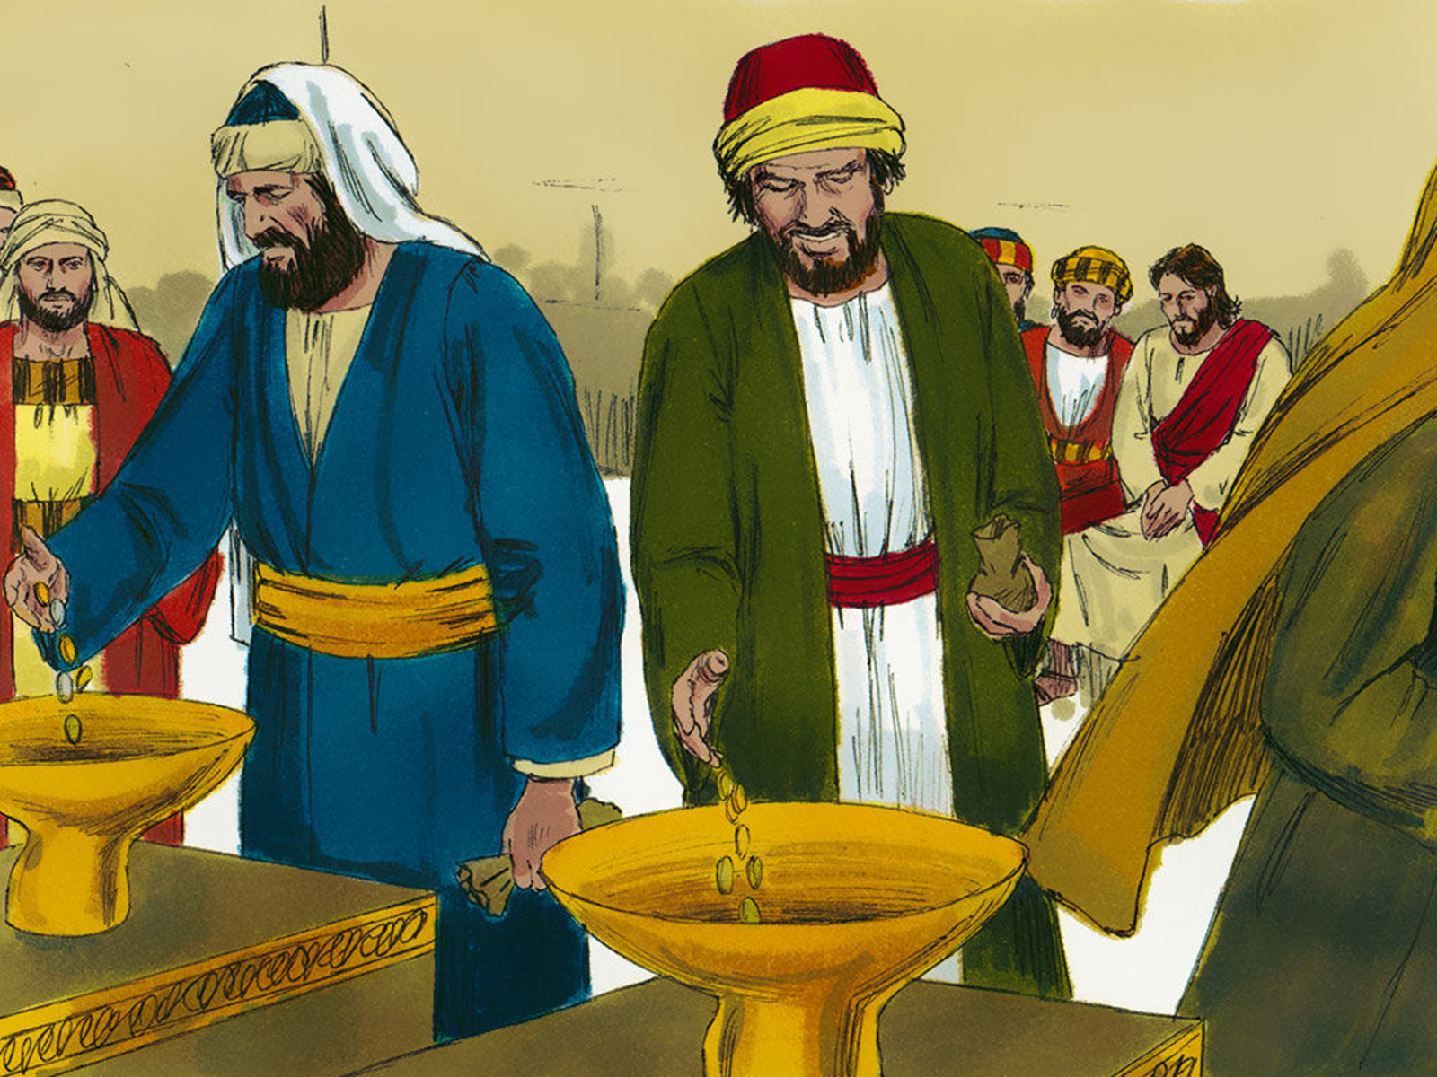
Social conformity
Biblical example – Practicing your righteousness in front of others
Pathfinder example – “You need to practice standing at attention so we don’t look bad at inspection.”
Staff example – “Working with young people will help me look good to my church.”
Chief characteristic – appearances

Slide 16
The Seven Levels of Moral Development
7
6
5
4
3
Matthew 23:23
2
Social conformity
1
Marketplace exchange
Reward and punishment

Slide 17
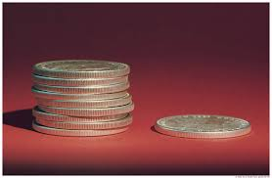
Law and order
Biblical example – Woes pronounced on the Pharisees
Pathfinder example – “If you don’t wear your uniform you can’t collect the offering for Pathfinder Sabbath.”
Staff example – “I need to work with our young people to help instill a sense of discipline in them.”
Chief characteristic – following rules

Slide 18
The Seven Levels of Moral Development
7
6
5
Luke 10:29-37
4
3
Law and order
2
Social conformity
1
Marketplace exchange
Reward and punishment

Slide 19
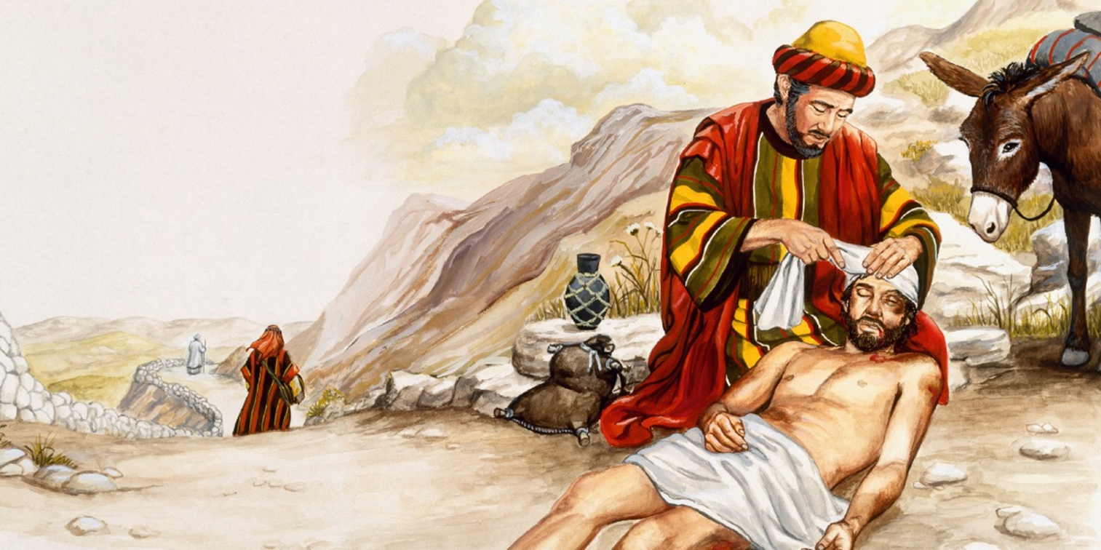
Love for others
Biblical example – The Good Samaritan
Pathfinder example – “We will help feed the homeless to show our love for those less fortunate than us.”
Staff example – “I want to help out because I remember how much I felt loved by my leaders when I was their age and our young people need to experience that.”
Chief characteristic – others focus

Slide 20
The Seven Levels of Moral Development
7
6
1st Samuel 20:14-15
5
Love for others
4
3
Law and order
2
Social conformity
1
Marketplace exchange
Reward and punishment

Slide 21
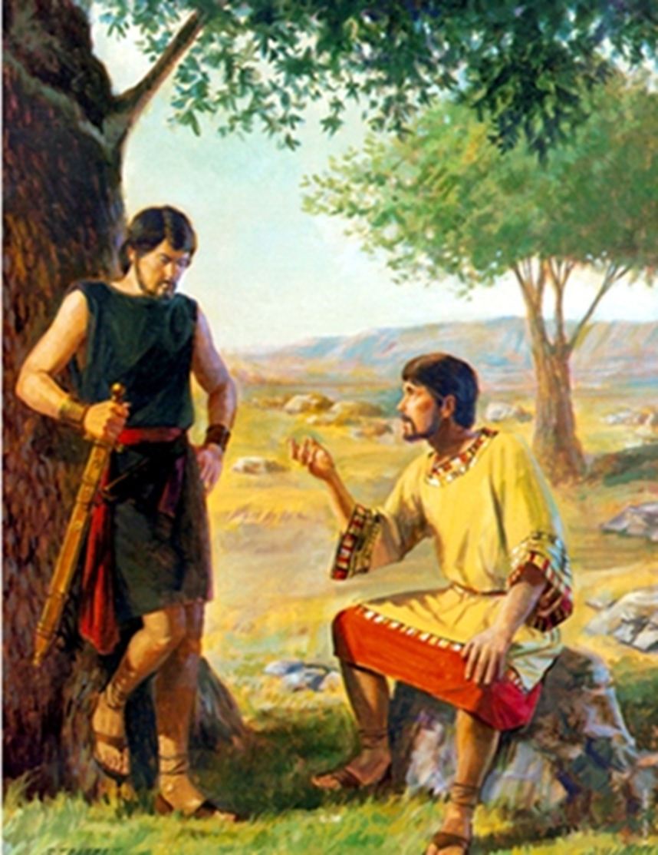
Principle-based living
Biblical example – David and Jonathan
Pathfinder example – “We will clean-up the trash at our campsite because it is the right thing to do”
Staff example – “I have committed to be a Christian and I will follow the great commission by working with our young people.”
Chief characteristic – principle

Slide 22
The Seven Levels of Moral Development
Exodus 32:9-14, 32
7
6
Principle-based living
5
Love for others
4
3
Law and order
2
Social conformity
1
Marketplace exchange
Reward and punishment

Slide 23
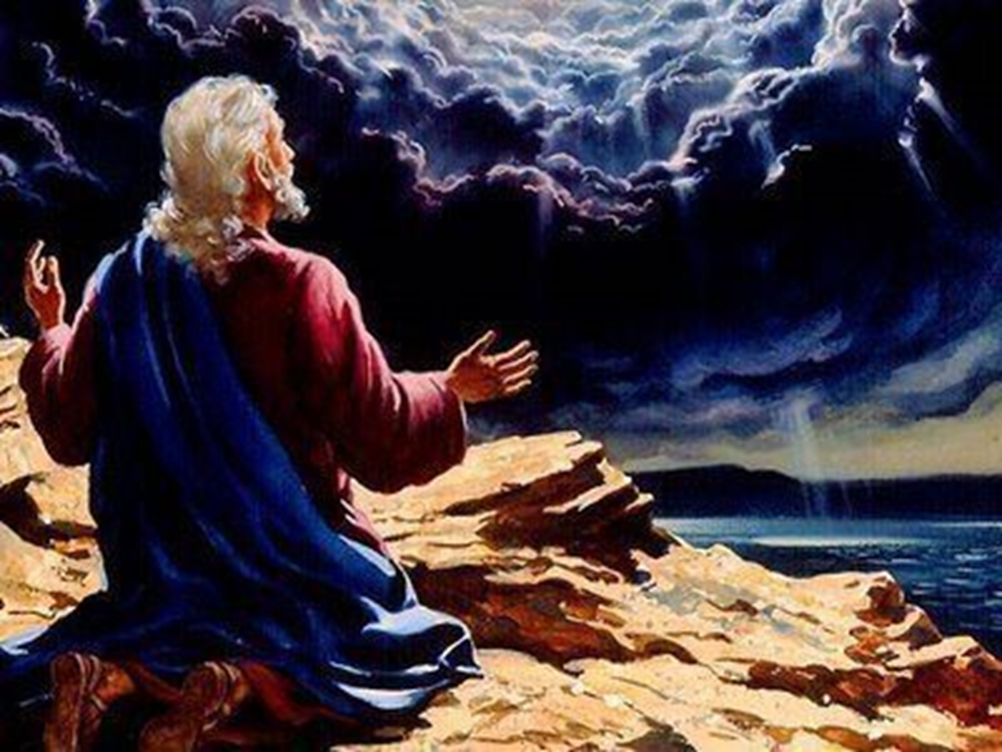
Understanding friend of God
Biblical example – Moses pleads with God
Pathfinder example – “I want to be God’s friend and have a growing relationship with Him”
Staff example – “As a friend of God, I know that leading and discipling His young people into a relationship with God is the greatest thing I can do for Him and them.”
Chief characteristic – relationship

Slide 24
The Seven Levels of Moral Development
7
Understanding friend of God
6
Principle-based living
5
Love for others
4
3
Law and order
2
Social conformity
1
Marketplace exchange
Reward and punishment

Slide 25
The Seven Levels of Moral Development
7
Understanding friend of God
6
God-
focus
Principle-based living
5
Love for others
4
Others-
focus
3
Law and order
2
Social conformity
1
Marketplace exchange
Self-focus
Reward and punishment

Slide 26
Growth and motivation
The different levels of motivation are not necessarily good or bad in themselves but represent different levels of spiritual maturity.
They can become bad when we refuse to grow. We need to grow from the first 4 levels to the last 3 levels.
People can operate at a variety of different levels, depending on the situation.
Remember God meets and deals with us where we are but He never intends to leave us there. (Example: the nation of Israel)
The technical term for this growth is sanctification.

Slide 27
The Seven Levels of Moral Development
7
Understanding friend of God
6
God-
focus
Principle-based living
5
Love for others
4
Others-
focus
3
Law and order
2
Social conformity
1
Marketplace exchange
Self-focus
Reward and punishment

Slide 28
Breakout Question #2 (5 min)
What things can we as leaders do to help both Pathfinders and staff to grow in their levels of motivation?

Slide 29
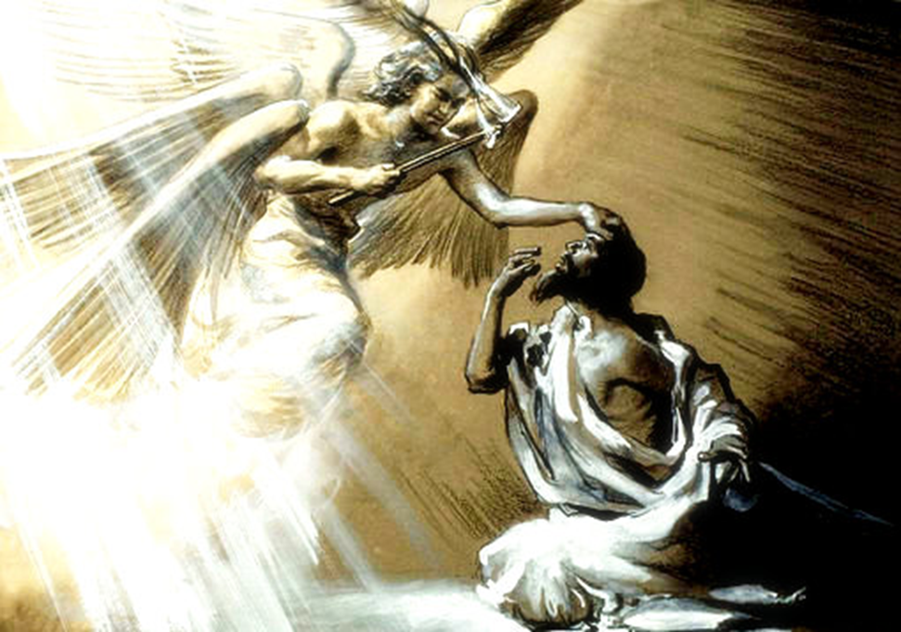
Biblical Example of Growth
Isaiah 6:1-8

Slide 30
Biblical Example of Growth
He is afraid
He acknowledges who he really is, a sinner
He receives the forgiveness of God, symbolized by the coal from the altar touching his lips
He proceeds to do God’s work, “Here am I, send me”

Slide 31
Other Examples of Growth
Abraham
David
Peter
Paul

Slide 32
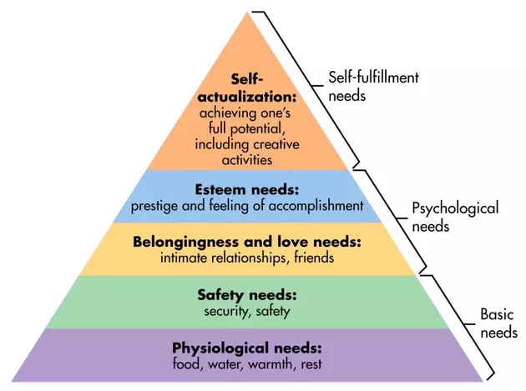
Humanistic View of Motivation: Maslow’s Hierarchy of Needs

Slide 33
Problems with Humanistic Views of Motivation
They tend to be centered on self

Slide 34
Motivating Staff - Practical Steps
Try to identify what the person’s primary level of motivation is.
Assign a task that best overlaps with their own level of motivation
Challenge them with new tasks that force them to think outside of the preferred level of motivation

Slide 35
Motivating Adolescents - Practical Steps
Enthusiasm
Be a model
Provide them opportunities to take the initiative
Involve them in decision making
Positive peer influence
Safe environment for risk taking
Build relationships

Slide 36
Motivation Final Thoughts
Motivation is accomplished by understanding and meeting the needs of the individual i.e. a relationship

Slide 37
Characteristics of Godly Motives
Humility - they are not done to gather the attention of anyone. They are done quietly, behind the scenes.
It is done for others out of a true sense of love and caring for them
It is done in a spirit of joy
It is a result of living the lifestyle of being a new creation in Christ.

Slide 38
Connecting the Dots
True fulfillment of our mission (the Great Commission) cannot happen outside of a relationship with God and with those we are reaching out to.

Slide 39
Motivation Final Thoughts
“The oil of grace gives to men the courage, and supplies to them the motives for doing every day the work that God appoints to them.”
Ellen G. White, Review & Herald, Mar 27, 1894.

Slide 40
Motivation Final Thoughts
”I no longer call you servants, because a servant does not know his master’s business. Instead, I have called you friends, for everything that I learned from my Father I have made known to you.”
John 15:15 (NIV)

Slide 41
Mission and Motivation
Any Questions/Comments/
Discussion?

