Slide 1
Teaching Investiture Classes for Today’s Pathfinder
Rose and Michael Kirks
Chesapeake Conference

Slide 2
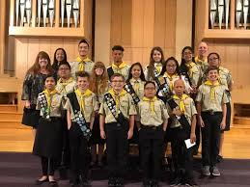
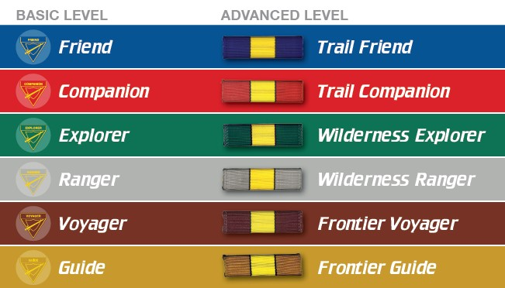
Investiture Achievement CURRICULUM
This is the core of the Pathfinder Ministry.
Lead the Pathfinders through an exciting journey as they learn and grow in their Christian experience.
Pathfinders in Grades 5-10 or ages 10 through 15.
Six classes: Friend, Companion, Explorer, Ranger, Voyager and Guide.
The older the pathfinder, the more in-depth is the study plan.

Slide 3
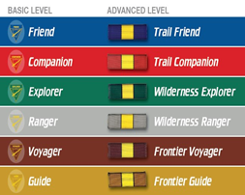
To maximize the success for each Pathfinder, Club Directors, Instructors must intentionally:
Inspire and motivate Pathfinders.
Emphasize quality, not quantity, of learning.
Establish a base of knowledge that can be built on in following levels.
Allocate time to practice new concepts and skills.
Aim for understanding rather than memorization.
Consider developmental and individual abilities of each Pathfinder.
Employ effective and flexible strategies to aid learning.
Use concrete and meaningful activities.

Slide 4
Purchase for each class level – contains the 8 tracks Instructor helps pathfinder record journals
Provides teaching tips
Records thoughts and feelings

Slide 5
INVESTITURE achievement 8 TRACKS ALL CLASS LEVELS
Achievement levels are grade/age focused.
Develop a relationship with God through a daily study of His word and prayer.
Embrace the Pathfinder/AY lifestyle and values.
Encourage spiritual growth through a discovery of the Bible and Christian history.

Slide 6
Engage pathfinders in active service.
Connect pathfinders to the community.
Engage pathfinders in friendship evangelism.
Connect pathfinders to their church.
Develop a relationship with God that fosters positive friendships, strong moral values, and civic responsibility.

Slide 7
Apply health and fitness principles that will benefit the participant for a lifetime.
Learn and practice safety procedures, first aid, and rescue skills.
Develop an understanding of God, the Creator of all things, through the study and observation of His Creation.

Slide 8
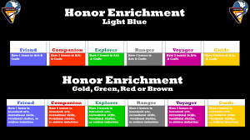
Develop the skills needed for maximum enjoyment of the outdoors.
Build self-confidence through outdoor experiences.
Develop team building skills.
Advanced Level
Learn new skills.
Participate in or study content areas new to them.

Slide 9
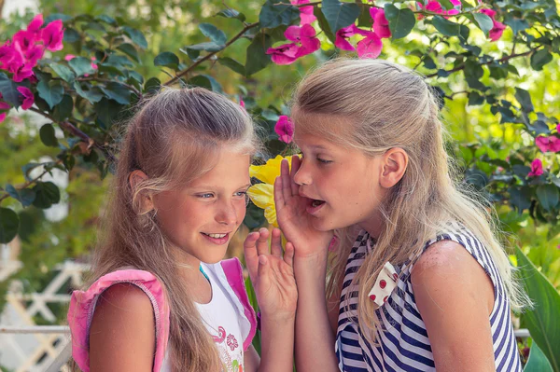
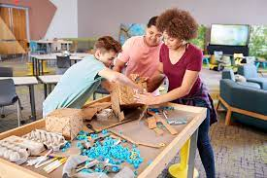
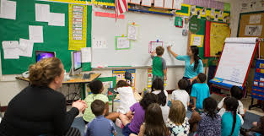
According to the NAD Pathfinder Instructor Award Training, When learning something new, we remember
10% of what we hear
15% of what we see
20% of what we both see and hear
40% of what we discuss
80% of what we experience directly or practice doing

Slide 10
The Pathfinder Club is an environment where individuals from different backgrounds with various abilities and personalities come together.
As a Director/Counselor/Instructor, an effective teacher requires the implementation of creative and innovative teaching strategies in order to meet the pathfinder individual needs and learning styles.

Slide 11
8 learning styles

Slide 12
VERBAL
pathfinders
instructors
Learn information through reading, writing, listening and speaking.
They love word games, puns and rhymes.
Use verbal teaching and activities in their experiences.
Ask them to assist members of their class.
Role playing can be a great opportunity to understand new concepts and ideas.

Slide 13
Visual Learning
PATHFINDER
INSTRUCTOR
Visual learners understand best when they see information.
They like diagrams, flowcharts and graphs.
They find handouts helpful, where they can write down what they hear or see as it is being described.
They like to read, draw and do craft and express themselves through creativity.
Use technology such as PowerPoint, videos and photos to present information such as PowerPoint, videos and photos.
Organize information well with headings and pictures.
Let the pathfinder be creative and use their imagination.
Use handouts.

Slide 14
Musical/auditory
pathfinders
instructors
Auditory learners thrive on having background music, and often need to hum or drum their fingers while studying or working on a project.
Benefit from reading a text out loud or using a tape recorder.
Verbal lectures, discussions and talking things through.
Hold discussions and debates.
Speak clearly so your pathfinders can hear you.
Allow pathfinders to use background music (with headset) while working.
Create jingles or rhymes to help teach information.

Slide 15
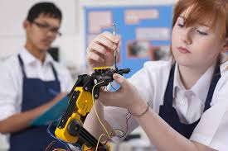
Physical/kinaesthetic
pathfinders
instructors
Hands on in order to understand the process and retain information.
This is a common learning style as many people prefer to learn while doing.
Use physical exercises and provide hands-on experiences.
Exercises where they are standing and walking are very effective.
Enhances teamwork within the Pathfinder group.
Get them to interact with physical objects or solve puzzles.

Slide 16
Logical / mathematical
pathfinders
instructors
They like to classify and categorize information and solve problems with numbers.
Good at analyzing cause and effect relationships.
Provide the class with problem-solving tasks.
Challenge them to work things out for themselves.
Ask them to interpret abstract visual information.
Include critical thinking exercises.

Slide 17
Social
Pathfinders
instructor
Performs best when they’re able to relate to others and work in group situations.
They need to be able to bounce off ideas and interact with each other.
They’re much better at reading emotions and facial expressions and are often extroverts.
Create situations where they can work in groups.
Let them role play to demonstrate processes.
Allow them to discuss and share stories.

Slide 18
Solitary
pathfinders
instructor
Learn and work best on their own.
This type of learner tends to be more introverted and prefers to learn processes and digest information on their own time, rather than with a group of people.
They are very independent.
Ask questions so you know what they're thinking and how they're feeling.
Provide individual problem-solving exercises.
Explain why the lesson material is important.
Give them ways to track their progress.

Slide 19
What type of learner is she?

Slide 20
COMBINATION
Solitary
Musical
Visual
Verbal

Slide 21
PATHFINDER CLASSOREE – another way to do investiture requirements
Sessions 1 and 4 are designated for the class levels.
These are ten mandatory honors that the Pathfinder Club will not need to teach during the year.

Slide 22
PATHFINDER bible enrichment
Each year, teams of six members study books of the Bible for the PBE.
Substitute the Devotional Life Bible readings in the IA curriculum with the with the books for the Bible Bowl.

